Slide 1
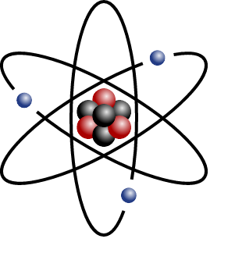
The discovery of the nucleus
How have the ideas about matter changed over the centuries?
Do you think the model we have today is the final one?

Slide 2
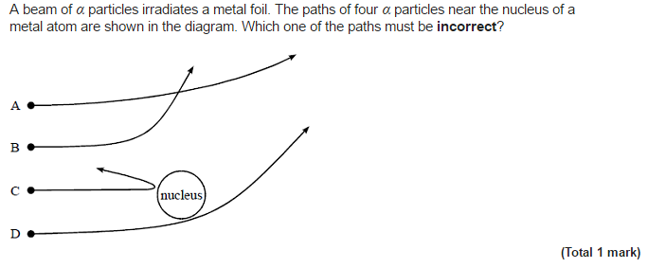
Rutherford scattering
Starter:

Slide 3
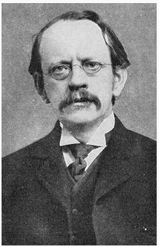
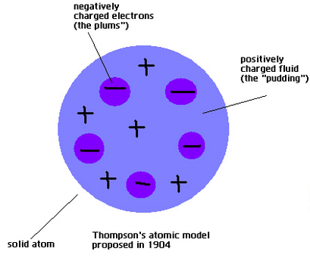
J.J. Thompson
Currant bun/Plum pudding
Electrons were thought to be spread out evenly throughout matter like currants in a bun with a positive mass between them like dough.
J.J. Thomson (1856 - 1940) discovered the electron and confirmed that it had a negative charge.

Slide 4
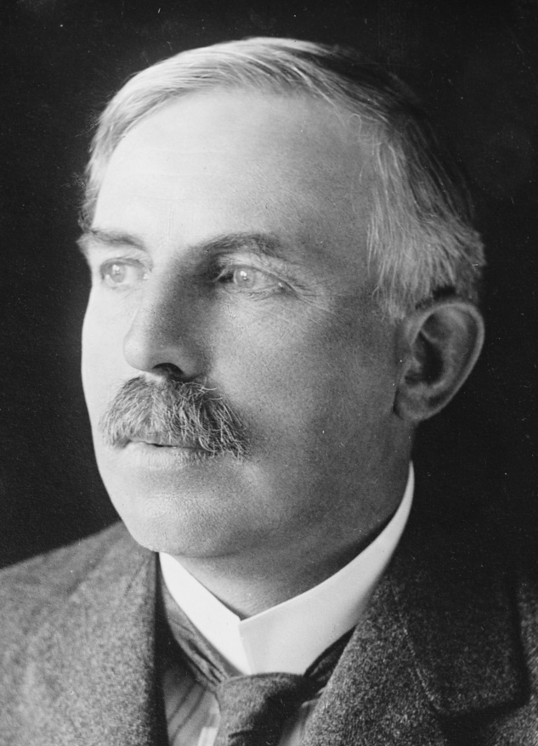
Ernest Rutherford
Knew that Alpha radiation was positively charged and that if he fired it through thick foil then a small amount of scattering should occur from the positive "dough"
Ernest Rutherford
(1871 - 1937)
Built upon the ideas of Thomson

Slide 5
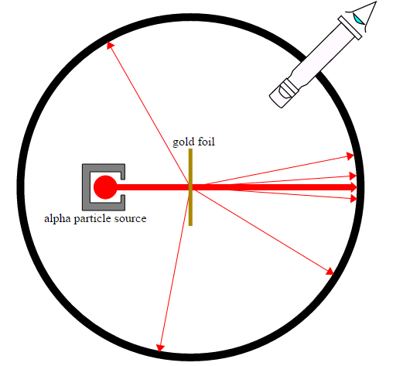
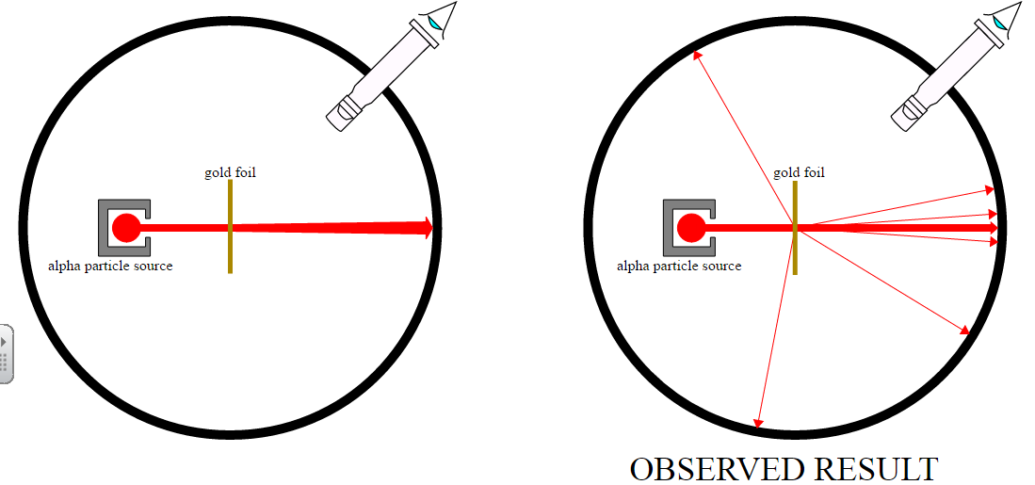
Rutherford’s Experiment
The experiment that Rutherford performed was to fire Alpha particles through very thin gold foil. A detector (fluorescent sheet and a microscope) was placed at the far side and move through an angle and monitored. The frequency of alpha particles arriving could be measured for different angles.
Results:
1) 1/2000 particles were deflected
2) About 1/10000 were actually deflected at angles greater than 90 degrees
What did Rutherford initially expect to see?

Slide 6
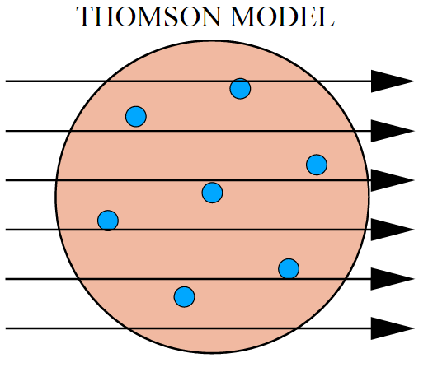
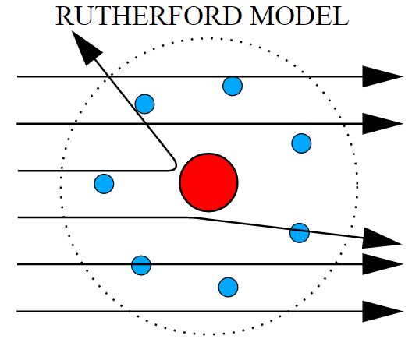
Comparing the models
Rutherford said"as incredible as if you fired a 15 inch naval shell at tissue paper and it came back"

Slide 7
A new model: The Nucleus
Rutherford's theory was consistent not only with his own experiment but also obeyed Newton's laws of motion and Coulomb's force law (for charged particles).
Finally by using different metals for the foil and different thicknesses he showed that the magnitude of the charge on the atomic nuclei was proportional to the atomic number Z and to the electron charges Ze
The results were not consistent with Thomson's model of matter. Rutherford calculated that:
Most of the atom must be empty so there was no deflection in most particles
Most of the mass and all of the positive charge must be locked up into tiny bits of matter in the centre of the atom.

Slide 8
Estimating atomic sizes
Rutherford measured that about 1 in 10000 alpha particles were scattered more than 90º
This means that the alpha particles has a 1 in 10000 chance of encountering a nucleus
If there are n layers of atoms to get through and the cross sectional area ratio of nucleus to atom is d² to D² then the formula to describe this experiment is:
Whilst this does not give the size of a nucleus Rutherford used gold of approximately 10⁴ atoms thick meaning the nucleus was 1/10000th the size of an atom

Slide 9
Summary
Scientist build models and ideas based on previous work from other scientists and from data they collect from their own experiments
Often an unusual or unexpected result creates a whole new theory
A new theory or model must not only explain the phenomena observed but it must also fit in with all of the other existing laws and models in science. Ideally it should also be able to make predictions about as yet untested ideas.
Rutherford’s model of the atom states that most of the mass is within a small nucleus inside an atom which has the diameter of approximately 1/10000th that of the atom within which is resides.

Slide 10
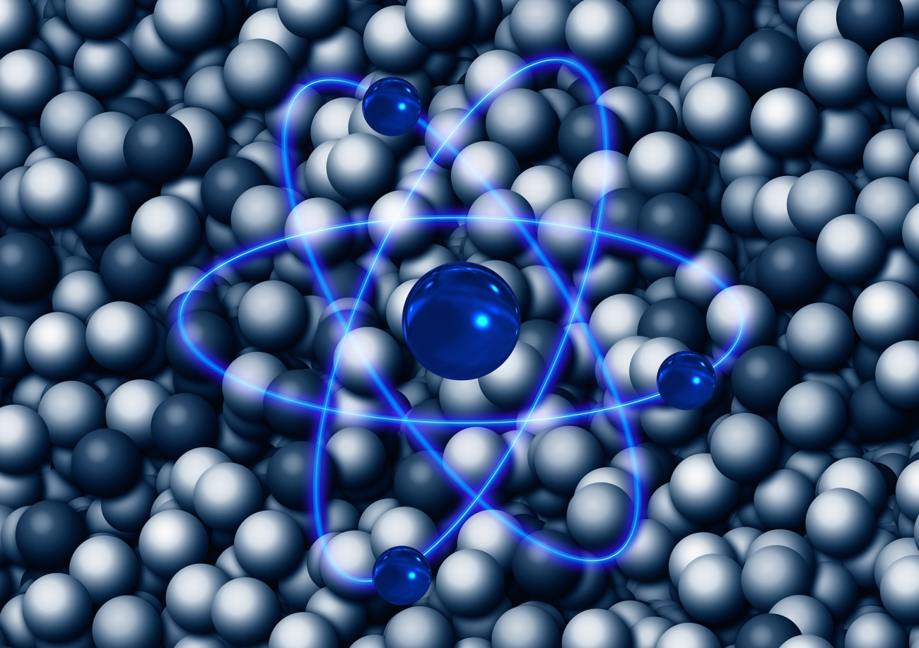
Nuclear Radius
How big is an atomic nucleus?
How can we measure or estimate something we cannot “see”?

Slide 11
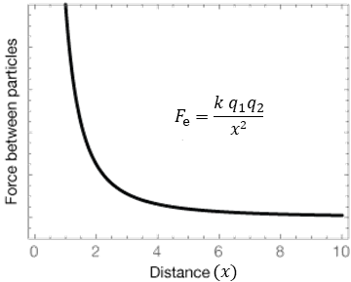
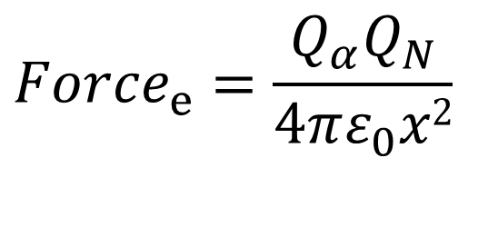
Coulomb’s Law
An alpha particle that deflects 180º has hit the nucleus head on. At the closest point the alpha particle will have stopped moving so all kinetic energy is transferred to electrical potential energy. Can use Coulomb’s (force) law to find the radius of the nucleus.
Can you recall Coulomb’s law?
$${Force}_{e}=\frac{Q_{α}Q_{N}}{4πε_{0}x2}$$

Slide 12

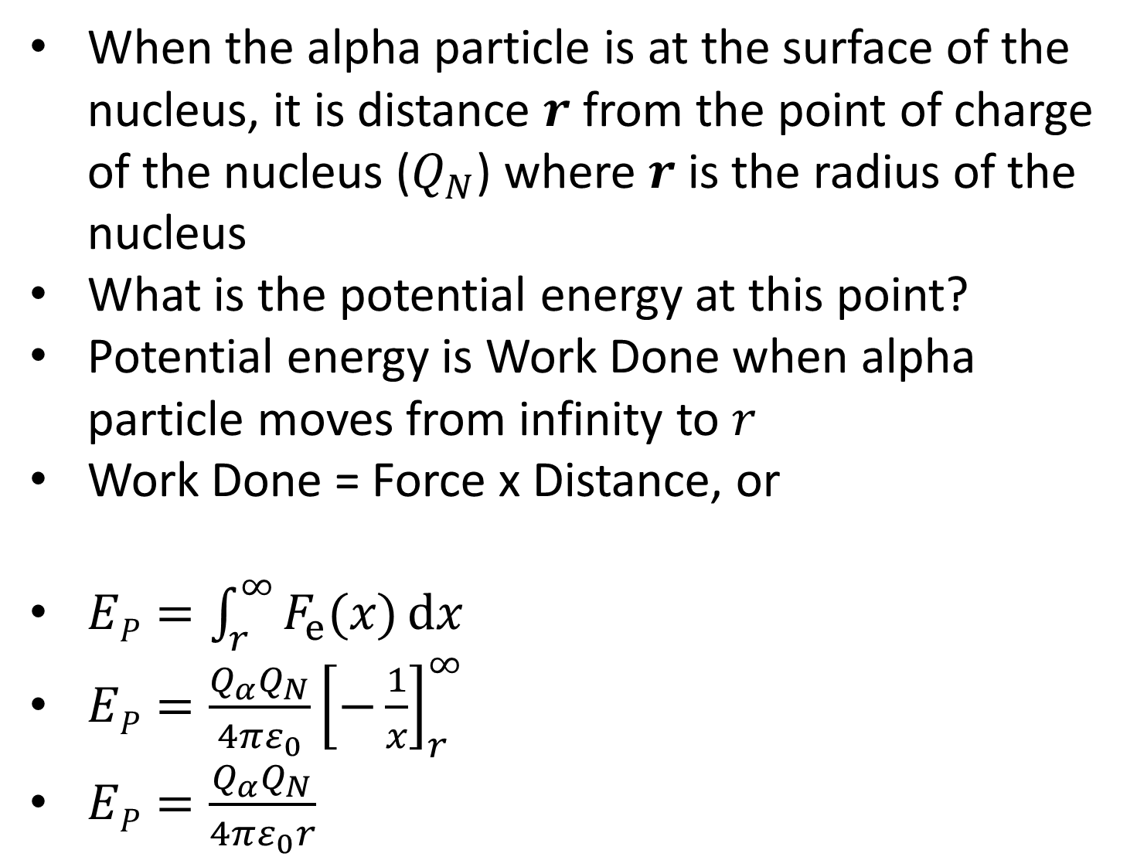
When the alpha particle is at the surface of the nucleus, it is distance $r$ from the point of charge of the nucleus ($Q_{N}$) where $r$ is the radius of the nucleus
What is the potential energy at this point?
Potential energy is Work Done when alpha particle moves from infinity to $r$
Work Done = Force x Distance, or
$EP=\int_{r}^{∞}{F_{e}(x)ⅆx}$
$EP=\frac{Q_{α}Q_{N}}{4πε_{0}}{\left[−\frac{1}{x}\right]}_{r}^{∞}$
$EP=\frac{Q_{α}Q_{N}}{4πε_{0}r}$
$$=\frac{Q_{α}Q_{N}}{4πε_{0}}\int_{r}^{∞}{\left(\frac{1}{x^{2}}\right)ⅆx}$$

Slide 13
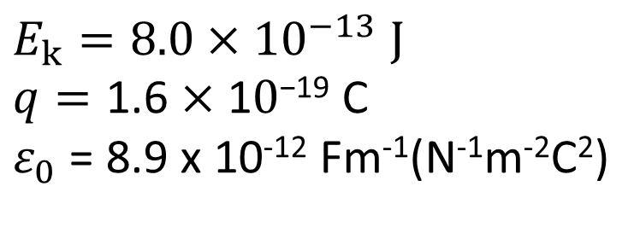
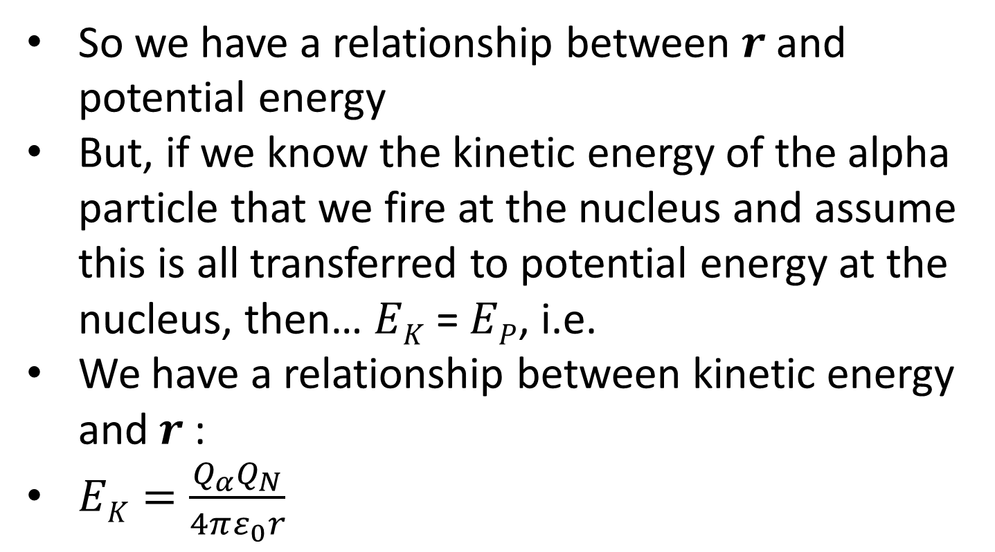
So we have a relationship between $r$and potential energy
But, if we know the kinetic energy of the alpha particle that we fire at the nucleus and assume this is all transferred to potential energy at the nucleus, then… $EK$ = $EP$, i.e.
We have a relationship between kinetic energy and $r$:
$EK=\frac{Q_{α}Q_{N}}{4πε_{0}r}$
Calculate the radius of the nuclei for gold atoms
(N is 79). Use values:
$$E_{k}=8.0×10^{−13} \text{J} \\ q=\text{1.6}×\text{1}0\text{−1}\text{9} \text{C}$$
$ε_{0}$ = 8.9 x 10⁻¹² Fm⁻¹(N⁻¹m⁻²C²)

Slide 14
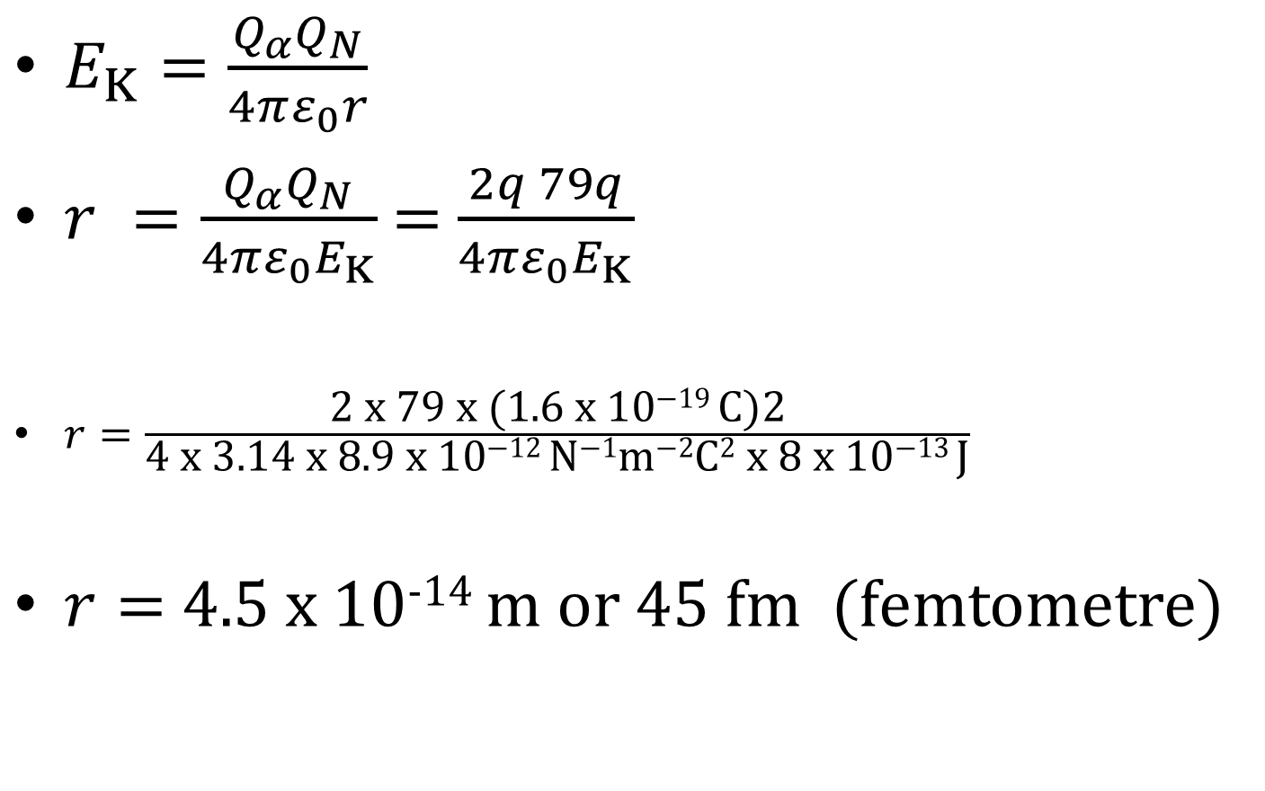
$E_{K}=\frac{Q_{α}Q_{N}}{4πε_{0}r}$
$r =\frac{Q_{α}Q_{N}}{4πε_{0}E_{K}}$ = $\frac{2q 79q}{4πε_{0}E_{K}}$
$r=\frac{\text{2 }\text{x}\text{ 79 }\text{x}\text{ (1.6 }\text{x}\text{ 10−19 }\text{C}\text{)2}}{\text{4 }\text{x}\text{ 3.14 }\text{x}\text{ 8.9 }\text{x}\text{ 10−12 }\text{N}\text{−1}\text{m}\text{−2}\text{C}\text{2} \text{x}\text{ 8 }\text{x}\text{ 10−13 }\text{J}}$
$r=$4.5 x 10⁻¹⁴ m or 45 fm (femtometre)

Slide 15
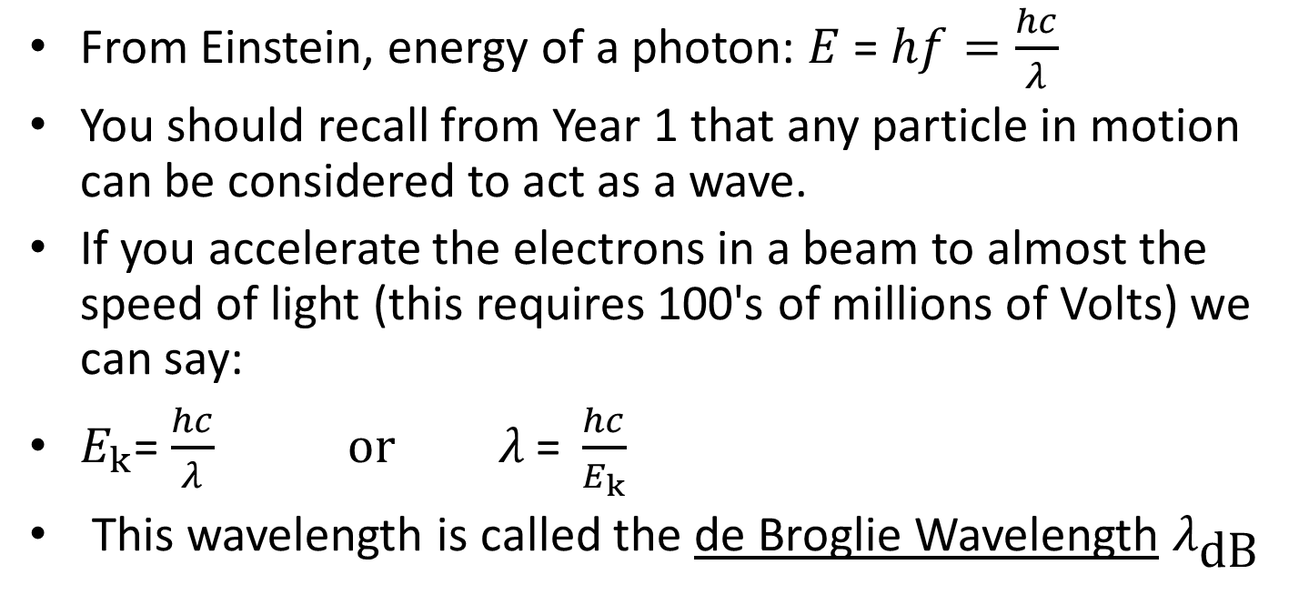

de Broglie Wavelength and Diffraction
From Einstein, energy of a photon: $E$ = $hf=\frac{hc}{λ}$
You should recall from Year 1 that any particle in motion can be considered to act as a wave.
If you accelerate the electrons in a beam to almost the speed of light (this requires 100's of millions of Volts) we can say:
$E_{k}$= $\frac{hc}{λ} or λ \text{= }\frac{hc}{E_{k}}$
This wavelength is called the de Broglie Wavelength $λ_{\text{dB}}$
Note that for relativistic particles: $E_{k} \text{=} mc^{2}$
And momentum: $ρ=mc$
So we can say: $λ_{\text{dB}}=\frac{hc}{E_{k}}=\frac{h}{ρ}$

Slide 16
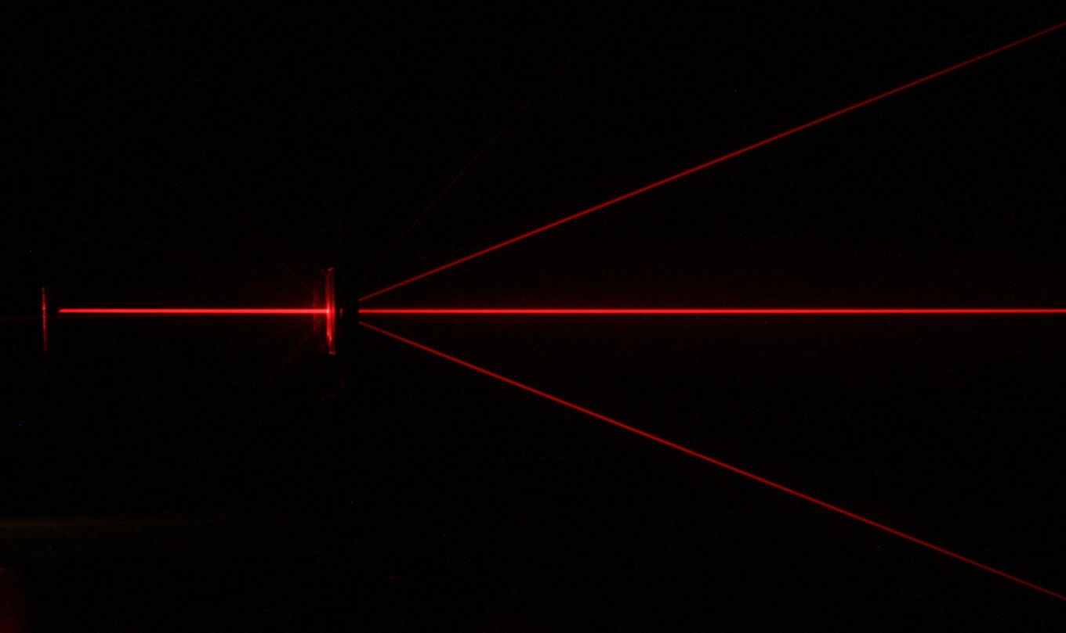
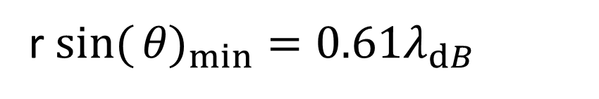
Diffraction by atoms
When relativistic electrons pass through a thin sample of a gas then diffraction occurs between the atomic nuclei.
The equation that calculates the minimum angle of diffraction is:
r $\sin{(}{θ\text{)}}_{min}=0.61λ_{ⅆB}$
The first diffraction angle is 44º for Oxygen. Use the formula above and the calculated wavelength of a relativistic electron to satisfy yourself that the Oxygen nuclei is about 2.6 fm if the electron has about 420MeV.

Slide 17
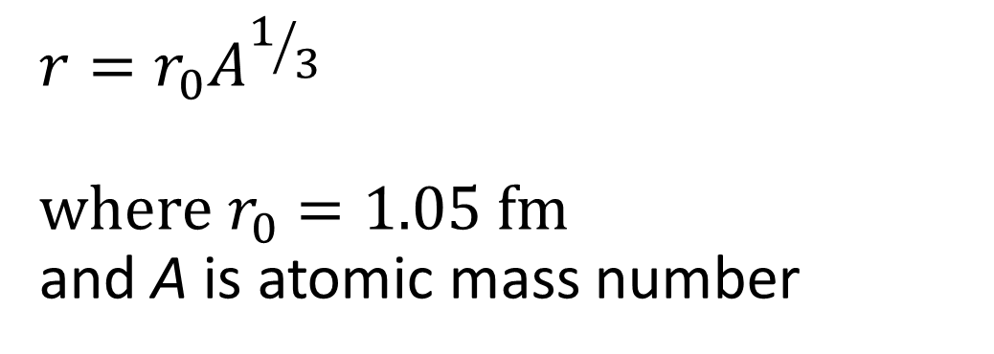

Nuclear radius vs Nucleon number
Experimental data using the electron diffraction technique has that:
Calculate $r$ for Gold (A = 197)
$$r=r_{0}A^{1/3}$$
$$\text{where} r_{0}=1.05 \text{fm}$$
and A is atomic mass number

Slide 18
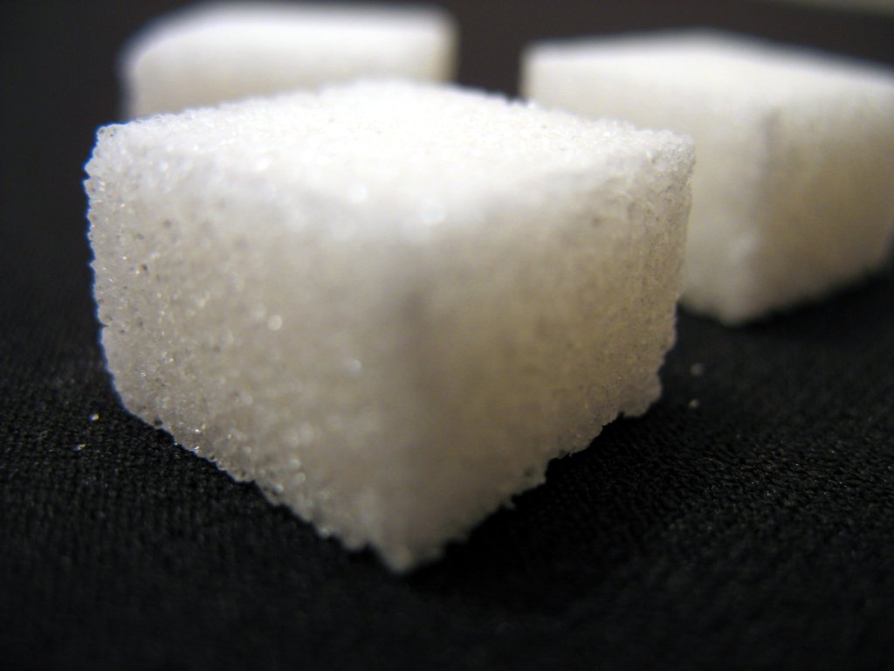
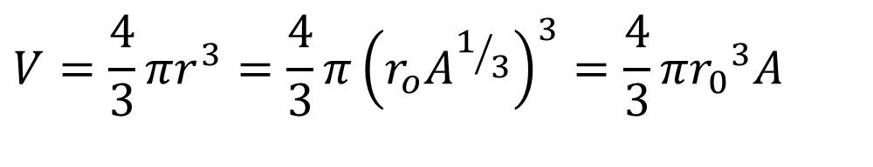
Nuclear Density
Assuming that the nucleus is a sphere then it's volume is:
Density is simply mass / volume and therefore using the mass of a nucleon as u we obtain:
$$V=\frac{4}{3}πr^{3}=\frac{4}{3}π{\left(r_{o}A^{1/3}\right)}^{3}=\frac{4}{3}π{r_{0}}^{3}A$$
This is the density of a Neutron star. If the population of the world (c.7 Billion) averaging 80kg per person was crushed into a cube of this density, how long would it's sides be?

Slide 19
Summary
There are several methods to calculate the approximate diameter of a nucleus including:
  Coulomb’s law applied to alpha particles
  Diffraction of relativistic electrons through gases
The several methods concur with each other and support the theory that the nucleus is about 10000th the size of an atom
The density of all nuclei are about the same regardless of atomic number, as they are all made of the same sub-atomic particles

