Slide 1
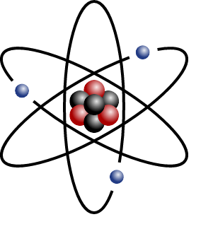
The discovery of the nucleus
How have the ideas about matter changed over the centuries?
Do you think the model we have today is the final one?

Slide 2
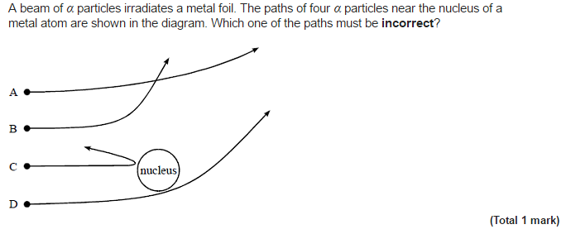
Rutherford scattering
Starter:

Slide 3
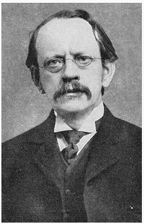
J.J. Thompson
Created a model of matter that was like a currant bun or plum pudding.
Electrons were thought to be spread out evenly throughout matter like currants in a bun with a positive mass between them like dough.
J.J. Thomson (1856 - 1940) discovered the electron and confirmed that it had a negative charge.

Slide 4
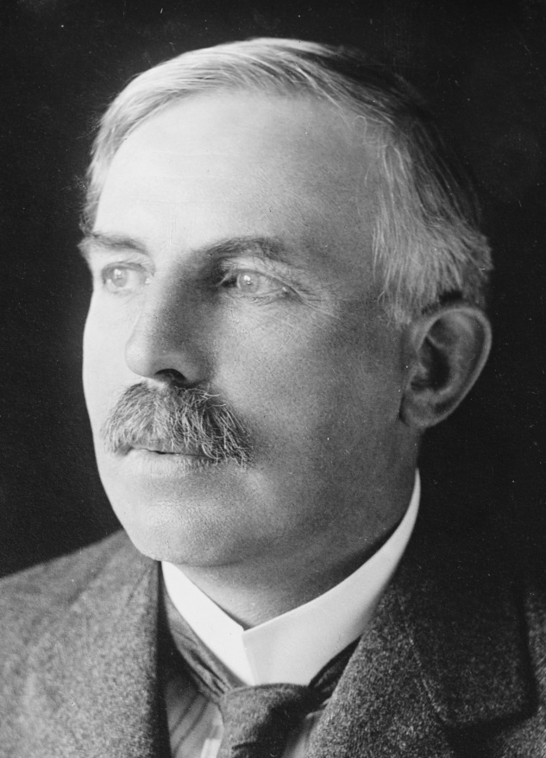
Ernest Rutherford
Knew that Alpha radiation was positively charged and that if he fired it through thick foil then a small amount of scattering should occur from the positive "dough"
Astonishingly some of the particles reflected from the foil as he is quoted saying "as incredible as if you fired a 15 inch naval shell at tissue paper and it came back"
Ernest Rutherford
(1871 - 1937)
Built upon the ideas of Thomson

Slide 5
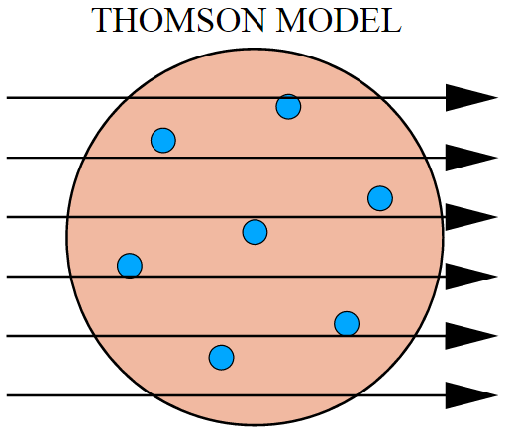
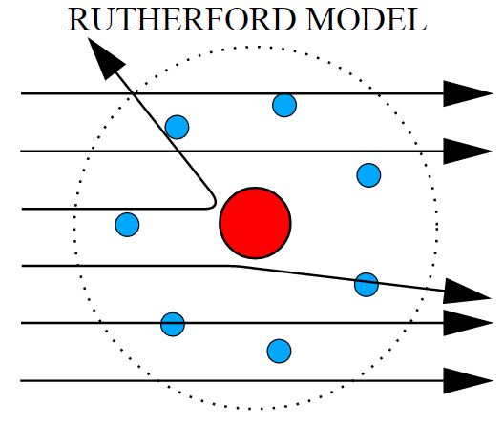
Comparing the models

Slide 6
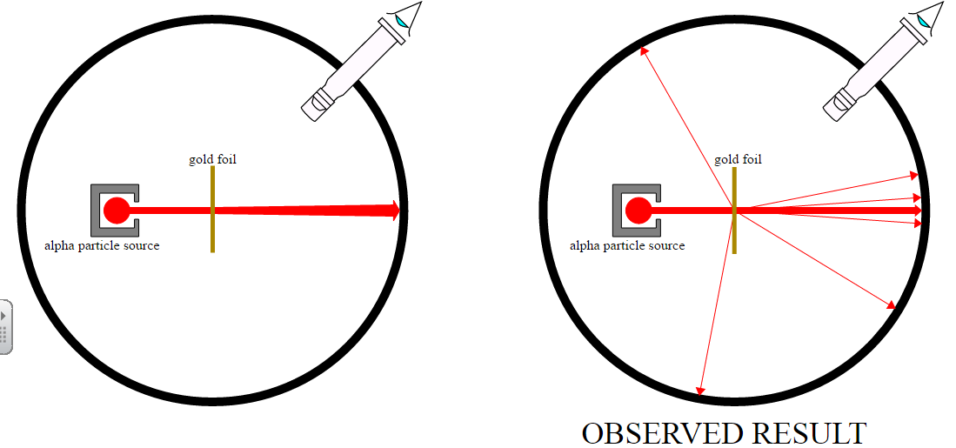
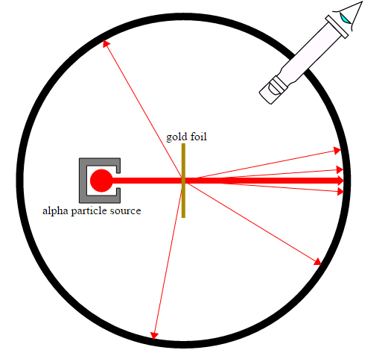
Rutherford’s Experiment
The experiment that Rutherford performed was to fire Alpha particles through very thin gold foil. A detector (fluorescent sheet and a microscope) was placed at the far side and move through an angle and monitored. The frequency of alpha particles arriving could be measured for different angles.
Results:
1) Only 1/2000 particles were deflected
2) About 1/10000 were actually deflected at angles greater than 90 degrees
What did Rutherford initially expect to see?

Slide 7
A new model: The Nucleus
Rutherford's theory was consistent not only with his own experiment but also obeyed Newton's laws of motion and Coulomb's force law (for charged particles).
Finally by using different metals for the foil and different thicknesses he showed that the magnitude of the charge on the atomic nuclei was proportional to the atomic number Z and to the electron charges Ze
The results were not consistent with Thomson's model of matter. Rutherford calculated that:
Most of the atom must be empty so there was no deflection in most particles
Most of the mass and all of the positive charge must be locked up into tiny bits of matter in the centre of the atom.
Why was it important that Rutherford’s new model also fitted in with Coulomb’s Law and Newton’s Laws?

Slide 8
Estimating atomic sizes
Rutherford measured that about 1 in 10000 alpha particles were scattered more than 90º
This means that the alpha particles has a 1 in 10000 chance of encountering a nucleus
If there are n layers of atoms to get through and the cross sectional area ratio of nucleus to atom is d² to D² then the formula to describe this experiment is:
Whilst this does not give the size of a nucleus Rutherford used gold of approximately 10⁴ atoms thick meaning the nucleus was 1/10000th the size of an atom

Slide 9
Summary
Scientist build models and ideas based on previous work from other scientists and from data they collect from their own experiments
Often an unusual or unexpected result creates a whole new theory
A new theory or model must not only explain the phenomena observed but it must also fit in with all of the other existing laws and models in science. Ideally it should also be able to make predictions about as yet untested ideas.
Rutherford’s model of the atom states that most of the mass is within a small nucleus inside an atom which has the diameter of approximately 1/10000th that of the atom within which is resides.

