Slide 1
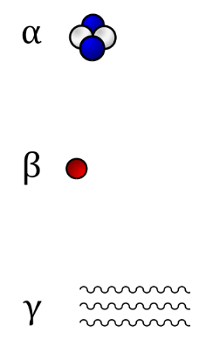
More about α, β and γ radiation
What do you already know about the properties of the different types of radiation?

Slide 2
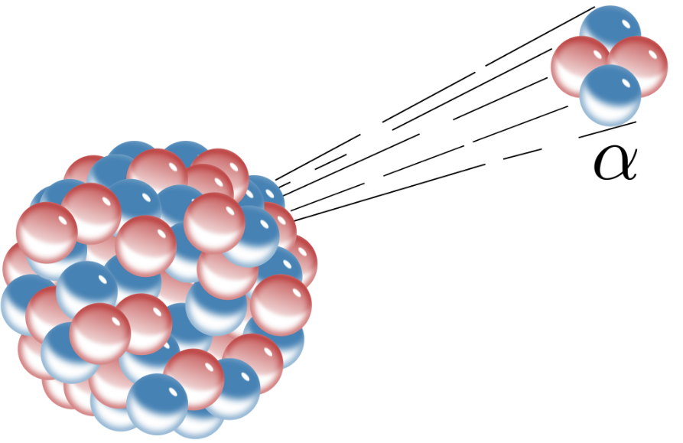
Analysis of alpha particles α
Rutherford managed to capture alpha particles and subject them to an electric current
He found that they emitted a light spectrum identical to that of Helium
This showed that they were identical to a Helium nucleus (Two protons and two neutrons)
Rutherford proposed the existence of neutrons two years before they were discovered by James Chadwick in 1932 (One of Rutherford’s students)

Slide 3
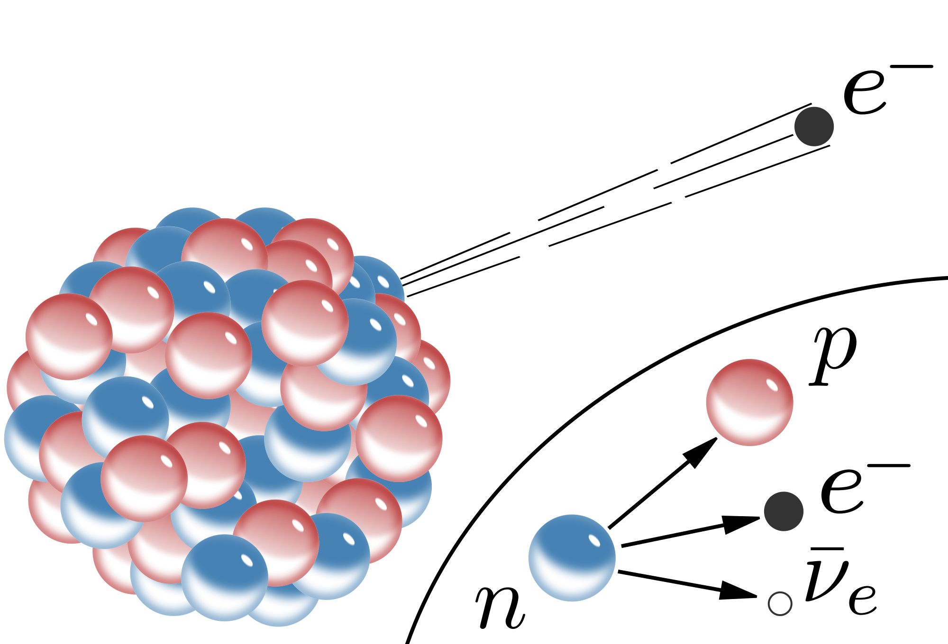
Analysis of Beta β radiation
Beta particles consist of fast-moving electrons. This was proven by deflecting them in a magnetic and electrical field. This gave the charge/mass ratio of the particles that showed their specific charge was the same as that of an electron.
If a nucleus has too many neutrons then it is susceptible to beta decay. This is where a neutron changes into a proton and an electron is created.

Slide 4
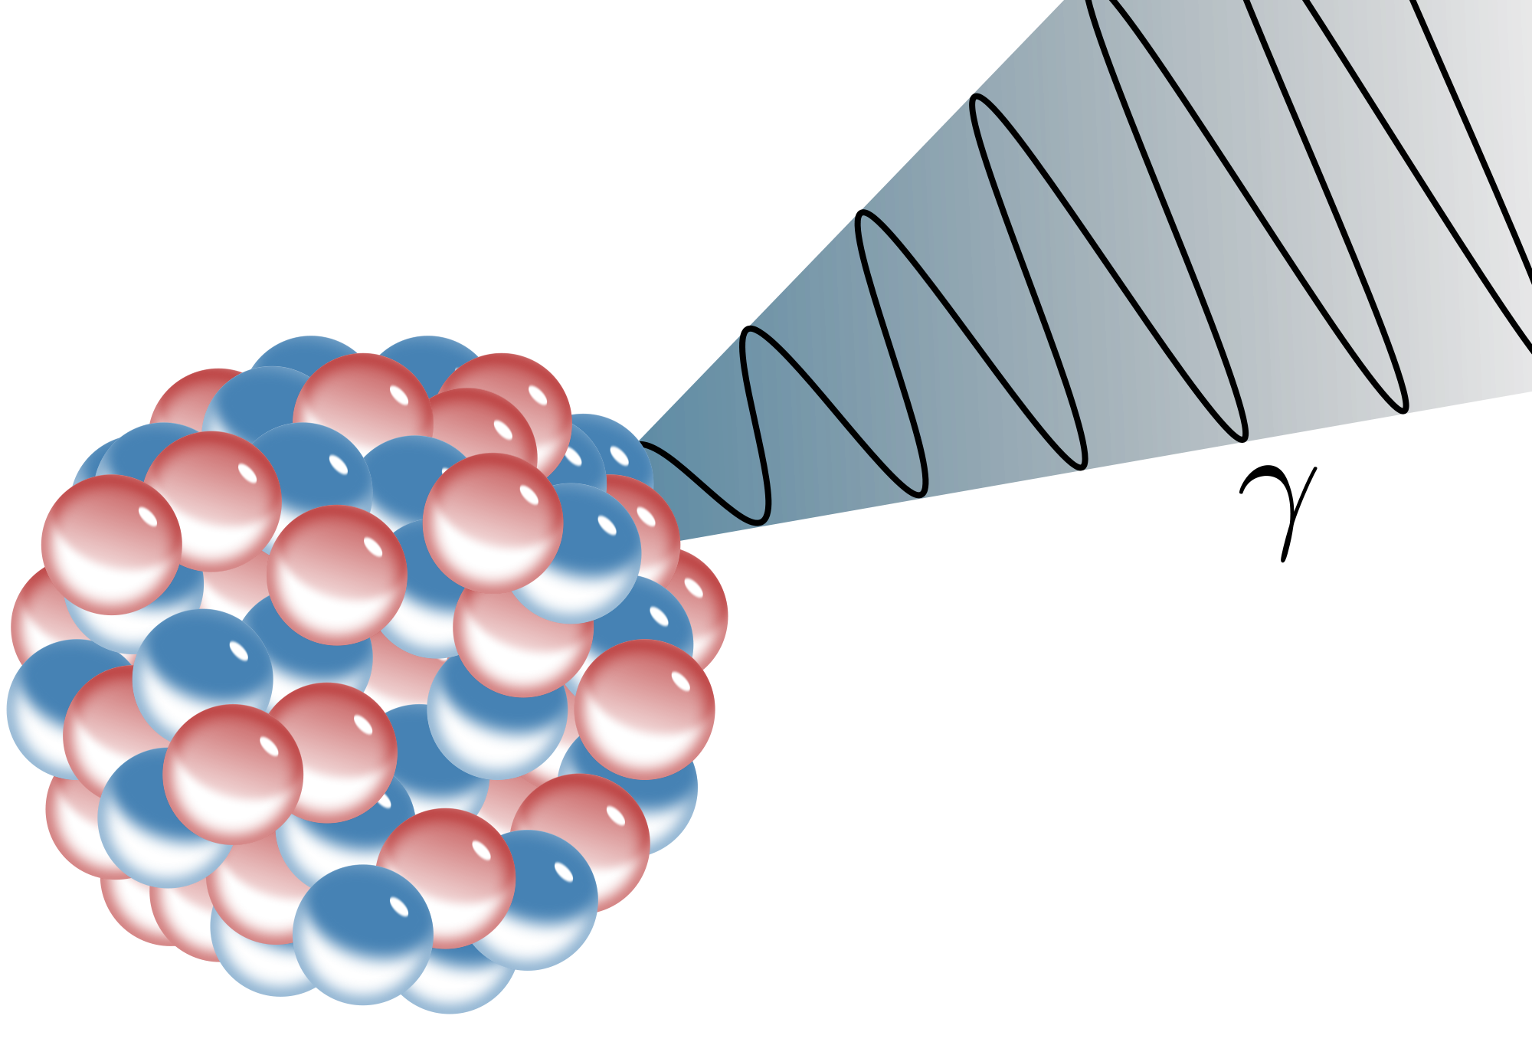
Analysis of Gamma γ radiation
Gamma radiation is electro-magnetic radiation with a wavelength in the order of 10⁻¹¹m
This was shown by diffracting the rays through crystals and analysing the diffraction pattern that is created

Slide 5
Gamma radiation and the inverse square law
As you move away from the radiation source then the radial distance r gets larger. Imagine the area of a sphere at distance r:
Recall that the energy in a photon is:
Therefore for n photons we have:
The intensity of the photons at a given radial distance is therefore:
Using a constant this then generalises to

Slide 6
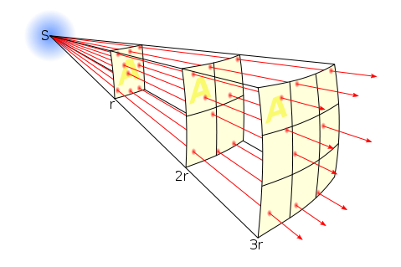

Slide 7
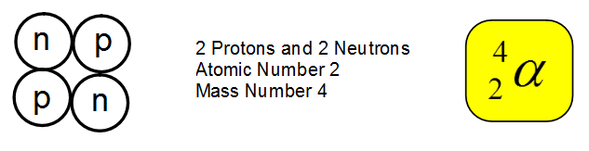
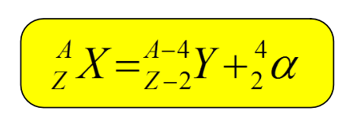
Alpha decay
Alpha Particles are exactly the same as a Helium Nucleus:
During Alpha decay a radioactive nucleus loses two protons and two neutrons. This means that it changes which element that it is. The element change is always two less than where it was before the reaction.

Slide 8
Beta Decay
Beta particles are exactly the same as electrons EXCEPT that they come from within a Nucleus.
PUZZLE: There are NO electrons in the Nucleus!
During Beta decay a Neutron turns into a Proton and an electron is formed. This electron is then emitted from the nucleus as a high speed electron or Beta particle.

Slide 9
Positron Β⁺ emission
This emission is when a proton turns into a neutron and a positive anti-matter electron (a positron) is created
These quickly annihilate when they encounter an electron

Slide 10
Electron Capture
A sheath electron in a low electron shell can be captured by the nucleus
This has a similar effect to Positron decay on the nucleus

Slide 11
Summary
Alpha is identical to a Helium nucleus and the formula for the changes in the nucleus are:
Beta is a high speed electron, emitted from a nucleus when an neutron turns into a proton
Positron decay (β⁺) occurs when a proton turns into a neutron

Slide 12
Summary
As you move away from an object the radiation decreases.
For gamma radiation this follows an inverse square law:

