Slide 1
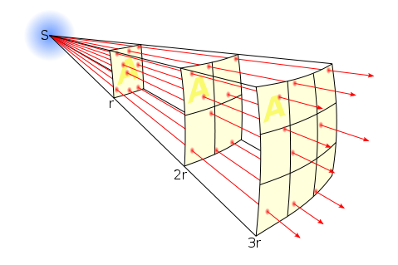
Investigation of the inverse-square law for gamma radiation

Slide 2
Gamma radiation and the inverse square law
As you move away from the radiation source then the radial distance r gets larger. Imagine the area of a sphere at distance r:
Recall that the energy in a photon is:
Therefore for n photons we have:
The intensity of the photons at a given radial distance is therefore:
Using a constant this then generalises to

Slide 3
Opportunities for assessment
Your teacher will decide what level of independence you will have in this experiment:
You are given a complete step by step method to follow
You are given a limited choices of lengths/gauges of wire to use and a method to follow
You are given a brief method but have to determine the ranges and to use after doing a preliminary experiment
You plan and execute the experiment yourselves
It is important that during your A-Level course you can show evidence that you have performed a range of independence in performing experiments.

Slide 4
Writing up your experiment
You must write up this experiment fully showing a clear competence in the following skill areas:
Use appropriate analogue instruments to record a range of measurements
Use appropriate digital instruments to record a range of measurements
Use ICT such as computer modelling, or data loggers with a variety of sensors to collect data, or use of software to process data
Use ionising radiation, including detectors

