Slide 1
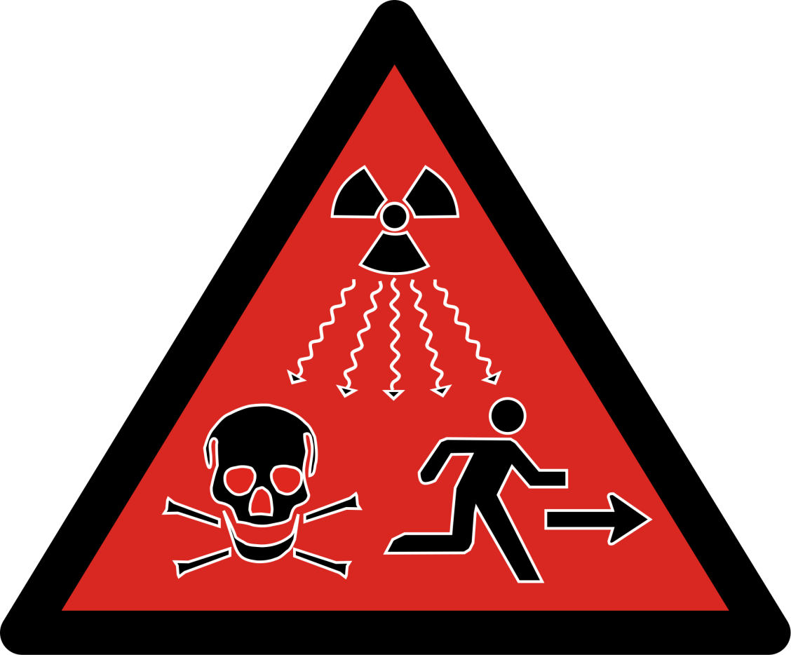
The dangers of radioactivity
Why is radiation dangerous? What does it do to living cells? What is a safe dosage?

Slide 2
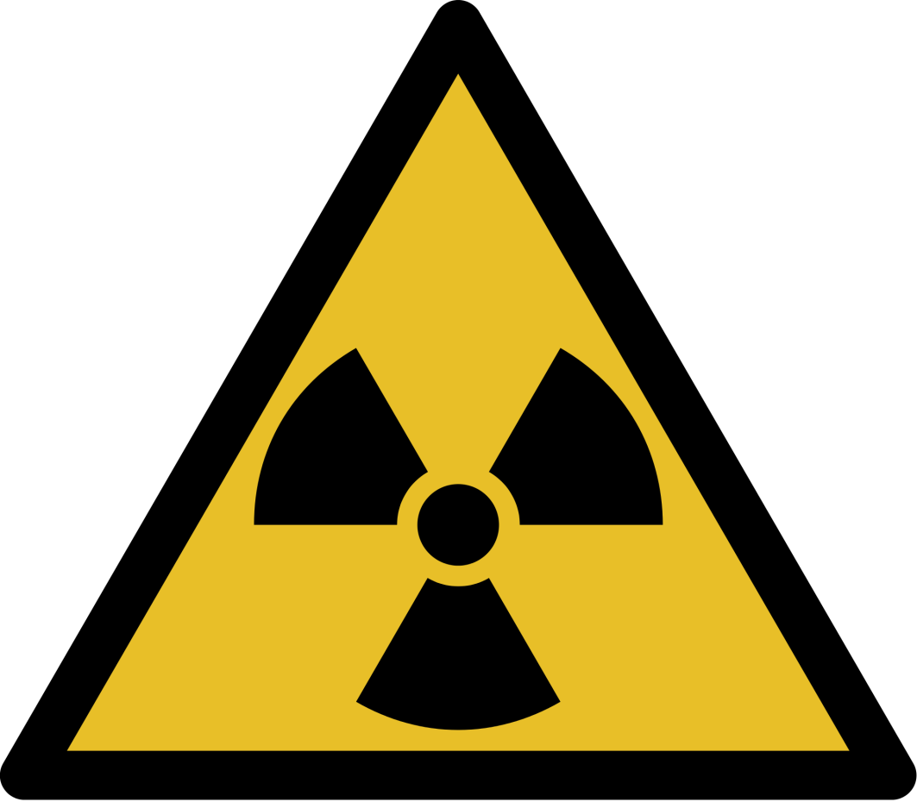
Ionising Radiation
Ionising Radiation is anything that can cause electrons to be removed from atoms, creating ions. This process is harmful to living cells by either killing them or damaging DNA which causes mutations that can be passed to future cell generations and cause cancer.
These include:
X-Rays
Gamma
Alpha
Beta
Protons
Neutrons

Slide 3
Monitoring Radiation
Workers in the nuclear industry have to wear a film badge to monitor how much radiation they receive. This contains a photographic film in a light proof case that will blacken if radiation strikes it.
The badge also contains 3 different thicknesses of material as well as different metals, that allow the user to be able to know what radiation type has been absorbed.

Slide 4
Different Ionisation - Different Dose
Alpha is more ionising than Beta and this is more ionising than Gamma
This means that simply measuring the amount of counts per second does not give an indication of the health implications unless combined with the type of radiation. The solution is the Sievert scale (Sv)
1 Sv is equivalent to 250kV X-rays which is a very high dosage so you will usually see milli-Seiverts quoted (mSv)
The maximum recommended limit is 20 mSv / year for a worker in the UK; the nuclear industry has this set to 10mSv / year

Slide 5
Background radiation
Everybody receives a small amount of background radiation from the environment, industry and medicine. This is generally harmless and adds up to a couple of mSv / year.
The background count rate should be monitored before an experiment and then subtracted from any readings to make the experiment accurate

Slide 6
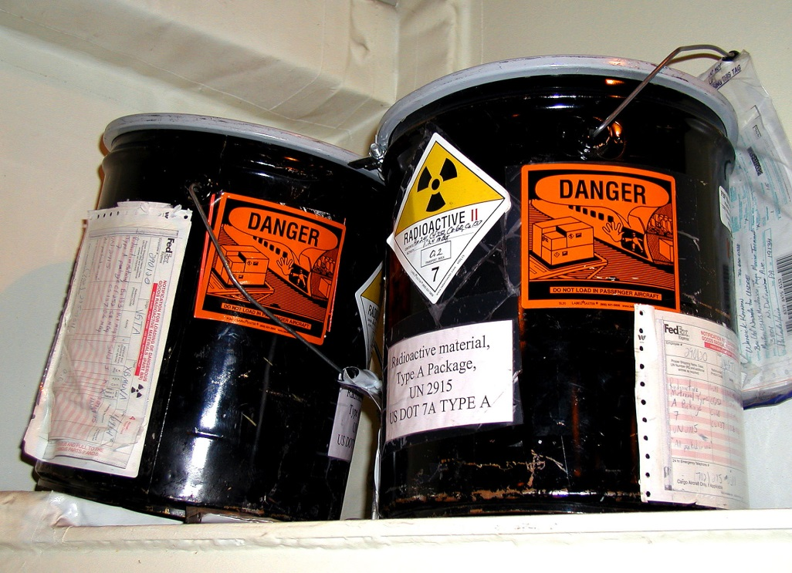
Storage of radioactive isotopes
Lead is a good absorber of Gamma rays so isotopes are stored in sufficient Lead so that the amount of rays escaping is about the same level as the background radiation.
Radioactive storage must be locked and a record must be kept of their inventory and their use.
All of the high level waste produced by the nuclear energy industry in the UK since it started in the 1950s would fit on one double decker bus!

Slide 7
Safe use of radioactive isotopes
Solids must be handled with tongs or tweezers - NEVER handle them directly
Gases and Liquids must be kept in sealed containers to stop them from being breathed in or eaten
Sources must be used for the minimum possible amount of time as the radiation dose is cumulative

Slide 8
Summary
Alpha radiation is the most ionising but it cannot penetrate the skin, it is therefore reasonably safe outside the body
The amount of radiation dose is a combination of the ionising ability of the radiation, its absorption and the amount of radiation – the units are Seiverts (Sv)
1000 Sv is immediately fatal; workers in the UK are limited to 20mSv / year by HSE regulations
Background radiation accounts for about 2mSv / year in the UK and is considered mostly harmless
Ionising radiation can cause cell death, mutation and cancer
When using radioactive sources a full risk assessment must be carried out to limit exposure to a minimum

