Slide 1
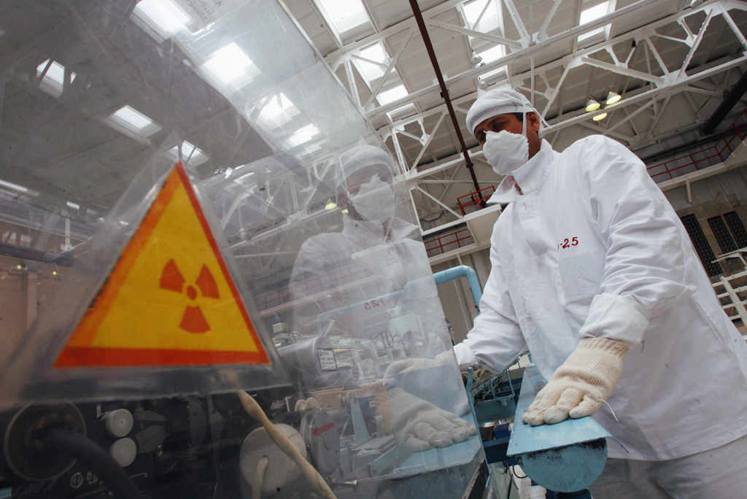
Radioactive isotopes in use
Do the risks outweigh the benefits for using radioactive sources?

Slide 2
Choosing an isotope
When you are selecting an isotope for use in industry or healthcare, what properties must be considered?
Half life of the isotope
Stability of the daughter isotope
Toxicity and biochemical suitability of the parent / daughter nuclei
Type of radiation that is emitted

Slide 3
Radio-Carbon dating
In the upper atmosphere cosmic rays can knock neutrons out of nuclei which then interact with Nitrogen 14 atoms to create Carbon 14 atoms.
These are radioactive with a half-life of 5570 years. The are absorbed by plants and enter the food chain.
When something dies the proportion of C14 reduces over time so can be used as a dating method.

Slide 4
Argon dating
The main drawbacks to Carbon dating is the relatively short half life and the fact that it can only dead organic material. To date rocks Argon 40 can be used which is trapped inside rocks.
This has a half-life of 1250 million years! The formation of Argon 40 is through electron capture of a sheath electron in Potassium
Can you write a nuclear equation to represent this?

Slide 5
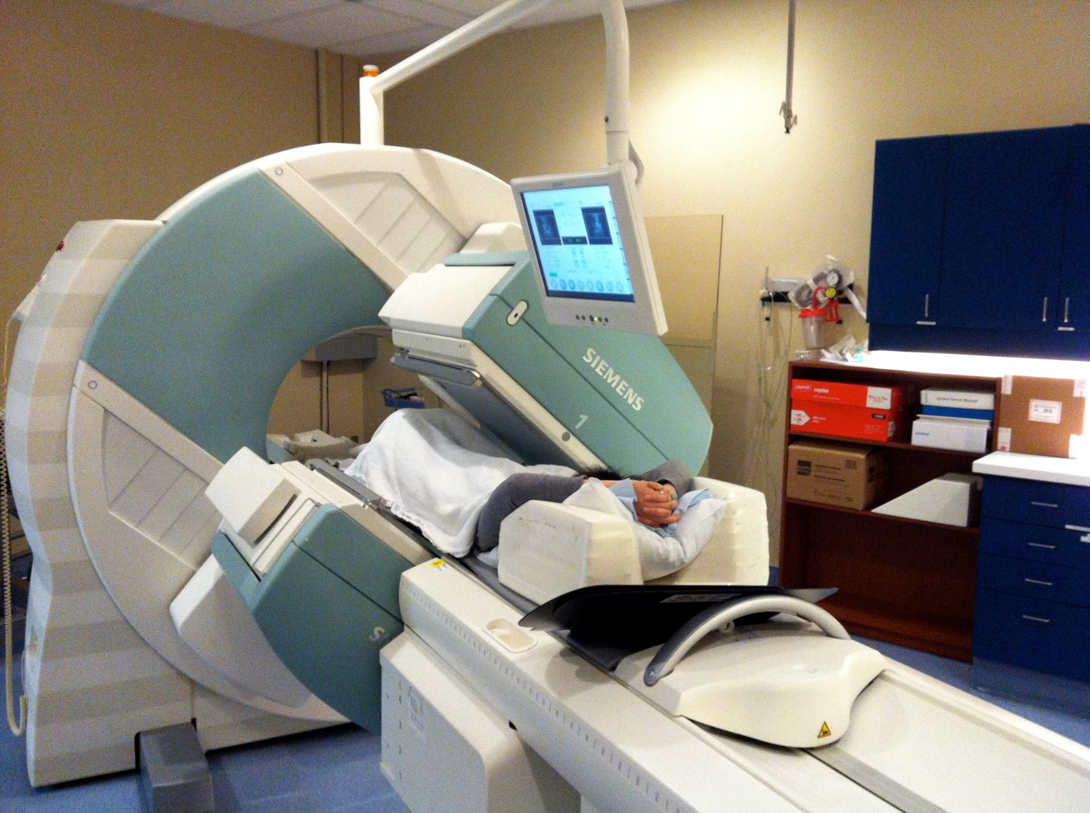
Radioactive Tracers
Recalling the initial list of required properties that an isotope needs it is clear that for medical tracers they are all essential.
Technetium 99 is a gamma emitter with a half-life of 6 hours, it has an inert daughter isotope that has a very long half-life and hence low activity.

Slide 6
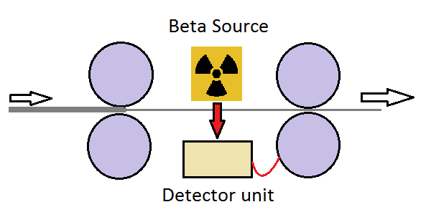
Paper / Metal thickness monitoring
When thin material of uniform thickness is needed, beta particles are passed through it.
The count rate at the far side of the material is a measure of the thickness of the material and this then controls rollers that can crush the material

Slide 7
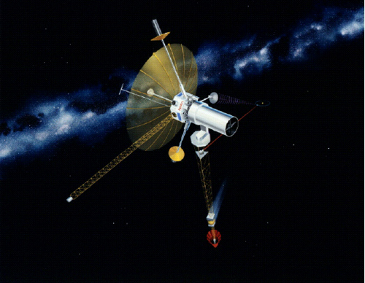
Remote Power Sources
Radioactive decay gives out energy that can be used to power devices, recall the formula:
Considerations include:
Having a long enough half-life to sustain the machine into the future
Not too long that too much material is needed due to low activity.

Slide 8
Summary
The main uses for radioactive material are:
  Industry as a scanning method
  Health care for scans and cancer treatment
  Nuclear weapons
  Nuclear energy
Considerations in selecting the isotope in each case are:
  Half life of the isotope
  Stability of the daughter isotope
  Toxicity and biochemical suitability of the parent / daughter nuclei
  Type of radiation that is emitted

