Slide 1
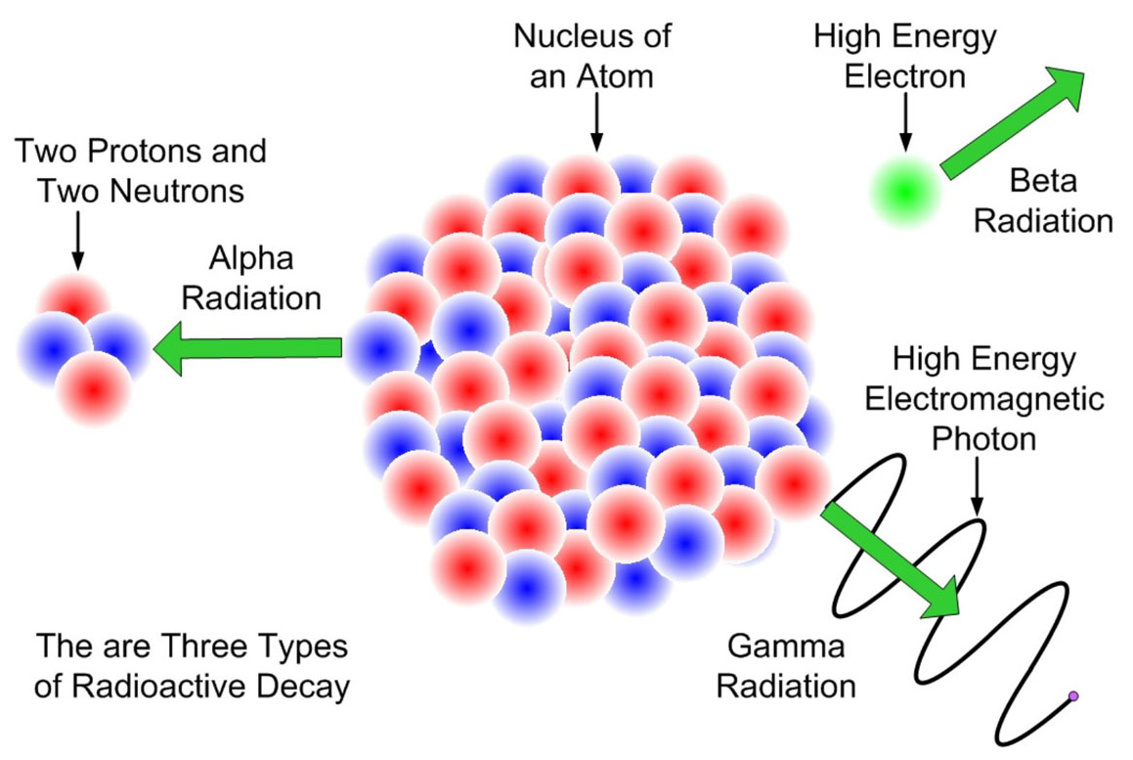
More about decay modes
Why do some isotopes decay and others are stable?
Why do some decay by Beta and others by Alpha?

Slide 2
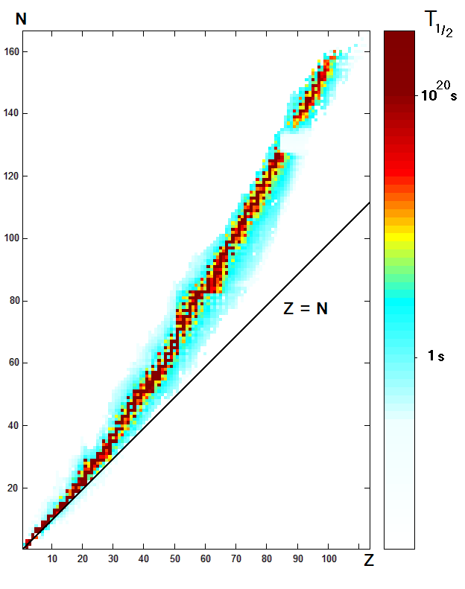
Proton / Neutron ratio
If you plot a graph of the elements in the periodic table you find there is a relationship between the number of protons and the number of neutrons
For elements up to Calcium the stable isotopes have approximately the same number of neutrons as protons. Beyond this there are slightly more neutrons than protons.
Isotopes that do not have the correct ratio have very short half-lives

Slide 3
Sub-atomic forces
Recalling that protons feel the electric force it is clear that adding more protons pushes the nucleus apart
Neutrons and protons feel the strong force so adding these pulls the nucleus together
Although the strong force is stronger than the electric force it has a shorter range
All of these considerations together create the stability of the nucleus – full knowledge of this is not required for A-Level Physics!

Slide 4
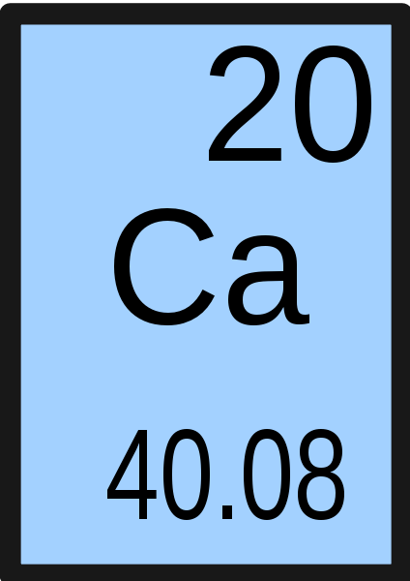
Small nuclei
For light isotopes up to Z = 20 then the stability line is approximately A = Z
Why is the mass given as 40.08?
It is the average mass of the different isotopes occurring in nature

Slide 5
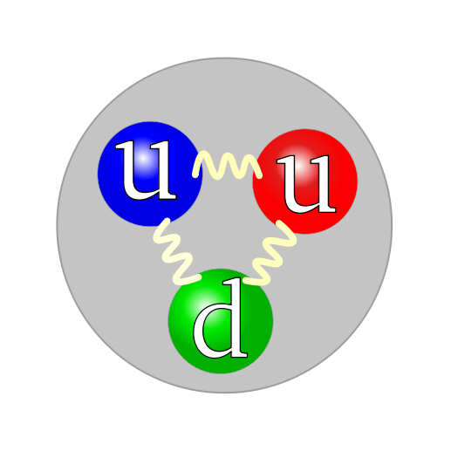
Isotopes above 20
The reason that the neutron ratio must increase for larger nuclei is because they still feel the strong nuclear force without exerting any repulsive force. This helps to balance the ever increasing repulsion of the protons.

Slide 6
Decay modes
Consider the β⁺ and β⁻ decays and how they effect the neutron : proton ratio
β⁻ decay does the exact opposite. If you look where an isotope is on the graph then you can see which way it needs to move to become more stable and this then defines the type of decay that will occur.
β⁺ decay (or electron capture) transforms a proton into a neutron so the isotope would move diagonally up and left on the N-Z graph.
Alpha decay causes both the proton and neutron numbers to decrease by 2 so the movement is diagonally to the bottom left.

Slide 7
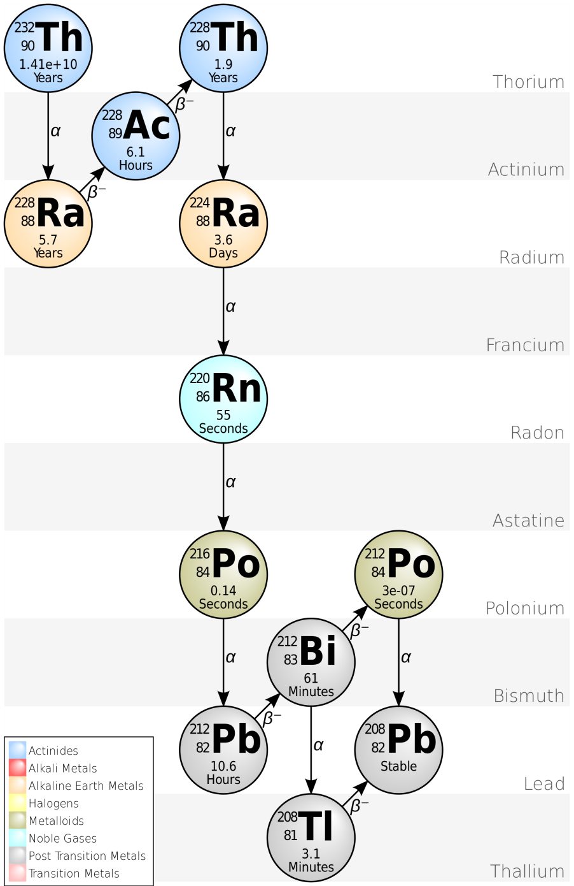
Radioactive series
As isotopes decay they may not end up becoming a stable nucleus (although they always become slightly more stable)
This means that the daughter nucleus will then undergo a further decay or a whole chain of decays.
Can you draw this decay chain onto an N-Z graph?
Note: The vertical axis can be mass A so the beta decays are horizontal. Ensure that you check the axis given in the exam!

Slide 8
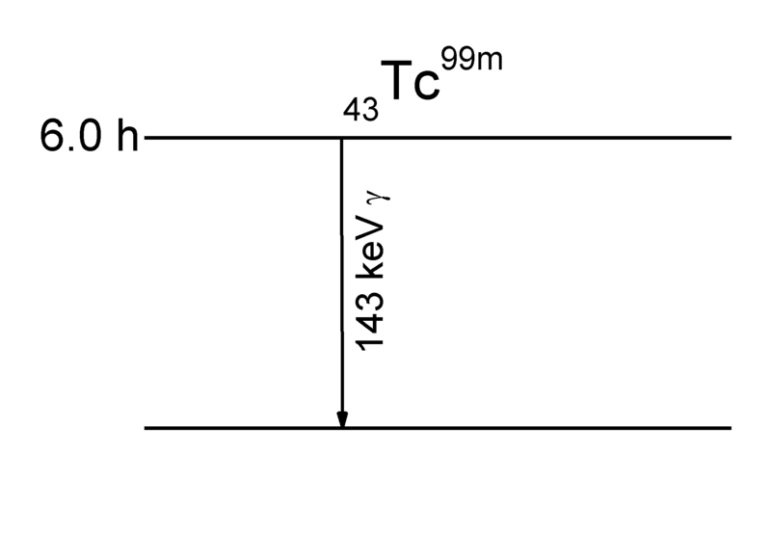
Nuclear Energy Levels
You are familiar with the idea that electrons are in energy levels (or shells) and that they can be excited but they quickly fall down to a more stable energy level and emit electro-magnetic radiation.
After a radioactive decay a nucleus is often left in an excited energy state. It will quickly then move to it's ground state and the energy change is released as a gamma photon.
Although this gamma ray is usually emitted within a fraction of a second there are rare isotopes that have a longer half life; this is called a meta-stable state. Technetium 99 has a meta-stable state with a 6 hour half-life

Slide 9
Summary
Stable isotopes up to Calcium (Z=20) have approximately the same number of neutrons as protons
Beyond this slightly more neutrons than protons are needed to hold the nucleus together
Α, β⁺and β⁻ decays all change the neutron / proton ratio in an isotope so the type of decay tends to stabilise the isotope
Gamma emission usually occurs alongside another decay as the nucleus becomes more stable
Care must be taken to check the axis of N/Z or A/Z graphs

