Slide 1
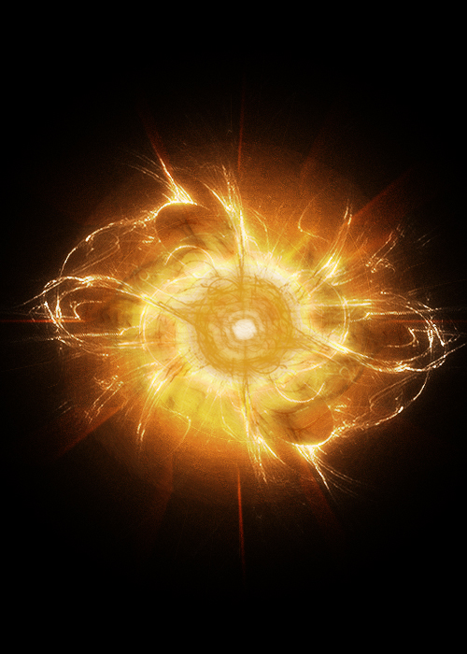
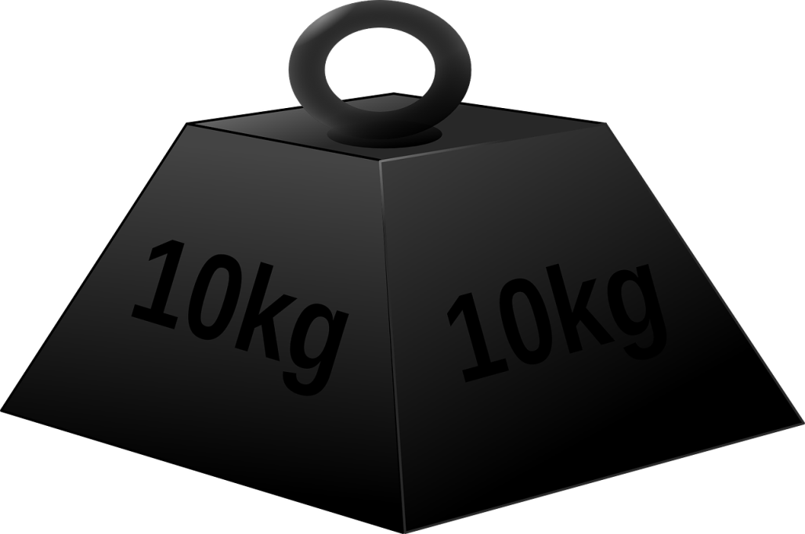
Energy and mass
How would you describe these two properties?

Slide 2
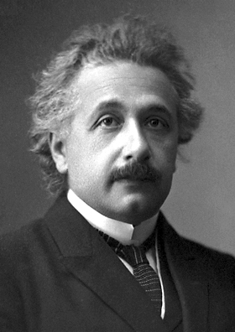
Albert Einstein
Famous for his theories of both General and Special Relativity.
His ideas were far reaching and counter-intuitive; fast moving objects appear shorter than they are, travel slower through time and have more mass!
Albert Einstein
(1879 - 1955)

Slide 3
Energy-mass equivalence
In 1905, Einstein published the special theory of relativity
The mathematics of the full theory is complex, but the ideas that came out of it were revolutionary:
Time slows down for an observer moving at a faster speed
The observed mass of an object increases with speed, as well increasing with total energy
Measured lengths decrease as an observer’s speed increases

Slide 4
Energy-mass equivalence
“E=mc²” tells us about how much energy we produce when antimatter and matter annihilate.
It also tells us how much mass increases by when we add energy to a system…
Imagine raising a 5kg bowling ball 1m off the ground:
Energy increase = GPE
= m x g x h
= 5 x 9.81 x 1
= 49.05 J
$$∆m =∆E / c2$$
$$∆m=\text{49.05 /} {{\text{(}\text{3 }\text{x}\text{ 10}}^{8})}^{2}$$
$∆m=5 x {10}^{−16}$ kg

Slide 5
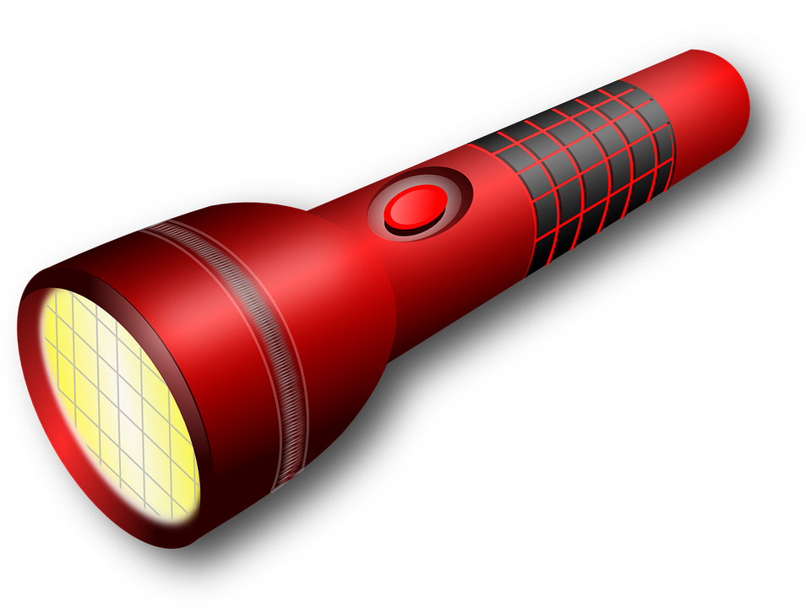
Mass change in reactions
If a torch gives out light then it is giving out energy. This means that the torch must be getting lighter!
How much mass does a 25W bulb lose in 30 minutes of use?

Slide 6
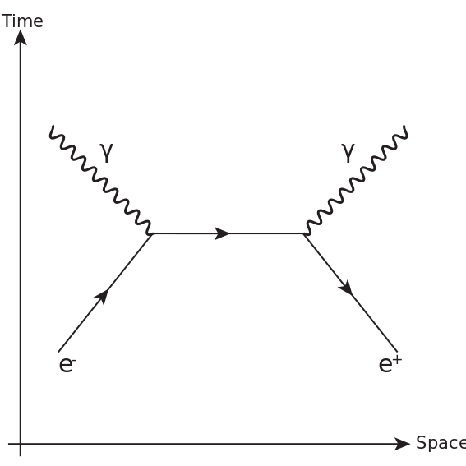
Mass / Energy conversion during annihilation
Remember that a particle / antiparticle annihilation creates two gamma photons of energy mc² where m is the mass of the particle. You can see that mass is converting to energy E = hf = mc²

Slide 7
Question 1
Calculate the minimum energies of the photons produced by the annihilation of a proton and antiproton:
E = mc² = (1.67 x 10⁻²⁷ ) x (3.0 x 10⁸)²
= 1.50 x 10⁻¹⁰ J
The minimum energies occur when the pair of particles have initially insignificant kinetic energy.
rest energy of a proton = 1.50 x 10⁻¹⁰ J
rest energy of an antiproton also = 1.50 x 10⁻¹⁰ J
Total mass converted into electromagnetic radiation in the form of two photons = 3.0 x 10⁻¹⁰ J
Therefore each photon has an energy of 1.50 x 10⁻¹⁰ J

Slide 8
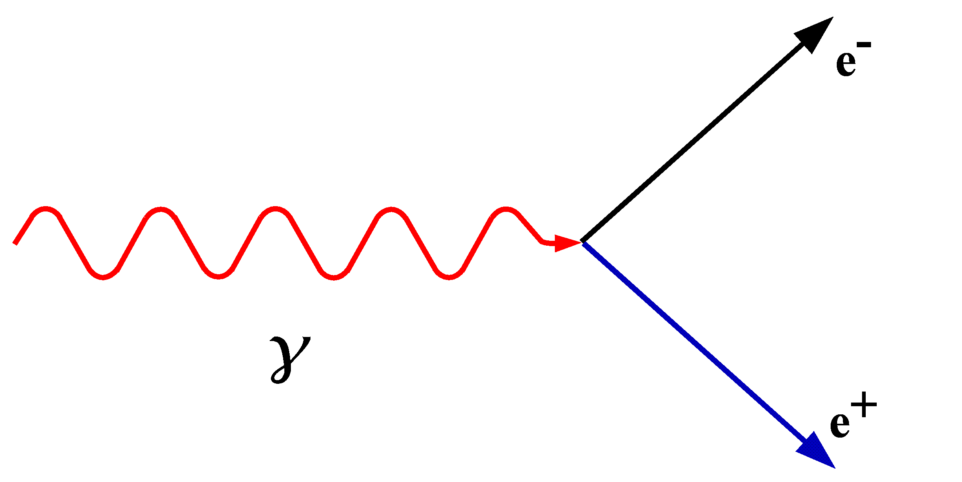
Energy / Mass conversion during pair production
Remember that you are making TWO particles so you need double the energy in the gamma ray!

Slide 9
Released energy
When radioactive particles are emitted from a nucleus ($α, β, or γ)$, energy is removed from the nucleus, so the mass decreases.
We can use the decrease in mass to calculate how much energy is lost!
Where does this energy go…?
Kinetic energy of the $α, β, γ$ particles, recoil of the nucleus, or neutrinos!

Slide 10
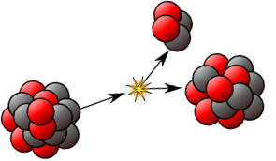
Energy conservation
In Alpha decay there is a loss of mass (even though there is no loss of sub-atomic particles) and this energy is shared between the alpha particle and the recoiling daughter nucleus. Beta decay is exactly the same and assume the mass of a Neutrino to be zero.

Slide 11
Atomic mass unit “u”
You’ll notice that the mass of each nucleon in Carbon 12 weighs LESS than a proton or neutron individually!!
1u = 1.661 x 10⁻²⁷ kg
m_{p}= 1.673 x 10⁻²⁷ kg
m_{n}= 1.675 x 10⁻²⁷ kg
Where does this difference in mass come from?
It arises due to something called “Binding Energy”, which we will come on to talk about very soon!

Slide 12
Question 2
A Polonium Isotope ${}_{84}^{210}{Po}$ emits an alpha particle and decays to form stable Lead ${}_{82}^{206}{Pb}$. Write an equation to represent this decay, and find the energy released:
Mass of ${}_{84}^{210}{Po}$ = 209.936 67u
Mass of ${}_{82}^{206}{Pb}$ = 205.929 36u
Mass of ${}_{2}^{4}α$ = 4.001 50u
${}_{84}^{210}{Po}$ → ${}_{82}^{206}{Pb}$ + ${}_{2}^{4}α$
Mass difference = 209.936 67u – (205.929 36u + 4.001 50u)
Mass difference = 5.81 x 10⁻³u
1 u = 931.3 MeV
Energy released = 5.81 x 10⁻³u x 931.3 MeV/u = 5.41 MeV

Slide 13
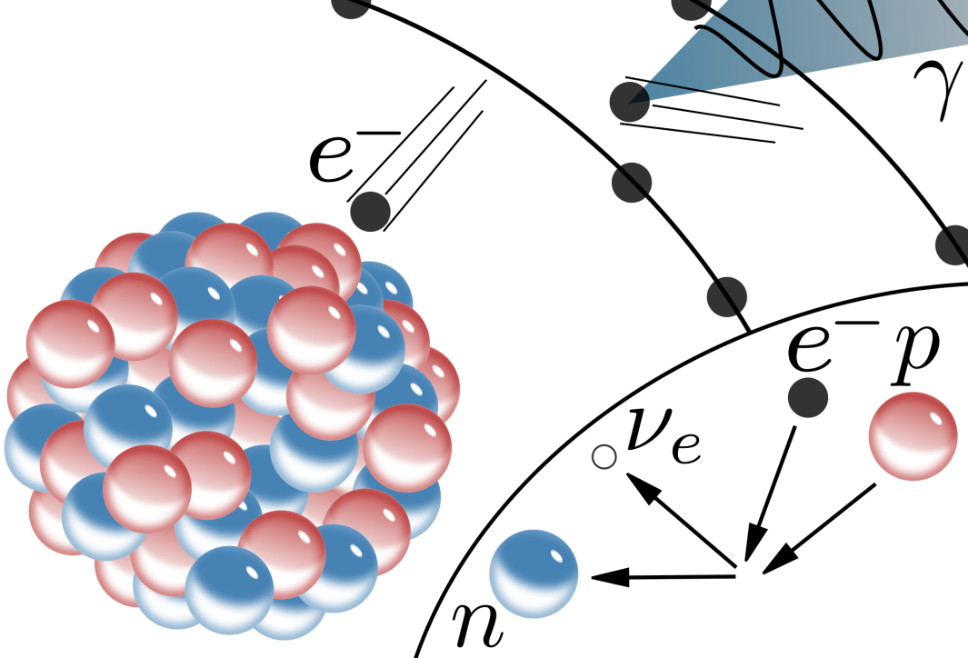
Electron Capture
Remember that this is a sheath electron (the inner electron shell) that is captured by the nucleus. When this happens the energy that is created (from loss of mass) is carried away by a neutrino.
There is also an X-ray that is emitted due to the shell vacancy being filled by an electron from a shell further out.

Slide 14
Summary
Einstein’s famous formula E=mc² states that mass and energy are interchangeable
The large constant of proportionality means that a large amount of energy is equal to a small amount of mas
Nuclear interactions create large amounts of energy due to the strong force; this means that mass changes are not negligible
Annihilation and pair production convert energy to mass and vice-versa

