Slide 1
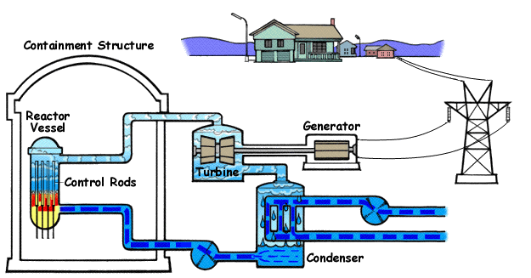
Fission and fusion
Can you fully describe the working of a nuclear reactor?

Slide 2
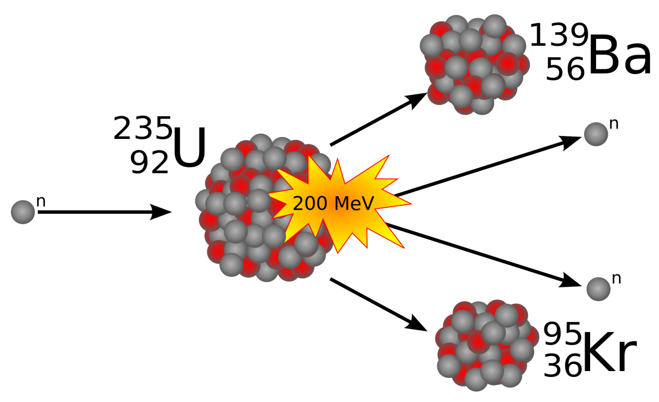
Nuclear Fission
Recalling that the stability of an atom can be measured from the average binding energy of the nucleus, therefore atoms above Z = 26 (Iron) will become more stable if they are broken apart.
This will also release energy as there is a mass deficit.

Slide 3
Induced Fission
Although natural nuclear decay is random and not predictable fission can be induced in some isotopes by bombardment with neutrons
Isotopes that this occurs with are called fissile. There are only two known fissile isotopes, Uranium²³⁵ and Plutonium²³⁹
Plutonium is created by bombarding Uranium²³⁵ with neutrons

Slide 4

Chain Reaction
When fission occurs it also releases 2 or 3 neutrons which can then go on to induce more fission reaction

Slide 5
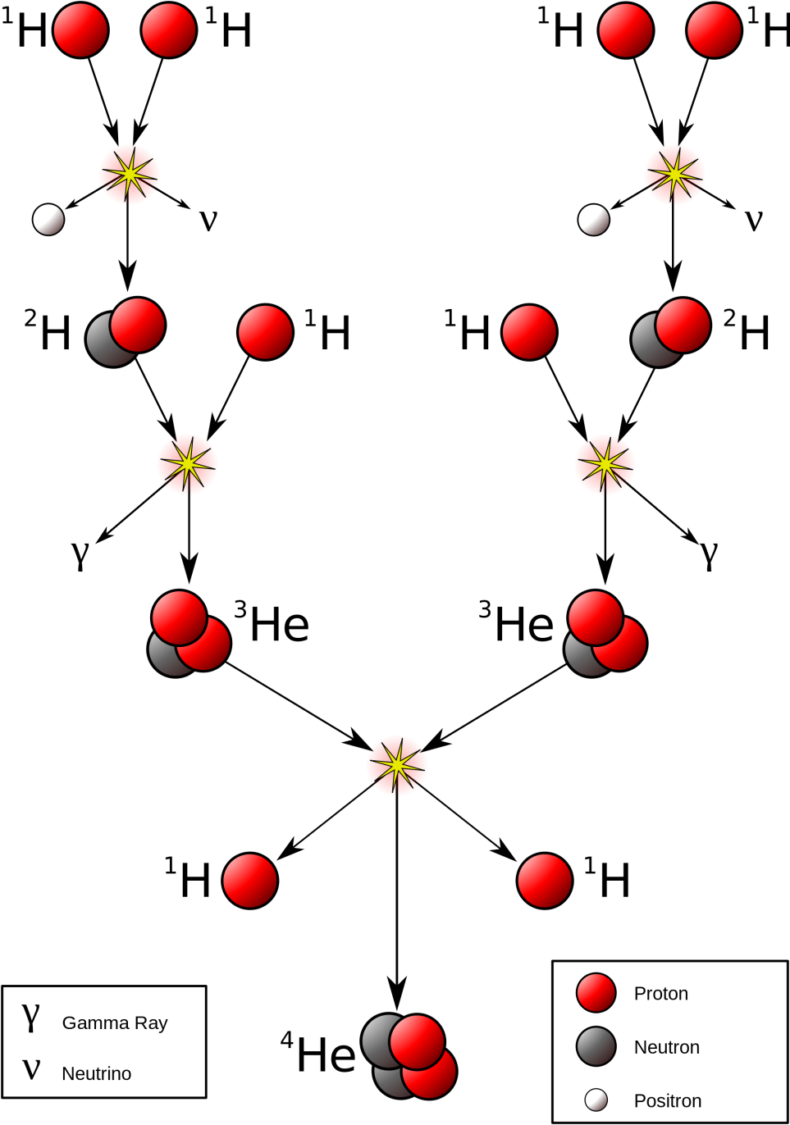
Nuclear Fusion
Fusion can be defined as bringing two nuclei together to form a larger nucleus.
Inside main sequence stars nuclear fusion is the power source where Hydrogen is being fused into Helium. This occurs mainly through the p-p chain

Slide 6
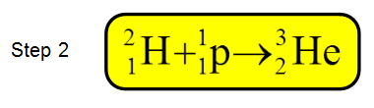
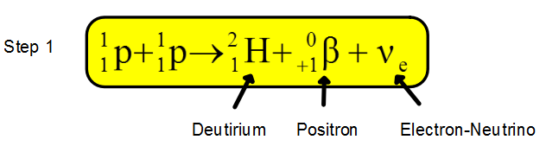
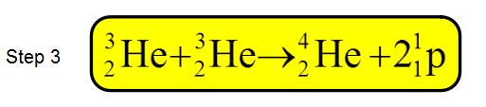
Nuclear reactions
The p-p chain can be expressed as a series of nuclear reactions. The first one is the most difficult as the proton - proton repulsion is extremely high as they approach to within the range of the strong nuclear force.

Slide 7
Energy and Mass
Energy can be formed when mass is destroyed using the equation:
The mass of the Hydrogen nucleus (A single proton) and the mass of the Helium nucleus (2 protons and 2 neutrons) can be used to calculate the energy created from the fusion reaction.
The rest mass of a proton is 1.672621777 x 10 kg
The rest mass of a Helium nucleus is 6.64456575 x 10 kg
Calculate the mass loss and hence the energy created when a single p-p chain reaction occurs

Slide 8
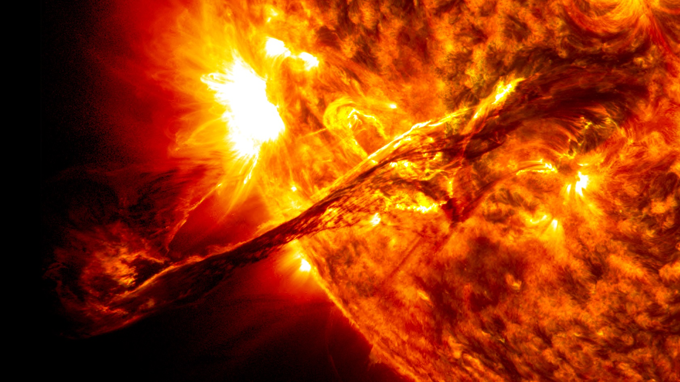
Mass loss in the Sun
The power output from the Sun can be measured from Earth and the standard value is 3.846 x 10²⁶ Watts
Given this figure, what is the mass loss in kg for the Sun every second?
What assumptions / errors do you think might be included in this calculation?

Slide 9
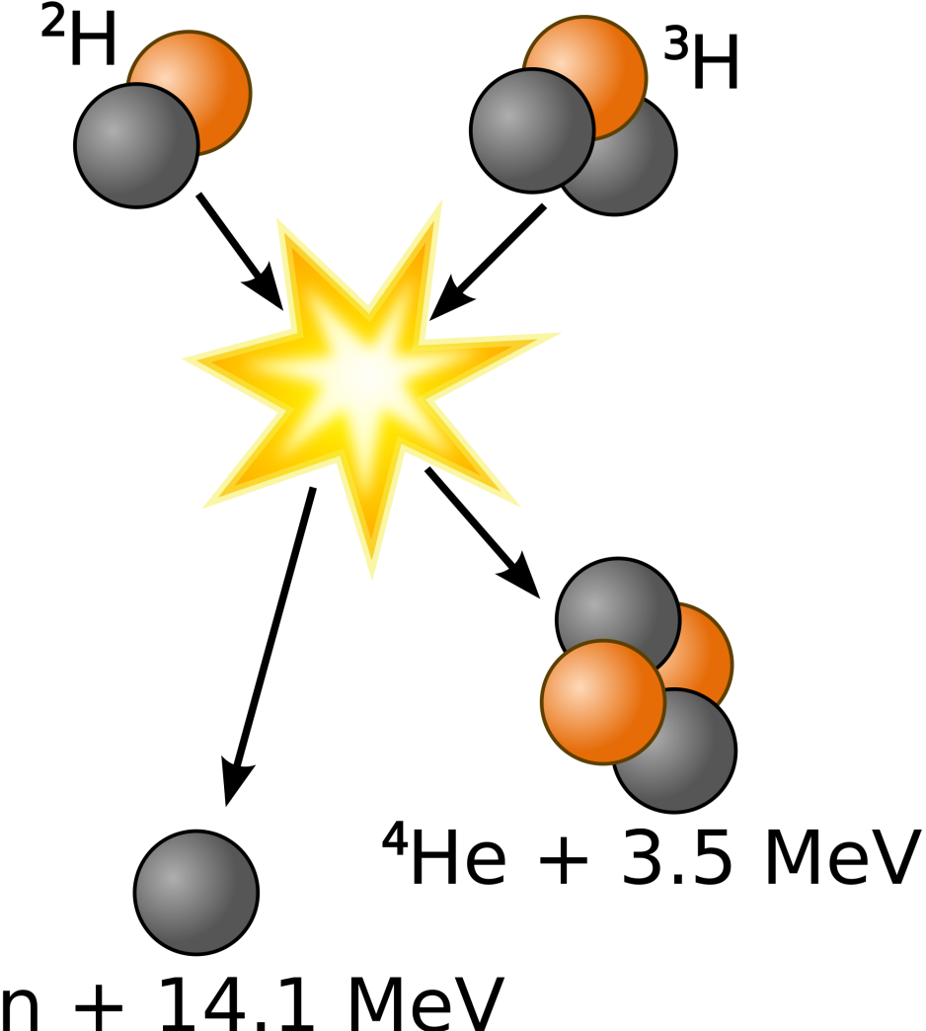
Fusion Power
It is too difficult to fuse single protons together (due to their repulsive forces) as it would take too much pressure and temperature (it can occur in stars)
JET (Joint European Torus) in the United Kingdom produces less power than it uses but it is a prototype that proves fusion can work. It uses isotopes of Hydrogen.

Slide 10
Making Tritium
Tritium can be created by utilising the neutrons from the fusion reaction to bombard Lithium⁶. This isotope of Lithium is naturally occurring in sea water as does Deuterium.

Slide 11
Moral choices and knowledge
A common statement from the Nuclear industry is that the more you know, the less you fear – nuclear energy produces very little waste and very little greenhouse gases
Fusion, if it is ever used to make power, will create no pollution and have an almost limitless supply of fuel
Science and governments try to educate people so that they can make informed choices with regard to energy production and research

Slide 12
Summary
Nuclear fission is the breaking apart of large nuclei into smaller ones. Induced fission works by bombarding fissile Uranium or Plutonium with neutrons
Fusion is the combining of smaller nuclei together. Stars do this via the p-p chain and laboratories are researching other mechanisms including isotopes of Hydrogen
Mass deficits occur in both reactions and hence energy is released which can be calculated using Einstein’s formula E=mc²

