Slide 1
Nuclear Consolidation
A2 Physics

Slide 2
Questions

Slide 3
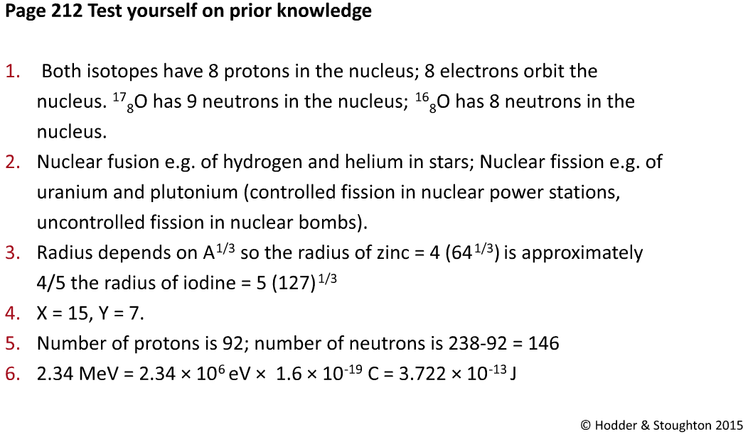
Answers

Slide 4
Questions

Slide 5
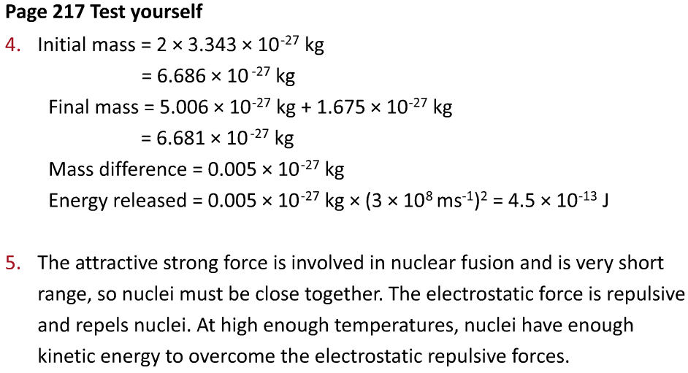
Answers

Slide 6
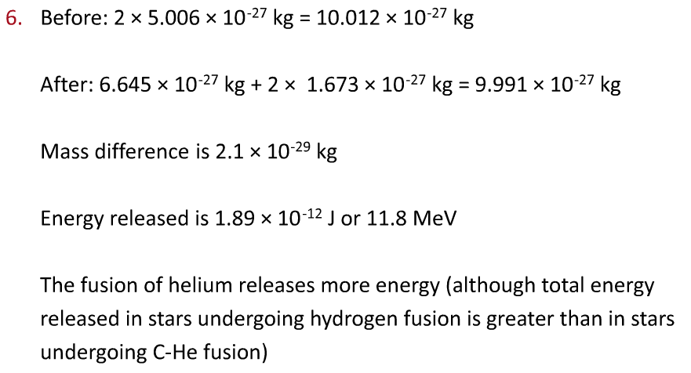
Answers

Slide 7
Questions

Slide 8
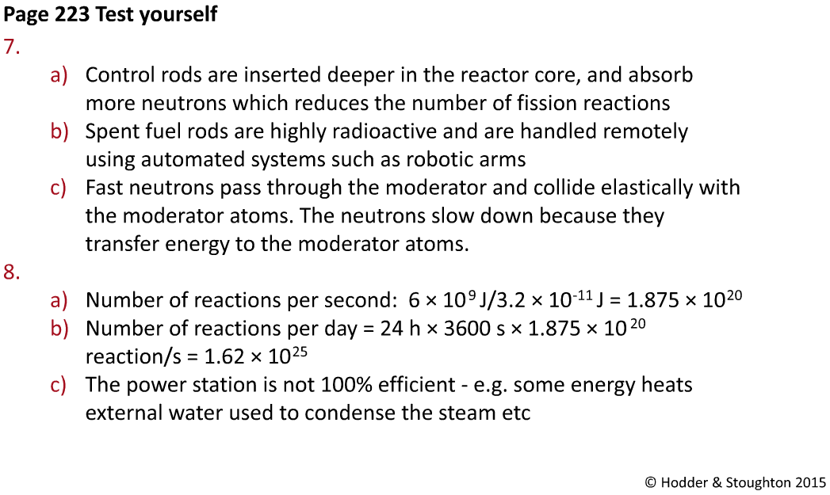
Answers

Slide 9
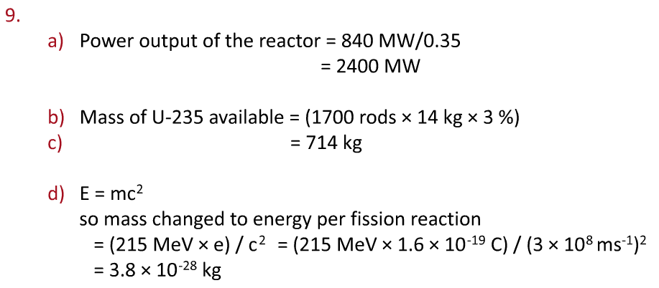
Answers

Slide 10
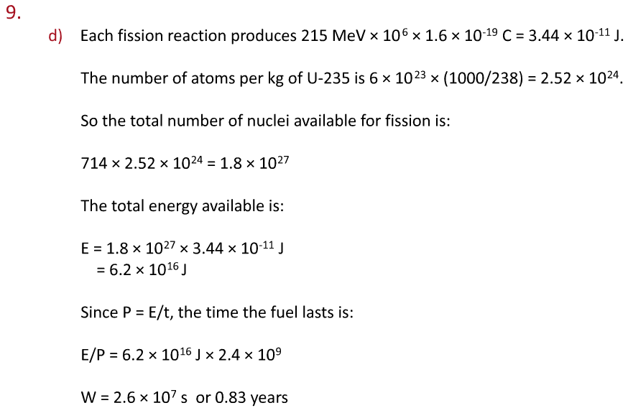
Answers

