Slide 1
Nuclear Fission and Fusion
Nuclear Physics

Slide 2
Aims
Einstein recap
Study and identify nuclear fission and fusion
Binding Energy Curve

Slide 3
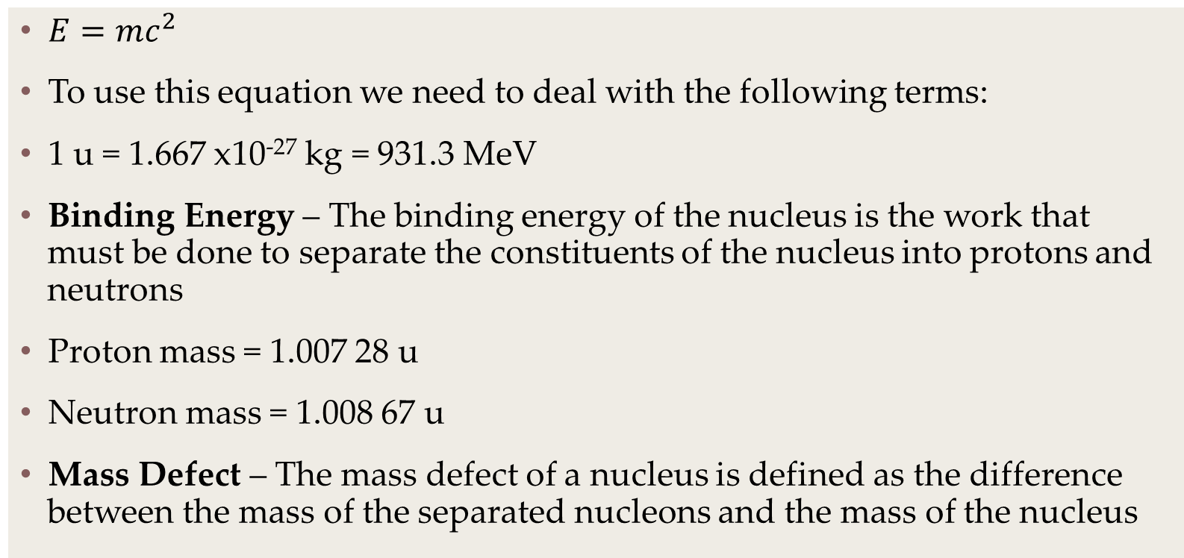
Einstein Recap
$E=mc^{2}$
To use this equation we need to deal with the following terms:
1 u = 1.667 x10⁻²⁷ kg = 931.3 MeV
Binding Energy – The binding energy of the nucleus is the work that must be done to separate the constituents of the nucleus into protons and neutrons
Proton mass = 1.007 28 u
Neutron mass = 1.008 67 u
Mass Defect – The mass defect of a nucleus is defined as the difference between the mass of the separated nucleons and the mass of the nucleus

Slide 4
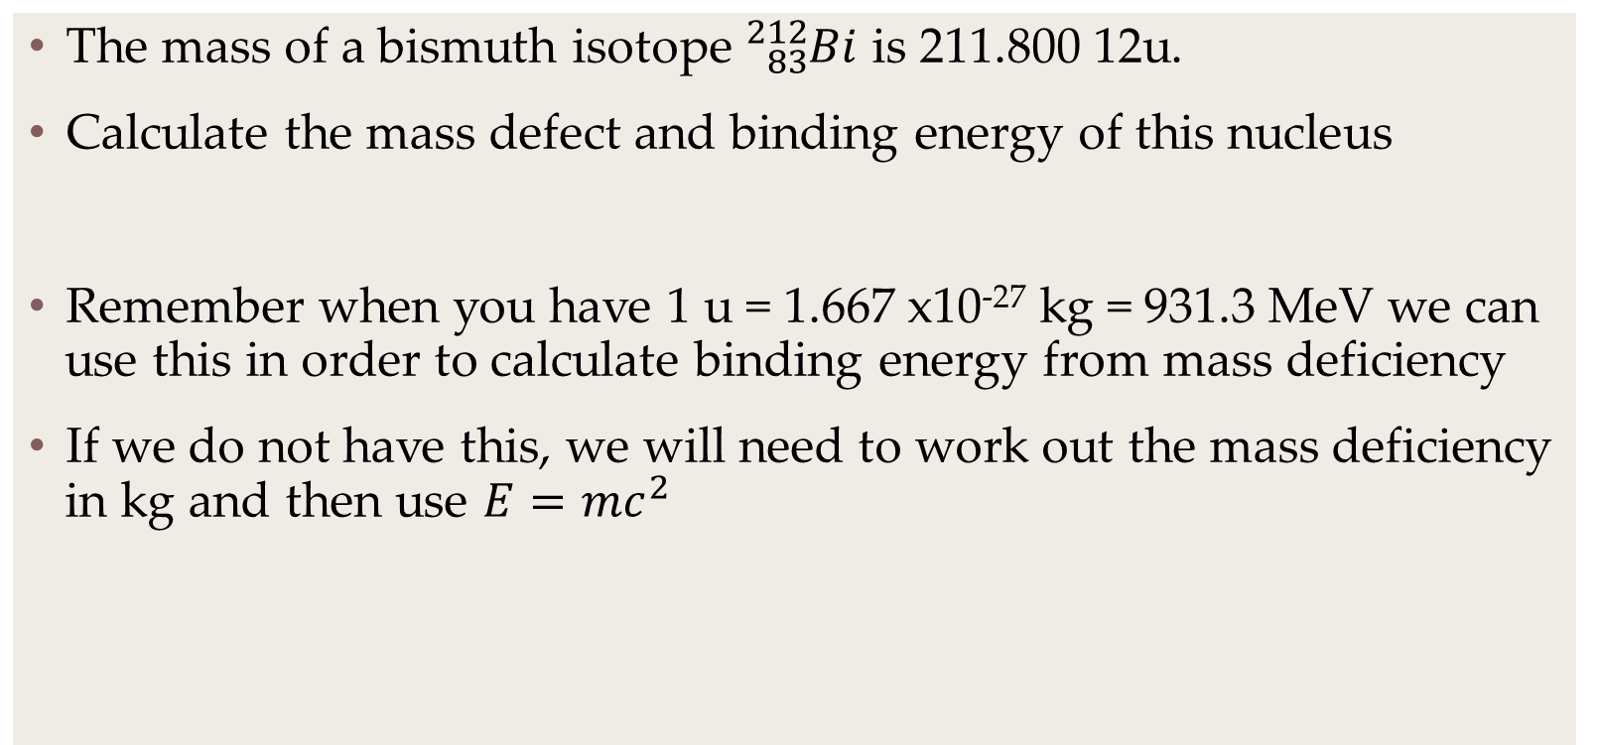
Einstein Recap
The mass of a bismuth isotope ${}_{83}^{212}{Bi}$ is 211.800 12u.
Calculate the mass defect and binding energy of this nucleus
Remember when you have 1 u = 1.667 x10⁻²⁷ kg = 931.3 MeV we can use this in order to calculate binding energy from mass deficiency
If we do not have this, we will need to work out the mass deficiency in kg and then use $E=mc^{2}$

Slide 5
Einstein Recap
Do the test yourself questions 1 to 3 on page 216 from the book.

Slide 6
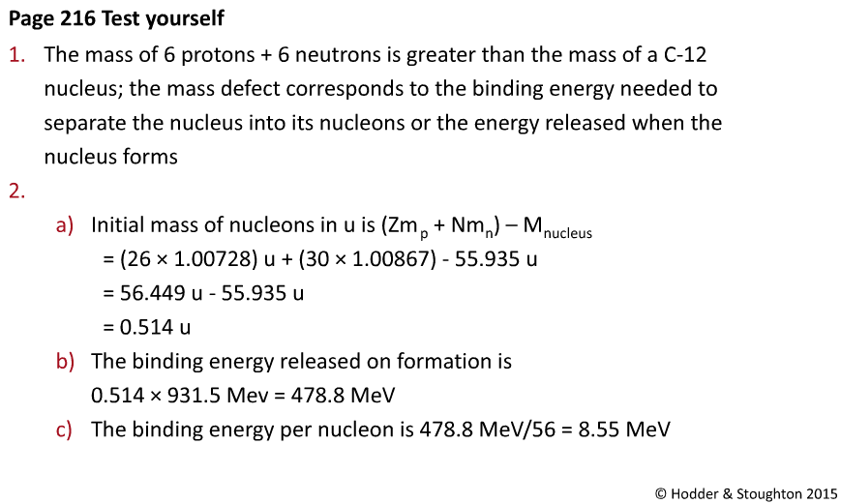
Einstein Recap Answers

Slide 7
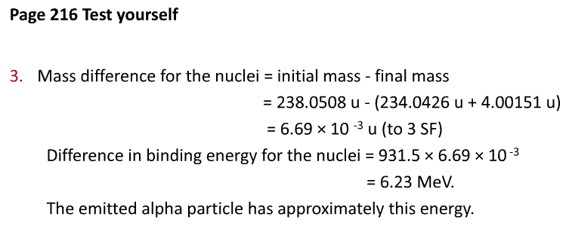
Einstein Recap Answers

Slide 8
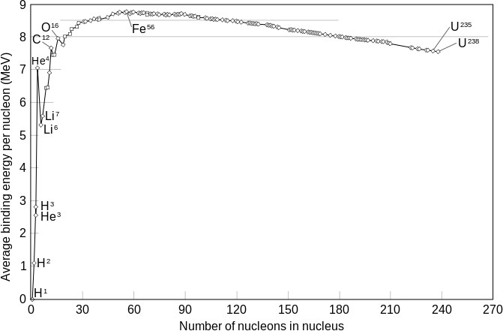
Binding Energy Curve

Slide 9
Nuclear Fission
Nuclear fission is the splitting of heavy parent nuclei into smaller daughter nuclei through the injection of free neutrons (and photons)
The process releases very large amounts of energy

Slide 10
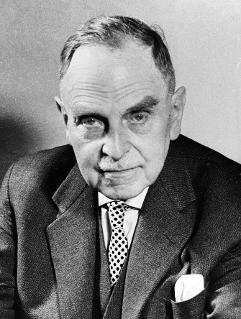
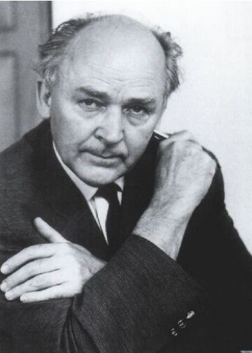
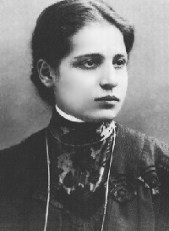
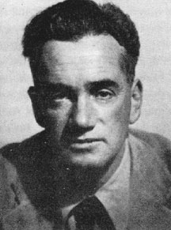
The Who’s Who of Fission
Nuclear fission of heavy elements was discovered on 17th December 1938 by Otto Hahn and his assistant Fritz Strassmann, and explained theoretically in January 1939 by Lise Meitner and her nephew Otto Robert Frisch.
Frisch named the process by analogy with biological fission of living cells.
It is an exothermic reaction which can release large amounts of energy both as electromagnetic radiation and as kinetic energy of the fragments (heating the bulk material where fission takes place).
In order for fission to produce energy, the total binding energy of the resulting elements must be less negative (higher energy) than that of the starting element.

Slide 11
Nuclear Fission
Fission is a form of nuclear transmutation because the resulting fragments are not the same element as the original atom.
The two nuclei produced are most often of comparable but slightly different sizes, typically with a mass ratio of products of about 3 to 2, for common fissile isotopes.

Slide 12
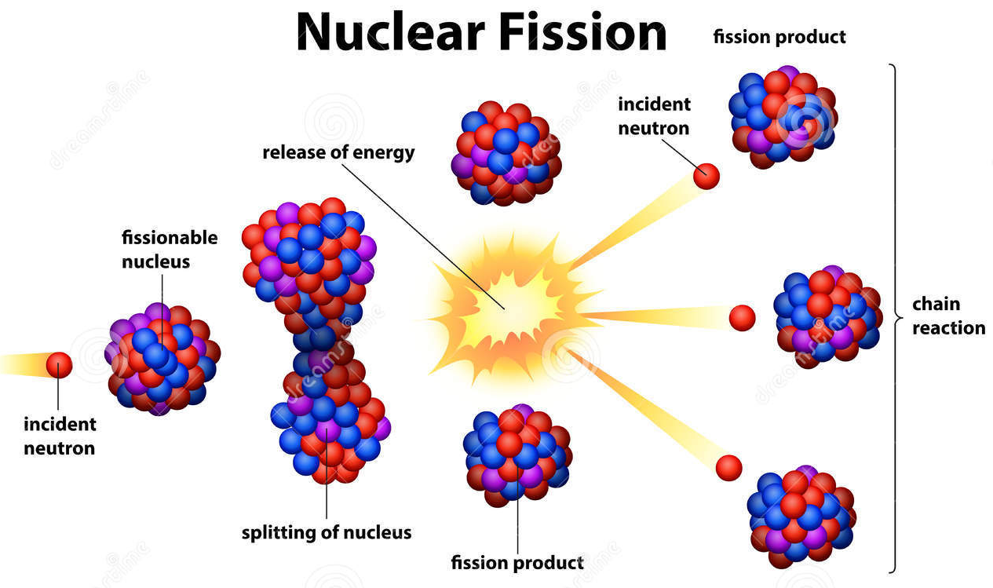
Nuclear Fission – The Liquid Drop Model

Slide 13
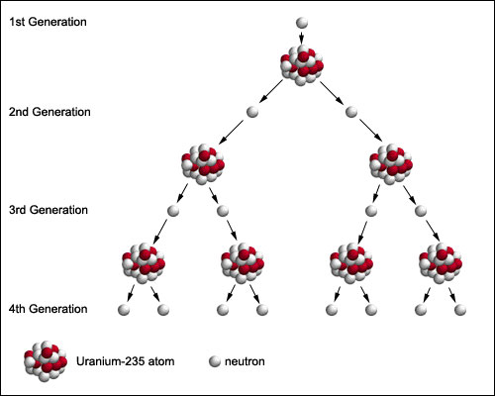
Chain Reactions

Slide 14
Critical Mass
Although two to three neutrons are produced for every fission, not all of these neutrons are available for continuing the fission reaction. If the conditions are such that the neutrons are lost at a faster rate than they are formed by fission, the chain reaction will not be self-sustaining.
At the point where the chain reaction can become self-sustaining, this is referred to as critical mass.
In an atomic bomb, a mass of fissile material greater than the critical mass must be assembled instantaneously and held together for about a millionth of a second to permit the chain reaction to propagate before the bomb explodes
The amount of a fissionable material's critical mass depends on several factors; the shape of the material, its composition and density, and the level of purity.
A sphere has the minimum possible surface area for a given mass, and hence minimises the leakage of neutrons. By surrounding the fissionable material with a suitable neutron "reflector", the loss of neutrons can reduced and the critical mass can be reduced.
By using a neutron reflector, only about 5 kilograms of nearly pure or weapon's grade plutonium 239 or about 15 kilograms uranium 235 is needed to achieve critical mass.

Slide 15
Controlling Chain Reactions
To maintain a sustained controlled nuclear reaction, for every 2 or 3 neutrons released, only one must be allowed to strike another uranium nucleus.
If this ratio is less than one then the reaction will die out; if it is greater than one it will grow uncontrolled (an atomic explosion).
A neutron absorbing element must be present to control the amount of free neutrons in the reaction space. Most reactors are controlled by means of control rods that are made of a strongly neutron-absorbent material such as boron or cadmium.
In addition to the need to capture neutrons, the neutrons often have too much kinetic energy. These fast neutrons are slowed through the use of a moderator such as heavy water and ordinary water. Some reactors use graphite as a moderator, but this design has several problems. Once the fast neutrons have been slowed, they are more likely to produce further nuclear fissions or be absorbed by the control rod.

Slide 16
Spontaneous Nuclear Fission
The spontaneous nuclear fission rate is the probability per second that a given atom will fission spontaneously--that is, without any external intervention.
Plutonium 239 has a very high spontaneous fission rate compared to the spontaneous fission rate of uranium 235.

Slide 17
Nuclear Fusion
Nuclear fusion is a nuclear reaction in which two or more atomic nuclei come very close and then collide at a very high speed and join to form a new nucleus.
During this process, matter is not conserved because some of the matter of the fusing nuclei is converted to photons.
Fusion is the process that powers active or "main sequence" stars.

Slide 18
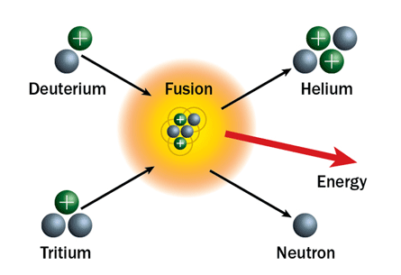
Nuclear Fusion

Slide 19
Fusing Nuclei
The origin of the energy released in fusion of light elements is due to interplay of two opposing forces, the nuclear force which combines together protons and neutrons, and the Coulomb force which causes protons to repel each other.
The protons are positively charged and repel each other but they nonetheless stick together, demonstrating the existence of another force known as nuclear attraction.
The strong nuclear force, overcomes electric repulsion in a very close range. The effect of this force is not observed outside the nucleus, hence the force has a strong dependence on distance, making it a short-range force. The same force also pulls the nucleons (neutrons and protons) together.

Slide 20
Fusing Nuclei
Because the nuclear force is stronger than the Coulomb force for atomic nuclei smaller than iron and nickel, building up these nuclei from lighter nuclei by fusion releases the extra energy from the net attraction of these particles.
For larger nuclei, however, no energy is released, since the nuclear force is short-range and cannot continue to act across still larger atomic nuclei. Thus, energy is no longer released when such nuclei are made by fusion; instead, energy is absorbed in such processes.

Slide 21
Fusion Future?
Research into controlled fusion, with the aim of producing fusion power for the production of electricity, has been conducted for over 60 years.
It has been accompanied by extreme scientific and technological difficulties, but has resulted in progress.
At present, controlled fusion reactions have been unable to produce break-even (self-sustaining) controlled fusion reactions.

