Slide 1
Nuclear Physics
The Atom

Slide 2
The historical atom
Since the dawn of time the first thoughts on scientific matters were concerned with….
“what is everything made up of?”
Many ancient cultures such as the greeks were first pondering such questions

Slide 3
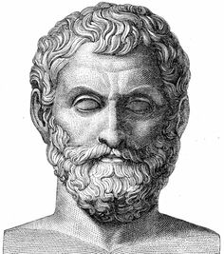
Greek atoms
600 B.C. Thales of Miletus discovered that a piece of amber, after rubbing it with fur, attracts bits of hair and feathers and other light objects
He suggested that this mysterious force came from the amber
Thales, however, did not connect this force with any atomic particle

Slide 4
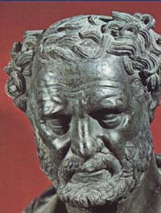
Not until around 460 B.C., did a Greek philosopher, Democritus, develop the idea of atoms
He asked this question: If you break a piece of matter in half, and then break it in half again, how many breaks will you have to make before you can break it no further?
Democritus thought that it ended at some point, a smallest possible bit of matter
He called these basic matter particles, atomos which means indivisible

Slide 5
On the right tracks but….
More philosophical than experimental but on the right tracks but not correct in terms on how atoms behaved

Slide 6
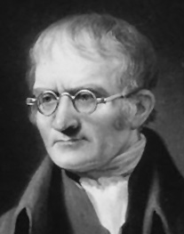
First experimental steps
Unfortunately, the atomic ideas of Democritus had no lasting effects on other Greek philosophers, including Aristotle. In fact, Aristotle dismissed the atomic idea as worthless. People considered Aristotle's opinions very important and if Aristotle thought the atomic idea had no merit, then most other people thought the same also.
For more than 2000 years nobody did anything to continue the explorations that the Greeks had started into the nature of matter.
Not until the early 1800s, did John Dalton used the concept of atoms to explain why elements always react in ratios of small whole numbers - the law of multiple proportions
He performed experiments with various chemicals that showed that matter, indeed, seem to consist of elementary lumpy particles
Although he did not know about their structure, he knew that the evidence pointed to something fundamental

Slide 7
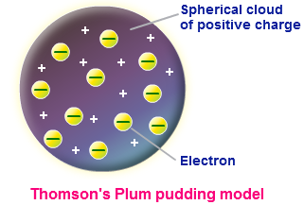
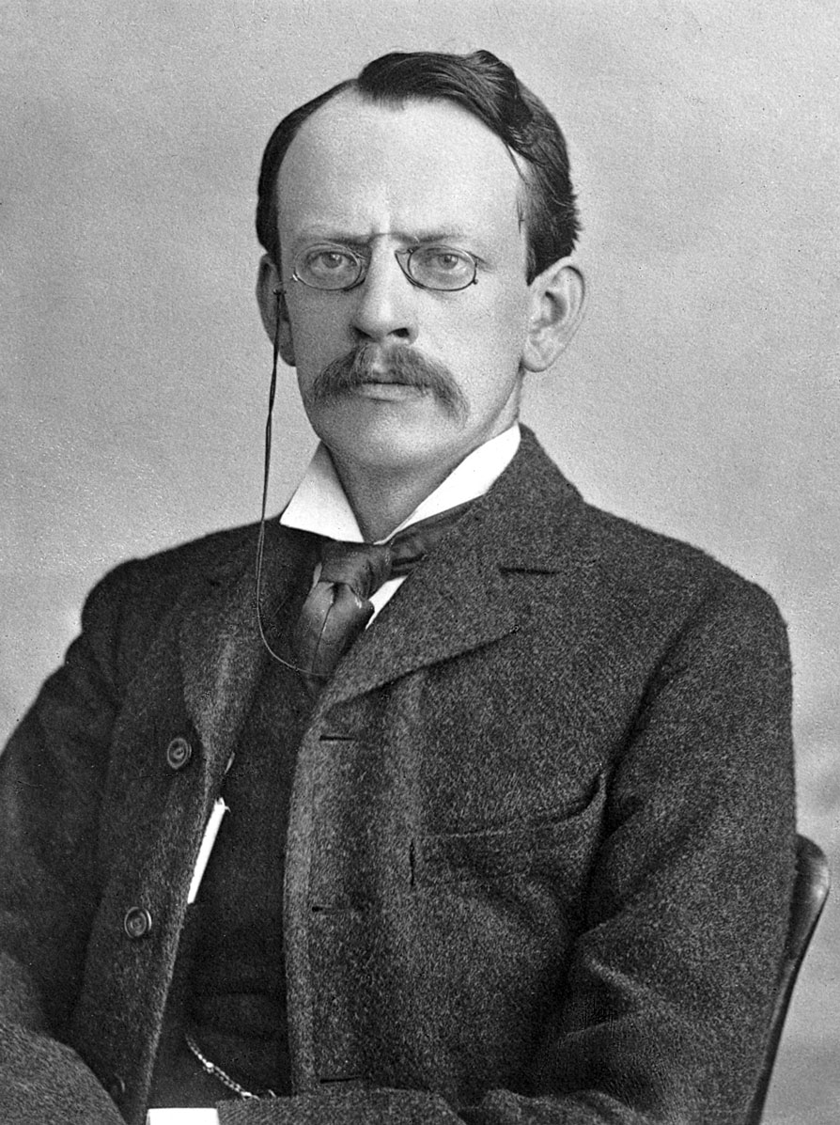
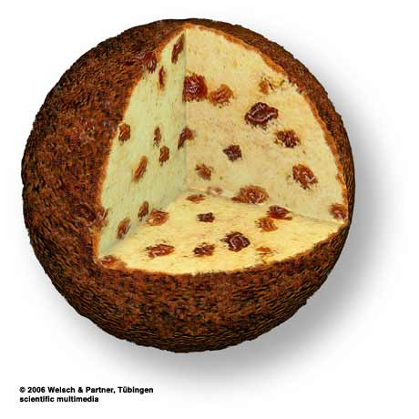
‘Dessert’ atoms?!
In 1897, the English physicist J.J. Thomson discovered the electron and proposed a model for the structure of the atom
Thomson knew that electrons had a negative charge and thought that matter must have a positive charge
His model looked like plums stuck on in a lump of pudding
This theory is affectionately known as the ‘plum pudding’ model

Slide 8
Question
What is wrong with the plum pudding model?

Slide 9
question
How would you rectify the plum pudding model problem?

Slide 10
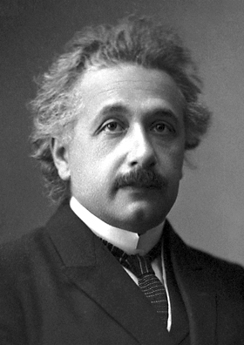
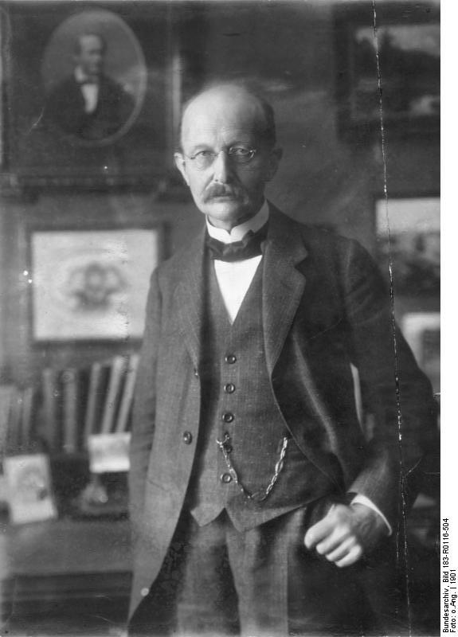
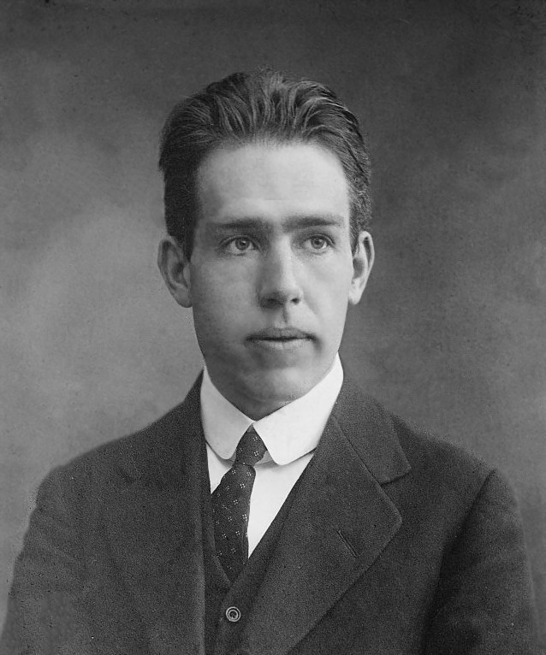
First steps towards the nuclear atom
As we have seen with today’s modern hindsight, there are consequences with the plum pudding model which needed to be dealt with
Around the early 1900s, names such as max planCk and niels bohr, along with albert Einstein (although he hated quantum physics) were probing the microscopic and discovering new things
One such discovery was α−radiation and more specifically, alpha radiation as particles

Slide 11
Ernest Rutherford and the nuclear atom
Between 1910-11, ernest Rutherford devised a series of experiments to probe the atom and to test whether Thomson’s view was correct
Using the newly discovered alpha particles, Rutherford’s two students hans Geiger and ernest marsden ‘probed’ the internal structure (as far as this set up allowed) the atom

Slide 12
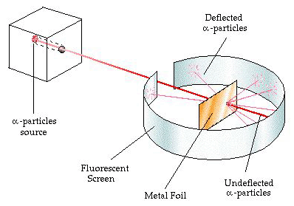
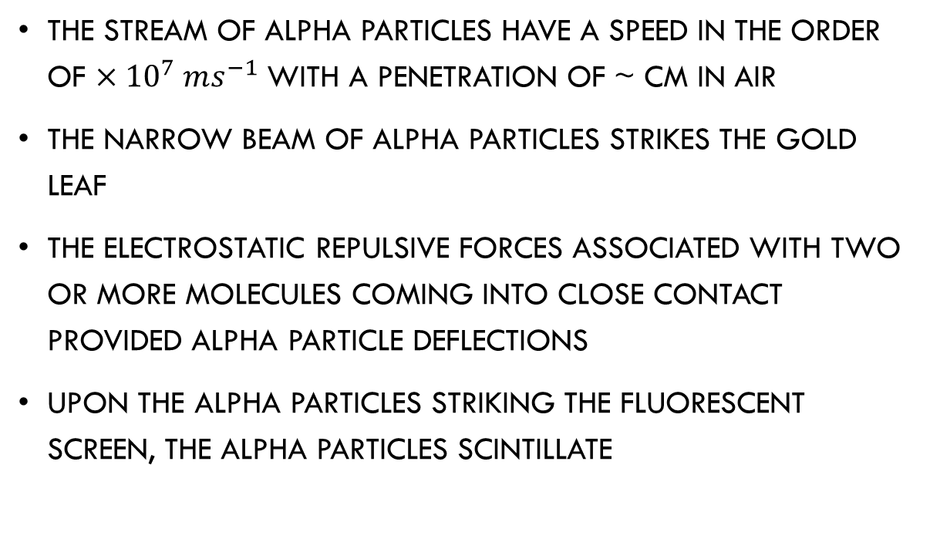
The rutherford gold leaf experiment
The stream of alpha particles have a speed in the order of $×{10}^{7} ms^{−1}$ with a penetration of ~ cm in air
The narrow beam of alpha particles strikes the gold leaf
The electrostatic repulsive forces associated with two or more molecules coming into close contact provided alpha particle deflections
Upon the alpha particles striking the fluorescent screen, the alpha particles scintillate

Slide 13
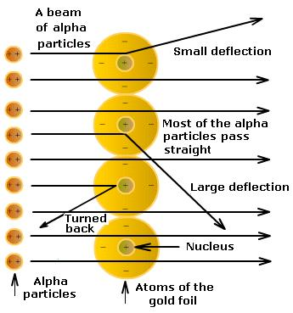
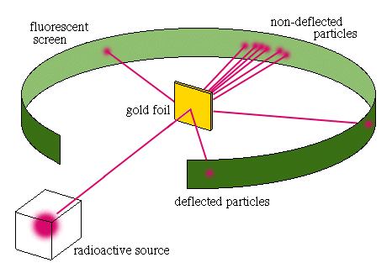
The gold leaf results

Slide 14
Spanner in the plum pudding!
RUTHERFORD STATED “IT WAS QUITE THE MOST INCREDIBLE EVENT THAT EVER HAPPENED TO ME IN MY LIFE, AS IF YOU HAD FIRED A 15-INCH SHELL AT A PIECE OF TISSUE PAPER AND IT CAME BACK AND HIT YOU”
Rutherford’s experiment had not only shown that the atom did not consist of a plum pudding nature, but also showed that the mass and positive charge of the atom was concentrated at the centre of the atom

Slide 15

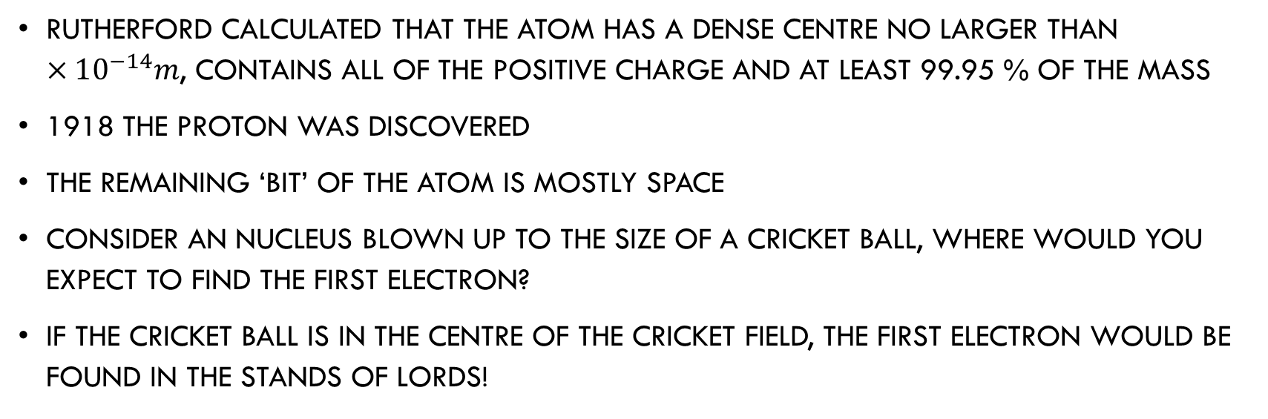
The nuclear atom
Rutherford calculated that the atom has a dense centre no larger than $×10^{−14}m$, contains all of the positive charge and at least 99.95 % of the mass
1918 the proton was discovered
The remaining ‘bit’ of the atom is mostly space
Consider an Nucleus blown up to the size of a cricket ball, where would you expect to find the first electron?
If the cricket ball is in the centre of the cricket field, the first electron would be found in the stands of lords!

Slide 16
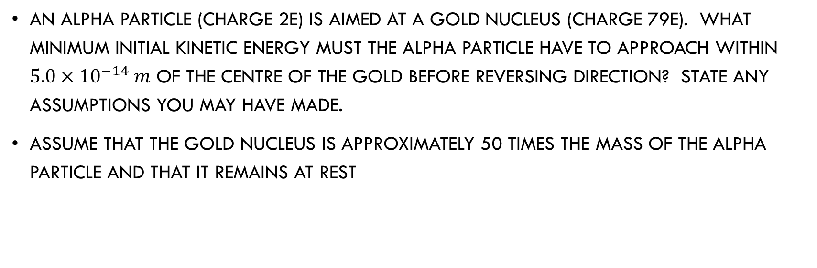
Hard question
An alpha particle (charge 2e) is aimed at a gold nucleus (charge 79E). What minimum initial kinetic energy must the alpha particle have to approach within $5.0×{10}^{−14} m$ of the centre of the gold before reversing direction? State any assumptions you may have made.
Assume that the gold nucleus is approximately 50 times the mass of the alpha particle and that it remains at rest

Slide 17
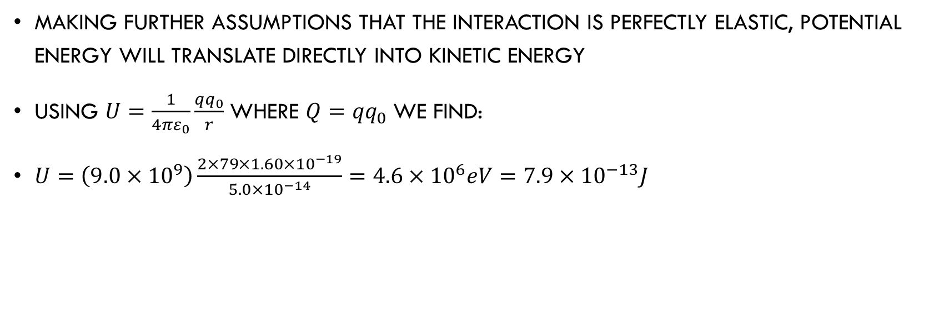
answer
Making further assumptions that the interaction is perfectly elastic, potential energy will translate directly into kinetic energy
Using $U=\frac{1}{4πε_{0}}\frac{qq_{0}}{r}$ where ${Q=qq}_{0}$ we find:
$U=\left(9.0×{10}^{9}\right)\frac{2×79×1.60×{10}^{−19}}{5.0×{10}^{−14}}=4.6×{10}^{6}eV=7.9×{10}^{−13}J$

Slide 18
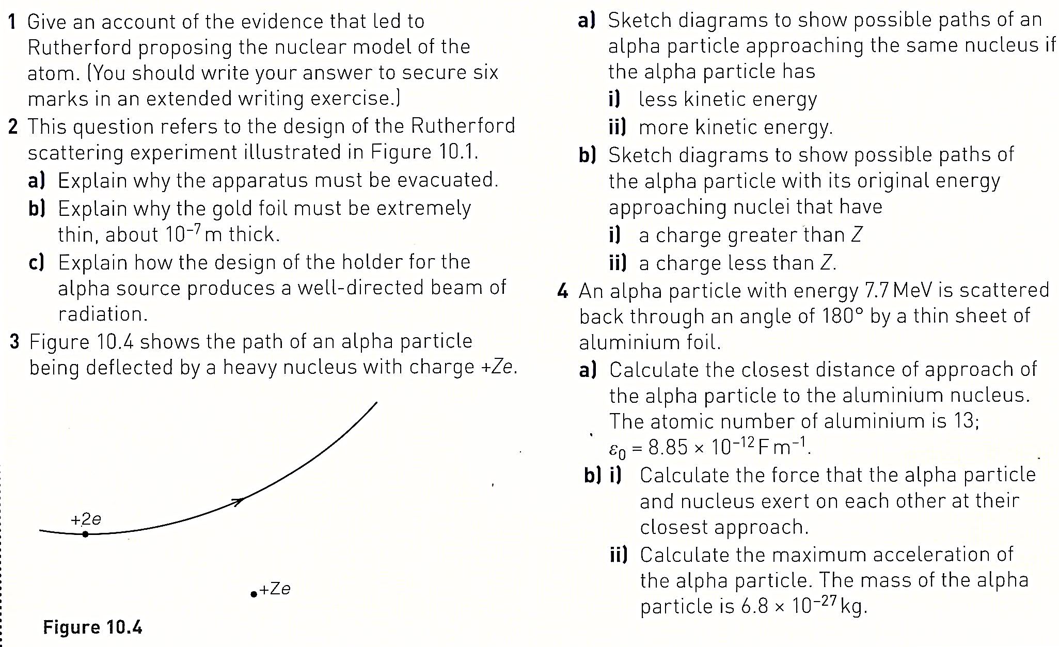
Questions

Slide 19
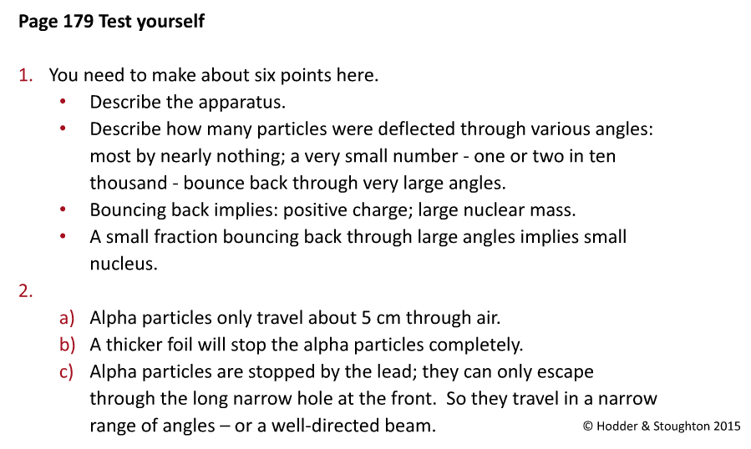

Slide 20
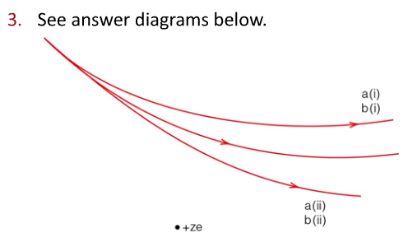

Slide 21
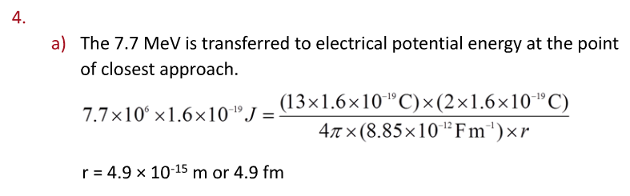

Slide 22
