Slide 1
Kinetic Theory of Gases
3.5.3 Thermal Physics

Slide 2
Aims
Gases
Brownian Motion
Avogadro
Molar Mass
Ideal Gas Law
Kinetic Theory

Slide 3
Moving Gases
As we noted last time, gases are moving situations which are complex systems
Also we noted that the pressure from a gas is due to the molecules striking the walls of the container
But how do we prove this?

Slide 4
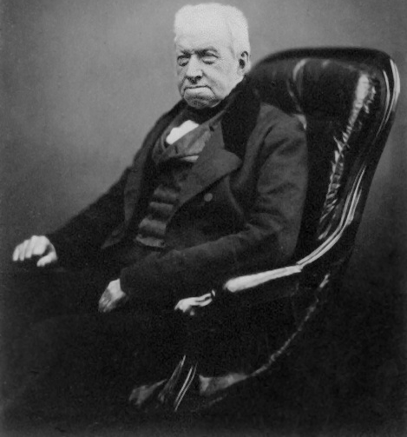
Brownian Motion
Robert Brown first observed gas
motion in 1827
He used pollen grains in water with a light source to view the random motion of the pollen grains
Now we use smoke particles instead of pollen grains

Slide 5
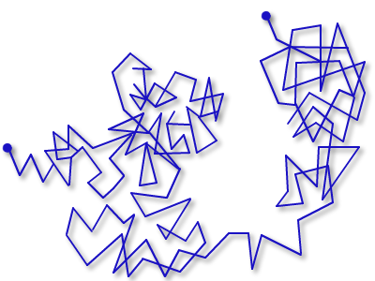
Brownian Motion Evaluation
Gas molecules are too small to see individually
The motion of the smoke particles results from collisions from the gas particles
The Brownian motion shows:
Varying lengths of motion
Random direction from collisions

Slide 6
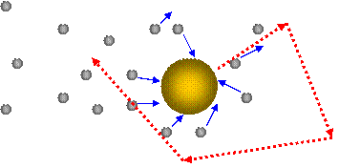
Brownian Motion Atomic Style

Slide 7
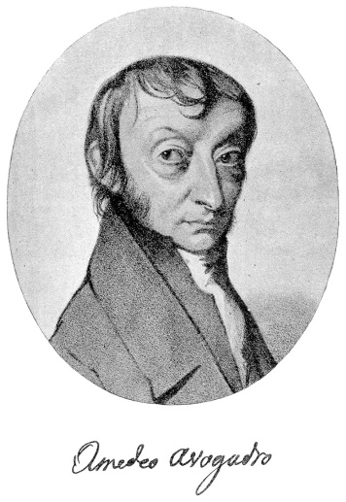
Avogadro’s Constant
In the 19th century, Amadeo Avogadro
Hypothesised that equal volumes of gases at the same temperature and pressure contain equal number of molecules
The Avogadro constant N_{A} is defined as the number of atoms in exactly 12g Carbon-12
6.022 140 857(74)×10²³ mol⁻¹

Slide 8
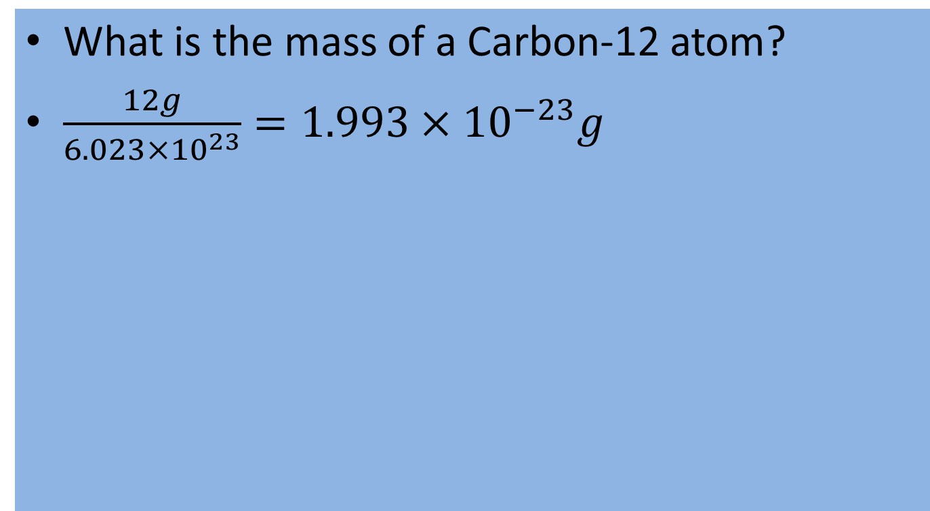
Question
What is the mass of a Carbon-12 atom?
$\frac{12g}{6.023×10^{23}}=1.993×10^{−23}g$

Slide 9
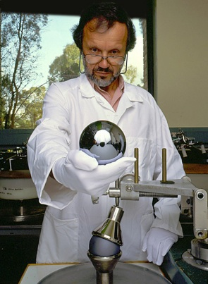
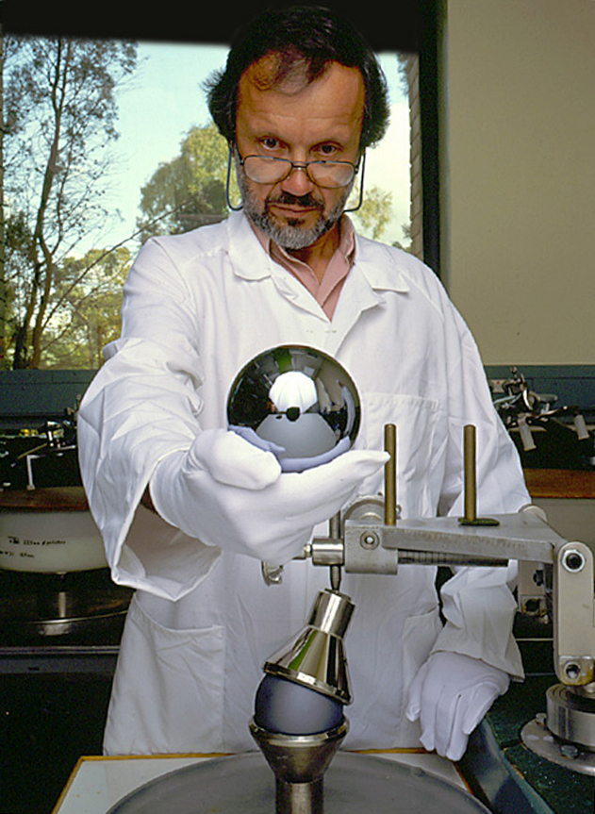
Use of Avogadro’s Constant
Redefining the kg
In 2007, a 4.8-kg single crystal of isotopically-enriched silicon (99.94% ²⁸Si) was grown, and two one-kilogram spheres cut from it.
Diameter measurements on the spheres are repeatable to within 0.3 nm, and the uncertainty in the mass is 3 µg.
Paper, published in January 2011, summarized the result of the International Avogadro Coordination and presented a measurement of the Avogadro constant to be 6.02214078(18)×10²³ mol⁻¹
(6.022 140 857(74)×10²³ mol⁻¹)

Slide 10
Molar Mass
One mole of mass is defined as the N_{A} amount of substance containing identical particles
The amount of moles in a substance is called its molarity and is given the unit mol

Slide 11
Ideal Gas Law
Previously was noted each of the gas laws;
Boyle’s Law
Charles’ Law
Amonton/Gay-Lussac Law
Finally we use the laws to describe ideal gases in their entirety

Slide 12
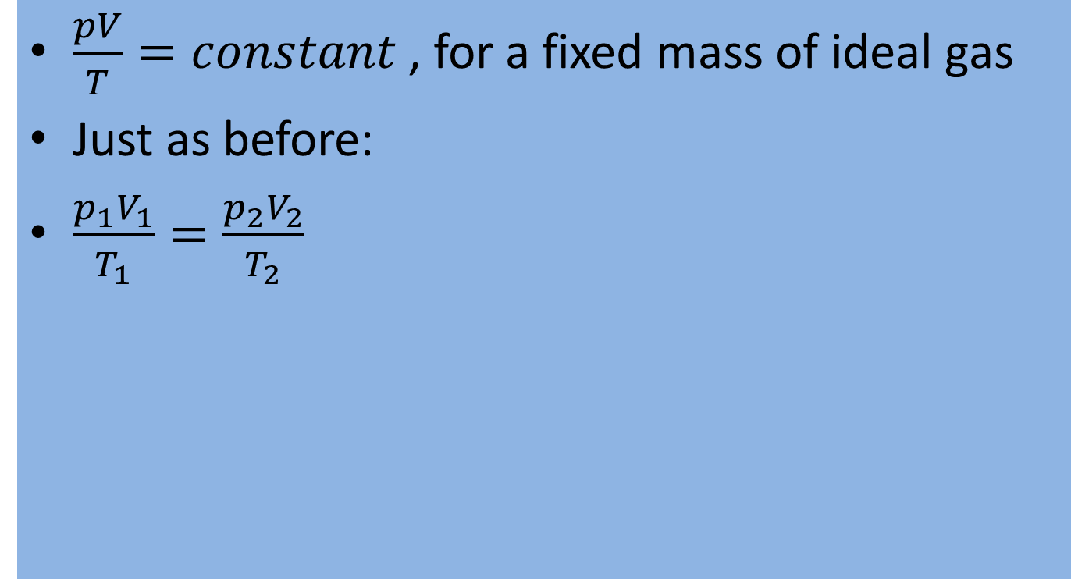
Ideal Gas Law
$\frac{pV}{T}=constant$, for a fixed mass of ideal gas
Just as before:
$\frac{p_{1}V_{1}}{T_{1}}=\frac{p_{2}V_{2}}{T_{2}}$

Slide 13
Ideal gas law and Avogadro
Equal volumes of ideal gases held at a constant temperature and pressure will contain the same amount of substance
273 K 101 kPa 0.0224 m³
Calculate ideal gas law for the above variable
8.31 J mol⁻¹ K⁻¹
Molar Gas Constant R

Slide 14
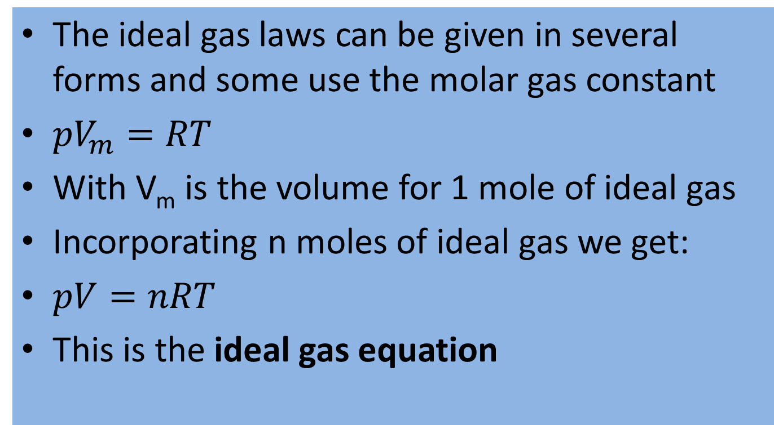
Why R?
The ideal gas laws can be given in several forms and some use the molar gas constant
${pV}_{m}=RT$
With V_{m} is the volume for 1 mole of ideal gas
Incorporating n moles of ideal gas we get:
$pV=nRT$
This is the ideal gas equation

Slide 15
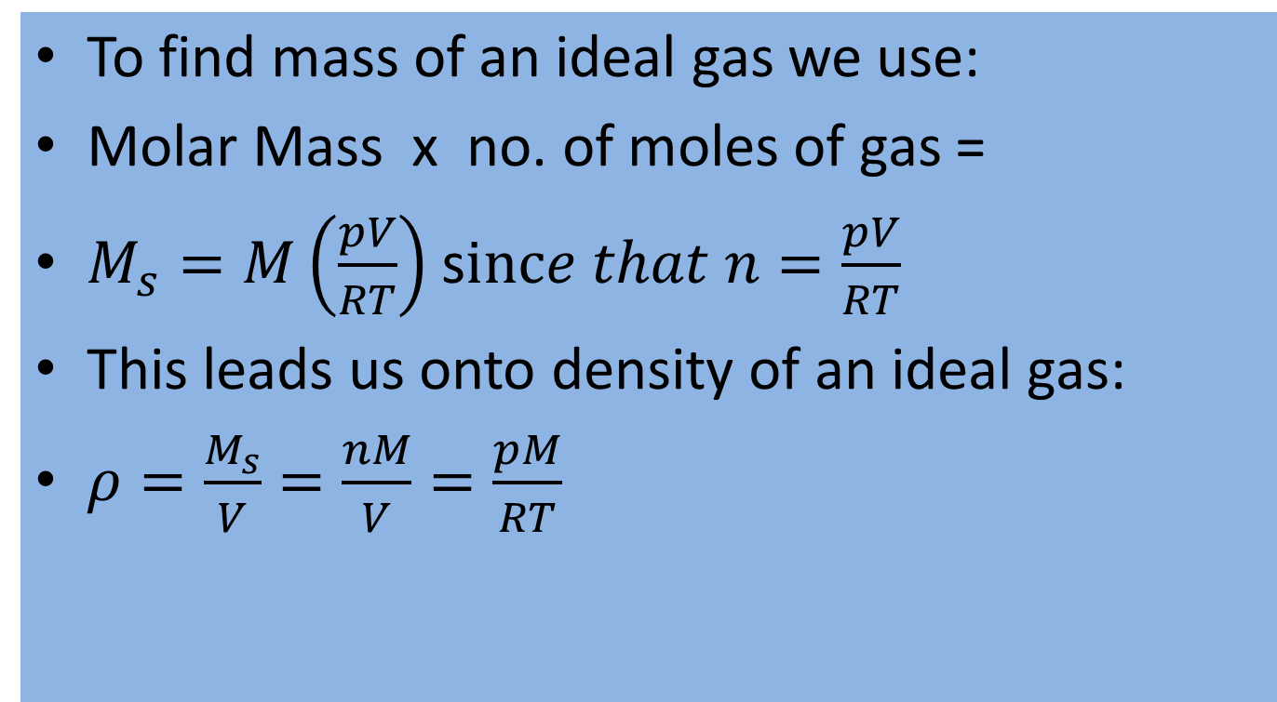
Mass and Ideal Gas
To find mass of an ideal gas we use:
Molar Mass x no. of moles of gas =
$M_{s}=M\left(\frac{pV}{RT}\right)$ s$ince that n=\frac{pV}{RT}$
This leads us onto density of an ideal gas:
$ρ=\frac{M_{s}}{V}=\frac{nM}{V}=\frac{pM}{RT}$

Slide 16
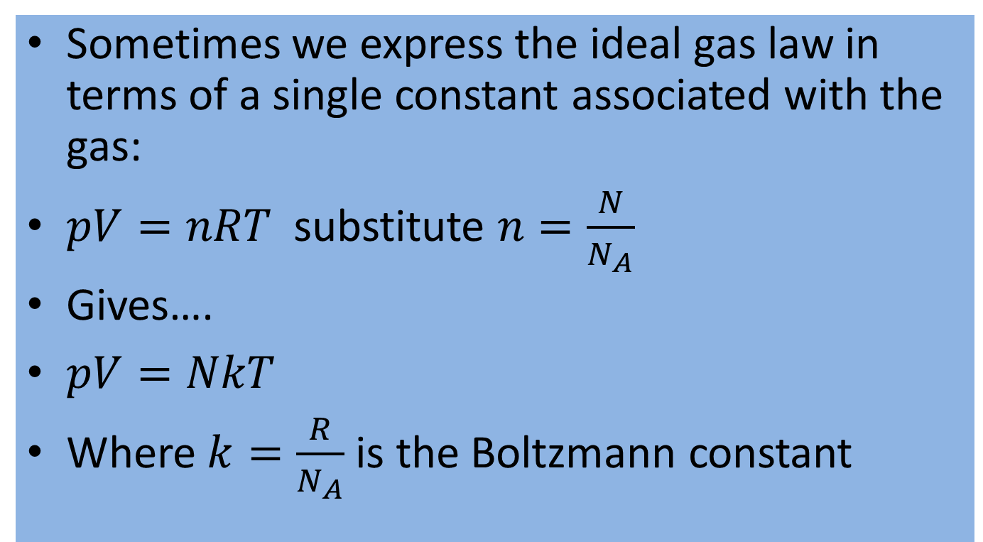
Ideal Gas Constant
Sometimes we express the ideal gas law in terms of a single constant associated with the gas:
$pV=nRT$ substitute $n=\frac{N}{N_{A}}$
Gives….
$pV=NkT$
Where $k=\frac{R}{N_{A}}$ is the Boltzmann constant

Slide 17
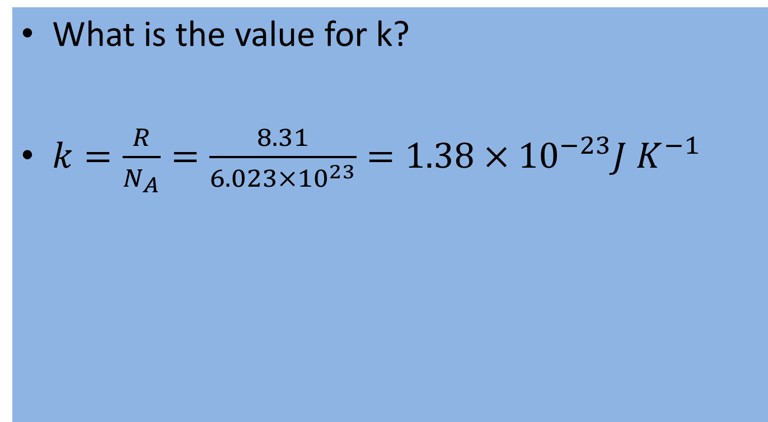
Boltzmann Constant
What is the value for k?
$k=\frac{R}{N_{A}}=\frac{8.31}{6.023×10^{23}}=1.38×10^{−23}J K^{−1}$

Slide 18
Question
(a) In a diesel engine, the piston compresses air at 305 K to a volume that is one-sixth of the original volume and a pressure that is 48.5 times the original pressure. What is the temperature of the air after the compression?
(b) A balloon contains 2.0 litres (1 litre = 10³ cm³) of nitrogen gas at a temperature of 77 K and a pressure of 101 kPa. If the temperature of the gas is allowed to increase to 23 ºC and the pressure remains constant, what volume will the gas occupy?

Slide 19
Kinetic Theory of Gases
The kinetic theory describes a gas as a large number of sub microscopic particles (atoms or molecules), all of which are in constant, random motion
The rapidly moving particles constantly collide with each other and with the walls of the container

Slide 20
Kinetic Theory
Kinetic theory explains macroscopic properties of gases, such as pressure, temperature, viscosity, thermal conductivity, and volume, by considering their molecular composition and motion
The theory postulates that gas pressure is due to the impacts, on the walls of a container, of molecules or atoms moving at different velocities

Slide 21
Assumptions of Kinetic Theory
The gas consists of very small particles known as molecules
This smallness of their size is such that the total volume of the individual gas molecules added up is negligible compared to the container
This is equivalent to stating that the average distance separating the gas particles is large compared to their size
These particles have the same mass
The number of molecules is so large that statistical treatment can be applied

Slide 22
Assumptions of Kinetic Theory
These molecules are in constant, random, and rapid motion
The rapidly moving particles constantly collide among themselves and with the walls of the container. All these collisions are perfectly elastic. This means, the molecules are considered to be perfectly spherical in shape, and elastic in nature.
Except during collisions, the interactions among molecules are negligible. (That is, they exert no forces on one another.)

Slide 23
Implications of Kinetic Theory
From the assumptions made in Kinetic Theory and thinking as creatively as possible in all terms physical….
What implications can you draw?

Slide 24
Implications of Kinetic Theory
Relativistic effects are negligible.
Quantum-mechanical effects are negligible. This means that the inter-particle distance is much larger than the de Broglie wavelength and the molecules are treated as classical objects.
Because of the above two, their dynamics can be treated classically. This means, the equations of motion of the molecules are time-reversible.

Slide 25
Implications of Kinetic Theory
The average kinetic energy of the gas particles depends only on the absolute temperature of the system.
The time during collision of molecule with the container's wall is negligible as compared to the time between successive collisions.
Because they have mass, the gas molecules will be affected by gravity.

Slide 26
Boyle’s Law by Kinetic Theory
The pressure of a gas at constant temperature
Increase pressure by reducing volume
Gas molecules travel less distance between impacts at the walls because of less space
Therefore more impacts per second = greater pressure

Slide 27
Pressure Law by Kinetic Theory
Proportionality between pressure and temperature keeping volume constant
The average speed of the molecules is increased with the increase in temperature
This results in more frequent and harder impacts from the molecules onto the container walls resulting in increased pressure

Slide 28
Properties of Kinetic Theory
Pressure and kinetic energy
Pressure is explained by kinetic theory as arising from the force exerted by molecules or atoms impacting on the walls of a container
Consider a gas of N molecules, each of mass m, enclosed in a cuboidal container of volume V
When a gas molecule collides with the wall of the container perpendicular to the x coordinate axis and bounces off in the opposite direction with the same speed (an elastic collision), then the momentum lost by the particle and gained by the wall is:

Slide 29
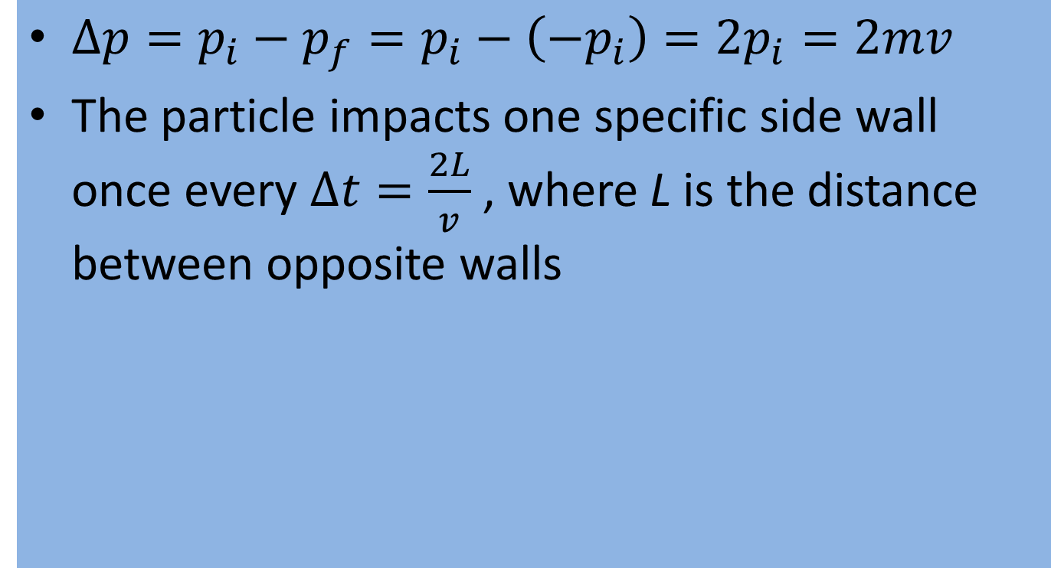
Momentum
$∆p=p_{i}−p_{f}=p_{i}−\left(−p_{i}\right)=2p_{i}=2mv$
The particle impacts one specific side wall once every $∆t=\frac{2L}{v}$ , where L is the distance between opposite walls

Slide 30
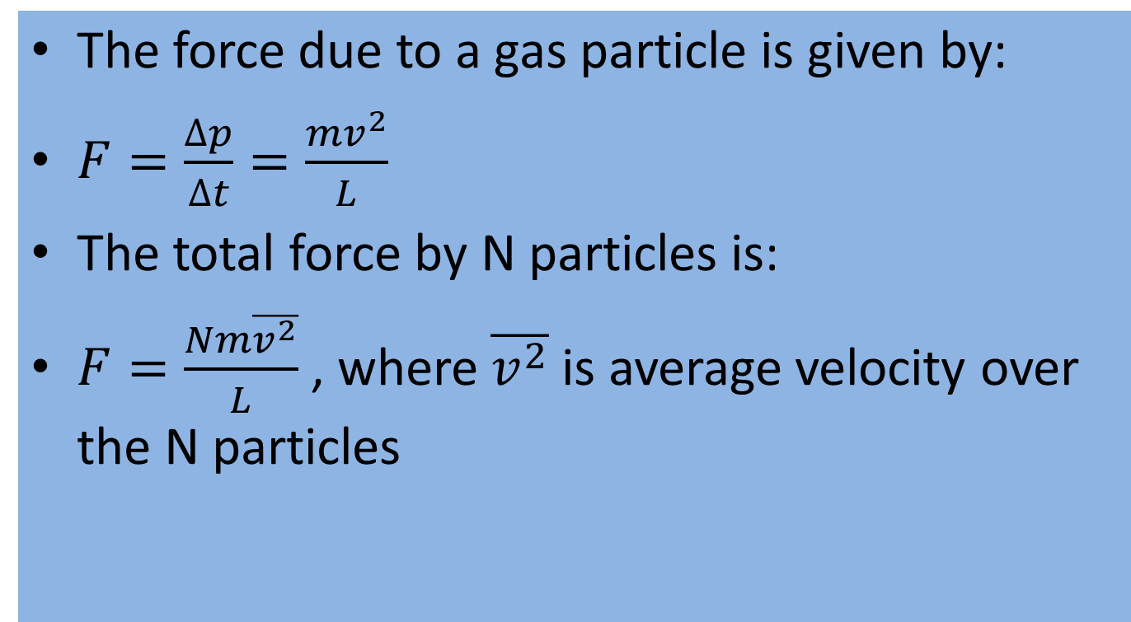
Force
The force due to a gas particle is given by:
$F=\frac{∆p}{∆t}=\frac{{mv}^{2}}{L}$
The total force by N particles is:
$F=\frac{Nm\overline{v^{2}}}{L}$ , where $\overline{v^{2}}$ is average velocity over the N particles

Slide 31
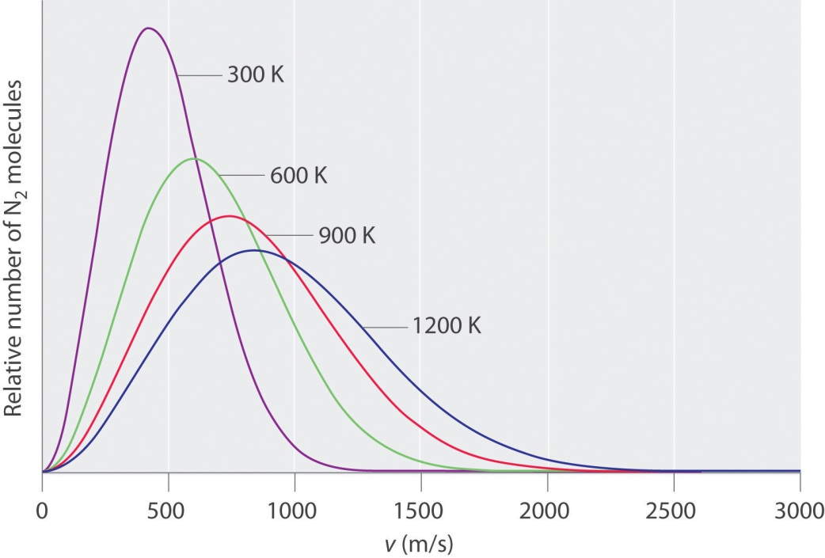
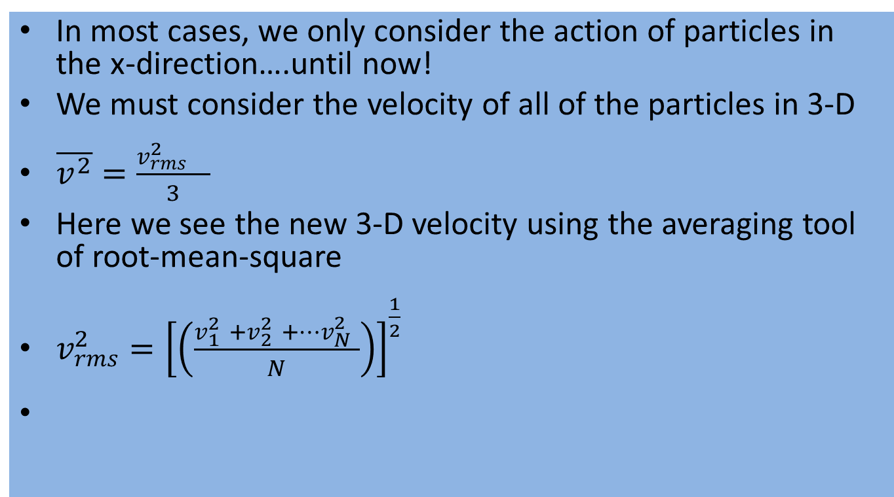
Averaging Velocity
In most cases, we only consider the action of particles in the x-direction….until now!
We must consider the velocity of all of the particles in 3-D
$\overline{v^{2}}=\frac{v_{rms}^{2} }{3}$
Here we see the new 3-D velocity using the averaging tool of root-mean-square
$v_{rms}^{2}={\left[\left(\frac{v_{1}^{2} +v_{2}^{2} +…v_{N}^{2} }{N}\right)\right]}^{\frac{1}{2}}$

Slide 32
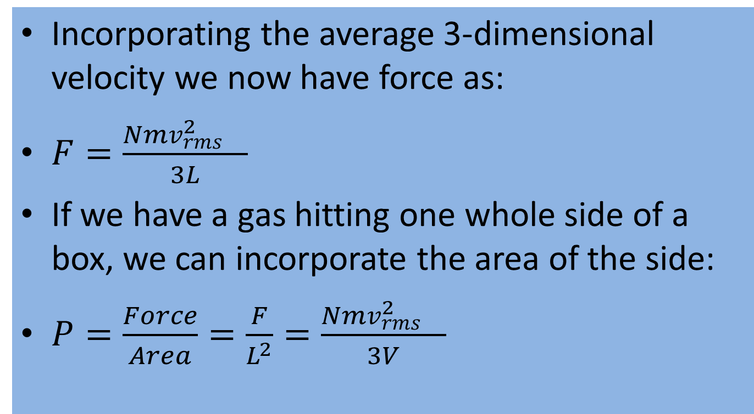
The New Force and Pressure
Incorporating the average 3-dimensional velocity we now have force as:
$F=\frac{Nmv_{rms}^{2} }{3L}$
If we have a gas hitting one whole side of a box, we can incorporate the area of the side:
$P=\frac{Force}{Area}=\frac{F}{L^{2}}=\frac{Nmv_{rms}^{2} }{3V}$

Slide 33
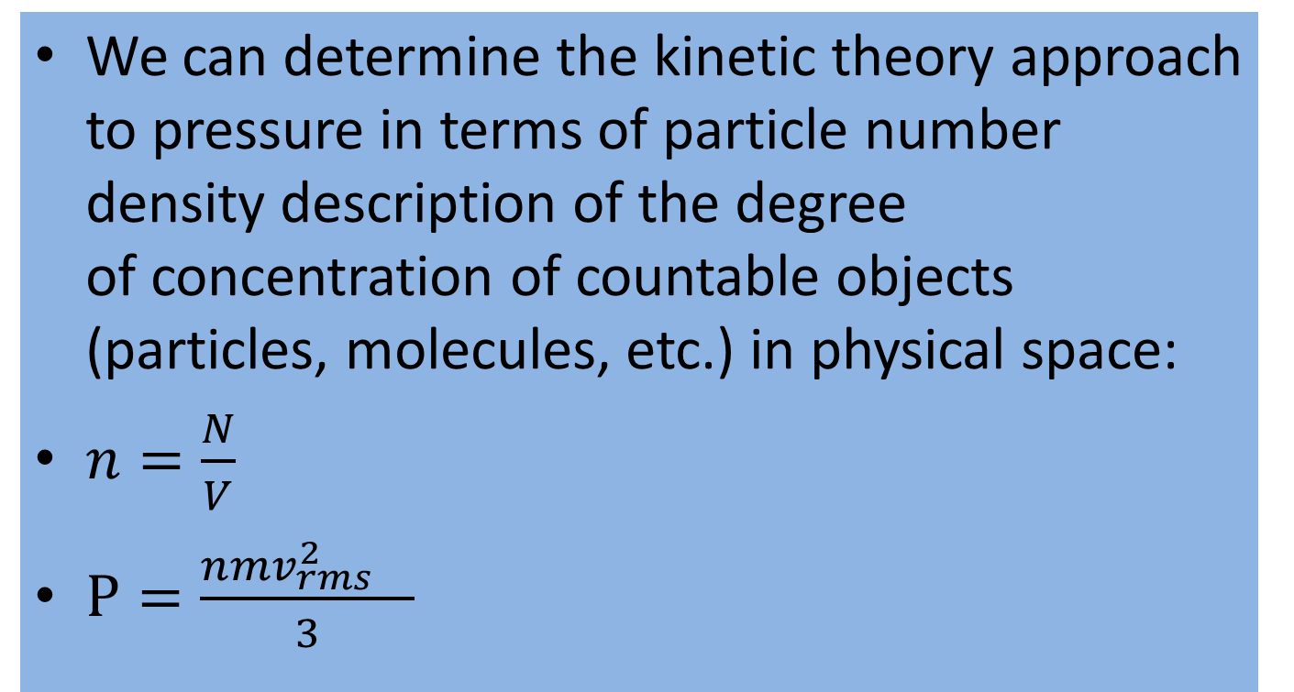
Kinetic Theory Pressure with n
We can determine the kinetic theory approach to pressure in terms of particle number density description of the degree of concentration of countable objects (particles, molecules, etc.) in physical space:
$n=\frac{N}{V}$
$P=\frac{nmv_{rms}^{2} }{3}$

Slide 34
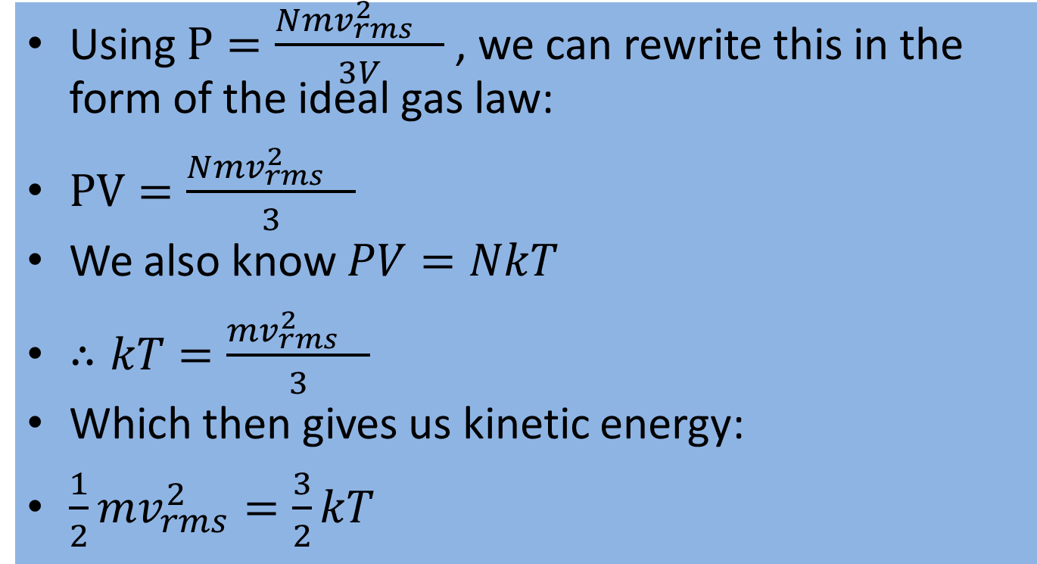
Kinetic Theory Meets Ideal Gas Law
Using $P=\frac{Nmv_{rms}^{2} }{3V}$ , we can rewrite this in the form of the ideal gas law:
$PV=\frac{Nmv_{rms}^{2} }{3}$
We also know $PV=NkT$
$∴kT=\frac{mv_{rms}^{2} }{3}$
Which then gives us kinetic energy:
$\frac{1}{2}mv_{rms}^{2}=\frac{3}{2}kT$

Slide 35
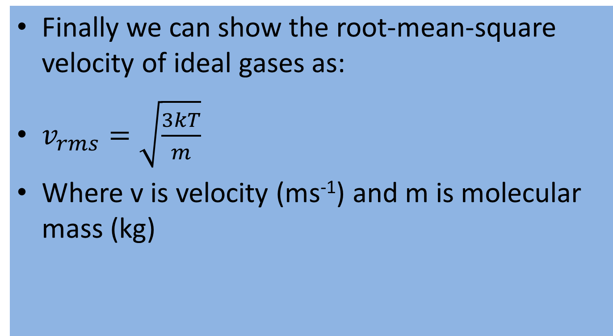
Kinetic Theory and v_{rms}
Finally we can show the root-mean-square velocity of ideal gases as:
$v_{rms}=\sqrt{\frac{3kT}{m}}$
Where v is velocity (ms⁻¹) and m is molecular mass (kg)

