Slide 1
The Experimental Gas Laws
3.5.3 Thermal Physics

Slide 2
Aims
Ideal Gas
Pressure
Volume
Boyle’s Law
Charles’ Law (Law of Volumes)
Amonton’s Law (The Pressure Law)

Slide 3
Idealised Situations
Within the wonderful world of Physics, we find that calculating is much easier when we consider idealised situations
The Universe contains many situations which are incredibly complicated such as rotating black holes and their gravitational effects
$c^{2}dr^{2}=\left(1−\frac{r_{s}r}{ρ^{2}}\right)c^{2}dt^{2}−\frac{ρ^{2}}{∆}dr^{2}−ρ^{2}dθ^{2}−\left(r^{2}+α^{2}+\frac{r_{s}rα^{2}}{ρ^{2}}\sin^{2}θ\right)\sin^{2}θ dφ+\frac{2r_{s}rα\sin^{2}θ}{ρ^{2}}c dt dφ$

Slide 4
Ideal Gases
Apart from black holes, even the mundane and taken for granted is incredibly complicated
Gases are no different
Take a moment to write down everything you know about a gas in terms of properties

Slide 5
Ideal Gases
Real gases are made up of molecules which have….
compressibility effects;
variable specific heat capacity;
van der Waals forces;
non-equilibrium thermodynamic effects;
issues with molecular dissociation and elementary reactions with variable composition.

Slide 6
Ideal Gases
When considering ideal gases, we like to simplify our gas to the very basic level:
The gas molecules are made up of point-like particles
Their mass is centred within the molecule
They move randomly
They do not interact with each other
They do collide but only elastically
They strictly obey the ideal gas laws

Slide 7
Pressure
As you already know, pressure is a force-area ratio given by:
$p=\frac{F}{a}$, where P is pressure in Nm⁻² or Pa, F is force in N and finally a is area where the force acts in m²

Slide 8
Question
Find the base units for pressure
${Nm}^{−2}=kg ms^{−2}m^{−2}=kgm^{−1}s^{−2}$ Using F=ma for def of N

Slide 9
Pressure
Back to pressure!
Gases exert pressure on the walls and surfaces of their environment such as pressurised diving tanks
Consider a balloon filled with gas, the balloon expands under the pressure exerted by the gas inside which fights against the pressure exerted by the atmosphere outside
This allows the balloon to remain inflated until it leaks sufficient gas through the pores and deflates over time

Slide 10
Pressure
Because the pressure is the same with ideal gases as it is with knife-points or books, the same law applies
The force is the force of the particles striking the area it acts against

Slide 11
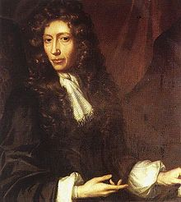
Pressure and Volume in Ideal Gases
Robert Townley and Henry Power were believed to the first scientists to discover that pressure and volume of gases were linked
Afterwards, this was confirmed by Robert Boyle with the help of his student Robert Hooke

Slide 12
Boyle’s Law
“For a fixed mass of gas at constant temperature,
$pV=constant$”
Where p = gas pressure and V = gas volume

Slide 13
Boyle’s Law

Slide 14
Boyle’s Law

Slide 15
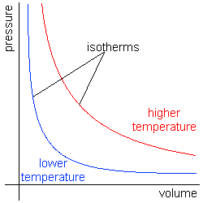
Boyle’s Law
If we plot the graph obeying Boyle’s law for two separate temperatures, we find that the isotherms act differently

Slide 16
Boyle’s Law
Isotherms can be plotted as straight lines on a p-V graph provided the graph is actually pressure vs. 1/volume
Mathematically this fact shows us that Boyle’s law can be re-written as:
$p=constant×\frac{1}{V}$
(which is conveniently a straight line equation)
$pV=k$

Slide 17
Using Boyle’s Law
Many situations in thermal dynamics requires us to calculate closed systems
Using Boyle’s law, we can find answers to such situations unless we require something else
Remember – Boyle’s law holds for ideal systems at constant temperature
$p_{1}V_{1}=p_{2}V_{2}$

Slide 18
Question
A hand pump of volume 2.0 x10⁻⁴ m³ is used to force air through a valve into a container of volume 8.0 x10⁻⁴ m³ which contains air at an initial pressure of 101 kPa.
Calculate the pressure of the air in the container after one stroke of the pump, assuming the temperature is unchanged.

Slide 19
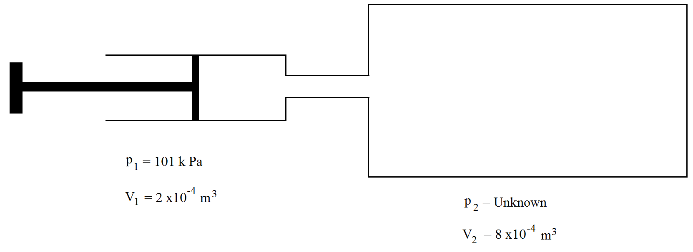
Question
$p_{1}V_{1}=p_{2}V_{2}$
$∴p_{2}=\frac{p_{1}V_{1}}{V_{2}}$
$=\frac{101 000×2×10^{−4}}{8×10^{−4}}$
$=25 250 Pa$
$∴final pressure=101 000+25 250=126 250 Pa$

Slide 20
Charles’ Law
Sometimes referred as the Law of Volumes, describes the experimental gas law which relates the expansion of a dry gas with the application of heat
“When the pressure on a sample of a dry gas is held constant, the Kelvin temperature and the volume will be directly related”
$V∝T$
$∴\frac{V}{T}=constant$, where V is the volume of the gas and T is the temperature in Kelvin

Slide 21
Using Charles’ Law
Just as with Boyle’s law, provided that a system holding an ideal gas is closed and well behaved (in terms of variables), we get….
$\frac{V_{1}}{T_{1}}=\frac{V_{2}}{T_{2}}$

Slide 22
Question
Given a container of carbon dioxide gas with an initial volume of 44 L and temperature of -8.7 °C, calculate the volume if the temperature is changed to 26.2 °C.
The first problem comes with the temperatures
$−8. 7^{o}C≡264.45 K and 26.2^{o}C≡299.35 K$
$\frac{V_{1}}{T_{1}}=\frac{V_{2}}{T_{2}}$ $∴V_{2}=\frac{V_{1}T_{2}}{T_{1}}=\frac{44×299.35}{264.45}=49.81K$

Slide 23
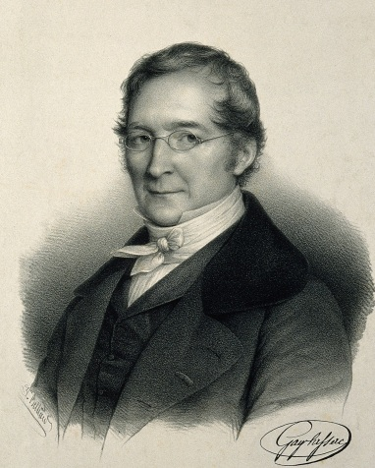
Amonton’s Law/Gay-Lussac’s Law
Amonton’s law sometimes known as the pressure law and sometimes attributed as Gay-Lussac law
“The pressure of a gas of fixed mass and fixed volume is directly proportional to the gas’s absolute temperature”
$P∝T$
Or
$\frac{P}{T}=constant$
where P is pressure and T is temperature in K

Slide 24
Using Amonton’s Law
Just as with the other relationships, we can use the pressure law when the system is fixed….
$\frac{P_{1}}{T_{1}}=\frac{P_{2}}{T_{2}}$

Slide 25
Question
10.0 L of a gas is found to exert 97.0 kPa at 25.0°C. What would be the required temperature (in Celsius) to change the pressure to standard pressure? (standard pressure is 101 325 Pa
Change 25.0°C to 298.0 K and that standard pressure in kPa is 101.325
$\frac{P_{1}}{T_{1}}=\frac{P_{2}}{T_{2}} ∴T_{2}=\frac{P_{2}T_{1}}{P_{1}}=\frac{97×298}{101.325}=311.3 K ≡38.3^{o}C$

Slide 26
Summary Questions
Page 211 from A2 Physics book

