Slide 1
Recap Write these down while I take the register
Boyle’s law?
Charles’ law?
Pressure law?
Combined gas law?
Work done by expanding gas?
Kinetic theory?

Slide 2
Recap
V $\text{ 1/}\text{P}$
Boyle’s law?
Charles’ law?
Pressure law?
Combined gas law?
V $\text{T}$
P $\text{T}$
$$\frac{pV}{T}=\text{constant}$$
V $\text{T}\text{/}\text{P}$

Slide 3
Recap
Work done by expanding gas?
Kinetic theory?
$$pV=\frac{1}{3}Nm{cRMS}^{2}$$
$$p=\frac{1}{3}⍴{cRMS}^{2}$$

Slide 4
Kinetic Energy
$$pV=\frac{1}{3}Nm{cRMS}^{2}$$
Kinetic theory
E$K=\frac{1}{2}m{cRMS}^{2}$
$$pV=\frac{2}{3}N EK$$
E_{K} $=\frac{3}{2Nm}pV$

Slide 5
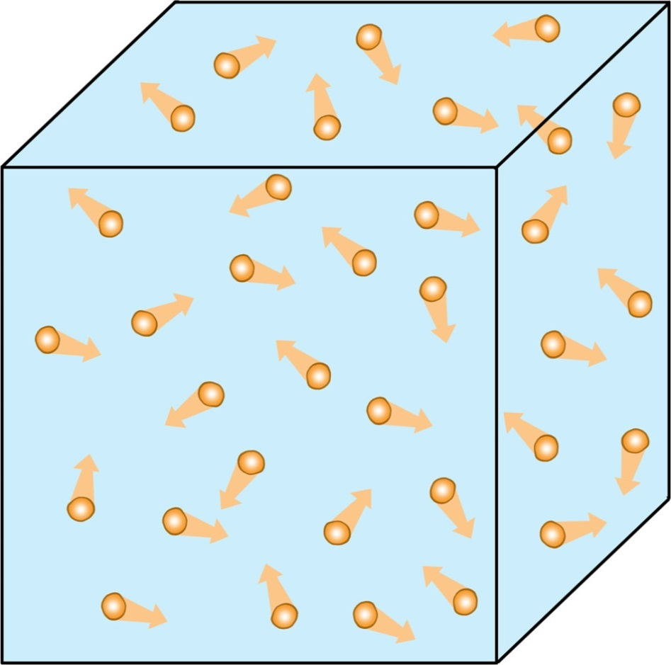
The Ideal Gas Law
To create a complete model of a gas what information would you need to have?

Slide 6
Ideal Gases
An ideal gas is one where:
the particles themselves can be thought of as taking up no volume
There are no significant forces between the particles
The motion of the particles is random

Slide 7
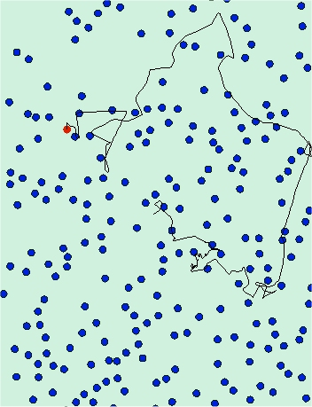
Brownian Motion
The particles in a fluid are always moving and their motion is random
This motion causes pressure when the particles collide with surfaces (and each other)
This motion is also responsible for diffusion of mixtures in fluids

Slide 8
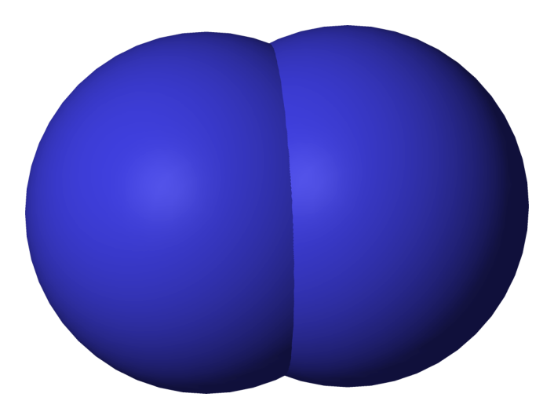
The Avogadro Constant
Because the particles in an ideal gas take up no volume themselves the volume of two gases at the same temperature must contain the same number of particles
At the same temperature one litre of Oxygen will have 16 times the mass as one litre of Hydrogen; they both contain the same number of particles but the mass is O₂ is 16x the mass of H₂

Slide 9
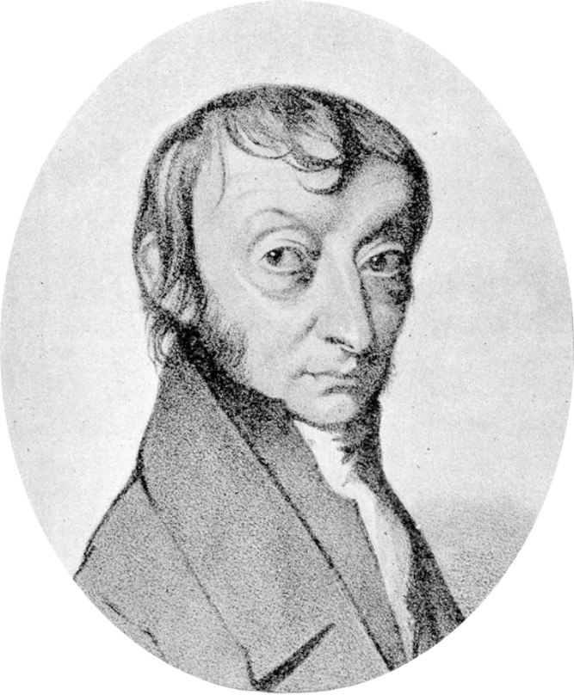
The Avogadro constant is the number Carbon atoms in 12g of Carbon-12
Originally this was the number of atoms in 1g of Hydrogen-1 however it is difficult to get a pure enough sample of Hydrogen-1 without isotopes being present
Amedeo Avogadro
1776 - 1856

Slide 10
Molar Mass
One mole of pure substance contains N_{A} particles in a sample
The molarity of sample is how many moles it contains; the unit is mol
The molar mass of a substance is the mass of 1 mol in kg mol⁻¹ (e.g. Oxygen gas is 0.032 kg mol⁻¹)

Slide 11
The Ideal Gas Equation
You know three gas laws:
Boyle’s law
Charles’ law
The pressure law
Also, Volume is proportional to number of molecules
Avagadro’s law
$$\frac{V}{n}=\text{constant}$$

Slide 12
The Ideal Gas Equation
Combine the four equations to give us the Ideal Gas Equation:
We call this constant: R and rearrange:
$$\frac{pV}{nT}=\text{constant}$$
$$pV=\text{nRT}$$

Slide 13
Calculating the constant
By plotting pV against nT (in Kelvin) for a gas then you get a straight line from the origin
The gradient of this line is R which is called the molar gas constant
The formula can then be rearranged to give:

Slide 14
The Boltzmann Constant
Another way of using the ideal gas equation is to know the number of particles (usually molecules) instead of the number of moles
This is often more useful to a Physicist whereas the previous formulae is used more by Chemists
The only difference is that the constant is different in the formula:

Slide 15
Summary
A mole of a substance contains the Avogadro constant of particles
The number of moles of a substance is called its molarity (mol)
The ideal gas equation has two forms using either the number of moles n or the number of particles N – care must be taken to use the correct constant in each case

