Slide 1
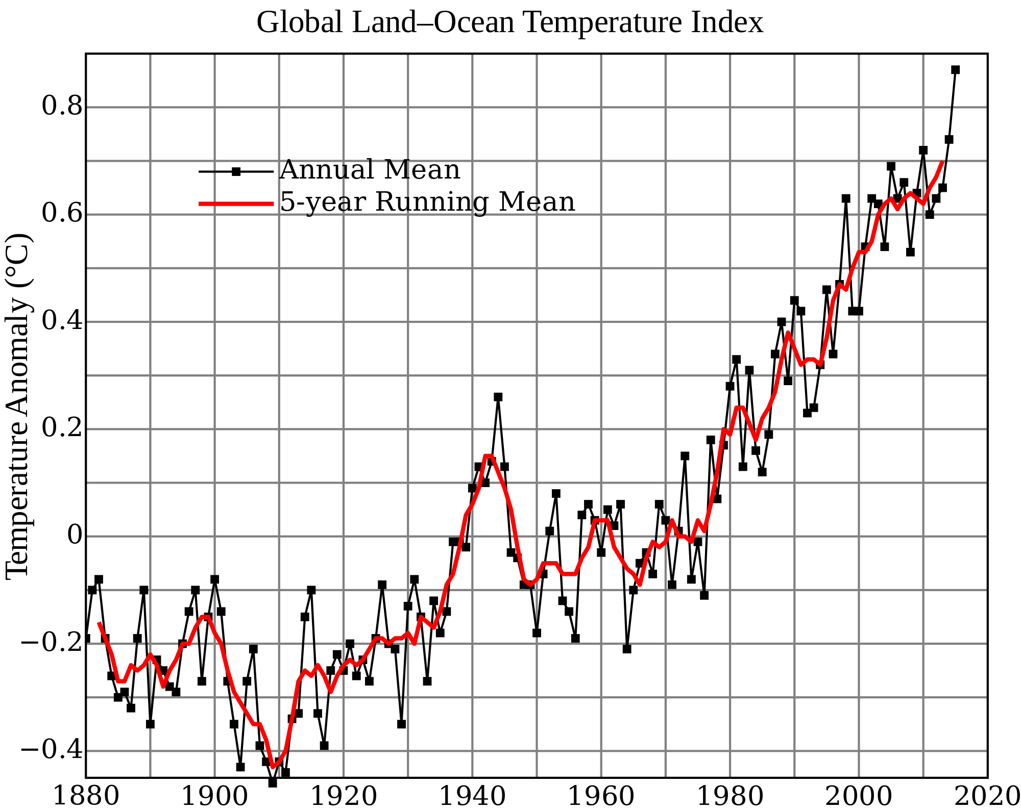
Internal Energy and Temperature
What does the word “Temperature” mean?

Slide 2
Energy Transfer
Energy can transfer from one place to another in two main ways:
When work is done on an object (i.e. a force is applied to it over a distance)
If one object is hotter than another object and heat flows via conduction, convection and radiation

Slide 3
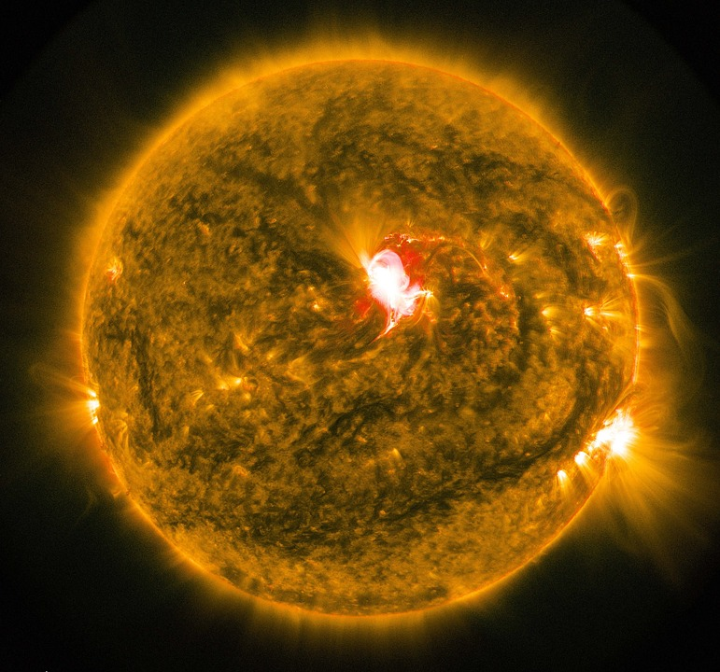
Internal Energy
The internal energy of a material is the total energy that it contains based on:
The kinetic energy of the particles
The position and hence potential energy of the particles
Other miscellaneous potential energies for instance magnetic forces

Slide 4
First Law of Thermodynamics
“The change of internal energy of the object is equal to the total energy transfer due to work done and heating”
This statement is linked to the conservation of energy
A useful outcome of this statement is that if work is being done on an object and it is not getting hotter then it must have an output rate of energy identical to the work being done on it.

Slide 5
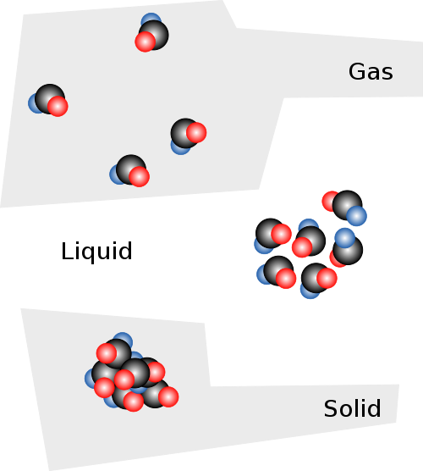
Changes of state
Recall that in solids the particles (atoms and/or molecules) vibrate around fixed positions
Increasing the energy of these particles can make them move around, melting the solid
Increasing the energy further may allow them to become so energetic they are free of interaction from each other and the substance becomes a gas.
The internal energy of an object is the sum of the random distribution of the kinetic and potential energies of its molecules

Slide 6
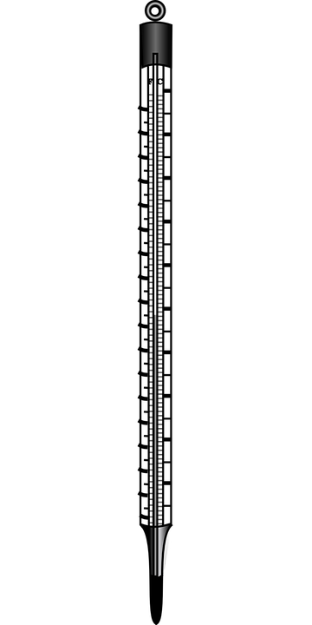
Temperature and temperature scales
The temperature of a substance is a measure of the hotness of a material, i.e. the hotter it is the more internal energy it possesses
A temperature scale requires two fixed points with fixed degrees between them
The Celsius scale is defined by:
0ºC is pure melting ice (Ice point)
100ºC is the temperature of pure steam at standard atmospheric pressure (Steam point)

Slide 7
The absolute scale
The absolute scale is one that was defined by Lord Kelvin and has units measured in his name. Note that they are not called degrees.
Absolute zero – 0 K is the lowest possible temperature
Triple point of water – 273.16 K is the temperature at which water can exist in all three states
Ice point of water is 273.15 K
To convert between Kelvin and Celsius you simply add 273.15 (and vice versa to convert back)

Slide 8
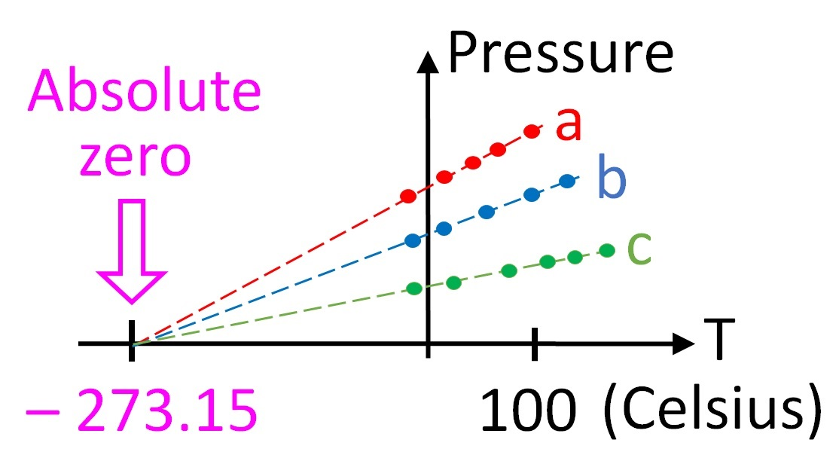
Finding absolute zero
If you cool a gas within a fixed volume then its pressure drops.
If you take measurements at various temperatures you can plot a straight line on a graph
Regardless of which gas you use, the lines intercept at absolute zero

Slide 9
Summary
Temperature is a measure of hotness and the higher the temperature the more internal energy the material has
The internal energy of a substance is defined as the total kinetic and potential energy of the particles it contains
Change of state is due to the change in internal energy of a substance
Temperature can measured in Celsius or Kelvin, with Kelvin being the absolute scale
To convert from Kelvin to Celsius you simply subtract 273.15

