Slide 1
CW | Internal Energy | 03/09/2018
Objective | To understand the changes in internal energy when a substance changes state
Starter activity (5 minutes):
Name the three states of matter and describe how the atoms are arranged
Challenge: explain the relative strength of the force between atoms Tricky challenge: What is the fourth state of matter and what is it like?

Slide 2
AO1 – convert between Celsius and Kelvin AO2 – define the term internal energy AO3 – explain how the internal energy of a substance changes as it changes state
Question
Two cubes are in a room. There are only two ways they can transfer energy between them. What are they?

Slide 3
K – convert between Celsius and Kelvin B – define the term internal energy A – explain how the internal energy of a substance changes as it changes state
Internal energy of a substance is the sum of the random distribution of the kinetic and potential energies of its molecules
The internal energy of an object due to its temperature is sometimes referred to as thermal energy

Slide 4
K – convert between Celsius and Kelvin B – define the term internal energy A – explain how the internal energy of a substance changes as it changes state
The internal energy of a substance might change due to other causes.
Can you think of any?
Magnetising an iron bar

Slide 5
K – convert between Celsius and Kelvin B – define the term internal energy A – explain how the internal energy of a substance changes as it changes state
Draw the arrangement of particles in a solid, liquid and a gas
For each describe the motion of the particles
Describe the energy changes as:
The temperature of the state is raised
The state is changed
Use the worksheet and textbook to help you

Slide 6
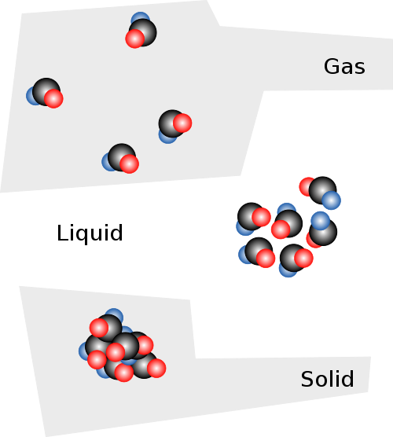
Changes of state
Recall that in solids the particles (atoms and/or molecules) vibrate around fixed positions
Increasing the energy of these particles can make them move around, melting the solid
Increasing the energy further may allow them to become so energetic they are free of interaction from each other and the substance becomes a gas.
The internal energy of an object is the sum of the random distribution of the kinetic and potential energies of its molecules

Slide 7
First Law of Thermodynamics
“The change of internal energy of the object is equal to the total energy transfer due to work done and heating”
This statement is linked to the conservation of energy
A useful outcome of this statement is that if work is being done on an object and it is not getting hotter then it must have an output rate of energy identical to the work being done on it.

Slide 8
K – convert between Celsius and Kelvin B – define the term internal energy A – explain how the internal energy of a substance changes as it changes state
Temperature
A measurement of how hot an object is
Heat is the total energy (internal energy)
Temperature is the average energy of the particles
There are different scales to measure this
Each scale has fixed points

Slide 9
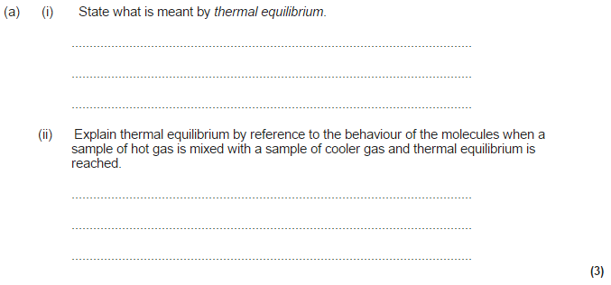

Slide 10
K – convert between Celsius and Kelvin B – define the term internal energy A – explain how the internal energy of a substance changes as it changes state
Celsius Scale
Ice point = 0°C
Steam point = 100°C
Both of these have to be at standard atmospheric pressure

Slide 11
K – convert between Celsius and Kelvin B – define the term internal energy A – explain how the internal energy of a substance changes as it changes state
Kelvin Scale
Absolute zero, 0K
Triple point of water, 273.16K

Slide 12
K – convert between Celsius and Kelvin B – define the term internal energy A – explain how the internal energy of a substance changes as it changes state
Temp in °C = temp in Kelvins -273.15
273.15 K is the ice point on the Kelvin scale

Slide 13
K – convert between Celsius and Kelvin B – define the term internal energy A – explain how the internal energy of a substance changes as it changes state
Temp in °C | Temp in K
0
 | 249
151
 | 373
-46
 | 301

Slide 14
K – convert between Celsius and Kelvin B – define the term internal energy A – explain how the internal energy of a substance changes as it changes state
Temp in °C | Temp in K
0 | 273
-24 | 249
151 | 424
100 | 373
-46 | 227
28 | 301

Slide 15
Objective | To describe the changes in internal energy when a substance changes state
K – convert between Celsius and Kelvin B – define the term internal energy A – explain how the internal energy of a substance changes as it changes state
Describe and explain the changes in internal energy when a substance changes state (6 Marks) Review: Rate yourself against the learning outcomes and discuss how you have done today. Set yourself a target for improvement.
To answer this question:
1-2 | The information conveyed by the answer is poorly organised and may not be relevant or coherent. There is little correct use of specialist vocabulary. The form and style of writing may be only partly appropriate
3-4 | The information conveyed by the answer may be less well organised and not fully coherent. There is less use of specialist vocabulary, or specialist vocabulary may be used incorrectly. The form and style of writing is less appropriate.
5-6 | The information conveyed by the answer is clearly organised, logical and coherent, using appropriate specialist vocabulary correctly. The form and style of writing is appropriate to answer the question.

