Slide 1
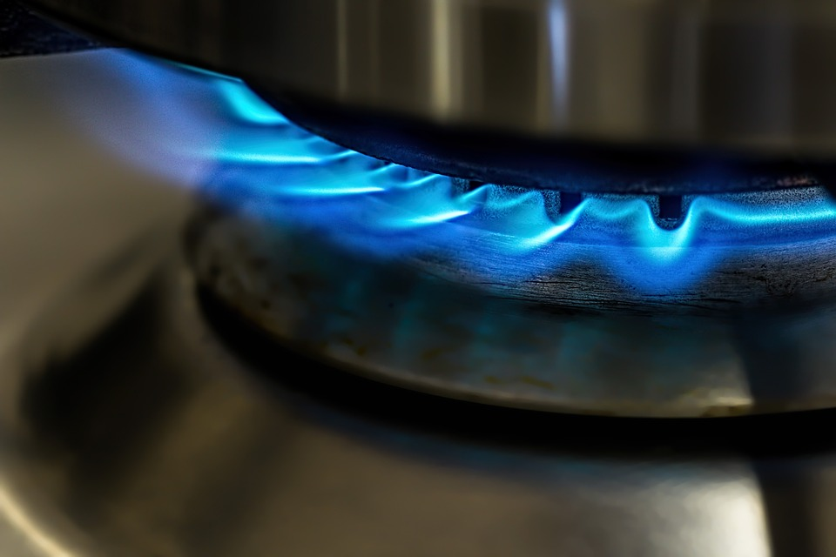
Specific Heat Capacity
What is the link between energy and temperature for matter?

Slide 2
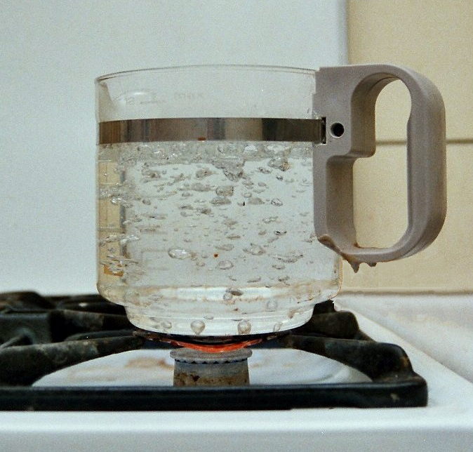
Does all matter heat in the same way?
If two identical beakers of water initially at 20ºC were heated using the exactly the same amount of energy would they both increase by the same temperature?
What would happen if one beaker contained water and the other one contained vegetable oil?

Slide 3
Definition of Specific Heat Capacity
“The specific heat capacity, c , of a substance is the energy needed to raise the temperature of unit mass of the substance by 1K without change of state”
J kg⁻¹ K⁻¹
What would be the units for c?
The larger the mass of the object then the more energy needed to heat it. The formula for the energy needed to change the temperature of an object is therefore:

Slide 4
Inversion tube experiment
Adding an exact amount of energy to a system can be achieved by doing work on the system
If a tube of balls is inverted then the contents fall down the tube of length L, converting potential energy into thermal energy
If this is repeated n times then the total energy change is:

Slide 5
The temperature change of the balls inside the tube can then be measured and the specific heat capacity can be calculated:
Note that the mass term m has cancelled out. Can you understand why it makes no difference in this calculation, how much mass there is?

Slide 6
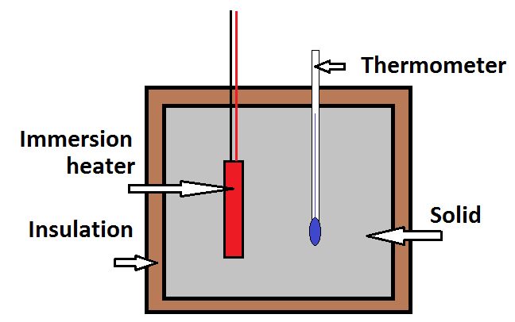
Calculating Specific Heat Capacity
Method:
Set up the equipment as shown in the diagram
Using E=IVt calculate the total energy input to the block over several minutes
Measure the change in temperature (Note: After turning off the heater you must wait until the end temperature attains a maximum

Slide 7
Results
Metal | Current /A | P.D. /V | Time /s | Energy /J | ΔT /K | S.H.C /J kg⁻¹ K⁻¹

Slide 8
Examples
Substance | Specific Heat Capacity / J kg⁻¹ K⁻¹
Aluminium | 900
Copper | 390
Iron | 490
Lead | 130
Oil | 2100
Water | 4200
How do these values compare to your results? Do they lie within your calculated uncertainties?

Slide 9
Using a calorimeter
If a liquid is used for this experiment then it needs to be placed inside a container and stirred throughout the experiment
The apparatus for this is called a calorimeter
The calorimeter will also be heated so its specific heat capacity is needed and the energy it absorbs must be included in the calculations
The overall formula then becomes:

Slide 10
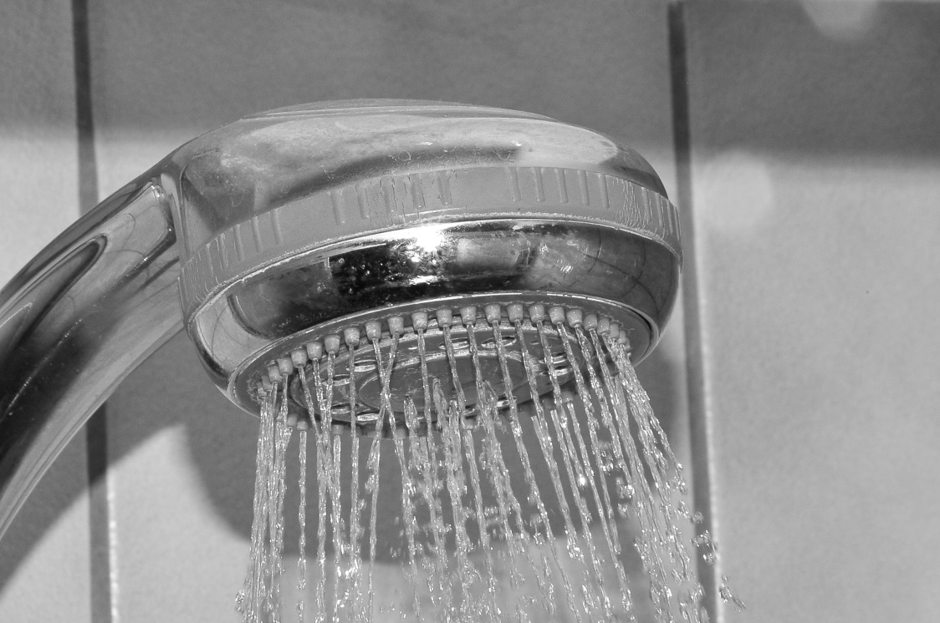
Continuous flow heating
In boilers, showers and solar panels there is a rate of change of temperature (or a mass per second of water flow)
This therefore creates a rate of energy input, which is power (Measured in Watts)

Slide 11
Summary
Not all materials heat at the same rate when energy is applied. The amount of energy required to raise a unit mass by 1K without changing state is called the specific heat capacity
The units of c are J kg⁻¹ K⁻¹
The formula for specific heat capacity is:
The rate of energy flow to sustain the heating in a system calculates power in Watts

