Slide 1
CW | Latent Heat | 26/09/2018
Calculate (a) the heat energy required to change 100g of ice at – 5ºC to steam at 100ºC.
From my learning today I will be able to:
Key: | state the definition of the term latent heat
Boost: | carry out an experiment to measure the melting point of salol
Aspire: | evaluate the experiment and identify sources of error

Slide 2
Latent heat
This is the energy required to change the state of a substance. e.g. melting or boiling.
With a pure substance the temperature does not change. The average potential energy of the substance’s molecules is changed during the change of state.
‘latent’ means ‘hidden’ because the heat energy supplied during a change of state process does not cause any temperature change.

Slide 3
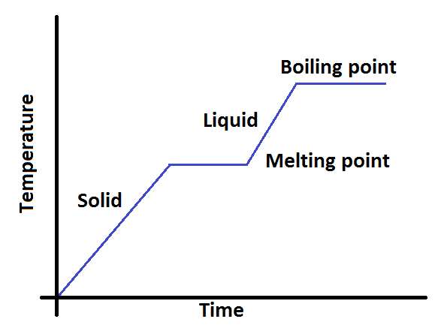

Slide 5
Specific latent heat, l
The specific latent heat, l of a substance is the energy required to change the state of unit mass of the substance without change of temperature.
ΔQ = m l
where:
ΔQ = heat energy required in joules
m = mass of substance in kilograms
l = specific latent heat in J kg ⁻¹

Slide 6
The energy needed to melt a substance is called the latent heat of fusion
The energy needed to evaporate a substance is the latent heat of vaporisation
You should be able to explain why a snowman does not melt quickly on a day when the temperature of the air is above OºC

Slide 7
Examples of SLH
Substance | State change | SLH (Jkg⁻¹)
ice → water | solid → liquid specific latent heat of fusion | 336 000
water → steam | liquid → gas / vapour specific latent heat of vaporisation | 2 250 000
carbon dioxide | solid → gas / vapour specific latent heat of sublimation | 570 000
lead | solid → liquid | 26 000
solder | solid → liquid | 1 900 000
petrol | liquid → gas / vapour | 400 000
mercury | liquid → gas / vapour | 290 000

Slide 8
Complete:
Answers
Substance | Change | SLH (Jkg⁻¹) | Mass | Energy (J)
water | melting | 336 000 | 4 kg | 1.344 M
water | freezing | 336 000 | 200 g | 67.2 k
water | boiling | 2.25 M | 4 kg | 9 M
water | condensing | 2.25 M | 600 mg | 1 350
CO₂ | subliming | 570 k | 8 g | 4 560
CO₂ | depositing | 570 k | 40 000 μg | 22.8

Slide 9
Question 1
Calculate (a) the heat energy required to change 100g of ice at – 5ºC to steam at 100ºC.
(b) the time taken to do this if heat is supplied by a 500W immersion heater.
Sketch a temperature-time graph of the whole process.
Stage 1: ice at – 5ºC to ice at 0ºC
ΔQ = m c Δθ
= 0.100 kg x 2100J kg ⁻¹ ºC ⁻¹ x (0 – (- 5)) ºC
= 0.100 x 2100 x 5
= 1 050 J

Slide 10
Stage 2: ice at 0ºC to water at 0ºC
ΔQ = m l
= 0.100 x 336 000
= 33 600 J
Stage 3: water at 0ºC to water at 100ºC
ΔQ = m c Δθ
= 0.100 x 4200 x 100
= 42 000 J
Stage 4: water at 100ºC to steam at 100ºC
ΔQ = m l
= 0.100 x 2 250 000
= 225 000 J
Stages 1 to 4: ice at – 5ºC to steam at 100ºC
= 1 050J + 33 600J + 42 000J + 225 000J
= 301 650J

Slide 11
(b) 500W heater
This supplies 500J per second to water.
Assuming no heat loss to the surroundings:
Stage 1:
1 050J / 500W = 2.1 seconds
Stage 2:
33 600J / 500W = 67.2s
Stage 3:
42 000J / 500W = 84s
Stage 4:
225 000J / 500W = 450s
Stages 1 to 4:
301 650J / 500W = 603.3s

Slide 12
(c) Sketch graph
temperature / ºC
100
0
stage 4
stage 2
stage 3
-5
100 200 300 400 500 600
time / s
stage 1

Slide 13
Question 2
A glass contains 300g of water at 30ºC. Calculate the water’s final temperature when cooled by adding (a) 50g of water at 0ºC; (b) 50g of ice at 0ºC. Assume no heat energy is transferred to the glass or the surroundings.
Let the final temperature be: θ_{F}
Heat energy lost by 30ºC water
= Heat energy gained by 0ºC water

Slide 14
m₃₀ c Δθ₃₀ = m₀ c Δθ₀
SHC cancels on both sides
0.300 x (30 - θ_{F}) = 0.050 x (θ_{F} - 0)
9 – 0.3θ_{F} = 0.05θ_{F}
9 = 0.35θ_{F}
Final temperature = 26ºC

Slide 15
(b) In this case heat energy from the water is also used to melt the ice at 0ºC before raising the ice’s temperature.
Let the final temperature again be: θ_{F}
Heat energy lost by 30ºC water
= Heat energy gained by 0ºC water
+ Heat required to melt the ice

Slide 16
m₃₀ c Δθ₃₀ = m₀ c Δθ₀ + m₀ l
0.300 x 4200 x (30 - θ_{F})
= [0.050 x 4200 x (θ_{F} - 0)]
+ [0.050 x 336 000]
37800 – 1260θ_{F} = 210θ_{F} + 16800
21000 = 1470θ_{F}
Final temperature = 14ºC
The ice cools the water far more than the cold water.

