Slide 1
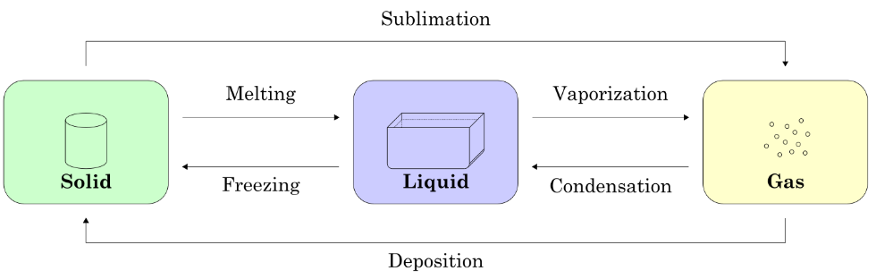
Change of state
Does changing state require energy?

Slide 2

Solids
Maintain their shape
Have a constant volume
Cannot be easily compressed
Molecules / atoms are close together and vibrate in fixed positions

Slide 3

Liquids
Flow and take the shape of a vessel
Have a constant volume
Cannot be easily compressed
Molecules / atoms are close together and can move around each other

Slide 4

Gases
Flow and take any shape, fill any space
Take the volume of any vessel or space
Can be easily compressed
Molecules / atoms are far apart and are free to move

Slide 5
Effect of heating
If you heat a pure substance then its temperature will increase, proportional to the energy supplied
At a definite temperature the rise will cease and the material will begin to change state at a constant temperature
Once all of the material has changed state then the temperature will begin to rise again
The energy needed to make the change of state occur is called latent heat

Slide 6
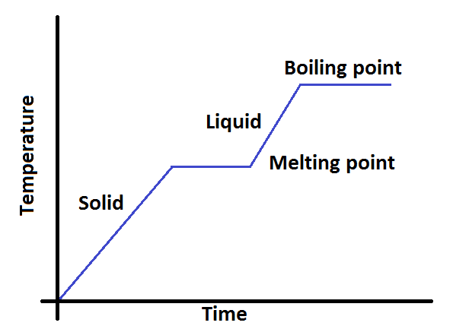
Graphical representation of heating

Slide 7

Latent Heat
The energy needed to melt a substance is called the latent heat of fusion
The energy needed to evaporate a substance is the latent heat of vaporisation
You should be able to explain why a snowman does not melt quickly on a day when the temperature of the air is above OºC

Slide 8
Specific Latent Heat
It is often useful to know how much energy is needed to make a unit mass of a pure substance change state.
  The specific heat of fusion l_{f}
  The specific heat of vaporisation l_{v}
What are the units?
J kg⁻¹

Slide 9
Analysing Graphs
Looking again at this graph you can see that the gradients of the solid and liquid states are not the same
The gradient represents the rate of change of temperature
A steeper gradient therefore shows which state heats quicker (and hence which state has a lower specific heat capacity)
The length of time to change state is proportional to the specific latent heat for each state change

Slide 10
Summary
When heating a pure substance there is a definite melting and boiling point
If the heat flow into the substance is constant then the rise in temperature is constant
At the melting and boiling point the rise in temperature halts while the change of state occurs
The energy needed to perform these changes are called the latent heat of fusion and latent heat of vaporisation
This information can be extracted from a graph and comparisons between specific heat of different states can be made

