Slide 1
CW | Experimental Gas laws | 04/10/2018
From my learning today I will be able to:
Key: | to state the three experimental gas laws and the relationships that derive from them
Boost: | describe the experiments and the consequences of the results
Aspire: | use the gas laws to calculate unknown quantities
Objective

Slide 2
Boyles Law – http://labs.minutelabs.io/Brownian-Motion/ http://www.physics-chemistry-interactive-flash-animation.com/matter_change_state_measurement_mass_volume/pressure_volume_boyle_mariotte_law_ideal_gas_closed_system_MCQ.htm Charles Law – Pressure Law – https://phet.colorado.edu/en/simulation/gas-properties Once you have the graphs try to deduce the following: Relationship between two quantities Any relationship between all three

Slide 3
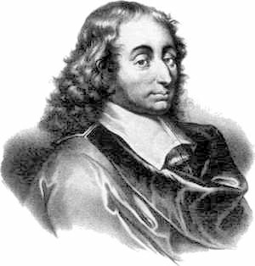
Pressure
The pressure of a gas is the force per unit area that it exerts normally (at right angles to) surfaces
The is effected by the temperature, volume of the gas and mass of the gas particles
The units are pascals (Pa or Nm⁻²)
Blaise Pascal
1623 - 1662

Slide 4
Boyle’s Law
If a gas is compressed under constant temperature then the pressure increases and the volume decreases
The relationship is found to be:
An experiment done at constant temperature is called an isothermal change

Slide 5
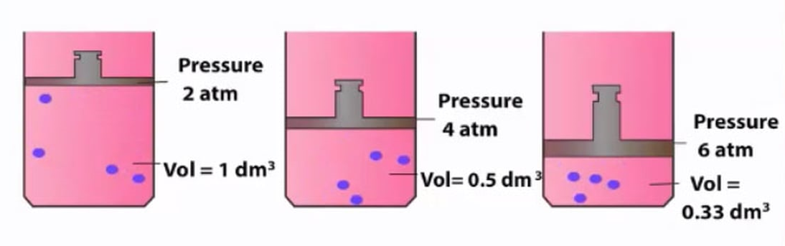
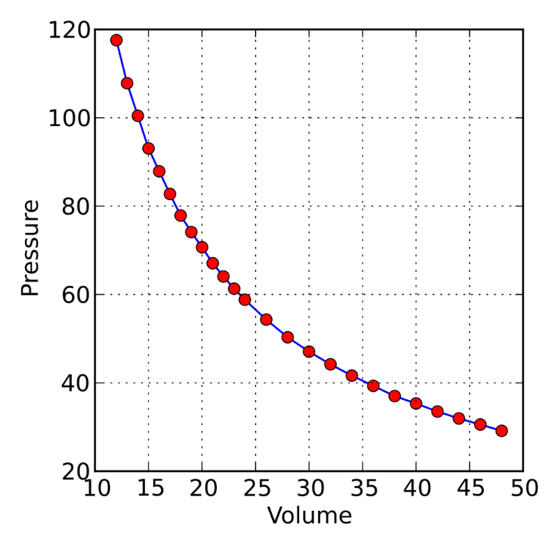
Experimental results create a curve.
How could you get a straight line?
Plot p against 1/V

Slide 6
Boyle’s law question
A gas has an initial volume of 300 m³ at standard atmospheric pressure (100 kPa). Calculate the final volume of this gas if its pressure is increased by 400 kPa at a constant temperature.
Boyle’s law: p₁ x V₁ = p₂ x V₂
100 kPa x 300 m³ = 500 kPa x V₂
30 000 = 500 V₂
V₂ = 30 000 / 500
Final volume = 60 m³

Slide 7
Charles’ Law
Reducing the temperature of a gas but maintaining the same pressure causes the volume to decrease
Plotting this on a graph gives a straight line
The intercept of this line with the x-axis always occurs at -273.15ºC (Absolute Zero)
The mathematical relationship is therefore:
An experiment done at constant pressure is called an isobaric change

Slide 8
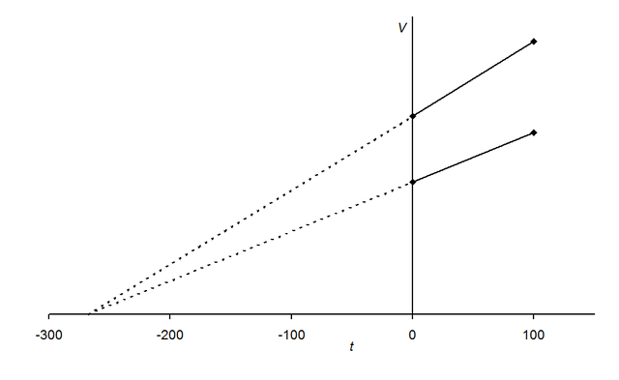
To obtain these results the gas must be ideal (i.e. there must be no interactions between particles)

Slide 9
Charles’ law question
A gas has an initial volume of 50m³ at a temperature of 127ºC. Calculate the final temperature required in ºC to decrease its volume to 20m³ at a constant pressure.
Charles’ law: V₁ / T₁ = V₂ / T₂
Temperatures must be in kelvin, so: T₁ = 400K
50m³ / 400K = 20m³ / T₂
T₂ = (20 x 400) / 50
T₂ = 160K
Final temperature = - 113 ºC

Slide 10
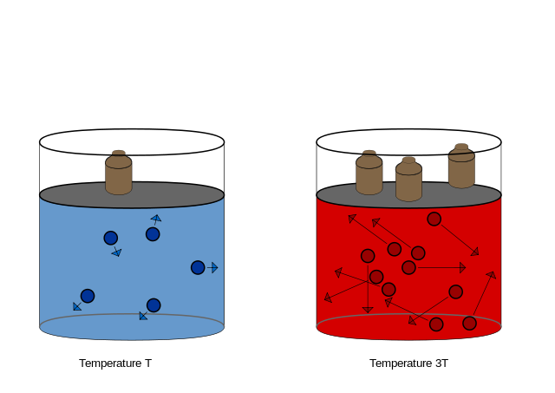
The Pressure Law
Reducing the temperature of a gas at a fixed volume reduces the pressure
As for Charles’ Law plotting this on a graph gives a straight line with an intercept at 0K
The mathematical relationship is therefore:

Slide 11
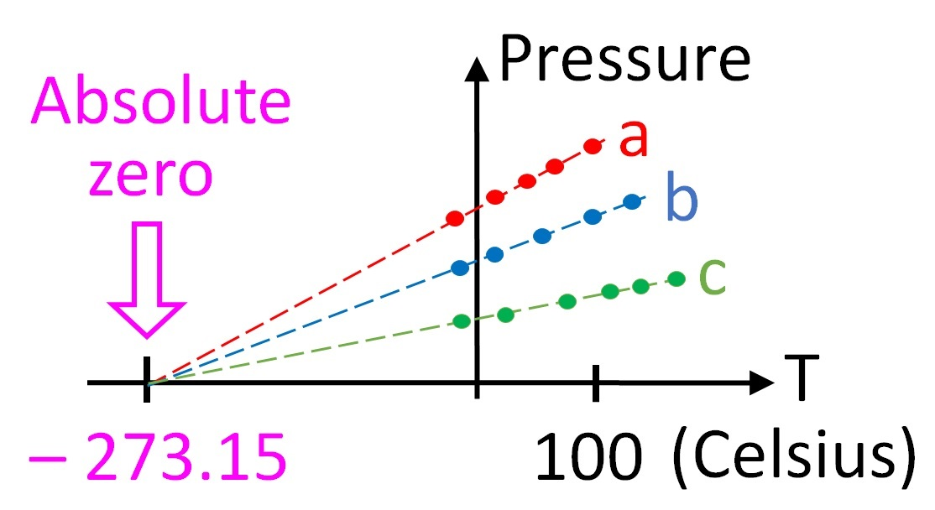
Note: This is Pressure against Temperature; Charles’ Law was identical in shape but plotted Volume against Temperature

Slide 12
Pressure law question
A gas has an initial pressure of 100kPa at a temperature of 27ºC. Calculate the final pressure of this gas if its temperature is increased by 300ºC at a constant volume.
Pressure law: p₁ / T₁ = p₂ / T₂
Temperatures must be in kelvin!
so: T₁ = 300K and T₂ = 600K
100 kPa / 300K = p₂ / 600K
p₂ = (100 000 x 600) / 300
Final pressure = 200 kPa

Slide 13
Summary
There are three measurements on a gas: Volume, Pressure and Temperature
There are three relationships between these variables:
Boyle’s Law
Charles’ Law
The Pressure Law

Slide 14

Work done
When a volume of gas is compressed but the pressure is maintained then heat must be transferred
The work done by a piston is therefore:

Slide 15
Activity (10 minutes):
An ideal gas in a container at a pressure of 2.1x10⁵ Pa and a Volume of 0.003m³ is at room temperature. It goes outside and its temperature drops by 15°C. Its pressure drops to 1.8x10⁵Pa. What is the new volume? A car tyre has a pressure of 2.06x10⁵Pa. The volume of the tyre is fixed. What will the pressure become as the car races and the temperature of the tyre goes up by 30K from the room temperature of the garage?

