Slide 1
CW | Experimental Gas Laws | October 21st 2014
Objective | To understand the experimental relationship between pressure, volume and temperature
From my learning today I will be able to:
Key: | to state the three experimental gas laws and the relationships that derive from them
Boost: | describe the experiments and the consequences of the results
Aspire: | use the gas laws to calculate unknown quantities
Starter activity (20 minutes):
Complete the learning conversation in your book using green pen.

Slide 2
CW | Experimental Gas laws | October 21st 2014
Objective | To use knowledge to measure the latent heat of fusion of ice
New learning (5 minutes):
Symbols used in this chapter are: p – pressure V – volume T – temperature (must be in K) R - molar gas constant k - Boltzman constant N - number of molecules n - number of moles
Key: | to state the three experimental gas laws and the relationships that derive from them
Boost: | describe the experiments and the consequences of the results
Aspire: | use the gas laws to calculate unknown quantities

Slide 3
CW | Experimental Gas laws | October 21st 2014
Objective | To use knowledge to measure the latent heat of fusion of ice
Activity (60 minutes):
Using the three web links below collect data and plot graphs for the three experiments. Boyles Law - http://www.physics-chemistry-interactive-flash-animation.com/matter_change_state_measurement_mass_volume/pressure_volume_boyle_mariotte_law_ideal_gas_closed_system_MCQ.htm Charles Law - http://group.chem.iastate.edu/Greenbowe/sections/projectfolder/flashfiles/gaslaw/charles_law.html Pressure Law – Once you have the graphs try to deduce the following: Relationship between two quantities Any relationship between all three
Key: | to state the three experimental gas laws and the relationships that derive from them
Boost: | describe the experiments and the consequences of the results
Aspire: | use the gas laws to calculate unknown quantities

Slide 4
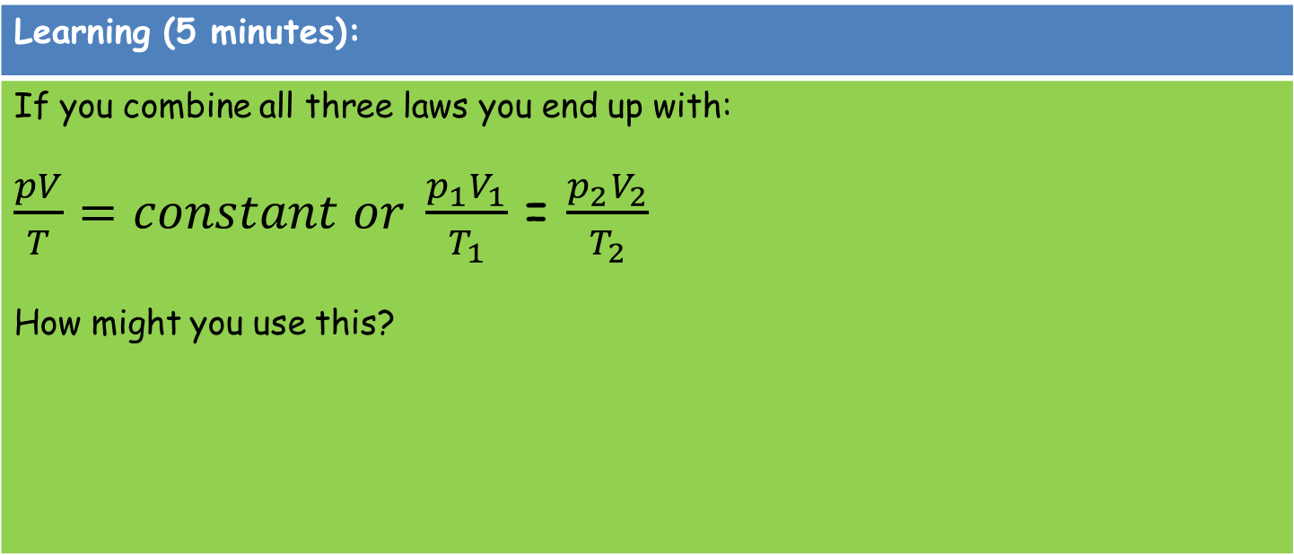
CW | Experimental Gas laws | October 21st 2014
Objective | To use knowledge to measure the latent heat of fusion of ice
Learning (5 minutes):
If you combine all three laws you end up with: $\frac{pV}{T}=constant or \frac{p_{1}V_{1}}{T_{1}}$ = $\frac{p_{2}V_{2}}{T_{2}}$ How might you use this?
Key: | to state the three experimental gas laws and the relationships that derive from them
Boost: | describe the experiments and the consequences of the results
Aspire: | use the gas laws to calculate unknown quantities

Slide 5
CW | Experimental Gas laws | October 21st 2014
Objective | To use knowledge to measure the latent heat of fusion of ice
Activity (10 minutes):
An ideal gas in a container at a pressure of 2.1x10⁵ Pa and a Volume of 0.003m³ is at room temperature. It goes outside and its temperature drops by 15°C. Its pressure drops to 1.8x10⁵Pa. What is the new volume? A car tyre has a pressure of 2.06x10⁵Pa. The volume of the tyre is fixed. What will the pressure become as the car races and the temperature of the tyre goes up by 30K from the room temperature of the garage?
Key: | to state the three experimental gas laws and the relationships that derive from them
Boost: | describe the experiments and the consequences of the results
Aspire: | use the gas laws to calculate unknown quantities

Slide 6
CW | Experimental Gas laws | October 21st 2014
Objective | To use knowledge to measure the latent heat of fusion of ice
Review (10 minutes):
Write a similar question for another student and work out the answer in the back of your book fro them to check. Pass books clockwise.
Key: | to state the three experimental gas laws and the relationships that derive from them
Boost: | describe the experiments and the consequences of the results
Aspire: | use the gas laws to calculate unknown quantities

