Slide 1
The Experimental Gas Laws
What measurements can be made on a gas?
How would changing one of these effect the others?

Slide 2
How a gas exerts pressure
A gas consists of molecules in constant random motion.
When a molecule collides with a surface it undergoes a momentum change as it reverses direction.
By Newton’s 2nd and 3rd laws the surface therefore experiences a force from the colliding molecule.
The pressure exerted by the gas is equal to the total force exerted by the molecules on a unit area of the surface.
pressure = force / area

Slide 3
The experimental gas laws
These state how the pressure, p volume, V and the absolute temperature, T of an ideal gas relate to each other.
Real gases at relatively low pressures and well above their condensation temperature behave like an ideal gas.
Air at normal temperature (20ºC) and at standard atmospheric pressure (101 k Pa) is a good approximation to an ideal gas.

Slide 4
Boyle’s Law
If a gas is compressed under constant temperature then the pressure increases and the volume decreases
The relationship is found to be:
An experiment done at constant temperature is called an isothermal change

Slide 5
Boyle’s law
For a fixed mass of gas at a constant temperature:
pV = constant
When a gas changes pressure from p₁ to p₂ while undergoing a volume change from V₁ to V₂ :
p₁ x V₁ = p₂ x V₂

Slide 6
An ideal gas is defined as a gas that obeys Boyle’s law at all pressures.
Real gases do not obey Boyle’s law at very high pressures or when they are cooled to near their condensation point.
Graphs of an ideal gas obeying Boyle’s law at different temperatures.

Slide 7
Boyle’s law question
A gas has an initial volume of 300 m³ at standard atmospheric pressure (100 kPa). Calculate the final volume of this gas if its pressure is increased by 400 kPa at a constant temperature.
Boyle’s law: p₁ x V₁ = p₂ x V₂
100 kPa x 300 m³ = 500 kPa x V₂
30 000 = 500 V₂
V₂ = 30 000 / 500
Final volume = 60 m³

Slide 8
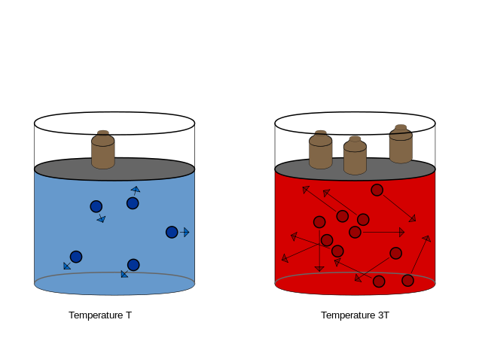
The Pressure Law
Reducing the temperature of a gas at a fixed volume reduces the pressure
As for Charles’ Law plotting this on a graph gives a straight line with an intercept at 0K
The mathematical relationship is therefore:

Slide 9
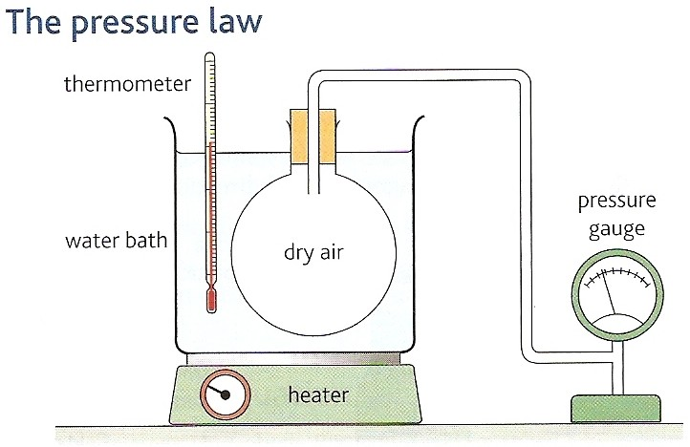
Pressure law
For a fixed mass of gas at a constant volume:
p = constant
T
When a gas changes pressure from p₁ to p₂ while undergoing a temperature change from T₁ to T₂ :
p₁ = p₂
T₁ T₂

Slide 10
Absolute zero
Absolute zero is the lowest possible temperature.
An object at absolute zero has minimum internal energy.
The graph opposite shows that the pressure of all gases will fall to zero at absolute zero which is approximately - 273ºC.

Slide 11
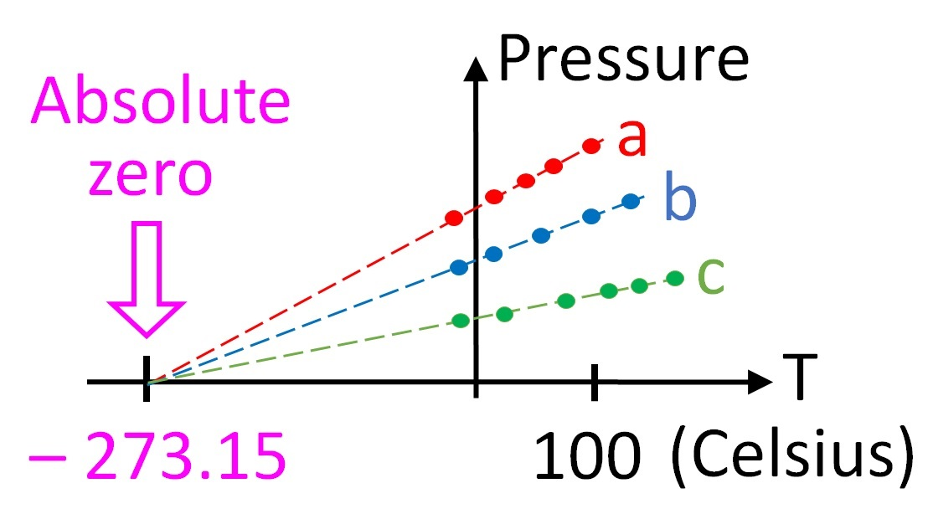
Note: This is Pressure against Temperature; Charles’ Law was identical in shape but plotted Volume against Temperature

Slide 12
Pressure law question
A gas has an initial pressure of 100kPa at a temperature of 27ºC. Calculate the final pressure of this gas if its temperature is increased by 300ºC at a constant volume.
Pressure law: p₁ / T₁ = p₂ / T₂
Temperatures must be in kelvin!
so: T₁ = 300K and T₂ = 600K
100 kPa / 300K = p₂ / 600K
p₂ = (100 000 x 600) / 300
Final pressure = 200 kPa

Slide 13
Charles’ Law
Reducing the temperature of a gas but maintaining the same pressure causes the volume to decrease
Plotting this on a graph gives a straight line
The intercept of this line with the x-axis always occurs at -273.15ºC (Absolute Zero)
The mathematical relationship is therefore:
An experiment done at constant pressure is called an isobaric change

Slide 14
Charles’ law
For a fixed mass of gas at a constant pressure:
V = constant
T
When a gas changes volume from V₁ to V₂ while undergoing a temperature change from T₁ to T₂ :
V₁ = V₂
T₁ T₂
Graph of an ideal gas obeying Charles’ law. The gas volume becomes zero at 0K.

Slide 15
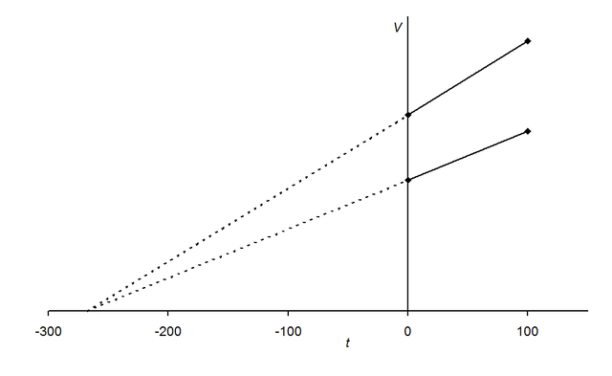
To obtain these results the gas must be ideal (i.e. there must be no interactions between particles)

Slide 16
Charles’ law question
A gas has an initial volume of 50m³ at a temperature of 127ºC. Calculate the final temperature required in ºC to decrease its volume to 20m³ at a constant pressure.
Charles’ law: V₁ / T₁ = V₂ / T₂
Temperatures must be in kelvin, so: T₁ = 400K
50m³ / 400K = 20m³ / T₂
T₂ = (20 x 400) / 50
T₂ = 160K
Final temperature = - 113 ºC

Slide 17
Work done
When a volume of gas is compressed but the pressure is maintained then heat must be transferred
The work done by a piston is therefore:

Slide 18
Summary
There are three measurements on a gas: Volume, Pressure and Temperature
There are three relationships between these variables:
Boyle’s Law
Charles’ Law
The Pressure Law

