Slide 1
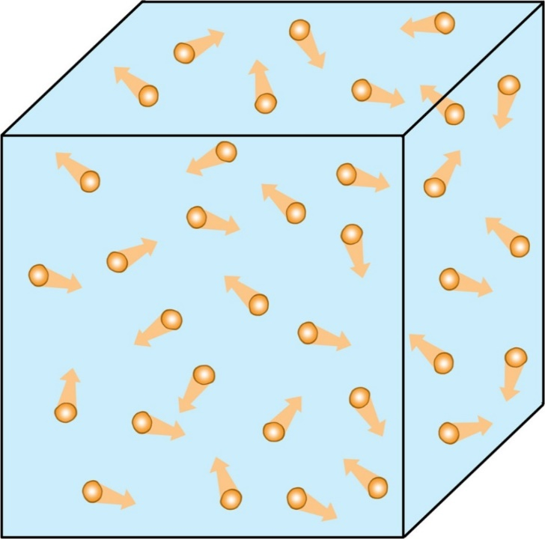
CW | Ideal Gas Law | 04/10/2018
To create a complete model of a gas what information would you need to have?
From my learning today I will be able to:
Key: | to state the three experimental gas laws and the relationships that derive from them
Boost: | describe the experiments and the consequences of the results
Aspire: | use the gas laws to calculate unknown quantities
Objective

Slide 2
Ideal Gases
An ideal gas is one where:
  the particles themselves can be thought of as taking up no volume
  There are no significant forces between the particles
  The motion of the particles is random
If the above conditions are true for a sample then a gas can be modelled using the particle theory (i.e. The position and velocity of every particle is not needed)

Slide 3
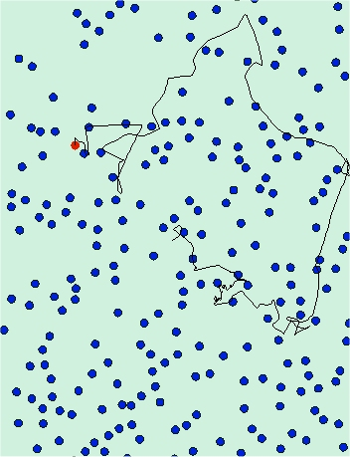
Brownian Motion
The particles in a fluid are always moving and their motion is random
This motion causes pressure when the particles collide with surfaces (and each other)
This motion is also responsible for diffusion of mixtures in fluids

Slide 4
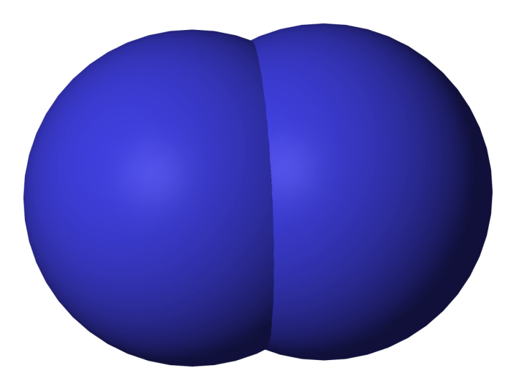

The Avogadro Constant
Because the particles in an ideal gas take up no volume themselves the volume of two gases at the same temperature must contain the same number of particles
At the same temperature one litre of Oxygen will have 16 times the mass as one litre of Hydrogen; they both contain the same number of particles but the mass is O₂ is 16x the mass of H₂

Slide 5
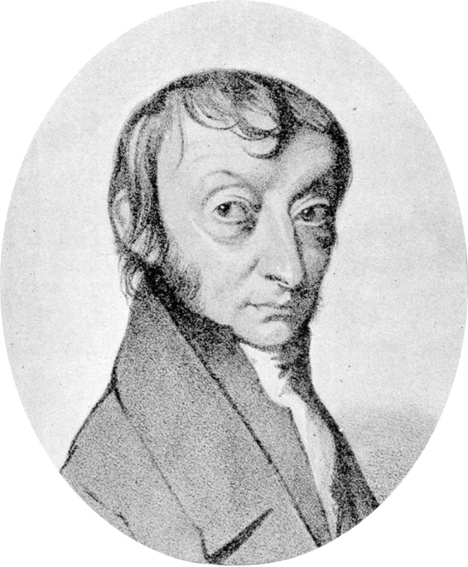
The Avogadro constant is the number Carbon atoms in 12g of Carbon-12
Originally this was the number of atoms in 1g of Hydrogen-1 however it is difficult to get a pure enough sample of Hydrogen-1 without isotopes being present
Amedeo Avogadro
1776 - 1856

Slide 6
Amount of substance, n
The amount of substance is the quantity of a substance measured in moles.
1 mole (mol) = N_{A} (6.023 x 10²³) particles of a substance.
The number of molecules, N contained in n moles of a substance will be given by:
N = n x N_{A}

Slide 7
Molar mass, M
The molar mass of a substance M is equal to mass of one mole of the substance.
The number of moles, n of a substance mass, M_{s} of molar mass, M will be given by:
n = M_{s} / M
Examples of M :
atoms of carbon 12 isotope = 12g
O₂ molecules made up of oxygen 16 = 32g
CO₂ molecules = 44g

Slide 9
The Ideal Gas Equation
You know three gas laws:
  Boyle’s law
  Charles’ law
  The pressure law
Can these three formulae be combined?

Slide 10
Calculating the constant
By plotting pV against T (in Kelvin) for a gas then you get a straight line from the origin
The gradient of this line is found to be nR where n is the number of moles of the gas and R is a constant called the molar gas constant
The formula can then be rearranged to give:

Slide 11
Question 1
Calculate the volume of one mole an ideal gas at 0ºC and 101kPa (standard atmospheric pressure)
pV = nRT
becomes: V = nRT / p
temperatures must be in kelvin, so: T = 273K
= (1 mol x 8.31 J K⁻¹ mol⁻¹ x 273K) / 101 000 Pa
= 0.02246 m³
volume = 22.46 dm³ (cubic decimetres OR litres)
This is also known as ‘molar volume’.

Slide 12
Question 2
A fixed mass of gas has its pressure increased from 101 kPa to 303 kPa, its volume by 5 m³ from 1 m³ while its temperature is raised from 20°C. Calculate its final temperature.
pV / T = a constant
can be written: p₁V₁ / T₁ = p₂V₂ / T₂
temperatures must be in kelvin, so: T₁ = 293K
(101k x 1) / 293 = (303k x 6) / T₂
T₂ = (293 x 303k x 6) / (101k x 1)
final temperature = 5274 K

Slide 13
Question 3
A container of volume 2.0 x 10 ⁻³ m³, temperature 20ºC, contains 60g of oxygen of molar mass 32g. Calculate its pressure.
pV = nRT
becomes: p = nRT / V
where: n = M_{s} / M = 60g / 32g = 1.875 mol
temperatures must be in kelvin, so: T = 293K
p = (1.875 x 8.31 x 293) / 0.002
pressure = 2.28 x 10 ⁶ Pa

Slide 14
The Boltzmann Constant
Another way of using the ideal gas equation is to know the number of particles (usually molecules) instead of the number of moles
This is often more useful to a Physicist whereas the previous formulae is used more by Chemists
The only difference is that the constant is different in the formula:

Slide 15
Summary
A mole of a substance contains the Avogadro constant of particles
The number of moles of a substance is called its molarity (mol)
The ideal gas equation has two forms using either the number of moles n or the number of particles N – care must be taken to use the correct constant in each case

