Slide 1
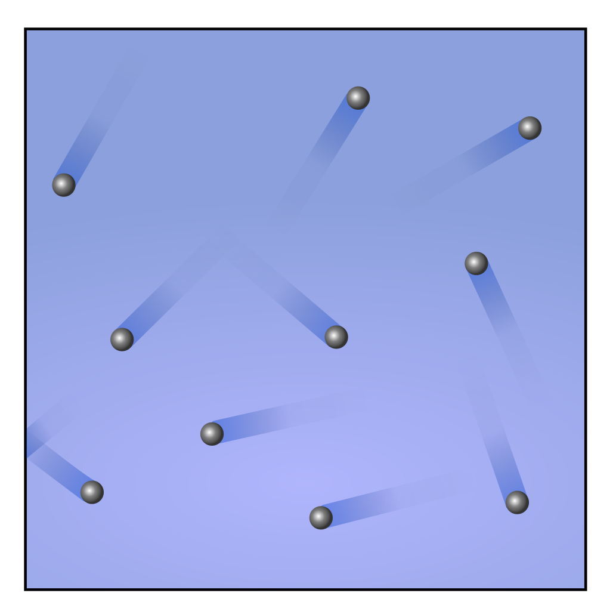
CW | The Kinetic theory of Gases | 18/10/2018
Can you explain the three gas laws using kinetic theory?
From my learning today I will be able to:
Key: | State five assumptions made when deriving the equations
Boost: | Explain the term “root mean square speed”
Aspire: | Apply formulae linking kinetic energy to ideal gas equations
Objective

Slide 2
Explaining the gas laws
The particles in a gas are moving at a variety of speeds
Their movement is random and they collide with the walls of their container, exerting a force which creates pressure
Increasing the temperature increases the velocity of the particles and hence increases the force they strike the container
Reducing the volume reduces the distance travelled between hitting the walls and hence increases the number of collisions per unit time

Slide 3
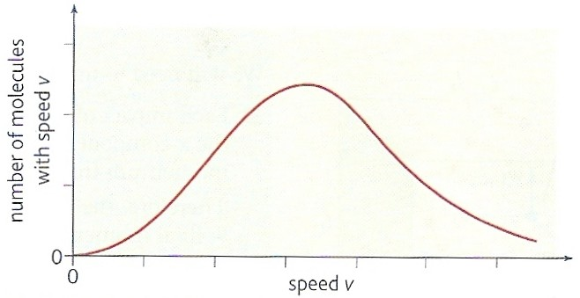
Molecular Speeds
In a gas the molecules are all moving at different speeds however the spread of their speeds is a bell curve.
The speed of an individual molecule may change when it collides with another gas molecule but the distribution of speeds remains the same provided the gas temperature does not change.

Slide 4
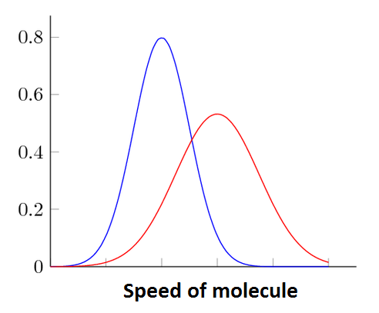
Effect of changing temperature
This graph shows the speed distributions of two gases. The red line would represent a hotter gas.
Note: The area under the lines represents the number N of particles present and should remain constant

Slide 5
Root mean square
A useful average calculation that can be performed on a sample is the root mean square
Square every value, divide by the number of data points N and then square root the total

Slide 6
Question
Calculate the RMS speed of four molecules having speeds 300, 340, 350 and 380 ms ⁻¹.
Squaring speeds:
90 000; 115 600; 122 500; 144 400
Mean of the squares:
(90 000 + 115 600 +122 500 +144 400) / 4
= 472 500 / 4 = 118 125
Root of the mean of the squares:
= √118 125
RMS speed = 344 ms⁻¹

Slide 7
The Kinetic Theory equation
There are five assumptions that have to be made about gases to create a kinetic theory equation:
The particles themselves take up no volume
The is no force of attraction between the particles
Their motion is random
There is no loss of kinetic energy, so collisions are elastic
The length of time of the collisions against the walls of the container are negligible

Slide 8
Derivation of: pV = ⅓ Nm(c_{rms})²
Consider N molecules of an ideal gas each of mass, m in a rectangular box of volume, V of dimensions l_{x}, l_{y}, and l_{z}.
Let u₁, v₁ and w₁, represent the velocity components of one of these molecules in the x, y and z directions, respectively.
The speed, c₁ of this molecule is given by:
c₁² = u₁² + v₁² + w₁²
l_{x}
w₁
l_{z}
u₁
v₁
z
y
l_{y}
x

Slide 9
l_{x}
w₁
w₁
w₁
w₁
w₁
w₁
- u₁
l_{z}
- u₁
- u₁
v₁
u₁
u₁
u₁
v₁
v₁
v₁
v₁
v₁
z
y
l_{y}
x

Slide 10
From Newton’s 2nd law of motion, the force exerted on the molecule during its collision with the box
= momentum change / time taken
= - 2mu₁ / t
= - 2mu₁ / (2 l_{x} / u₁)
= - mu₁² / l_{x}
From Newton’s 3rd law of motion the force, F₁ exerted ON THE BOX is in the opposite direction:
F₁ = + mu₁² / l_{x}
l_{x}
w₁
- u₁
l_{z}
v₁
l_{y}

Slide 11
but: pressure = force / area
therefore the pressure, p₁ exerted by the molecule is given by:
p₁ = force / area of face l_{z}, l_{y}
= (mu₁² / l_{x} ) / (l_{y} x l_{z} )
= (mu₁² ) / ( l_{x} x l_{y} x l_{z} )
= (mu₁² ) / ( V )
The total pressure, p exerted by N molecules is given by:
p = (mu₁² ) / ( V )
+ (mu₂² ) / ( V )
+ (mu₃² ) / ( V )
+ …… (mu_{N}² ) / ( V )

Slide 12
p = m [u₁² + u₂² + u₃² + …u_{N}² ] / V
but the mean value of u² , < u² > is given by:
< u² > = [u₁² + u₂² + u₃² + …u_{N}² ] / N
hence:
p = Nm < u² > / V
As the molecules are moving randomly in all directions it can also be shown that:
p = Nm < v² > / V
and
p = Nm < w² > / V

Slide 13
combining all three:
3p = Nm (< u² > + < v² > + < w² > ) / V
but:
c² = u² + v² + w²
and so:
3p = Nm < c² > / V
3p = Nm (c_{rms} )² / V
3pV = Nm (c_{rms} )²
and so:
pV = ⅓ Nm (c_{rms} )²

Slide 14
Question 1
A container of volume 0.05m³ has 0.4kg of an ideal gas at a pressure of 2.0 x 10 ⁷ Pa. Calculate the RMS speed of the gas molecules.
pV = ⅓ Nm(c_{rms})²
becomes: (c_{rms})² = 3pV / Nm
Nm = mass of the gas
(c_{rms})² = (3 x 2.0 x 10⁷ x 0.05) / 0.4
= 7.5 x 10 ⁶ m²s⁻²
RMS speed = 2 740 ms⁻¹

Slide 15
Question 2
Show that the kinetic theory equation can be written: p = ⅓ ρ(c_{rms})² where, ρ is the density of the gas. Use this equation to estimate the RMS speed of air molecules at 0°C and 101kPa when the density of air is: ρ_{air} = 1.3 kgm⁻³. Comment on your answer.
Proof:
pV = ⅓ Nm(c_{rms})²
becomes: p = ⅓ (Nm/V) (c_{rms})²
(Nm/V) = (mass/volume of the gas) = density
and so: p = ⅓ ρ(c_{rms})²

Slide 16
RMS speed for air:
(c_{rms})² = 3 p / ρ
= (3 x 101 000 Pa) / 1.3
= 2.33 x 10 ⁵ m²s⁻²
RMS speed = 483 ms⁻¹
Comment:
This a little greater than the speed of sound in air at 0°C (330 ms⁻¹)

Slide 17
Molecules and Kinetic Energy
You can calculate the mean kinetic energy of the molecules by simply dividing the total energy by the number of particles, which simplifies to the following:
Another useful formula for this calculation is:

Slide 18
Total Internal Energy
From the previous equation we can calculate the total energy of n moles of a gas at temperature T Kelvin:

Slide 19
Question
Calculate the mean ke of air molecules at 0ºC. Use this answer to calculate the RMS speed of the O₂ and CO₂ molecules. (M = 32g and 44g respectively)
[k = 1.38 x 10 ⁻²³ J K⁻¹; N_{A} = 6.023 x 10²³]
Mean KE:
¹/₂ m (c_{rms} )² = ³/₂ kT
= 1.5 x 1.38 x 10 ⁻²³ J K⁻¹ x 273K
mean molecular ke = 5.65 x 10 ⁻ ²¹ J

Slide 20
Oxygen RMS Speed:
¹/₂ m (c_{rms} )² = ³/₂ kT
becomes: (c_{rms} )²
= (2 x 5.65 x 10 ⁻ ²¹ J) / m
mass of O₂ molecule
= 32g / N_{A}
= 0.032 kg / 6.023 x 10²³
= 5.31 x 10 ⁻ ²⁶ kg
(c_{rms} )²
= (2 x 5.65 x 10 ⁻ ²¹ J)
/ 5.31 x 10 ⁻ ²⁶ kg
= 212 806 m²s⁻²
O₂ RMS speed = 461 ms⁻¹
CO₂ RMS Speed:
mass of CO₂ molecule
= 44g / N_{A}
= 0.044 kg / 6.023 x 10²³
= 7.31 x 10 ⁻ ²⁶ kg
(c_{rms} )²
= (2 x 5.65 x 10 ⁻ ²¹ J)
/ 7.31 x 10 ⁻ ²⁶ kg
= 154 582 m²s⁻²
CO₂ RMS speed = 393 ms⁻¹

Slide 21
Summary
You must be able to discuss the assumptions that make a gas ideal:
The particles themselves take up no volume
The is no force of attraction between the particles
Their motion is random
Their collisions are elastic
The length of time of the collisions against the walls of the container are negligible
The Root Mean Square calculation must be understood (and the difference to a mean calculation)

Slide 22
Summary continued
You must be able to use the following equations to find the pressure, volume, energy and root mean square speed of ideal gases:

