Slide 1
Planning & Liaison required for large scale events
Unit 21 – P5.
https://www.youtube.com/watch?v=wl65SPPrKGQ
https://www.youtube.com/watch?v=8Yz6iYxXjzc
https://www.youtube.com/watch?v=XN2sCwmmhfY
https://www.youtube.com/watch?v=7DyunDQbVa4
https://www.youtube.com/watch?v=bq6zbVLYz54

Slide 2
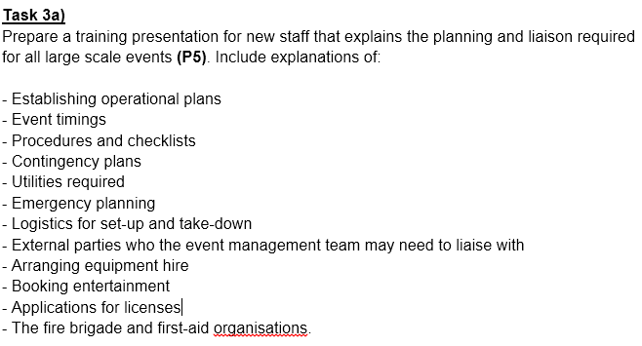

Slide 3
For each section, cover the following:
Describe this area of event planning – what is it and what does it involve?
Why is this task so important to the smooth running of an event?
Explain what could happen if this area of event planning was not carried out effectively.

Slide 4
a) ESTABLISHING OPERATIONAL PLANS
An Operational Plan is a detailed plan used to provide a clear picture of how a team, section or department will contribute to the achievement of the organisation's strategic goals.
Also called “Event Plan” or “Event Management Plan”.
For events, this relates to documenting all relevant factors of the event in advance, then using the plan to coordinate a variety of different tasks (operations) with the common goal of ensuring the event runs smoothly and is a success.
Establishing the final operational plan can take years/months to complete, involving many meetings/liaisons between organisers and third parties until all aspects of the event have been considered and planned.

Slide 5
Operational plans ctd…
Look at these examples:
List the key contents of an Operational Plan.
What other factors should/could be included in an Operational Plan?
Examples:
Operational Plan “Template”
Christian Music Festival
Isle of Wight Festival

Slide 6
B) EVENT TIMINGS
Timings should be considered for the planning phase of an event as well as for the actual event itself.
Planning Gant Charts
Event Planning Timeline
Planning a Timeline for an Event
Key points:
Deadlines: Realistic. Plan around the “unmovable”.
Communication/publishing of schedules for staff is essential, as well as regular progress meetings.

Slide 7
C) PROCEDURE CHECKLISTS
Procedure: a set of actions which is the official or accepted way of doing something.
What procedures will need to be in place/staff trained to follow for a large scale event?
Many procedures relate to Emergency situations (such as?)
E.G: Evacuation, Lost children, Lost property, Security incidents, Traffic management. Each of these should have a checklist of steps for staff to follow if they occur during the event.
Checklists of the steps for each procedure should be made available to the staff involved (these are often written into the operational plan) and staff should be trained (how?) on how to follow the procedures.
Example

Slide 8
D) CONTINGENCY PLANS
Back up plans could be needed for a number of predictable OR unforeseen circumstances.
Examples?
Staff must be made aware of “fall-back” plans for situations such as:
Issues with weather/shelter.
Delays.
Cancellations.
Equipment malfunction.
Staff absence.
Double bookings.
https://www.bbc.co.uk/news/av/uk-england-hampshire-18559510/rain-causes-gridlock-at-isle-of-wight-festival
https://www.bbc.co.uk/news/uk-england-hampshire-22734684

Slide 9
E) UTILITIES REQUIRED
Why are utilities needed?
Electrical supply. How Do Organisers Use Power For Music Festivals? | RubberBox
Water supply. Glastonbury Festival (gpsuk.com)
Sewage. Toilets | Glastonbury Festival (glastonburyfestivals.co.uk)
Waste management: http://www.bbc.co.uk/news/entertainment-arts-23129719
Who do organisers need to contact to ensure utilities are provided?
Glastonbury Festival?

Slide 10
F) EMERGENCY PLANNING
What different “emergencies” could happen at a large event?
Organisers must be prepared to deal with emergency situations, so emergency plans will form a large part of the operational plan.
Risk Assessments.
Emergency procedures in place.
Warnings (visual and audible) to help avoid emergencies.
Health and safety staff and equipment (and training for other staff).
First Aid.
Access.
(You will look at this section in depth for P6)

Slide 11
G) LOGISTICS FOR SET-UP & TAKE-DOWN.
Timings – coordination of contractors all wanting to set up their service (this should be written into the event timeline/schedule).
Examples of contractors who need to set up?
Communication is of key importance – Why?
Set-up must start at a time that allows all necessary equipment/services to be set up (and checked) in time for the start of the event.
Experienced/qualified staff – Health and safety, quality standards.
Access – controlling numbers of contractors/staff on-site (and security clearance).
Take down must be completed by an agreed time with the venue, so should therefore be planned in a similar way as set-up.

Slide 12
H) LIAISING WITH THIRD PARTIES
Third parties are people not directly involved in the event, but have a relationship with the organisers.
Examples of third parties?
Lines of communication with external parties should be kept open before, during and after the event (regarding timings, payments etc.).
Specific staff from the event management organisation may be made responsible for liaising with specific third parties.
Page 11-12

Slide 13
I) ARRANGING EQUIPMENT HIRE
Equipment needs must be calculated and sourced/booked in plenty of time so they are available for the event.
Booking/payments MUST form part of the gannt chart/event time plan.
Examples?
Research should be undertaken to find reliable suppliers, able to guarantee high quality equipment at good value for money, on time.
Once hired, delivery/set-up logistics will need to be arranged.

Slide 14
J) BOOKING ENTERTAINMENT
Client needs (theme, budget).
Research .
Booking and confirmation of dates, to avoid double booking (then marketing).
Communication with entertainment/agents.
Schedules.
Hospitality arrangements.
Additional costs?
Special effects, additional staff etc.
Glastonbury headliners aren’t paid as much as you think | Metro News

Slide 15
K) APPLICATION FOR LICENCES
Licenses must be applied for/in place in time for the start of the event.
Accuracy of application details is vital.
Alcohol
Public Entertainment
The local council will consider/grant licences based on a variety of factors (with the interests of the local community key to any decisions).

Slide 16
L) EMERGENCY SERVICES
Liaison with fire brigade, police, first aid services is important in case they need to attend the event for any reason.
They should be made aware of the event size, details, access points and key staff.
Emergency services can be very helpful during the planning phase, to advise on health, safety and security.
They have the authority to stop the event, so must be consulted to ensure they are satisfied.
If they are required to attend, the festival organisers will have to foot the bill.
Voluntary or Private fire/medical organisations are often used (who have expertise in event safety).

Slide 17
CONCLUSION
Summarise the importance of completing these tasks for:
i) The client
ii) The planners
iii) The customers.

Slide 18
Other Reading
The cost of staging a music festival: 'We spent £30,000 on the waste' | Music | The Guardian

