Slide 1
Blink once on the required letter
Blink twice when the word is formed, like pressing a space bar
Blink rapidly for a mistake
E | A | R | I | O | T | N | S | L
C | U | D | P | M | H | G | B | F
Y | W | K | V | X | Z | J | Q
You have part of a sentence, the whole class will make a complete sentence

Slide 2
This isn’t an easy way to communicate and I hope Gemma isn’t going to make us write an essay like this, let alone a book
This isnt an
easy way to
communicate
and I hope
Gemma isn’t
going to make
us write an
essay like
this let alone
a book

Slide 4
Aesthetics: Concerned with beauty or the appreciation of beauty
How are the elements of film form used to create aesthetic effect in this sequence?
• Does the beauty of this moment in the film also propel the narrative forward?
• Does the narrative pause to allow the spectator to appreciate the aesthetic qualities
of the film?
• Does the decision to create a strong aesthetic effect suggest something about the
film’s key message?
• Is the aesthetic effect in this sequence typical of this filmmaker?
• How is the pace of the film being managed?
• How is the look of the film being created?
• How is sound design contributing to effect and audience response?
• How is choreography of actors within space being exploited?
• How is set design contributing to the film at any given moment?

Slide 5
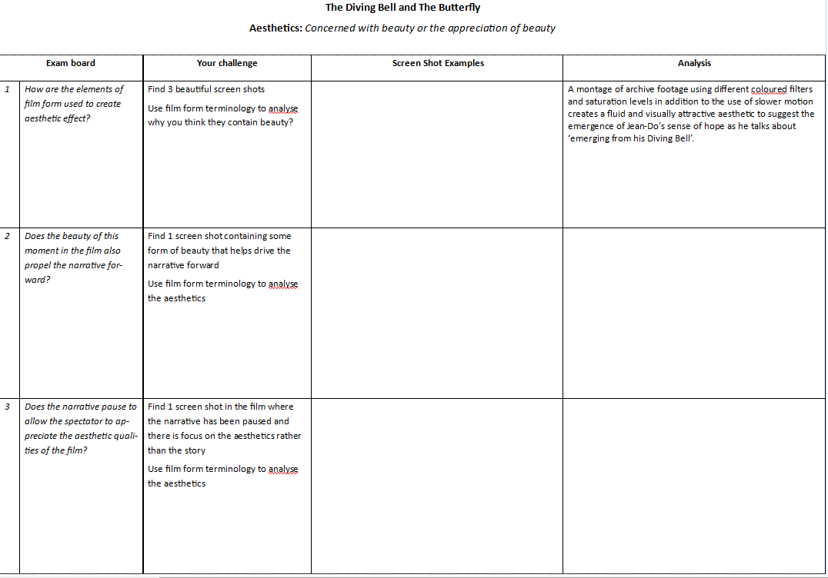
‘ASETHETIC CHALLENGE’ ON GOL
.pub
.docx

Slide 6
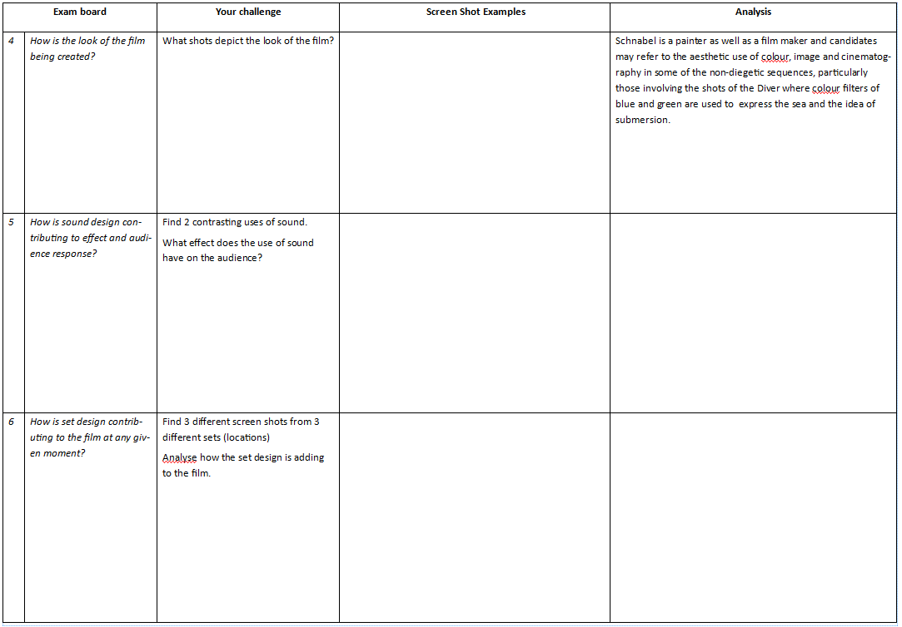
Some general notes/pointers on aesthetics…
The use of in camera techniques (DVD extras)
The obsessive and claustrophobic use of point-of-view
The pauses and escape of the fantasy scenes
The sound perspective, including inner monologue
Lack of non-diegetic sound
The fact that it was shot at the real location, the coldness of the hospital, the freedom of the beach and his fantasy locations

Slide 7
Exam Question
Explore how aesthetic effects are created in your chosen film. Illustrate your answer by close reference to at least one sequence from your chosen film.
In your answer, consider:
What you understand by an 'aesthetic effect’
Examples of how key elements of film form from your chosen film create an aesthetic effect
How an aesthetic effect is created in at least one sequence from your film. [20]

