Slide 1
Assignment D4 Unit 2
Name:
Pin No:

Slide 2
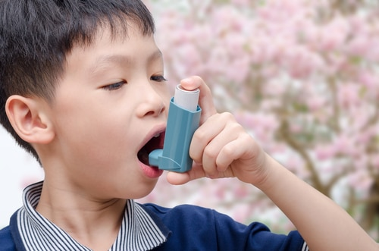
Asthma
How it affects a child’s learning and development:
Physical: It can affect daily activities such as running and exercise because they can become out of breath. It can also affect their sleep.
Intellectual: They may have time off from nursery or school as they are unwell.
Language: If they don’t go to school
Emotional: They might feel isolated and upset and unsure how to manage
Social: It can affect their friendships as the other children may treat them friendly.
Asthma is a condition that causes breathing problems for children.
They will experience shortness of breath, coughing and might feel wheezy.
It happens when the airways in their lungs become swollen and filled with mucus.

Slide 3
Asthma
How it affects a child’s learning and development:
Physical:
Intellectual:
Language:
Emotional:
Social:

Slide 4
Health and Nutrition
How it affects a child’s learning and development:
Physical:
Intellectual:
Language:
Emotional:
Social:

Slide 5
Home Environment
How it affects a child’s learning and development:
Physical:
Intellectual:
Language:
Emotional:
Social:

Slide 6
Autism
How it affects a child’s learning and development:
Physical:
Intellectual:
Language:
Emotional:
Social:

Slide 7
Personality
How it affects a child’s learning and development:
Physical:
Intellectual:
Language:
Emotional:
Social:

