Slide 1
NAME: CACHE PIN NO: Assignment B2 Observation booklet for HARRY

Slide 2
Four Different observation methods to support Harry

Slide 3
Narrative observation
Narrative observations are a good way for the Key Person / Early Years Worker to write down exactly what Harry is doing.
It gives them a chance to get to know him and they can write this observation in detail to really find out how Harry is settling in and what he likes doing at the setting.
You can write a paragraph or more to also look at Harry’s development and his skills that he is doing well and might need help with, such as holding a pencil or feeding himself might be difficult for him at the moment.
Advantage- the early years worker will be able to get know the child well and will be able to build a bond with the child.
Disadvantage- when early years workers does the narrative observation it takes a lot of time that the early years worker might not have

Slide 4
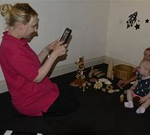
Photograph observation
Photograph observations are a quick and easy way to observe and evidence children’s achievements.
It is important for parents to see and understand how their child is learning and developing. A key person is responsible for making sure children have fun and interesting activities to do, that support them to become confident learners.
The early years worker / key person can take a photo of a child and then annotate underneath the photo to explain the photo and what the child is doing. This helps them plan for their learning and provide suitable next steps. For example, if Harry is able to paint a face shape, then the key person could plan an activity to sketch or draw a face with a body.
These observations are quick and easy to fill out and the parents can see the child is enjoying and learning. There might not be a lot of written detail, but the pictures can be put in a folder or learning journey to show how Harry has settled in and what he likes to do at nursery.

Slide 5
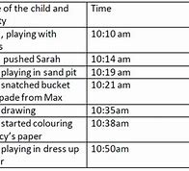
Time sample observation
Time sample observations are good when children are settling in, like Harry. If the key person wants to know what Harry is doing each morning, then they can check and write down the activities he does and how long he stays at them.
Early years workers / the key person can note down times during the day or for a specific amount of time and can change activities to suit Harry if he does not show interest in some of them. For example, if he doesn’t sit in the reading area or go into the role play area, the key person can take a small group in and help them explore and work together.
This is like a quick check of what the child is doing and helps with planning and sharing information with parents and carers.
This observation method is usually quick and provides information that help a key person see what Harry likes or dislikes. They can also pick up on any concerns or behaviour issues such as not sharing .

Slide 6
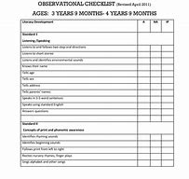
Checklist observation
Checklist observation can be used to find out if Harry has certain physical skills. The children can be given a ball and asked to roll, throw and catch.
Lots of different skills can be ticked off from the list just by observing a child for some time.
It also helps to do this when children start at a setting so that the key person knows their starting point for writing or drawing, holding a pencil, feeding themselves etc…
If Harry does something well the key person will tick it off the list. If they need support or can’t do it confidently, they will make a note that they need practice.
Advantages- its easy for the early years worker / key person to fill out and the early year worker can use the information to show the child’s progress.
Disadvantages- it doesn’t show how quickly or long the child learnt that skill and it don’t show much detail.

