Slide 1
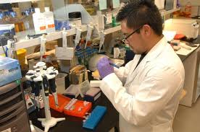
Operations Management: Research and Development
Starter: Which type of companies rely on research and development? Why?
Notes:
Pharma, aircraft and electronics – super important
Car manufacturers, construction

Slide 2
Learning Objectives
Explain what is meant by innovation, research and development
Explain the process of product design and development
Evaluate the costs and benefits of innovation, research and development for a business and its stakeholders

Slide 3
R&D Key terms
Invention: the discovery of something new
Innovation: the commercial exploitation of invention
Product Innovation: bringing a new idea to the marketplace
Process Innovation: bringing a new idea to the workplace
Research: an investigation (enquiry and discovery) used to generate new business ideas
Development: changing new ideas into commercial propositions

Slide 4
QUESTION:
Which industries spend the most on R&D?

Slide 5
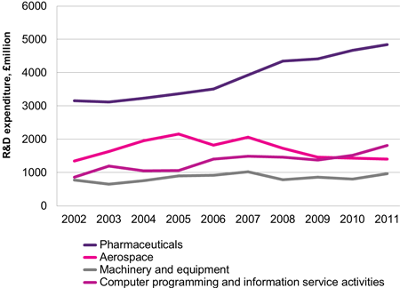
UK R&D expenditure

Slide 6
Purpose of R&D
Solving problems
Developing new products/materials
Improving quality
Reducing costs

Slide 7
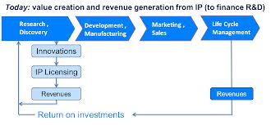
Product design and development process
Identification of problem
Research
Development of ideas and solutions to solve the problem
Development of prototypes
Test marketing
Final design
Testing
Manufacturing
Launch (supported by promotion)
Notes:
From Times case studies

Slide 8
QUESTION: Why is R&D so important to some companies?

Slide 9
Benefits of R&D
Developing unique products (USP)
Provides competitive advantage
Provides long term income
Premium prices
Identifies new opportunities
Motivation for staff
Enhances reputation/image
Benefits consumers with a greater variety of goods and services
Notes:
From Times case studies

Slide 10
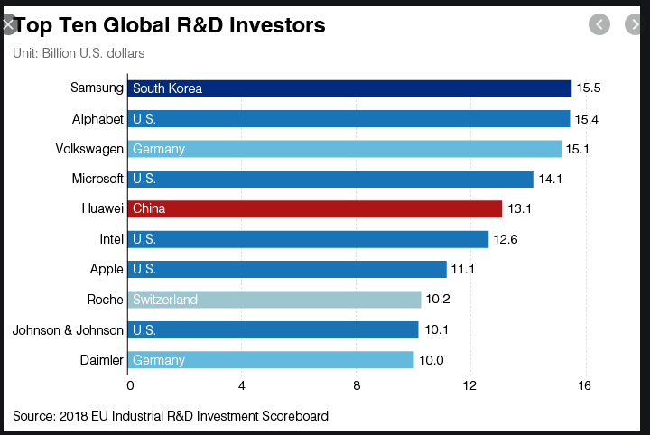
R&D Investment by company Top 10 – How much?

Slide 11
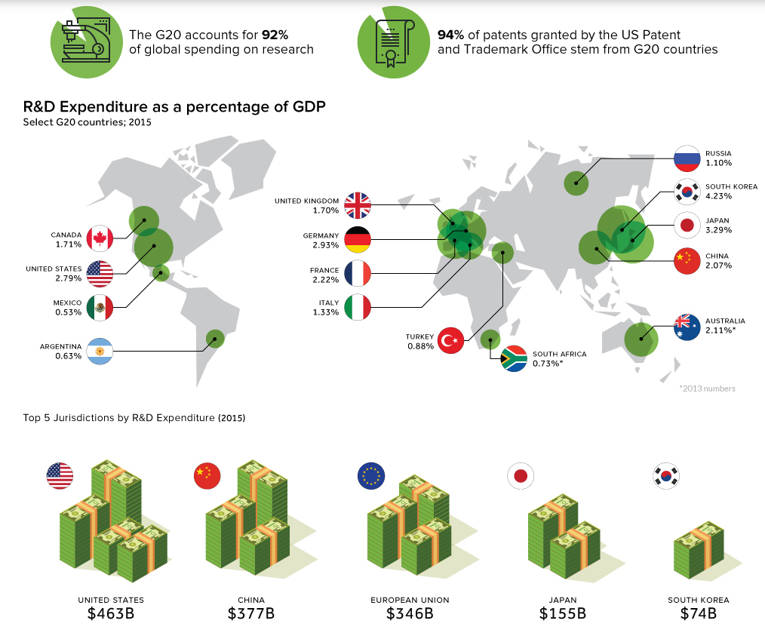
https://www.visualcapitalist.com/global-leaders-r-d-spending/

Slide 12
Challenges and costs of R&D
High financial costs, hard to estimate
Long timescales
Uncertain outcomes
Conditions may change during the R&D process
Reactions of rival companies
Possibility of failure and the associated impact on reputation
Notes:
From Times case studies

Slide 13
Activities
Read pages 538 – 541 of the text book
10 minutes
Answer the questions on the R&D worksheet (these will form your notes for the topic)
15 -20 minutes
Complete the past paper question.
Pay close attention to the structure of your paragraphs
15 – 20 minutes

