Slide 1
A2: Features and Appeal of Destinations
Natural Attractions
Landscape and Topography
Natural Phenomena

Slide 2
Features and Appeal of Destinations
Different destinations will have different features that attract tourists. These include:
Natural attractions, such as landscape and other natural phenomena
The weather or climate, such as snow for skiing or sun for beach holidays
Man-made or built attractions, such as historical buildings or theme parks
Tourist facilities, such as accommodation and entertainment.

Slide 3
Natural Attractions
Different types of natural attraction and landscape features attract tourists as they allow them to admire natural beauty or support activities they may want to take part in.
The landscape and topography of an area is a big draw to tourists. Some of these include:

Slide 4
Landscape and Topography
Beaches are very appealing and are usually a natural attraction (some can be man-made!)
Waterfalls and rivers can be popular tourist destinations, attracting tourists from all over the world.
Mountains are high altitude destinations providing dramatic landscapes with high peaks and deep valleys.
Flora and Fauna - some tourists travel specifically to see a destinations plants and animals.
Natural phenomena are very attractive to tourists, examples include volcanoes, geysers and auroras.

Slide 5
Beaches
Beaches are very appealing and are usually a natural attraction (some though can be man-made!)
Why are some beaches more appealing than others?
What do you look for in a beach?
Can you name me some famous beaches (long haul and short haul - you may Google if necessary!)?

Slide 6
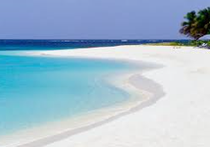
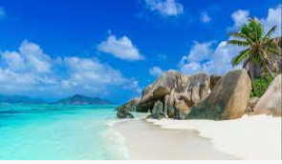
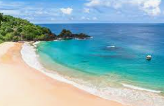
Beaches
Some of the best rated beaches in the world are:
Source d’Argent - Seychelles
Baio da Sancha - Brazil
Shoal Beach - Antigua
Pick 2 famous beaches (one man made & one natural, research and create a PP slide with:
A photo of the beach
A map showing its location
The latitude and longitude of the beach – e.g. 35ºN and 120ºW
A short explanation as to why it is popular
Reference your research source at the bottom of the slide; use this reference tool to help you; https://www.citethisforme.com/
(See Exemplar for layout and content required, and template below)
Once completed, print out your example and place it into your folder, you have 15 minutes

Slide 7
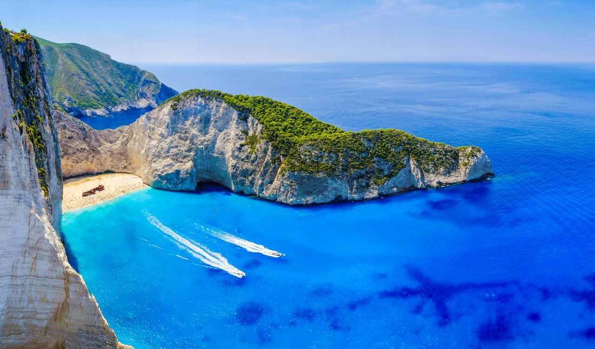
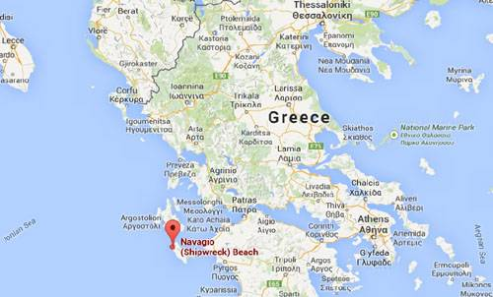
Navagio, Greece
Name - Navagio (Zakynthos Shipwreck or Navagio Bay)
Location - Zakynthos island, Greece
Lat/long - 37o N and 20o E
Why is it popular? - It is a beautiful beach with white sand and clear water. It is known as ‘Shipwreck Cove’ due to a shipwreck which washed up there in 1983. It is the one of the most photographed sites in Greece.
Greekacom. 2021. Zakynthos Navagio (Shipwreck beach) | Zakynthos Beaches | Greeka. [online] Available at: <https://www.greeka.com/ionian/zakynthos/beaches/navagio-or-shipwreck/> [Accessed 20 May 2021].

Slide 8
1.
Name -
Location -
Lat/long -
Why is it popular? –
Reference:
Notes:
Reference here:

Slide 9
2.
Name -
Location -
Lat/long -
Why is it popular? –
Reference:
Notes:
Reference here:

Slide 10
Waterfalls and Rivers
Waterfalls and rivers can be popular tourist destinations in their own right, attracting tourists from all over the world.
What waterfalls and rivers can you name and where are they located?
In groups of 6, take a continent each (except Antarctica), complete and share the PP slide so you all end up with 6 in total. Print these off and place into your folder.
The longest River
The MOST VISITED Waterfall by tourists (plus a photo for both)
Use the templates provided, you have 10 mins…..!

Slide 11
North America
Longest River
Cities and towns on the river?
Image
Most visited Waterfall
Where/Height?
Image

Slide 12
2. South America
Longest River
Key cities/towns on river
Image
Most visited Waterfall
Where/Height?
Image

Slide 13
3. Europe
Longest River
Key cities/towns on river
Image
Most visited Waterfall
Where/Height?
Image

Slide 14
4. Asia
Longest River
Cities/towns on the river?
Image
Most visited Waterfall
Where/Height?
Image

Slide 15
5. Africa
Longest River
Cities and towns on the river?
Image
Most visited Waterfall
Where/height?
Image

Slide 16
6. Oceania
Longest River
Cities/towns on the river?
Image
Most visited Waterfall
Where/Height?
Image

Slide 17
Mountains
Mountains are high altitude destinations providing dramatic landscapes with high peaks and deep valleys, they are popular for activity holidays.
What mountain ranges do you know?
What is the appeal/why do people go there?
What activities do people participate in (think both winter and summer)?
Complete the two tables, print off and put in your folder.

Slide 18
Mountains
What types of holidays are the following destinations popular for? Where are they?
Atlas mountains
Pindos mountains
Cairngorm
Courchevel
St Moritz
Whistler
The Andes

Slide 19
Mountainous areas - Largest Mountain
Continent | Largest mountain - country - height (m) | Mountain Range
Europe | Elbrus - Russia - 5642m | Caucasus
N.America
S.America
Asia
Africa
Australia / Oceania
Antarctica

Slide 20
Mountainous areas - tourist activities
Activity | Example - named area | Country/continent
Rock climbing | El Capitan - Yosemite National Park (watch a movie called the Dawn Wall - amazing) | USA - North America

Slide 21
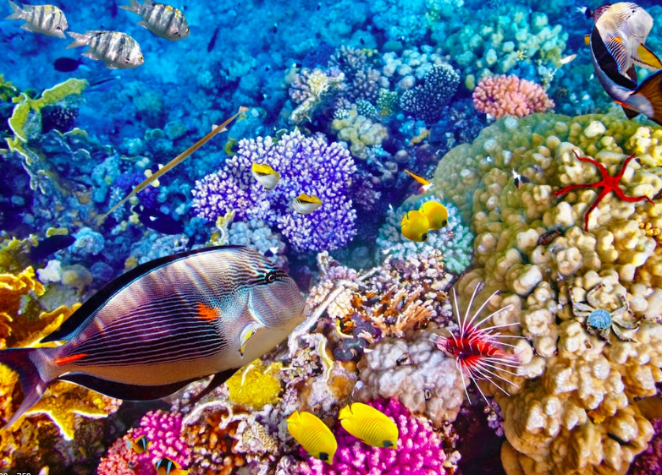
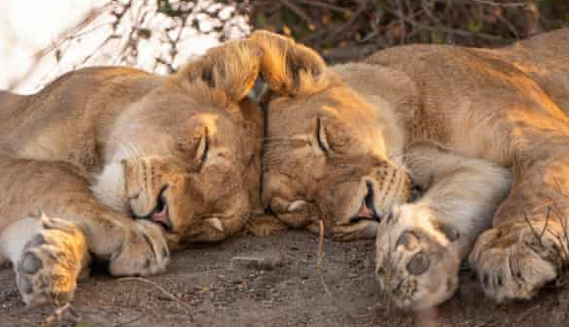
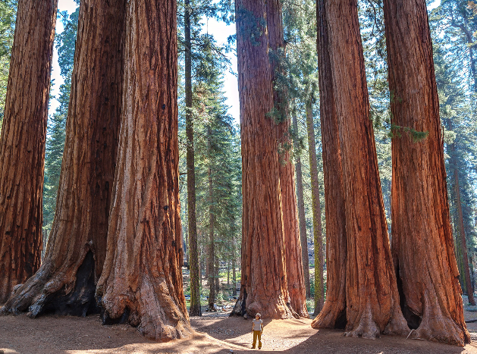
Flora and Fauna
Some tourists travel specifically to see a destinations plants and animals.
What do the terms flora and fauna mean?
What destinations would you visit to see flora and fauna?
What would you do?
What is the appeal?

Slide 22
Bhutan Flora and Fauna
Q.1. Look up definitions and explain the terms:
Flora -
Fauna -
Horticulturist -
Q.3. Find 5 facts about Bhutan
Q.4. How to get to Bhutan from the UK?
Transport -
Company -
Price -
Duration of journey -
Q.2. Map showing Location of Bhutan

Slide 23
Flora and Fauna - Second task
Kuoni is a tour operator specialising in luxury tailor made holidays. Visit the link below to see an example of a holiday offered by Kuoni.
https://www.kuoni.co.uk/kenya/safaris/taste-of-kenya
Answer the following questions based on the itinerary -
What is the capital of Kenya? -
Lake Nakuru National Park is home to how many species of bird? -
Name the Nature Reserve called ‘The most famous reserve in the world’ -
The migration of what animal takes place here between July and August? -
One country bordering Kenya contains the highest mountain in Africa, name the mountain and country -
What type of alternative transport is offered on Day 5, name two advantages of this in a Nature Reserve? -
An additional extra to the trip is a 3 day excursion to an island known as ‘Spice Island’ - which island is this?
The island named above has a UNESCO site called Stone Town - what does UNESCO stand for? -

Slide 24
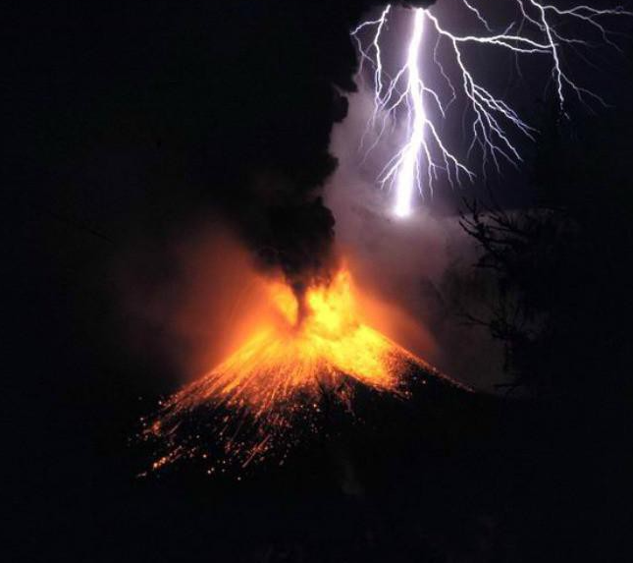
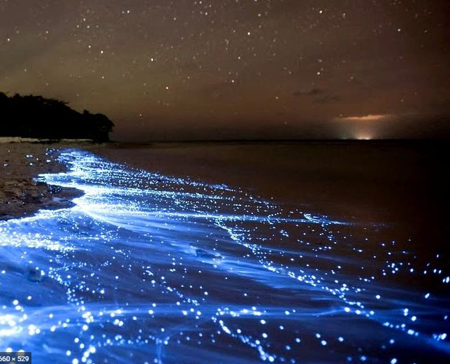
Natural phenomena
Natural Phenomena can be very attractive to tourists. Examples include volcanoes, geysers and auroras.
research and find a European country where you could visit a Volcano, a geyser and see the Aurora Borealis. Add a picture of each feature from the country complete with its name (i.e. name the volcano and geyser).

Slide 25
Natural Phenomena in ____________
Volcano -
Geyser
Aurora Borealis
Best time of year to visit -
Why is it appealing -

Slide 26
PRINT OUT THE FOLLOWING SLIDES AND PLACE IN YOUR FOLDER
2 x Beaches Activity
6 x Waterfalls and Rivers
Mountain Areas – Largest
Mountain Areas – Tourist Activities
Flora and Fauna – Bhutan Activity
Flora and Fauna – Safari Activity
Natural Phenomena Activity

Slide 27
PRINT OUT ALL OF YOUR FEATURED SLIDES AND PLACE INTO YOUR FOLDER; I WILL CHECK NEXT LESSON

