Slide 1
A2: Features and Appeal of Destinations
Lesson 5:
Tourist Facilities and Amenities (their availability and standards).

Slide 2
STARTER…
Facility = a place, amenity, or piece of equipment provided for a particular purpose.
Amenity = a desirable or useful feature or facility of a building or place.
Look at the pictures of facilities/amenities on the next few slides…
- Name the facility/amenity.
- Why are they important for tourism?

Slide 3
STARTER: FACILITIES/AMENITIES
TYPE |  | IMPORTANCE TO TOURSIM
a)
b)
c)
d)
e)
f)
g)

Slide 4
Facilities/Amenities – a)

Slide 5
Facilities/Amenities – b)

Slide 6
Facilities/Amenities – c)

Slide 7
Facilities/Amenities – d)

Slide 8
Facilities/Amenities – e)

Slide 9
Facilities/Amenities – f)

Slide 10
Facilities/Amenities – g)

Slide 11
FACILITIES/AMENITIES - Notes
Introduction | 1) Transport/Communication | 2) Accommodation
3) Events/Entertainment | 4) Local Culture | 4) Facilities for Business/Leisure.

Slide 12
Facilities/Amenities- Introduction
Destinations must offer a RANGE of facilities/amenities to meet the needs of visitors (AVAILIBILITY).
The more limited the range, the less likely the destination will attract tourists, unless…
Some travellers specifically look for under-developed destinations (off the beaten track) – Examples?
It can be part of the appeal to visit somewhere undiscovered/over-developed by mass tourism.
The standard of facilities/amenities can also impact on the appeal of a destination – customers may choose a destination with more luxurious facilities, or modern amenities either as a treat or because they themselves have high standards and expectations.
Unreliable amenities could have a negative impact on someone’s trip, so people may choose a destination to avoid this risk – Examples?

Slide 13
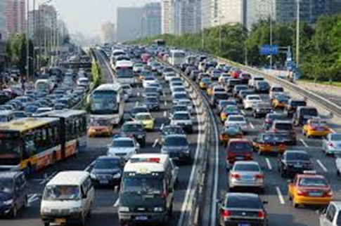
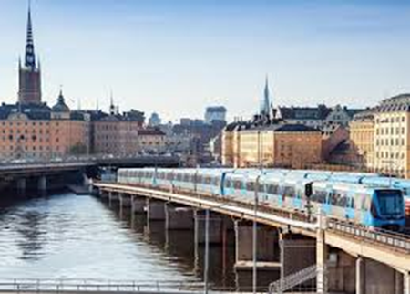
1) TRANSPORT/COMMUNICATION (Infrastructure)
Think about transport IN and AROUND a destination: Examples? (add to your notes).
https://www.youtube.com/watch?v=W9OVoJQT0u0
What aspects of a destination’s transport system will APPEAL to tourists?
Easy to use - Good VFM (deals/saver tickets etc.).
Access to other amenities/facilities. - Reliability.
Comfort - Safety/security.
What are the knock on effects of not having a well-developed transport system?
Limited access to other parts of the destination/attractions.
Economic factors?

Slide 14
1) TRANSPORT/COMMUNICATION
One example of this is the islands of Cape Verde, located 300 miles off the coast of Senegal in the Atlantic Ocean. There are ten islands, but only four have international airports: Sal, Boa Vista, Santiago and Sao Vicente. However, there are poor links from these islands, so it is difficult for tourists to visit the other islands.
How does this impact tourists/tourism?
This means that tourists tend to stay in the hotels near the international airports, having a sun and sand holiday rather than experiencing local culture and benefiting the other islands.
What is the ideal solution?
Local air links and rapid ferry routes would open up the other islands to tourism, and this could improve the tourist experience and benefit the economies of the other islands.
Gillian, Dale. BTEC Nationals Travel & Tourism Student Book.

Slide 15
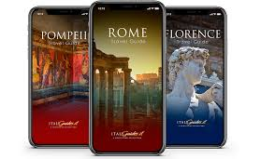
1) TRANSPORT/COMMUNICATION
- Communication systems will be used to provide information to tourists in a destination.
- The quality/reliability/accessibility of the information can make a tourist’s experience more smooth and provide information about attractions that they may be unaware of.
- Examples of communication methods?
https://www.capetown.travel/
Information they can provide for tourists?
Maps - Timetables
Attractions Info - Accommodation etc.
- What problems/barriers may tourists face with communication systems?

Slide 16
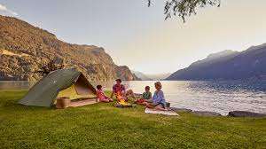
2) ACCOMMODATION
Destinations should offer a range of accommodation to be able to appeal to the numerous different budgets and preferences of their visitors.
REVISION: Different types of accommodation?
Serviced/Non-Serviced?
▸ hotels of different grades
▸ guest houses
▸ bed and breakfast
▸ Airbnb
▸ holiday centres
▸ campsites
▸ self-catering villas.

Slide 17
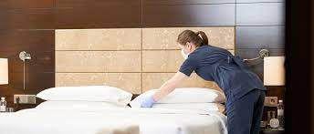
2) ACCOMMODATION
Destinations should carefully plan which types of accommodation they allow to be built (as part of their tourism strategy).
Cheap low-grade accommodation will attract tourists looking for cheap holidays (not interested in appreciating/interacting with the local culture).
This means the wider economy will not benefit (and tourists with more money to spend may be put off visiting the destination).
Watch the following 2 clips – identify the different types of tourists who will be attracted to these destinations:
Dubai Hotels
Phuket – Hostel

Slide 18
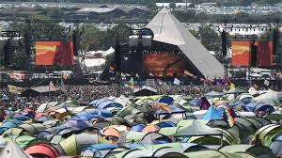
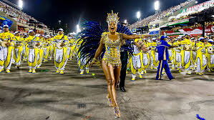
3) EVENTS & ENTERTAINMENT
Different types of events can add to the appeal of a destination – for example?
Sports events
Concerts/shows
State events
Cultural events
Some events will be the main appeal for tourists (with the famous event/destination linked) – for example?
Festivals?
Carnivals?

Slide 19
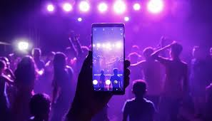
3) EVENTS & ENTERTAINMENT
Many tourists like to enjoy entertainment as part of their holidays OR as the main reason for their visit.
Examples of entertainment enjoyed by tourists? (add to your notes).
Most destinations will offer a range of entertainment/nightlife, but for some destinations the entertainment is the main attraction for some types of tourist.
Examples?
Las Vegas?
Ibiza?
Amsterdam?

Slide 20
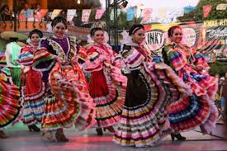
4) LOCAL CULTURE
The opportunity to taste local food & drink, observe and appreciate local traditions and customs can be a huge appeal for some tourists to visit a destination.
Therefore, a destination that offers facilities that allow tourists to do this may attract more visitors.
This type of tourism is also much more likely to bring wider economic benefit to a destination as a whole.
Facilities that offer this opportunity include:
Independent Hotels and Restaurants.
Cultural centres/venues.
Craft shops/demonstrations
Village home-stays

Slide 21
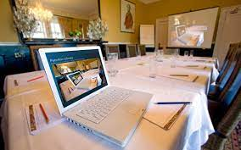
5) FACILITIES FOR BUSINESS/LEISURE
Additional facilities can add to the appeal of a destination that already provides all the essentials for tourists.
Tourists may want to look for additional leisure facilities, even if they are staying in a beach resort (e.g. sports facilities or excursions).
Why?
Business tourists also need specialist facilities (as well as good transport links):
Wi-Fi, teleconferencing, photocopying etc.
Flexible meal times.
Meeting/conference rooms/facilities.
Desks/work areas in rooms.

Slide 22
Facilities/Amenities - Destination Research
Research the different facilities/amenities at your given destination – Use the same destination from last lesson.
1. Paris 2. Berlin 3. Sydney 4. Athens
5. Barcelona 6. Prague 7. Moscow 8. New York
9. Tokyo 10. Toronto 11. Los Angeles 12. Madrid
13. Beijing 14. Rome 15. Cairo 16. Istanbul
17. Dubai 18. Amsterdam 19. Bangkok 20. Brussels
- Complete the table on TEAMS, listing facilities/amenities for each of the 5 categories.
How important do you think the facilities/amenities are for the tourism industry in your destination?
Provide an explanation for your opinion.
Notes:
Reference here:

Slide 23
Destination Research – Facilities/Amenities
Name of Destination: Importance of “Facilities/Amenities” to tourism there? | 1) Transport/Communication | 2) Accommodation
3) Events & Entertainment | 4) Local Culture | 5) Business/Leisure Facilities

Slide 24
Key Terms – Facilities/Amenities
Key Term | Meaning
Facility
Amenity
Infrastructure
Internal Flights
Serviced Accommodation
Non-Serviced Accommodation
Village Home-stays

Slide 25
Complete any unfinished work for homework, upload to Teams.

