Slide 1
Stages of Development as a Tourist Destination
What is the Tourist Area Life Cycle?

Slide 2
Stages of development as a tourist destination
In 1980 R.W.Butler developed a model known as the Tourist Area Life Cycle (TALC)
This can be used to help us understand how tourist destinations develop and evolve. The model can not be applied to all destinations, but is useful in planning and shows how destinations can be viewed as finite resources (limited in its size or lifespan).

Slide 3
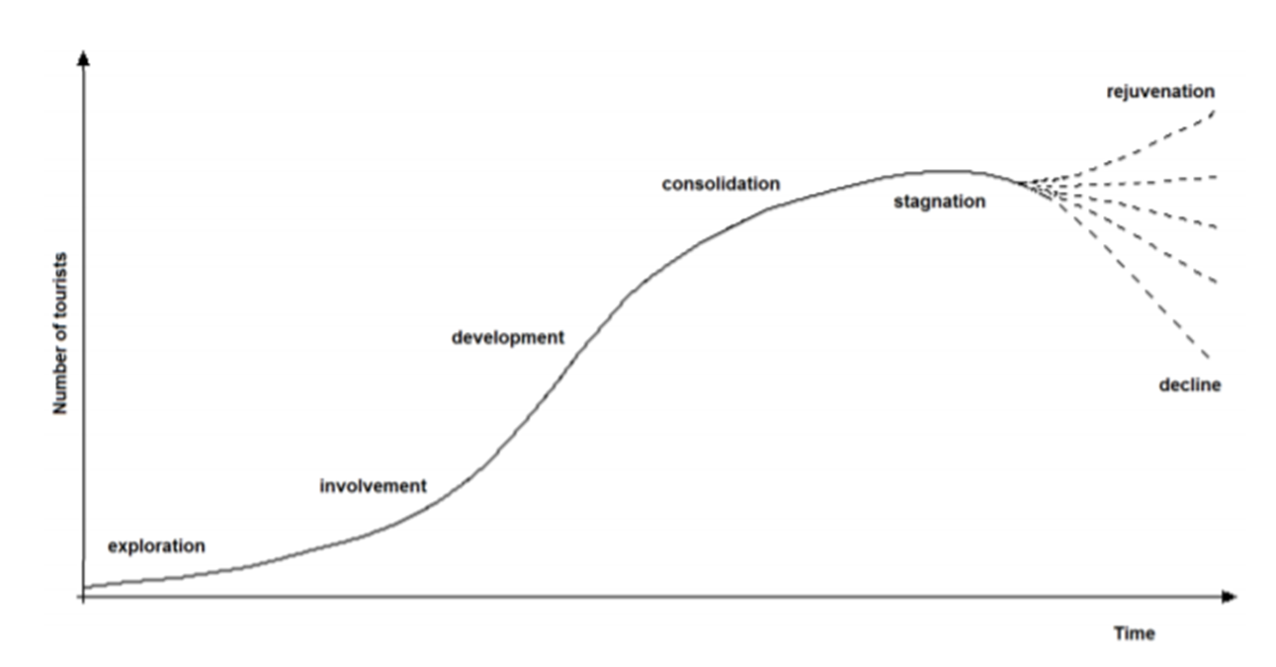
Tourist Area Life Cycle (TALC) - Butler

Slide 4
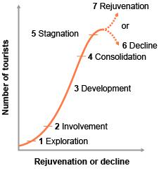
Exploration
The seven stages of tourist development
A small number of tourists visit the area. The area is unspoilt and few tourist facilities exist.
People who visit are likely to be termed “travellers” as they are the people looking for new adventure and new experiences.
Travellers will have booked their own independent transport and their impact is low.
Local cultures and attractions will remain largely undisturbed.
Travellers like to explore and immerse in local cultures, foods and language. They do not like to associate themselves a tourists.

Slide 5
Involvement
The seven stages of tourist development
Local people start to provide some facilities for tourists. There starts to become a recognised tourist season.
Travel companies start to organise transport links and tourist numbers increase.
Local government starts to investigate how tourism can be developed
Local investment in facilities and infrastructure
Advertising the tourist destination may start

Slide 6
Development
The seven stages of tourist development
The host country starts to develop and advertise the area. The area becomes recognised as a tourist destination.
Rapid growth in the number of tourists and many arrive as part of organised tours.
Private companies move in and take control of the tourist market.
Infrastructure and appearance of the destination will be different. Large build projects more likely to provide accommodation, facilities and attractions.
Local government role needs to protect local people and ensure sustainable tourism development.
Heavy advertising and distinct tourist seasons

Slide 7
Consolidation
The seven stages of tourist development
Tourist numbers are still growing, but not so rapidly.
Local population may have become resentful of the tourists rather than expressing an interest in the visitors.
Extensive advertising to extend the tourist season and attract more tourists.

Slide 8
Stagnation
The seven stages of tourist development
This is the stage of mass tourism. Peak tourist numbers have been reached and the tourists are likely to look for the same experience as they would have at home but possibly with a better climate
Mass tourism at its worse can attract all-inclusive tourists who ignore local culture and food.
Tourists expect locals to speak English and go out on organised tours and not use local transport.
The environment may be spoilt or hidden by man made attractions
Problems and negative impacts of tourism are evident. The destination is commercialised and overcrowded.
The destination is a described as a mature destination and cannot attract more tourist or sustain current numbers.

Slide 9
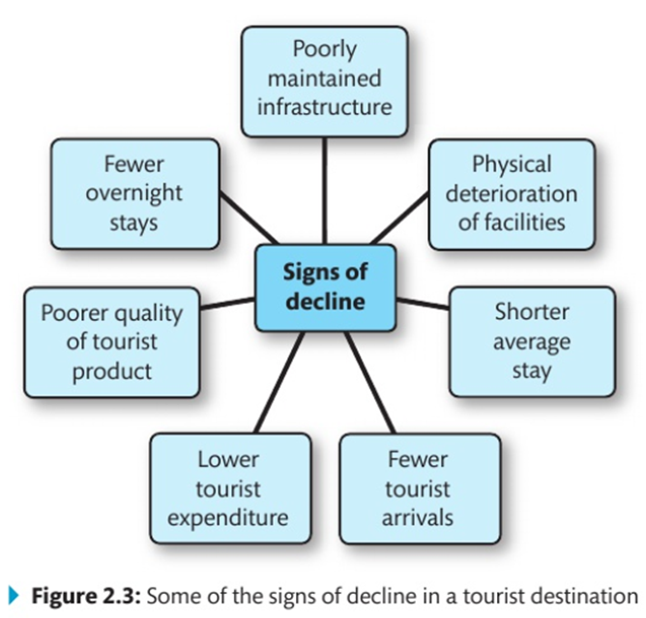
Decline
The seven stages of tourist development
At this stage some tourist facilities start to close or fall into disrepair as tourist numbers decline and go elsewhere. In a worse case situation the tourism industry may fail completely

Slide 10
Rejuvenation
The seven stages of tourist development
If action is taken, destination managers can avoid a complete decline.
The resort can be rejuvenated with large amounts of investment and total redevelopment which can include sustainable tourism strategies.

Slide 11
CLASSIC EXAMPLE
Blackpool

Slide 12
Blackpool
Why did most people holiday in places like Blackpool up to the 1960s?
Then and Now….?
Where would you have placed Blackpool on the TALC model in the 1950’s?
Where do you think Benidorm would be now on the TALC model?

Slide 13
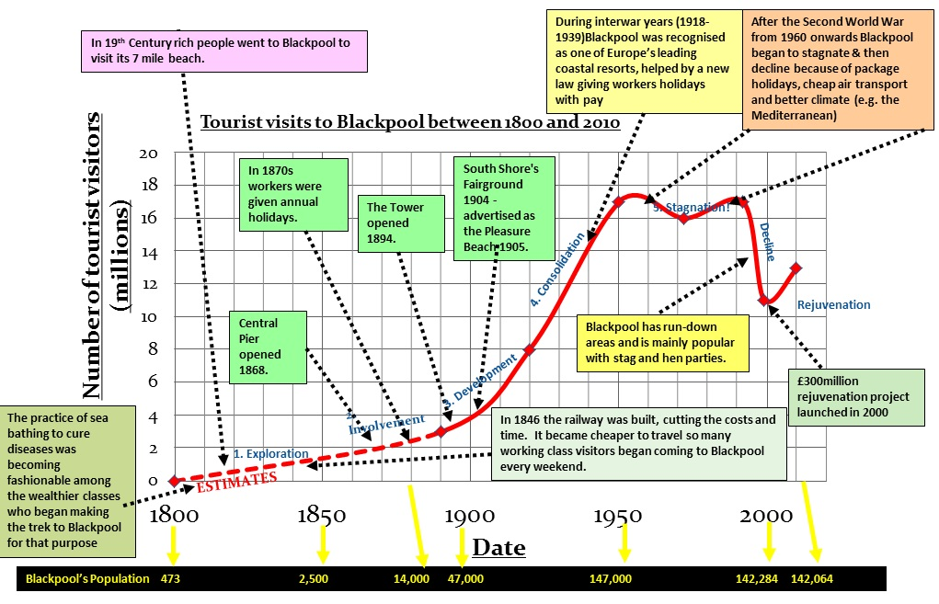

Slide 14
Where would you place the following? Use the blank model and plot…. Be ready to justify your answers
Australia (Sydney)
UK (London)
Japan (Tokyo)
Cap Verde
Jamaica
Antarctica
The Falkland Islands
Kenya
Kyrgyzstan
Tunisia
Vietnam
Nepal
Dubai
South Africa (Cape Town)
Spain (Benidorm)
Puerto Rico
USA (New York)
Romania
Egypt
New Caledonia (South Pacific)

Slide 15
Over to you – Slides Presentation task!
Applying this model to destinations is not an exact Science, I would like you to -
Pick a location for each stage (look back at our choices before)
Do some research of your chosen location, and justify why they are at this stage in the TALC model
Include some pictures of your location which justify its position in the model
Include one or two useful links to tourism related sites for that location, where you have found your information.

Slide 16
Exploration
Location:
Justification:

Slide 17
Involvement
Location:
Justification:

Slide 18
Development
Location:
Justification:

Slide 19
Consolidation
Location:
Justification:

Slide 20
Stagnation
Location:
Justification:

Slide 21
Decline
Location:
Justification:

Slide 22
Rejuvenation
Location:
Justification:

Slide 23
Case Study
Go onto GOL and read all of the TALC handouts and the case study examples of Sitges and Callafel.
Be prepared to be quizzed about it in the next lesson.

Slide 24
BIG IMAGE
Kyrgyzstan

