Slide 1
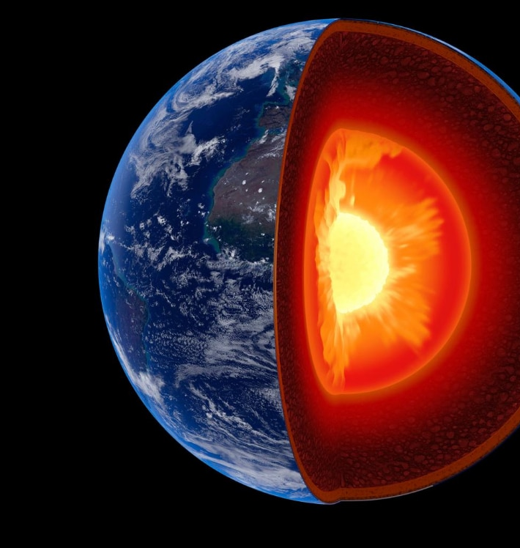
3.1.5.2 Plate tectonics
Earth structure and internal energy sources. Plate tectonic theory of crustal evolution: tectonic plates; plate movement; gravitational sliding; ridge push, slab pull; convection currents and seafloor spreading.

Slide 2
Use the following link to help label the diagram below of the structure of the earth and complete the table to show the properties of continental and oceanic crust. http://www.coolgeography.co.uk/A-level/AQA/Year%2013/Plate%20Tectonics/Plate%20tectonics/Tectonics.htm
 | Continental crust | Oceanic crust
Thickness
Age
Density
Composition

Slide 3
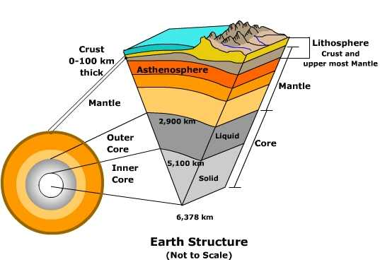
What is the difference between the lithosphere and the asthenosphere?

Slide 4
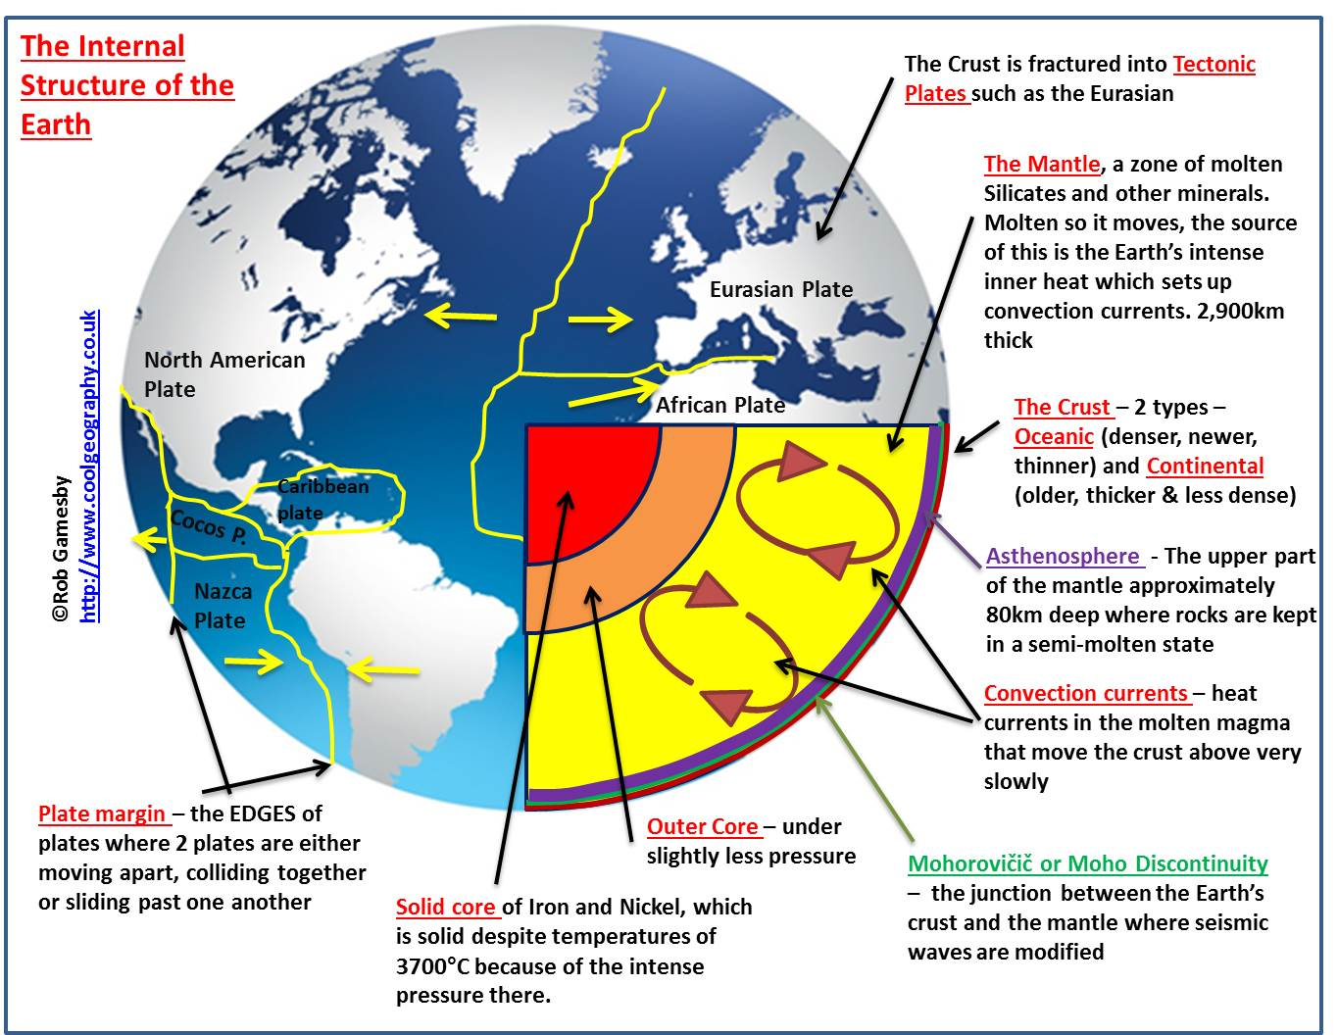
Add any other information to your diagram from the slide.

Slide 5
The importance of the core as a source of energy
The core’s internal heat is the major cause of the Earth’s activity. Some of this heat may be primeval – retained by the ball of dust and gas from which the Earth evolved. But we now know that by far the greatest source of heat energy within the Earth is derived directly from radioactivity. Natural radioactive decay of uranium, thorium, potassium and other elements provides a continuous but slowly diminishing heat supply. The Earth is a vast nuclear power station!

Slide 6
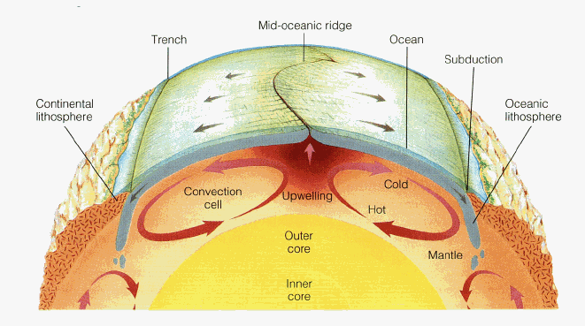
Whilst scientists are agreed that the plates move they continue to debate the mechanisms which drive the movement.
Until recently, the dominant theory suggested the heat from the core was transferred to the Earth’s surface via large convection currents in the asthenosphere. The heated magma spreads out under the lithospheric plates and begins to cool which cause them to become denser and start to sink downwards.
However, many scientists do not believe that convection explains the massive forces needed to move the plates. Instead they have suggested two alternative hypotheses; gravitational sliding - ridge push and slab pull.

Slide 7
Wegener’s theory
What is it?
https://www.youtube.com/watch?v=RA2-Vc4PIOY – Video clip on Alfred Wegener’s theory of continental drift.

Slide 8
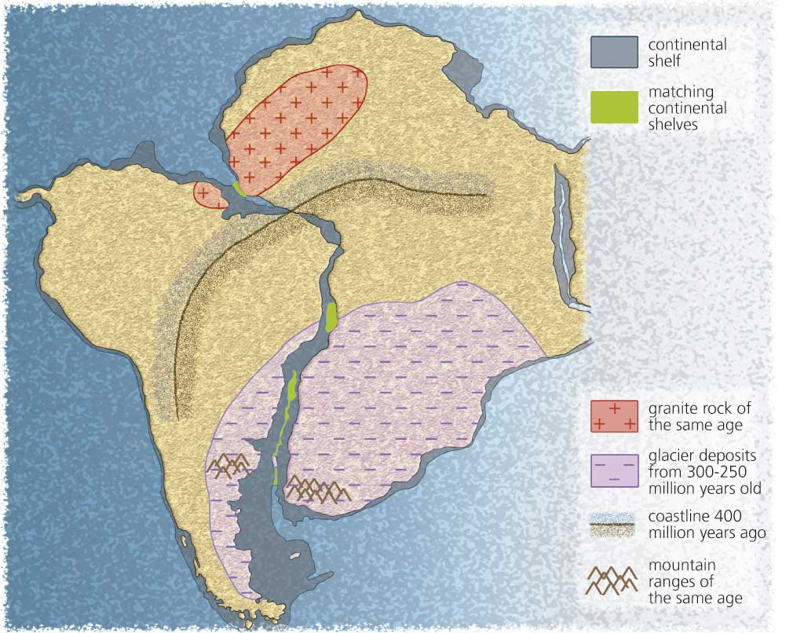
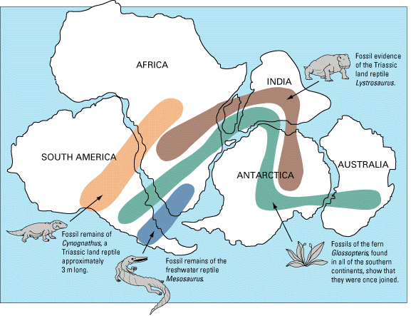
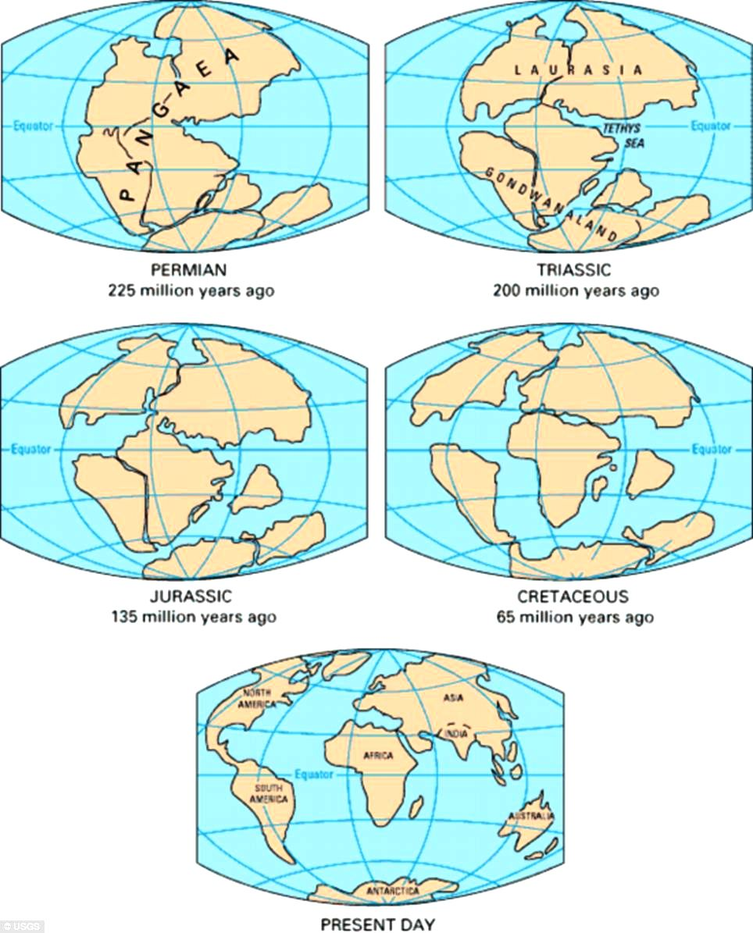
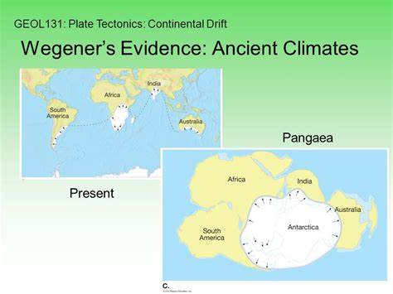
Explain how each of these images provide evidence for Alfred Wegener’s theory

Slide 9
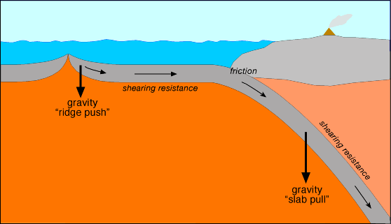
Ridge-push (gravitational Sliding) and slab-pull.
Scientists believe that it is not convection currents alone causing plate movement. Two further ideas have become accepted mechanisms for plate movement: ridge push (gravitational sliding) and slab pull.
Ridge push = at spreading centres where plates are moving apart, such as the mid-Atlantic ridge.
Slab pull = at subduction zones where one plate is pulled down into the mantle.

Slide 10
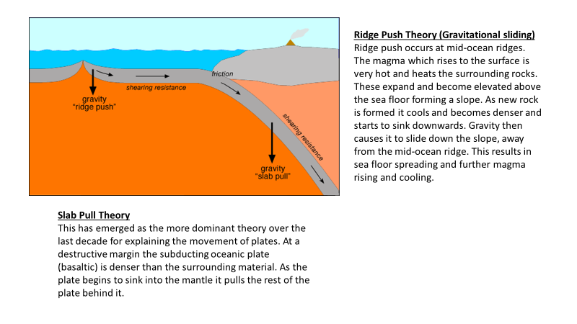
https://www.youtube.com/watch?v=kwfNGatxUJI – video clip explaining the ridge push and slab pull theories

Slide 11
Exam Question: Outline the process of slab pull in relation to plate movement (AS 2018)

Slide 13
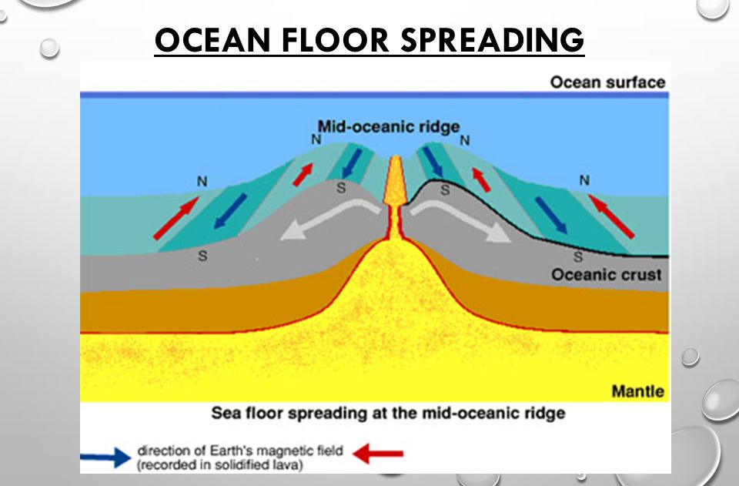
Evidence of sea floor spreading
Harry Hess, an American geologist studied the age of the rocks on the floor of the Atlantic Ocean, finding that the youngest were in the middle (Iceland) and the oldest nearest the USA and the Caribbean.
The rate of spreading is estimated to be at 5cm per year. This has been confirmed by palaeomagnetism.
Every 400,000 years or so, the Earth’s magnetic field switches polarity, causing the magnetic north and south poles to swap. Magnetite (iron oxide) in lava erupted onto an ocean floor records the Earth’s magnetic orientation at that time. Sea floor spreading from mid-ocean ridges is shown by mirror-images patterns of ‘switches’ or reversals.
https://www.youtube.com/watch?v=GyMLlLxbfa4 – Harry Hess

Slide 14
Comment on the extent to which the features shown in the image support the theory of plate tectonics
Jigsaw fit of land either side of the Atlantic Ocean – look at the continental shelf
Mid Atlantic Ridge is equidistant from Europe/North American
Fault lines radiate from the MAR – evidence of pressure being released from movement
Does it feel perfectly? Any anomalies? What could cause these? Hotspots?

Slide 15
How does the alternate banding of normal and reverse magnetism of the oceanic crust support the theory of plate tectonics?
Response should show knowledge and understanding of crustal formation at Mid Oceanic Ridges leading to/associated with sea floor spreading i.e movement away from ridge/ divergence.
New crust aligned with prevailing magnetic field, periodic changes of earth’s magnetism every 400,000 years.
Alternate symmetrical banding at increasing distances from MOR- mirror image.

Slide 16
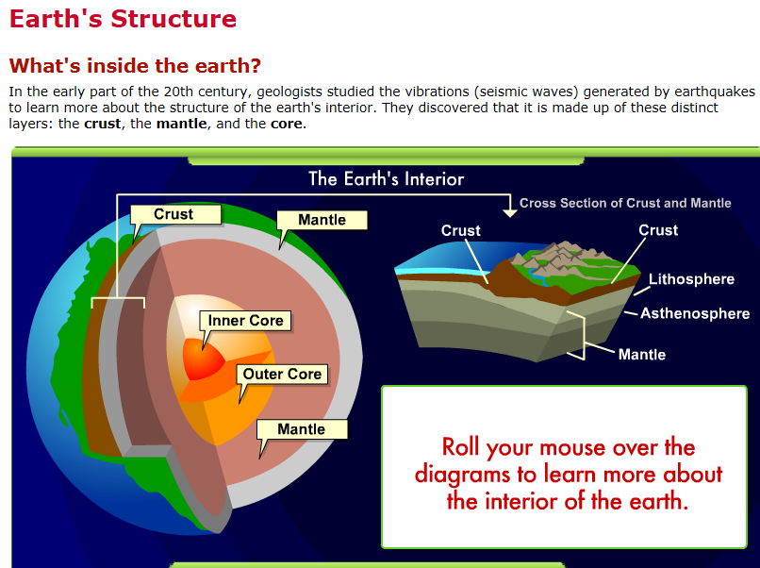
https://www.learner.org/interactives/dynamicearth/index.html
An excellent interactive website. Complete the activities in the introduction, earth structure and plate tectonics section.

Slide 17
Review questions
What are the characteristics of the core, mantle and crust?
What is the difference between the lithosphere and the asthenosphere?
What are the internal sources of heat?
How are oceanic and continental plates different?
What evidence is there for continental drift?
What did Harry Hess discover?
What are convection currents and how do they move plates?
Explain the theories of ridge push and slab pull.
How does paleomagnetism explain the concept of sea floor spreading?

