Slide 1
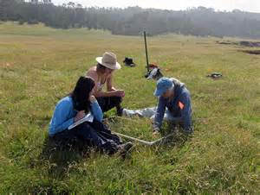
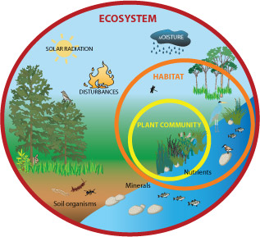
3.7 Research methods
3.7.1 Scientific methodologies and
3.7.2.1 Quantitative measures and abiotic factors

Slide 2
Investigation design
When designing an investigation, data collected must be relied upon to be able to draw valid conclusions.
The table on the next slide outlines the various qualities that a good investigation must have taken into account.
Most environmental investigations will need to measure both biotic and abiotic factors.
All investigations must have an appropriate risk management.

Slide 3
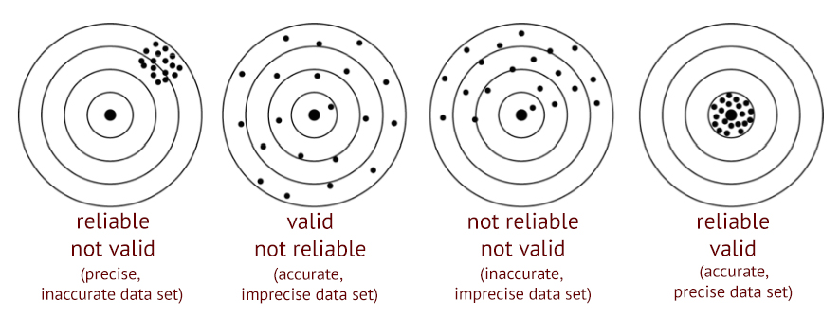
Quality | Explanation
Accuracy | A measure of how close to the true/real value the recorded data is
Bias | Deviation from results either due to systematic errors or flaws in study design leading to flawed data or data collection
Precision | Intervals between possible recorded results. E.g. measuring in milligrams rather than grams
Representative data | Data that accurately reflects the complete data set
Reliable data | Provides consistent results that are repeatable. Reliability can be achieved with repeat measurements
Anomalous results | A result that differs from other results in a data set. Repetition of the study will identify anomalous results
Validity | If accurate, precise and reliable data is collected then it is valid and conclusions can be based on results.
Dart board analogy to explain reliable, precise, accurate and valid results

Slide 4
Ecological monitoring
Ecological monitoring is an important part of wildlife conservation programmes. A good investigation may be used to do the following:
Find species richness in an area
Monitor habitat conditions and see how they change
Monitor features of populations such as;
Population size
Age structure
Growth rate
Breeding rates
Territory size
Population movements

Slide 5
Scientific method
Pairs – list the main stages of any scientific investigation
3 mins
Identify topic of interest
Literature search to find out what is know already
Construct hypothesis
Design experiment
Carry out experiment to test hypothesis
Analyse results and make conclusions
Develop the study further and plan further research

Slide 6
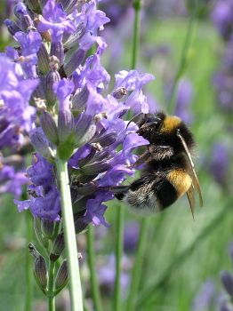
Hypotheses and Statistics
Once a scientist has identified what they want to research they will propose a hypothesis.
A hypothesis is an explanation you can test statistically.
E.g. A hypothesis could be that a particular species of bee prefers to visit purple flowers. This could be based on the observation that there is a difference in the number of visits the bees make to purple flowers. If found to be likely, then conservationists may choose to plant more purple flowering plants to help the bees survival.
Science can actually never prove anything with absolute certainty but using statistical tests on data obtained in an investigation, we can see if the results were because of chance or likely to be significant.
A hypothesis is the explanation you think is behind an observation. To show a scientific hypothesis to be true, you need to:
1. Write a null hypothes. This is a statement that says there is no effect or no relationship between variables or populations (it is the ‘non-event’ of the hypothesis)
2. Show that the null hypothesis is false. (This is done through a statistical test)

Slide 7
Hypotheses and Statistics
For our hypothesis above: a particular species of bee prefers to visit purple flowers.
The Null hypothesis would be: There is no difference in the number of visits the bee makes to purple and other colours of flower
A stats test will give you a probability of your results being significant or not. If the probability is too low then the null hypothesis is accepted and the researchers assume that no link exists and result are due to chance or other unknown factors.

Slide 8
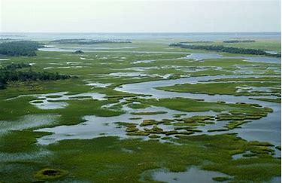
Null Hypotheses Practice
Investigation 1:
How does the position within the salt marsh (lower, middle and top) affect the species diversity.
The top of a salt marsh will only be covered in salty water for a short time whilst the bottom for longer. Plants in salty water need special adaptation to survive.
Hypothesis: There is more species diversity in the top area of a salt marsh compared to the lower area.
Null hypothesis: There is no difference between the species diversity of plants found on the lower, middle and upper areas of the salt marsh.
Notes:
Salt marshes are tidal regions on the coast where the flora are covered in water for different times during the tidal flow depending on the position of the marsh.

Slide 9
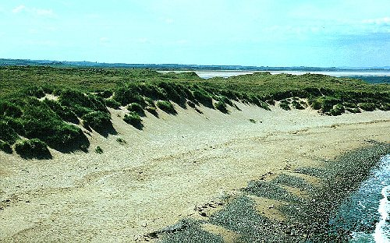
Investigation 2:
How does the distance from the shoreline affect the diversity of species found on a sand dune.
Hypothesis: There is a correlation/link between the distance from the shoreline and the diversity of species found on a sand dune.
Null hypothesis: There is no correlation/link between the diversity of species found on the sand dune and the distance from the sea shore.

Slide 10
Investigation Planning
What key planning decisions on data collection do you need to make before you write an investigation plan?
Data decisions

Slide 11
Remember - good scientific research needs good planning
Location of sampling sites – random or systematic sampling
Timing of sampling – dependent on variables being measured
Count – what data are you counting, measuring, identifying
Number of samples – for a representative mean
Size of sample – variables measured that differ a lot need larger samples
Standardised sampling techniques – allows comparison
Statistically analysis
Design a mnemomic to remember these planning stages
5 mins
Lazy Tigers Can Never Stop Sniffing Snow

Slide 12
Think about the following when planning
Random
Sample location
Systematic
Stratified
Number of samples
Sample size
Representative data
Standardises sampling method
Timing
All at the same time
Range of occasions
Use of preliminary studies

Slide 13
Investigating populations
Environmental scientists need to know population sizes (i.e. counting numbers of individuals from samples) to:
Study the dynamics of a population
Look at the distribution of the members of a population to see if they are influenced by a biotic or an abiotic factors
Impact assessments (measuring effects of disturbance from changes in ecosystems)
Restoration ecology (restoring ecological systems that have been damaged)
Set harvest limits on commercial and game species (e.g. fish, deer, etc.)
Controlling pest populations
DIFFICULTIES
It can be difficult or simply not possible to count all of the individuals in the target area.
SOLUTIONS
Need to estimate population size using some form of sampling technique.
There are numerous types of sampling techniques. Some are designed for specific types of organisms (e.g. non-mobile vs. mobile animals).

Slide 14
Preliminary Studies
Once a hypothesis has been decided and an experiment designed a preliminary study is used to test the reliability of the methods chosen.
Investigations can be time consuming and expensive so preliminary experiments can give an idea whether or not the entire experiment is worth performing.
It will give information about the success of the sampling techniques chosen plus the size and number of samples to be taken in order to get valid results.

Slide 15
Sampling
The object is to collect as many randomly selected samples as possible (so as to increase the proportion of the total population sampled) within a sensible time frame.
The accuracy and reliability of an estimate increases with the number of samples taken. This is because the number of individuals found in any given sample will vary from the number found in other samples. By collecting numerous samples, the effect of these variations can be averaged out.
Sampling should be done to avoid biasing the data. Bias can be caused by deliberate selection of locations for convenience or to support or dismiss a hypothesis. Such biases can cause the population size to be either over estimated or under estimated, and can lead to erroneous estimates of population size.
To avoid bias, sampling is:
Random sampling
Systematic sampling
Stratified sampling (not on your specification)

Slide 16
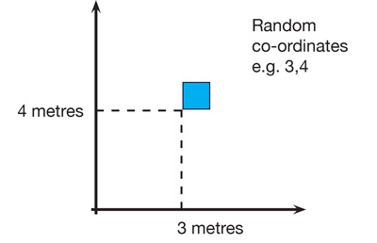
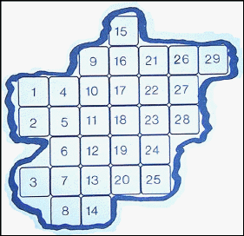
Sample location - Random Sampling
The principal assumptions of this technique are that samples taken are representative of the population as a whole.
Method
Lay out 2 long tapes at right angles in the study area
Obtain a series of coordinates by using randomly generated numbers taken from a table or computer
Place a quadrat at the intersection of each pair of coordinates and the number of individuals of the target species is then counted in each of the chosen quadrats.
Different ‘axes’ made with tapes may be done in different areas to collect more samples
If the sample area is an irregular shape then numbers can be allocated and then chosen at random with a random number generator
Random sampling with a frame quadrat video
http://www.bing.com/videos/search?q=using+quadrats&&view=detail&mid=45D8E03FDC5EF69EC1E545D8E03FDC5EF69EC1E5&FORM=VRDGAR

Slide 17
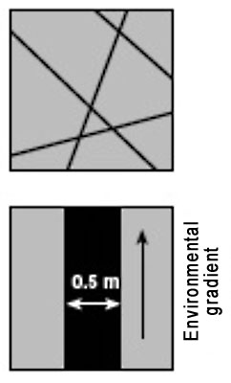
Sample location - Systematic sampling
To investigate changes in habitats (where there is an environmental gradient) or along lines of succession (sand dunes, rocky shores) systemic sampling is more appropriate.
Transects are used:
Line transect - records all of the species which actually touch the rope or tape stretched across the habitat. A lot of organisms could be missed out = less representative.
Belt transect – a frame quadrat is laid down along a straight line and species recorded in the transect
Interrupted belt transect - records all those species present in a number of quadrats places at fixed points along a line stretched across the habitat.
Line Transects
Belt Transects
Line transect video
http://www.bing.com/videos/search?q=using+quadrats&&view=detail&mid=48C6E5A75A89FB9823BB48C6E5A75A89FB9823BB&FORM=VRDGAR

Slide 18
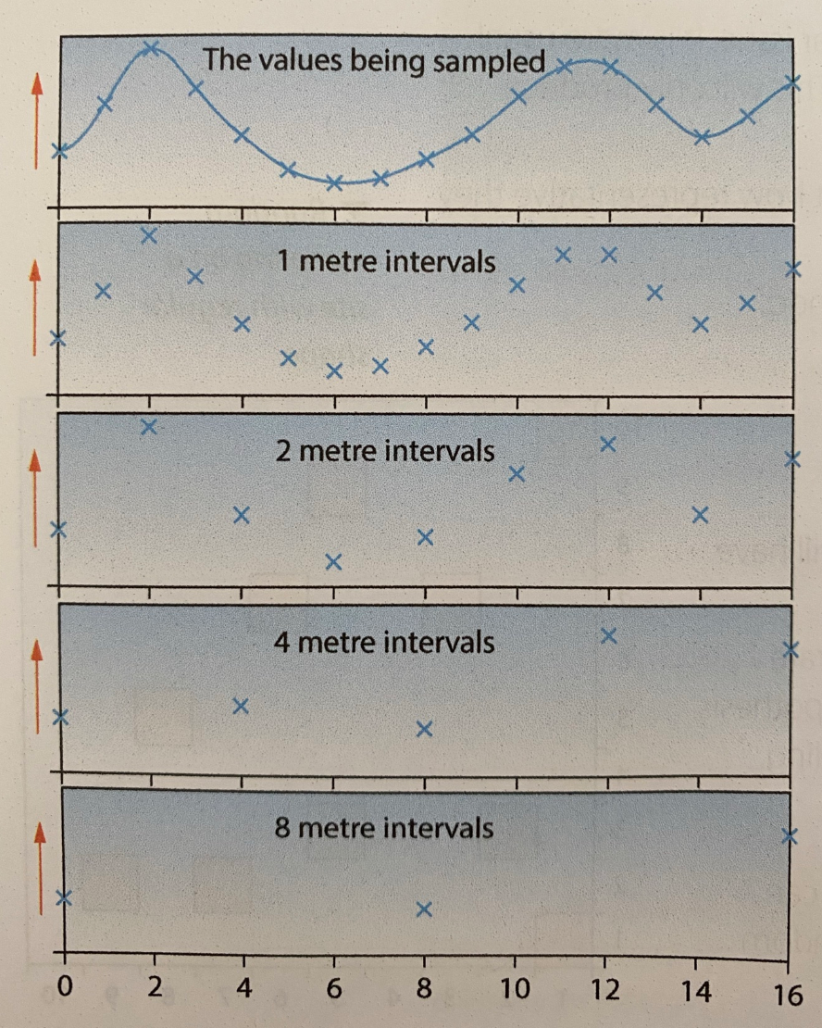
Interrupted belt transect intervals
When deciding on the distance between the samples taken in a belt transect, you need to ensure that the distance does not affect data collected. Variations in measurements need to be observed.
In the graphs 2m intervals does not miss any variations that are identified with 1m intervals.
4m interval fail to detect important peaks and troughs in the graphs

Slide 19
Sample timing
If something being investigated changes with time, then you may need to plan to sample on different occasions to produce a mean value that is accurate.
Timings between samples depends on the rate of change. Preliminary studies can help to identify this.
E.g.
studying population changes of tigers is a long-term change and samples should be taken over a long period of time (years).
Studying migratory patterns of species show seasonal changes to studies would be carried out in the relevant season
Studying road side noise pollution will show short term changes and timings would have to be done at particular times of the day.

Slide 20
Sample Size and Numbers of Samples
Sample Size
If the variable being measured is not homogenous then larger samples are more likely to preoduce representative results. The sample size needed can be determined with a preliminary study
Number of samples
A single sample may not be representative as there may be variability between samples.
Multiple samples eliminate this effect (in an exam don’t ever say less than 10)
If possible during a preliminary study, a running mean can be calculated to show how many samples should be taken.

Slide 21
Activity
Work through the worksheet
Answer the questions
The ideal number of samples is that when collecting more samples would not significantly change the mean value that can be made.
While you carry out an investigation calculate a running mean of your samples until it does not change.
You must also have enough samples to be able to carry out a statistical test

Slide 22
3.7.2.1 Quantitative/comparative/numerical measures
It is important to be able to compare data about populations in different locations or at different times in the same place. There are many methods available to do this.
Population size/density
Abundance scales
Species richness/diversity (simpsons diversity index covered in population dynamics topic)
Species frequency
Species density
Percentage vegetation cover
The Lincoln index

Slide 23
Species Density
Density = the mean number of individual per unit area.
Achieved by counting numbers of organisms within a quadrat or whole population. Some well dispersed species may need sub-sampling
Advantage: it is an objective measure
Disadvantage: time consuming if the size or number of sampling units is large

Slide 24
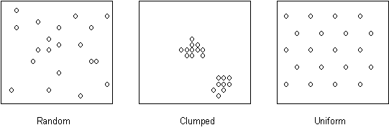
Species Frequency
This is a measure of the dispersal of a species by recording the proportion of all samples in which it is found. High species frequency shows the species is generally distributed.
Frequency = likelihood of a particular species occurring in a quadrat.
If a species is present in 15 out of 30 quadrats then the frequency of its occurrence is 50%.
Advantage: it is a good method to use for species that are hard to count e.g. grass
it is a quick assessment of general distribution
Disadvantage: there is no information about density and the detail of distribution of a species
there is no measure of actual numbers of species
This diagram shows how species may be distributed in different ways

Slide 25
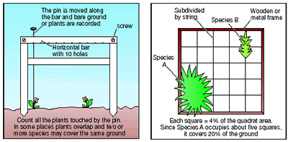
Percentage Vegetation Cover
Percentage cover = estimate of the area within a quadrat that a particular species covers or the area of sky that is obscured by vegetation for tree cover (within a quadrat held up against the sky)
Advantages: it avoid needing to count individuals so is faster
is useful for identifying species where its hard to see individuals e.g. mosses, lichens and sponges
Disadvantages: it can be difficult to do with overlapping organisms (plants)

Slide 26
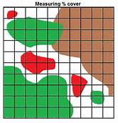
Calculating Percentage Cover Using a Frame Quadrat
To record percentage cover of species in a quadrat, look down on the quadrat from above and estimate the percentage cover occupied by each species (e.g. species A - D left).
Species often overlap and there may be several different vertical layers. Percentage cover may therefore add up to well over 100% for an individual quadrat.
The estimation can be improved by dividing the quadrat into a grid of 100 squares each representing 1% cover. If the plant takes up a more than half od a square that will represent 1% cover.
This is only practical if the vegetation in the area to be sampled is very short, otherwise the string/wire will impede the laying down of the quadrat over the vegetation.

Slide 27
Species richness/diversity
Biodiversity is an important indicator of a habitats health.
High Biodiversity = healthier the habitat
Biodiversity refers to the variety of living organisms in an area.
It can be considered at 3 different levels:
HABITAT DIVERSITY
SPECIES DIVERSITY
GENETIC DIVERSITY

Slide 28
Species Diversity
A species is a group of similar organisms, that can reproduce and produce fertile offspring.

Slide 29
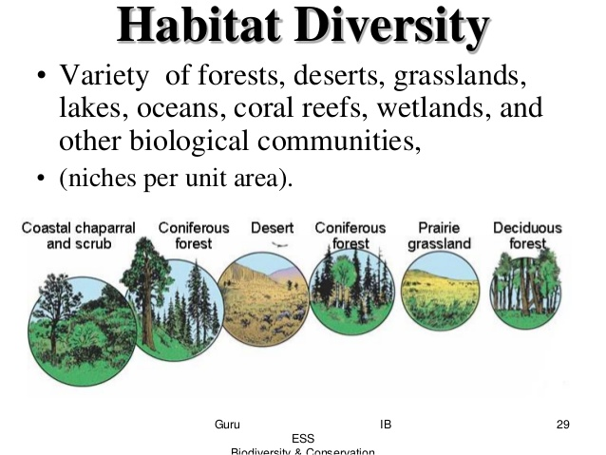
A habitat is the area inhabited by a species.
It includes physical factors, like soil, temperature (abiotic factors) as well as biotic factors (living organisms)
Habitat Diversity = the number of different habitats in an area.

Slide 30
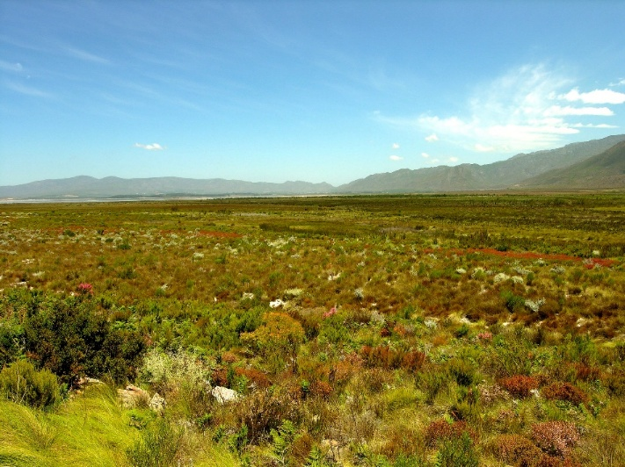
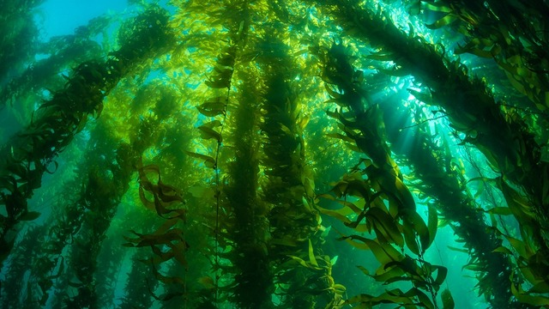
Which is more diverse?
To be called bio diverse..
Lots of different species
Large and similar numbers of each species

Slide 31
Species Diversity
Evenness Richness
The number of different species in a habitat
The number of individuals in each species

Slide 32
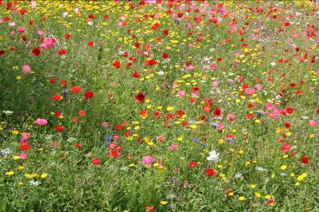
Species diversity
Maintaining high species diversity is
important because it indicates
ecological stability
A low diversity value may indicate an
unstable ecosystem/infertility or pollution
So, monitoring species diversity enables us to check:
that an ecosystem is healthy
that it has not changed
the success of conservation management techniques
Species diversity is influenced by the physical environment
In general, the harsher the environment the fewer species there are and the lower the diversity
Diversity tends to be higher in warm, wet, tropical areas than in cold, dry high latitudes

Slide 33
This calculation takes into account both species richness and evenness. If a community with high diversity was randomly-sampled twice, there is a good chance that the two samples will contain different species. However, if a low-diversity community were sampled twice, it is likely that both of the samples will contain many of the same species. Simpson (1949) derived a formula based on the expected outcome of two random samples.
SIMPSON’S DIVERSITY INDEX

Slide 34
SPECIES RICHNESS?
 | Number of individuals
Flower species | Habitat 1 | Habitat 2
DAISY | 300 | 20
DANDELION | 335 | 49
BUTTERCUP | 365 | 931
TOTAL | 1000 | 1000
Both have 3

Slide 35
SPECIES EVENNESS?
 | Number of individuals
Flower species | Habitat 1 | Habitat 2
DAISY | 300 | 20
DANDELION | 335 | 49
BUTTERCUP | 365 | 931
TOTAL | 1000 | 1000
Habitat 1 has numbers which are much closer

Slide 36
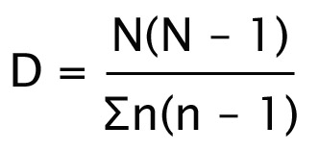
Measuring species diversity
Where:
N = total number of organisms of all species
n = total number of organisms of a particular species
Σ = sum of

Slide 37
Back to the worked example
 | Number of individuals
Flower species | Habitat 1 | Habitat 2
DAISY | 300 | 20
DANDELION | 335 | 49
BUTTERCUP | 365 | 931
TOTAL | 1000 | 1000

Slide 38
Let’s work out habitat 1 to start with
n(n-1)
Flower species | Habitat 1
DAISY | 300
DANDELION | 335
BUTTERCUP | 365
TOTAL | 1000
= 89700
300 x 299
335 x 334
= 111890
365 x 364
= 132496
Add them all up = 334086
Now let’s do N(N-1)
D = 999000 / 334086
1000 x 999 = 999000
D = 2.99

Slide 39
Now for habitat 2
n(n-1)
Flower species | Habitat 2
DAISY | 20
DANDELION | 49
BUTTERCUP | 931
TOTAL | 1000
= 380
20 x 19
49 x 48
= 882
931 X 930
= 865830
Add them all up = 867092
Now let’s do N(N-1)
D = 999000 / 867092
1000 x 999 = 999000
D = 1.15

Slide 40
A low value of diversity would suggest that the habitat was dominated by a few species and therefore a small change to the environment would have a large affect on the habitat

Slide 41
Measuring species diversity
Students sampled freshwater invertebrates at two sites, A and B, in Carding Mill Valley, Shropshire. Their results are shown below.
Invertebrates | Numbers of individuals caught
 | Site A | Site B
Stonefly larvae | 1 | 0
Mayfly larvae | 5 | 1
Shrimps | 12 | 6
Water lice | 10 | 5
Calculate the index of diversity at sites A and B
Site A
D = 28 x 27/ (5x4) + (12x11) + (10x9) + (1-0)
= 756/243
= 3.1
Site B
D = 12x11/ (1x0) + (6x5) + (5x4)
=132/50
=2.64

Slide 42
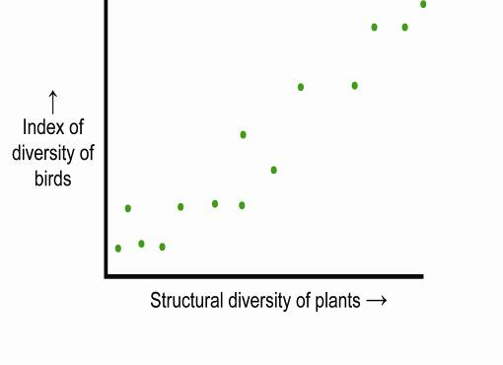
Diversity and ecological stability
The graph shows the relationship between the index of diversity of birds and the structural diversity of the plants on some farmland. Structural diversity = the different forms of plants present in a particular area e.g. grasses, herbs, shrubs and trees
What is the relationship?
Directly proportional or positive correlation
Bird species diversity depends on plant structural diversity
Why does this relationship exist?
The more varied the structure, the greater the number of habitats or niches. Birds feed and nest at different heights in vegetation

Slide 43
How many species are there?
Estimate: 5-10 million but only 1.4 million have so far been named
Scientists estimate the total number of species by drawing a graph of the total species found over time. There is a gradual reduction in the rate of finding new species so this can be used to extrapolate the total number that exist.
Why are some species still undiscovered?
Live in inaccessible ecosystems – deep oceans
Are in such small numbers they have not been found

Slide 44
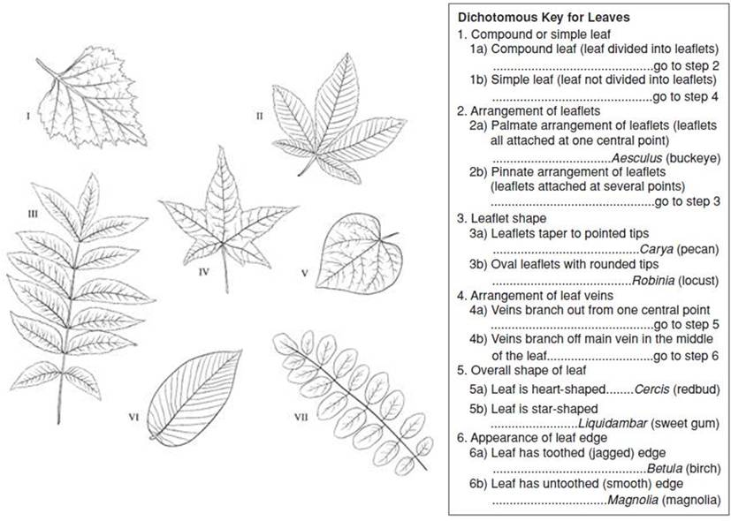
Species Identification Keys
Used to identify species seen/caught when sampling

Slide 45
Abundance scales
Counting numbers of individuals of plant species in different areas is very time-consuming. If quantitative detail in not required then abundance scales can be used. General comparisons can then be made between different areas.
DAFOR abundance scale
Qualitative scale that is a relatively quick way of assessing the abundance of species in a study area.
Method
Species are identified in an area and allocated to a category based on their abundance:
D = Dominant
A = Abundant
F = Frequent
O = Occasional
R = Rare
Limitiation
This is a subjective method and different peoples ideas of abundance may vary. No statistical test can be done on this as it is qualitative.

Slide 46
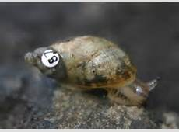
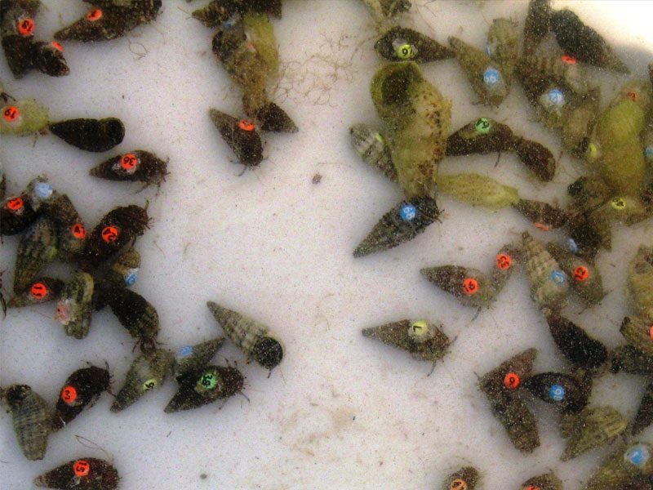
Mark-release-recapture and Lincoln Index
Objectives:
To understand when and how to use the mark-release-recapture method to measure abundance of a species and the limitation of this method
To calculate population sizes using the Lincoln index and explain the assumptions that are made when using this index

Slide 47
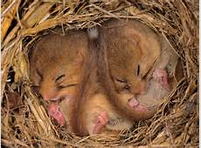
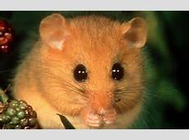
How would we find the population size of dormice?

Slide 48
Mark-release-recapture
The problem with counting animals is getting a good estimate of the total number in the area; they move quickly, they cover larger area and they try to remain hidden. So the capture, release, recapture method is used
Capture a sample of animals (the sampling method will depend on the animal). The larger the sample the better the estimate works.
Count all the animals in this sample (n₁) and mark (using one of methods below) then so that they can be recognised later.
Release all the animals where they were caught and give them time to mix with the rest of the population (typically one day).
Capture a second sample of animals using the same trapping technique.
Count the total animals in the second sample (n₂), and the number of marked (i.e. recaptured) animals in the second sample (m).
Calculate the population estimate using the Lincoln Index

Slide 49
Lincoln Index
N = population
n₁ = total number first caught and marked
n₂= total number caught in second sample
m = number of marked individuals in second sample
Total population = number in 1st sample x number in 2nd Sample
Divided by number in 2nd sample that have marks
http://www.youtube.com/watch?v=tD3LWjpWYKY
http://www.biologyexchange.co.uk/resource/25/

Slide 50
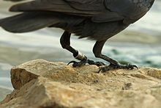
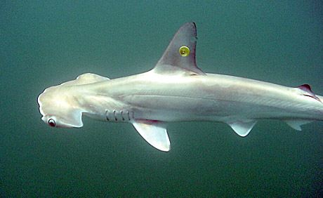
Marking techniques
Invertebrates - a spot of paint
Birds - leg-rings
Mammals - a shaved patch of hair
Fish - small metal disks.
Larger animals - collecting a small blood sample and making a DNA fingerprint.
Marking should:
not be harmful to animals
prevents reintegration to the population
will not wash off
will not makes animals more susceptible to predators.

Slide 51
Assumptions
Individual animals are mobile and can be caught
The size of the population does not change during the time of study from either; immigration/emigration, deaths or births
Method of marking is non-toxic and does not make individuals more conspicuous and susceptible to predation
The mark id not lost/rubbed off during the investigation
Marked individuals released from the first sample distribute themselves evenly amongst the remainder of the population (and have time to do this)
All individuals in the population have the same chance of being caught

Slide 52
Limitations
Accuracy of the Lincoln index is based on capturing a large proportion of the population and this may be difficult to do with some species
Animals that are territorial will not be distributed evenly and therefore the results will not be accurate. If you sample in the same area the second time you will just end up with the same individuals being caught
Task: Modelling Mark-release-recapture

Slide 53
3.7.2.1 Measuring Abiotic Factors
It is important to measure abiotic factors in environmental investigations.
Many abiotic factors are measured using electronic meters that need to be calibrated before use so that readings are accurate.
Examples of electronic meters include:
Temperature
pH
Dissolved oxygen
Light levels
Wind and water velocity

Slide 54
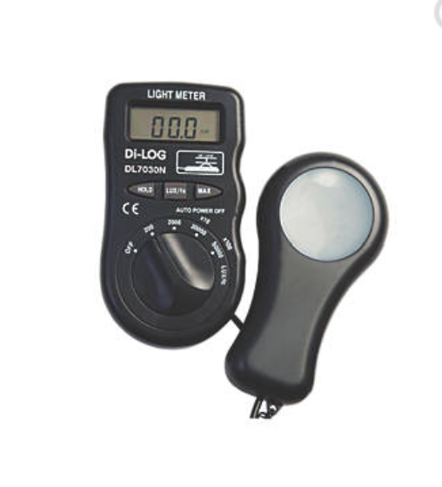
Light intensity
When using a light meter, a standardised method needs to be used e.g. holding the sensor at the same height from the ground and facing the same direction

Slide 55
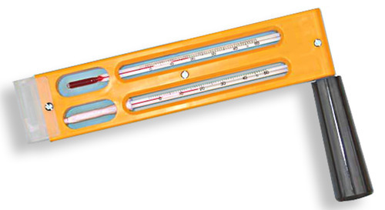
Humidity (traditional method)
Measured using a whirling hygrometer
2 thermometers (1 wet and 1 dry) are spun, the wet one is cooled by the evaporation of the water. The rate of evaporation depends on the humidity in the atmosphere. The temperature difference between the 2 thermometers can be compared with a table of values to estimate humidity.
To ensure accuracy, spinning is continued until no further cooling occurs

Slide 56
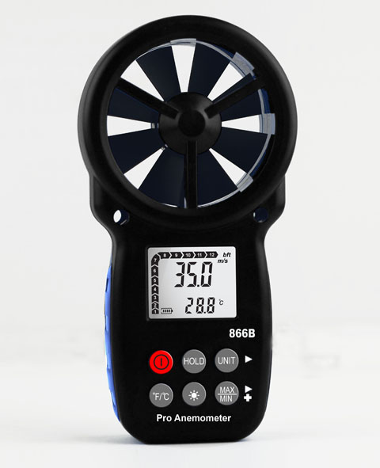
Wind Velocity
Measured using an electronic anemometer
Standardised by:
Holding at the same height above ground
Ensuring there are no obstacles to air flow
Axis of rotation must be horizontal or vertal (depending on type)
Impeller type anenometers must face into the wind

