Slide 1
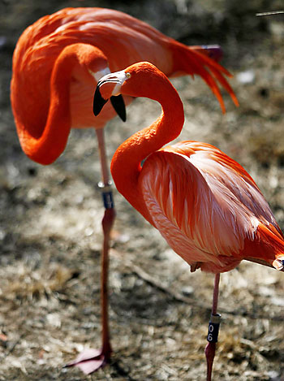
Population Dynamics
3.1.3

Slide 2
Specification: part of section 3.1.3
Content | Additional details
Management of desirable species: • release programmes • habitat management. | Students should understand that a knowledge of population dynamics and carrying capacity can help in conservation programmes.
Control of undesirable species: culling/eradication
r- and k- selection strategies and how they affect the ease with which species can be over-exploited | The importance of r- and k-selection strategies should be understood in predicting species' vulnerability to exploitation/population losses.

Slide 3
Population Dynamics
Topics to be covered
Population dynamics
Population growth and regulation
The stages of population growth
Carrying capacity
Controlling carrying capacity
Predator-prey relationships

Slide 4
Why Study Population Dynamics

Slide 5
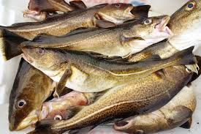
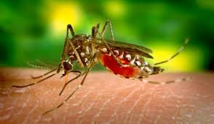
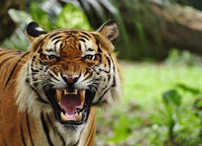
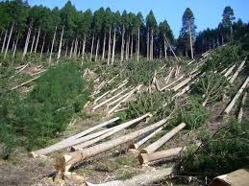
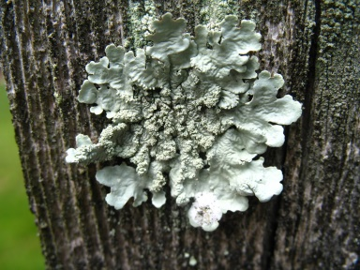
Food – North sea fish need to be monitored
so that over fishing does not demolish all stocks
Pest – mosquitoes need to be monitored to control the numbers and the spread of disease.
Endangered species - Tigers need to be
monitored to asses the amount of conservation
needed to preserve them.
Raw material – Forest need to be monitored to maintain the availability of wood.
Indicator – Lichens need to be monitored to
check levels of pollution

Slide 6
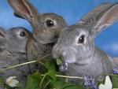
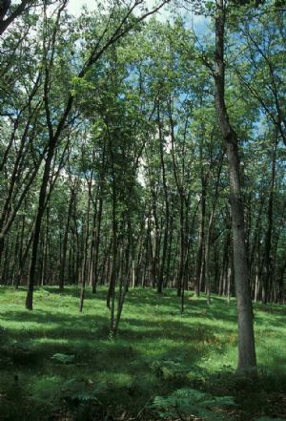
Populations
Population Ecology is concerned with the question: why is a population the size it is?
This means understanding the various factors that affect the population.
Population = The no. of individuals of a particular species in a given area/habitat in a certain time.
For example, all the oak trees in a deciduous woodland or all the house sparrows in a town.

Slide 7
What determines population growth?
The growth of a particular population at a particular time is determined by:
Birth rate – the reproductive capacity of the population
Mortality/ death rate – the rate at which organisms die in a population.
Immigration - the movement of individuals into a population.
Emigration - the movement of individuals out of a population.
Notes:
Individuals can also leave or enter a population. It is easy to imagine animals being able to do this, but plants too can use seed dispersal to enter or leave a population.

Slide 8
Population regulation
Population size
= starting population + births + immigrants – deaths - emigrants
Population change
= (births + immigration) – (mortality + emigration)

Slide 9
Factors that affect birth rates
Reproductive potential = is the maximum possible rate of reproduction of a species under optimum conditions and unlimited resources.
Ensures production of sufficient offspring to replace the individuals that die. It includes a surplus of young to ensure survival of the species.
Many fish have a high reproductive potential ie they can produce many young. Why so high?
Chances of dying are high. (high mortality rate)

Slide 10
r-selected species
These are species that can respond rapidly to low survival rates.
They reach sexual maturity quickly, produce many young and can disperse widely.
r-selected
species include
mice, locusts
and greenfly.

Slide 11
k-selected species
These are species that recover slowly from a decline in population.
They usually reach sexual maturity at an older age, produce few young, but often live for a long time.
An increase in the death rate caused by a change in the habitat or by human exploitation may cause a population crash.
The low reproduction rate of k-selected species may make it impossible to replace the losses.
k-selected species include whales, elephants, rhinos.

Slide 12
Factors that Affect Mortality Rates
Factors that give rise to environmental resistance will affect mortality rates.
Environmental resistance is all the factors that may limit the growth of a population, such as accumulation of waste, scarcity of resources or adverse climatic conditions.
These include:
Drought food supply
Flood disease
Volcanic
eruptions
Density dependent factors
Density independent factors

Slide 13
Density Dependent factors
Factors whose effects on populations depend on the density or size of the population e.g.:
Food supply
Predation
Disease
Habitats
Parasitism
Water supply

Slide 14
Density Independent factors
Factors whose effects on populations do not depend on the density or size of the population e.g.
chemical pollution,
temperature.
Drought
Flood
Volcanic eruption
Hurricane

Slide 15
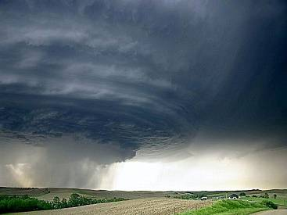
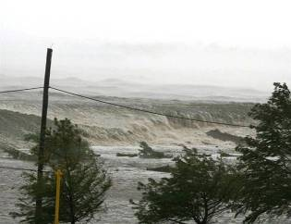
Density Independent Factors
Density Independent factors exert their effects irrespective of the population size.
If a hurricane strikes a small island, it is likely that everything will be killed, no matter the size of the populations
This is useful when designating wildlife reserves – they need to be as big as possible so that a disaster such as a hurricane or tsunami can’t wipe everything out.

Slide 16
Migration
Migration by humans refers to population movement to seek better conditions or escape unpleasant ones and is often a permanent move for the people involved.
Most wildlife migrations are very different
Migration of wildlife involved the regular cyclical movement of entire populations to and from areas, usually to find the best areas for feeding or breeding
Most wildlife migrations follow the annual cycle of seasons

Slide 17
Population growth and regulation
If a species arrives in a new habitat, its ability to survive will depend on whether it is adapted to the conditions.
The growth of the population is controlled by:
Density independent factors
Density dependent factors
The final size of the population is controlled by the carrying capacity of the habitat.

Slide 18
Stages of Population Growth
Colonisation:
Organisms first arrive in an are.
Lag Phase
The population stays fairly constant as they establish territories, find mates, food etc
Log phase
The population grows rapidly as there is plenty of food, space etc and survival is good.
Stabilising phase
Density dependent factors become more importans as the population density rises. Food shortages, disease, competition for breeding sites etc become more importans, so survival rates drop.
Stable fluctuating phase
The long-term population remains constant with good and then bad years where the population fluctuates around the mean.

Slide 19
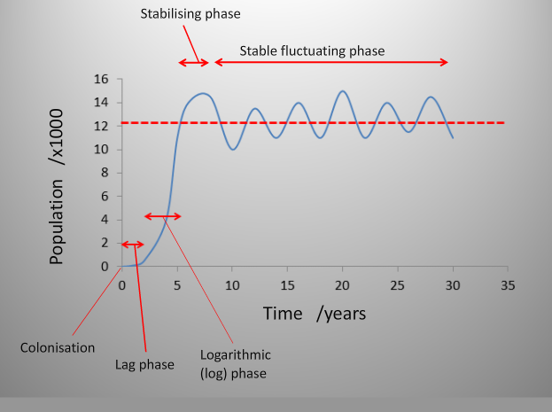
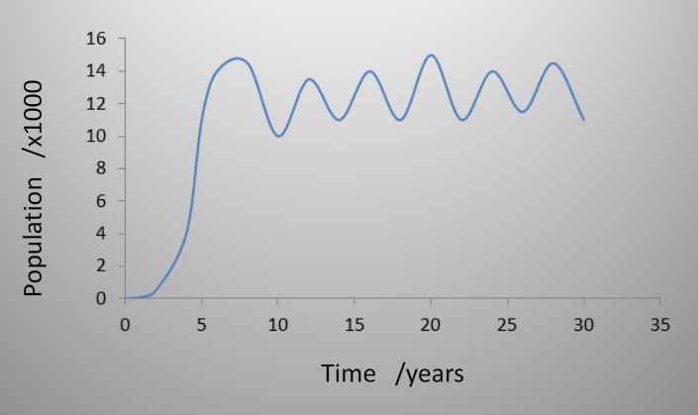
Sigmoidal Population Growth Curve

Slide 20
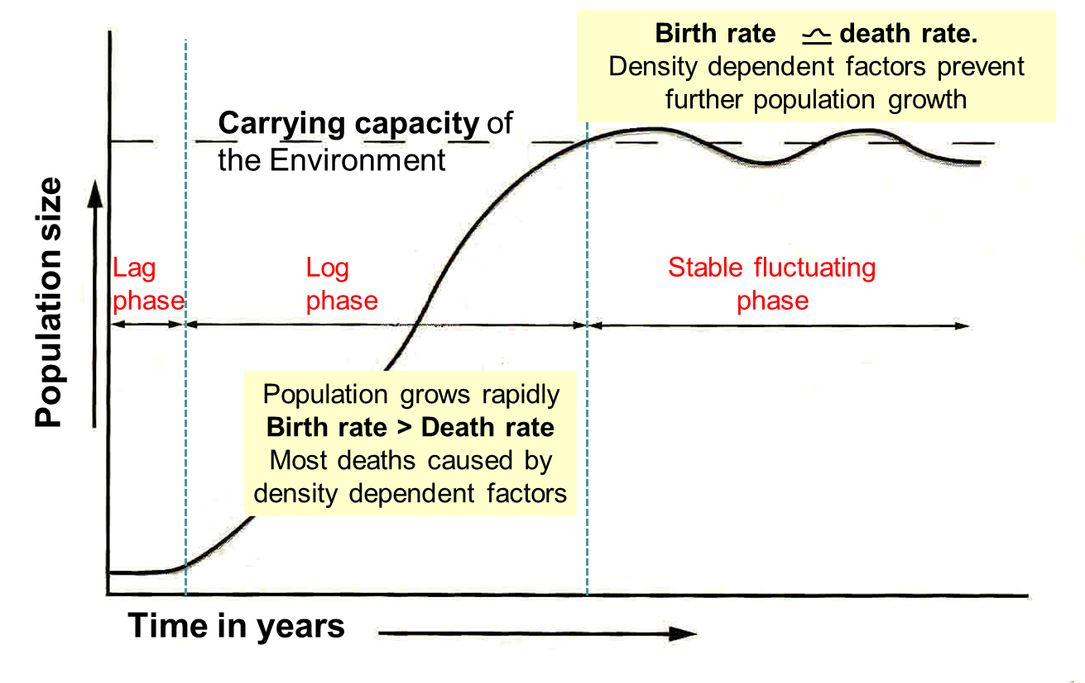
Birth Rates & Death Rates in the Growth Curve

Slide 21
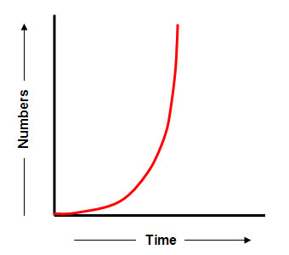
J shaped Growth Curve
Describes a situation where the population growth curve stops abruptly as environmental resistance becomes suddenly effective. Growth is said to be density independent because growth rate is not tied to population density. Reasons may include:
Seasonality
The end of the breeding season
The application of an insecticide

Slide 22
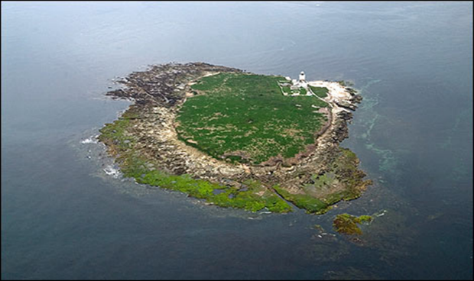
Exercise - What do You remember?
Name the 3 main phases of a sigmoidal growth curve in order.
Explain briefly what each means.
What 4 things determine a population’s growth?
What is meant by Biotic / reproductive Potential?
What is Environmental Resistance?
What would happen in terms of population size if 2 rabbits were cast away on an island?
Population size of rabbits
Time / years

Slide 23
Carrying Capacity
The carrying capacity is the maximum population that a habitat can support sustainably.
If the population is below the carrying capacity then survival is good and the population rises: lots of food, plenty of nest sites etc.
If the population is above the carrying capacity then survival is more difficult due to shortages in food and nest sites, easier spread of disease etc. The population declines.

Slide 24
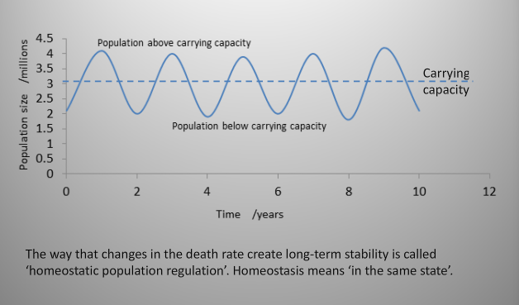

Slide 25
Controlling Carrying Capacity
The carrying capacity of a habitat is not a fixed population size.
It can be affected by environmental change e.g.
Colonisation of a new predator
Extinction of a predator
Climate change affecting food supploies
Loss of breeding sites
Habitat management for wildlife conservation often involve controlling the environment to increase the carrying capacity for desired species.

Slide 26
Controlling Carrying Capacity
The carrying capacity of an area can be increased by controlling the limiting factors:
Density independent factors:
Provide water
Prevent flooding
Density dependent factors
Food supply
Breeding sites
Control disease
Predator control
Competitor control

Slide 28
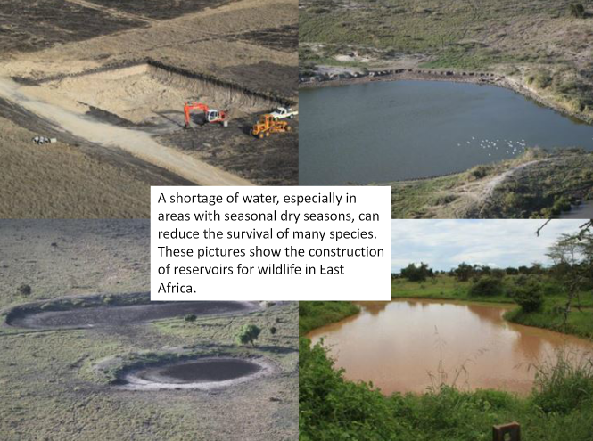

Slide 31
Homeostatic regulation of population size

Slide 32
Homeostatic regulation of population size
Alternative diagram to previous slide
Explaining the fluctuations in the stationary phase

Slide 33
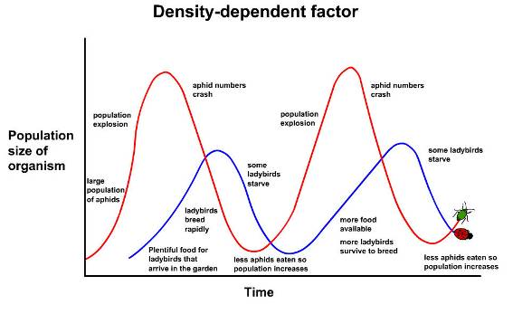
Homeostatic control of populations
Populations fluctuate around the carrying capacity due to negative feedback processes. So population control is a self regulating system.
Negative feedback:- When a system moves out of equilibrium, negative feedback processes act to return the system to equilibrium.
It is an example of homeostasis.
Homeostasis:- the combined processes that maintain balance in a living organism or the environment.

Slide 34
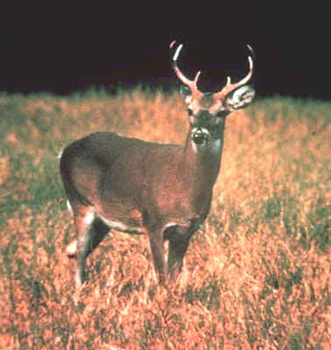
‘Oh Deer’
Predator-prey relationships
Play game …

Slide 35
Modelling Population Growth Activity – Oh Deer! Can only be done with a full class.
2 students are a pair of deer.
Others are resources of space, water, shelter or food.
Deer and resources stand each end of a large space and face out from each other.
Deer and resources make mime of requirement / what they are and deer then move to wards a resource that matches what they mimed.
Resources caught are converted to deer so population grows but amount of resources decreases.
What happens when there are not enough needs?
Deer die and become a resource
Observe changes in population size.

Slide 36
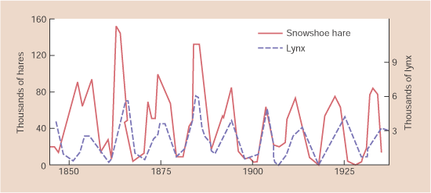
Predator – Prey population relationships
These relationships show how this self–regulation of population size can take place.
This graph shows the relation ship between the snowshoe hare and its predator the lynx.
http://www.bbc.co.uk/schools/gcsebitesize/science/edexcel/environment/populationsandpyramidsrev5.shtml Bitesize revision page. Use tab 5 to see Population notes and case study animation of ladybirds and aphids. Also lynx and hare graph.

Slide 37
Another Predator-Prey Example
Ladybirds and greenfly
Note the time lag between predator and prey. The predator peaks and troughs are just behind the prey.
Also the numbers of prey are usually greater than those of the predator. Can you explain this?

Slide 38
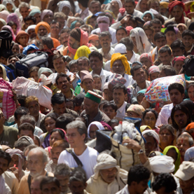
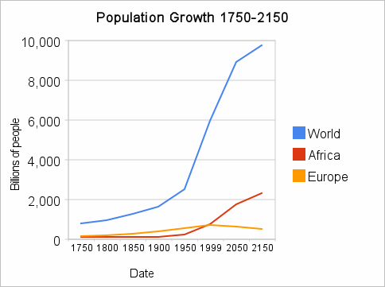
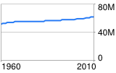
Do populations stay the same?
UK POPULATION
GROWTH
http://www.npr.org/2011/10/31/141816460/visualizing-how-a-population-grows-to-7-billion 1 min 45 s Human Population growth. What causes them to grow? Filling up video is below the first podcast bit!
Birthrate
Death rate (mortality)
Immigration
Emigration

Slide 39
Summary of populations
https://www.youtube.com/watch?v=KFViSog6ZJw

Slide 40
Artificial population control
Intervention to artificially control the population through culling may be required to enable the species or habitats to survive where natural control mechanisms no longer regulate the population.

Slide 41
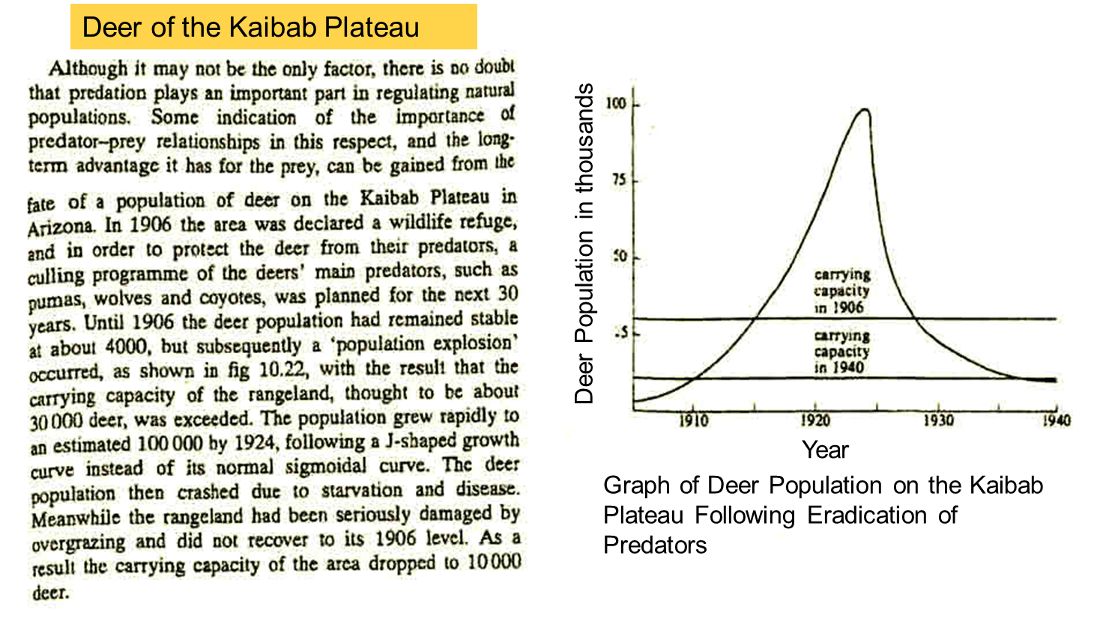
The Importance of Predators
READ the article in the booklet and answer questions on next slide.

Slide 42
Kaibab Deer Population Questions
What is culling? Why does it take place?
What were the deer predators?
Why did the deer suddenly decline in number after 1924?
What happened to the Carrying capacity of the area between 1906 and 1940?
Why did it change?

