Slide 1
Oceanic islands
These are islands that are sufficiently isolated from major land masses so it is difficult for species to colonise. This often produces unusual communities of species.
https://www.youtube.com/watch?v=bk7W0mjH_Hg
https://www.youtube.com/watch?v=9P7jXveokDY
https://www.youtube.com/watch?v=Z5wRA6AipH4

Slide 2
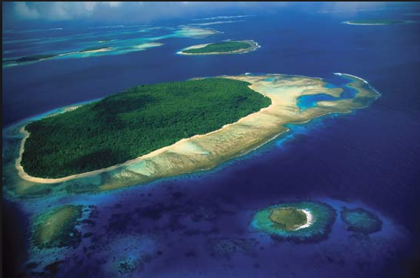
Ecological features
Isolation and biodiversity: most oceanic islands were formed by volcanic eruptions or the build-up of sand from nearby coral reefs. Their isolated positions make it difficult for most continental species to colonise. Marine species and seabirds can colonise relatively easily as can plants with floating seeds. Some species may have colonised by chance such as tortoises carried on drifting logs, or terrestrial birds carried by strong winds.

Slide 3
The species that succeed in colonising will gradually evolve to occupy the available ecological niches. Evolution has produced unique species on different islands because the conditions that affected selection pressure, and the characteristics that provide survival advantage, are different on different islands.
The biodiversity of isolated islands may be low because they are difficult to colonise, so some taxa may be absent or have few original colonists, such as mammals, land birds, reptiles, amphibia, and land plants. The local evolutionary processes may produce many endemic species with small ranges and small populations that make them vulnerable to extinction.

Slide 4
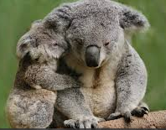
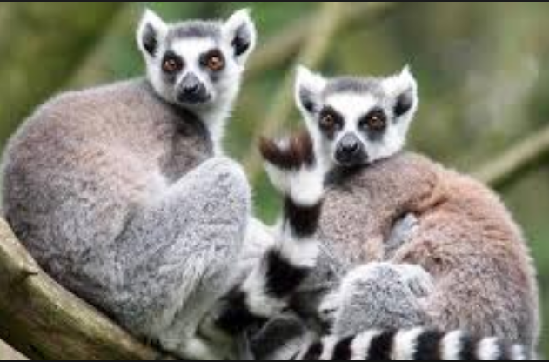
Lack of mammal predators:
It is difficult for mammals to colonise isolated islands. Seals and bats may do so but not terrestrial mammals. Some larger islands still have mammal species from when they were attached to larger continents but they have evolved into unique species, for example, the marsupials of Australia or the lemurs of Madagascar

Slide 5
Importance of oceanic islands
The high proportion of endemic species increases the possibility of the discovery of unique medicines or features that could be used in biomimetics

Slide 6
Threats
Exploitation of species: some island species were heavily exploited in the past, usually for food, for example, the Dodo, giant tortoises, and marine turtles.

Slide 7
Introduced species:
Lack of mammal predators meant that the indigenous species did not have to adapt to survive the arrival of predatory species such as rats from shipwrecks, or cats that were introduced as pets.
Introduced herbivores such as goats and rabbits often destroy the indigenous plant communities.
The lack of predators allowed herbivore populations to become very large.
Introduced plants may have colonised and out-competed the indigenous
vegetation.
Pathogens may have been introduced that affect the indigenous species. Avian malaria was introduced to Hawaii which has killed off many bird species. Above 1500m malaria rarely occurs because it is too cold, but as global warming cause temperatures to rise, avian malaria spreads to higher altitudes and the range of indigenous bird species is reducing.

Slide 8
Habitat change/destruction:
urban development, the expansion of agriculture and tourist developments have caused habitat destruction on many islands.

Slide 9
Conservation efforts
These usually involve attempts to stop or reverse the damaging effects of human actions.
The biggest single action that has conserved endemic species has been the eradication of introduced species such as rats, goats, cats, and rabbits.
Introduced species have been successfully eradicated from nearly 1000 islands.

Slide 10
Islands | Introduced species controlled
Ramsay Island (Wales, UK) | Rats
Lewis and Harris (Scotland, UK) | Weasel
South Georgia (British Overseas Territory, South Atlantic) | Rats
Flatey (Iceland) | Rats, House mice
Diego Garcia (British Indian Ocean Territory) | Cats
Hawaii - several islands (USA) | Rats

