Slide 1
Tropical Rainforest

Slide 2
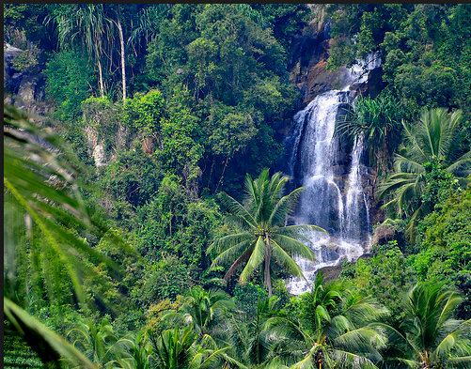
Tropical Rainforest https://www.youtube.com/watch?v=DgU7gsBOhUI
Tropical rainforests are the most biodiverse terrestrial ecosystems.
They have not been fully researched but the relative ease with which new species can be discovered suggests that over half of all terrestrial species live in tropical rainforests, although the rainforests only cover about ten per cent of the Earth’s land area.

Slide 3
Ecological features
The tropical climate has been relatively stable over long time periods, compared with regions further away from the equator.
This has given rainforest species a long time to evolve and become adapted to local abiotic and biotic factors.
This has produced a huge number of different species, although many are relatively rare and may have small ranges.
Being adapted to relatively stable conditions can make species vulnerable to extinction as a small change in environmental conditions may move them outside their range of tolerance.
https://www.youtube.com/watch?v=JEsV5rqbVNQ

Slide 4
High light levels allow photosynthesis rates to be high, providing a lot of food energy to support a rich food web.
Constant warm temperatures and regular high rainfall allow plants to grow throughout the year without the seasonal changes that occur in higher latitudes.
This ensures reliable food supplies are available to animals throughout the year.

Slide 5
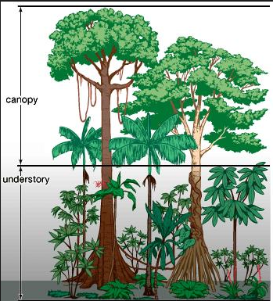
Although there are high light levels, there is also a lot of competition for light.
Plants that have evolved to grow a tall trunk will have better access to light but must invest a lot of energy over a long time to produce it.
Smaller plants may need to evolve methods of utilising lower light levels, such as denser chlorophyll or additional pigments to absorb other wavelengths of light.
Plants that are epiphytes have greater access to light without being tall but may have less reliable water and nutrient supplies.

Slide 6
Very high biodiversity
High biodiversity on its own does not make an area important but it does increase the chances of finding species that are useful to humans, for example, new food species, medical discoveries, biomimetic applications.
Because there are no cold winters to kill off herbivores, plants need to protect themselves from being eaten.
This is often done by producing toxic chemicals such as alkaloids that may have medicinal value for humans.
Animals also produce medicinally valuable chemicals to avoid predation, especially those that cannot protect themselves with teeth or claws, or those that use venom to catch prey.
So, taxa such as frogs and reptiles are much more likely to produce medicinally useful chemicals than mammals or birds.

Slide 7
Resource | Uses
Timber Medicines Captopril that reduces blood pressure | House construction, furniture, tools
Fibres | Cotton Hemp – rope Raffi a – rope, baskets Wood cellulose -rayon
Resins, oils, and waxes | Rubber – latex gloves, vehicle tyres Carnuba wax – floor and car polish, confectionary coating palm oil – processed foods, cooking oil, biofuels
Food | Chocolate from cacao, Pineapples, lemons, Brazil nuts, vanilla, coff ee, bananas, oranges, Spices – pepper, turmeric, cinnamon Bushmeat New food species Genetic resources for crop breeding
Medicines | Cinchona trees produce quinine which is used to prevent malaria Mexican wild yams produce diosgenin, used to make medicines such as cortisone to treat arthritis and asthma Curare lianas produce d-turbocuarine, used to treat multiple sclerosis and Parkinson’s disease and used in anaesthesia Venom of the Fer-de-Lance snake, used to develop the medicine

Slide 8
Climate maintenance
Tropical rainforests are very important for increasing downwind rainfall.
Over half the rainfall in the Amazon rainforest results from transpiration elsewhere in the forest rather than coming directly from the evaporation of seawater.
As with temperate broadleaf woodland and all trees, carbon sequestration by photosynthesis stores large amounts of carbon in tropical rainforests which helps to reduce the natural greenhouse effect.

Slide 9
Soil maintanance
The warm, moist conditions make dead vegetation decay very rapidly so nutrients are re-absorbed by trees very quickly.
Because of this, soils in tropical rainforests are often very shallow.
The vegetation cover and tree roots are important in preventing the soil that is present from being eroded, as the foliage protects the soil from heavy rain and the roots hold the soil together.
Forest clearance can lead to serious soil erosion.

Slide 10
Threats
A wide range of human activities threaten tropical rainforests. Some take place in the forest area itself but some threats start elsewhere such as atmospheric pollution.
Fuelwood collection
Wood is the most important domestic fuel in rural areas of LEDCs. The rate of wood collection is usually faster than the rate of re-planting and natural re-growth.

Slide 11
Threats
Timber harvesting
Timber from tropical rainforests is harvested for use in two main ways:
use in the country of origin for house construction and furniture;
export to MEDCs for use in products such as furniture, doors, windows, decking, and plywood.

Slide 12
Threats - Clearance for alternative land uses
Large areas of rainforest are cleared for other uses, mainly agriculture.
Subsistence agriculture: ‘slash and burn’ or ‘shifting field’ agriculture has been carried out in rainforests for hundreds of years and generally caused few environmental problems.
Small clearings were made by felling trees to create an area that could be farmed by a family. These would be farmed for a few years then abandoned as nutrients were depleted and forest regrowth reclaimed the clearing. The family would make a new clearing elsewhere.
This type of agriculture is sustainable as long as there is enough time for the forest to recolonise the cleared area and for the soil fertility to recover before it is cleared again. If the human population density is too high, then the time gap between an area being abandoned and cleared again will be too short.
The forest would not have recolonised fully and the soil would not have regained its fertility. The family could not farm the area for as long as previously. If this continues then the forest will be degraded and the soil fertility will decline.
https://www.youtube.com/watch?v=sctentt_vDY

Slide 13
Threats
Commercial agriculture: as human populations grow, the demand for farmland increases and habitats such as rainforests may be cleared.
Rainforest clearance for cash crops and cattle ranching is often unsustainable, as the poor tropical soils may become infertile and fail to provide high yields indefinitely. If the land is abandoned, it may be difficult for the forest to re-colonise if there are no surviving forest areas nearby from which species could recolonise.
Large areas of rainforest have been cleared for commercial cultivation of cash crops, mainly for export, for example, palm oil plantations in South East Asia, soya bean production in Brazil, and coffee plantations in Vietnam.

Slide 14
Threats
Mineral extraction: there are many valuable deposits of metal minerals present under tropical rainforests, including aluminium, iron, gold, silver, and copper.
Extraction results in habitat loss and can cause water pollution when the mineral is processed, such as discharges of turbid drainage water, cyanide, and mercury.

Slide 15
Threats
Reservoirs: new hydroelectric power schemes can flood large areas of forest and create a barrier to mobile species such as migratory fish and river dolphins.
The reservoir of The Tucurui HEP scheme in Brazil covers an area of 2850 km2.
The decomposition of dead organic matter in deep, static, reservoir water can produce acidic, deoxygenated water that may be harmful to aquatic life downstream.
The flow of water out of the reservoir may be controlled to generate electricity to match demand.
Fluctuating river levels downstream can affect wildlife

Slide 16
Threats - Climate change:
The temperature rise caused by climate change may directly affect the survival of some species.
Temperature change will also affect wind and precipitation changes.
Droughts in tropical rainforests caused by climate change will increase the number of forest fires and the area the fires cover. Fires are also likely to last longer, causing more severe damage. A short fire may just burn off dead vegetation and leaf litter, but a long fire may boil tree sap and kill the trees.
The populations of many frogs and toads in cloud rainforest, in countries such as Costa Rica, are declining. Rising temperatures are producing less humid air and clouds are forming higher up the mountains. This reduces the area of habitat that is sufficiently humid for them to survive.
Epiphytic plants such as orchids and air plants absorb water from the bark surface of the trees they live on. Their populations decline if the air is less humid.
Some models predict that some rainforest areas will be replaced by savannah grassland.

Slide 17
Threats - Tourism
As with any developments, an expansion of tourism facilities can threaten habitats and wildlife.
Ecotourism is an increasingly important way of generating income without having to destroy the forest.
However, in some countries the large numbers of visitors can cause damage as has been found in Costa Rica and Malaysia.

Slide 18
Conservation efforts
Many protected areas have been established to conserve tropical rainforest.
Korup National Park in Cameroon, Africa
http://www.conservationleadershipprogramme.org/project/primate-conservation-korup-national-park-cameroon/

Slide 19
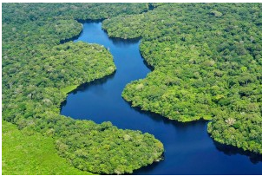
Alto Maues reserve, Brazil 2014
http://www.planetexperts.com/brazil-creates-rainforest-reserve-thats-larger-delaware/
http://innovatedevelopment.org/2014/11/26/de-railing-deforestation-with-a-new-amazonian-reserve

Slide 20
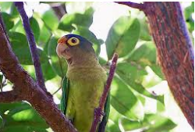
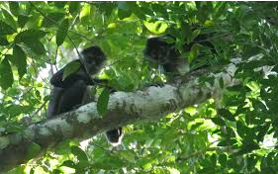
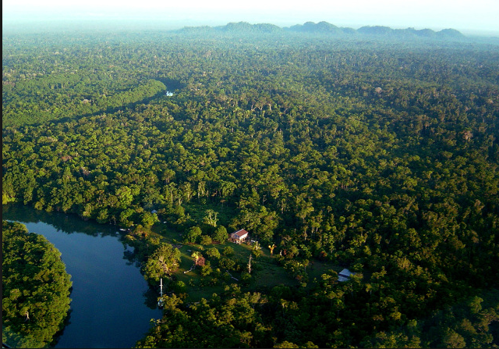
Rio Bravo Conservation and Management Area in Belize, Central America,
http://www.pfbelize.org/conservation/

Slide 21
Debt for nature swaps
Many countries that have threatened rainforests are in debt to other countries, with little realistic chance of being able to pay it all back.
The country that lent the money may be prepared to cancel the debt in return for a partial repayment or a guarantee that an area of the rainforest will be protected.
The USA has cancelled debts of $24m owed by Guatemala and $21m owed by Brazil.
Sometimes an intermediary organisation such as a conservation charity may negotiate to pay off part of a debt in return for the balance of the debt being cancelled.
The country that has had its debt cancelled agrees to conserve a wildlife habitat.
The WWF has organized debt for nature swaps in this way to protect rainforests in Costa Rica and the
Philippines.

