Slide 1
Methods of conserving biodiversity

Slide 2
Methods of conserving biodiversity: selected habitats:
temperate broadleaf woodland
tropical rainforest
coral reefs
deep-water coral reefs
oceanic islands
mangroves
Antarctica.

Slide 3
Temperate broadleaf woodland https://www.youtube.com/watch?v=Ecbwpzr92Ps
Features:
regular water supply
summers not very hot
winters not very cold
seasonality.

Slide 4
Importance:
high biodiversity
resources
climate control
soil erosion control
recreation.
https://www.youtube.com/watch?v=f68mTvSsYS4

Slide 5
Woodland resources
Temperate broadleaf woodland was historically important for a wide range of resources.
Wood was used for:
building construction – timber frames, wattle and daub panels;
fencing; tools;
carts;
wood fuel;
charcoal for metal smelting.
The woodlands were also a resource for food from animals and flora found there, for example, deer, wild boar, fruit, nuts, herbs.
Forest resources are no longer widely exploited in the UK except timber from commercial plantations.

Slide 6
Recreation
Many woodlands are important for public recreation: walking, camping, cycling, picnics etc.

Slide 7
The hydrological cycle
All trees play a role in the hydrological cycle through interception, evapotranspiration, and the control of water in the soil.

Slide 8
Carbon sequestration
All plants absorb carbon as carbon dioxide during photosynthesis but most release it again during respiration and the decay of their vegetation.
Plants with woody tissue can build up a store of carbon in the cellulose and lignin that forms wood, so woodlands form large reservoirs of stored carbon which reduces atmospheric carbon dioxide concentrations as they grow.

Slide 9
Threats:
deforestation for other land uses
fragmentation of remaining woodland
management change.

Slide 10
Threats
Woodland clearance: as societies have developed and populations have grown,
natural woodland habitats have been cleared to provide space for new land uses:
• farmland;
• plantations of single species or non-indigenous species;
• urban developments;
• transportation infrastructure, for example, new roads;
• mineral extraction.
Habitat fragmentation: woodland clearance may leave remaining areas that are
isolated from each other. If animals cannot move between these areas, then each
separate population becomes more vulnerable to extinction.
Conservation efforts: different woodland management techniques create
woodlands of different wildlife value.

Slide 11
Conservation efforts:
designated protected areas
legal protection of ancient woodland in the UK
conservation management.

Slide 12
Designated protected areas
Sherwood Forest National Nature Reserve.
Epping Forest SAC.
There are many woodland SSSIs.
Many UK National Parks have areas of deciduous woodland.
The 2012 National Planning Policy Framework states that ‘…planning permission should be refused for development resulting in the loss or deterioration of irreplaceable habitats, including ancient woodland and the loss of aged or veteran trees found outside ancient woodland, unless the need for, and benefits of, the development in that location clearly outweigh the loss’.
Although ancient woodlands may be generally protected, overgrazing by deer or deliberate clearance of ground vegetation may prevent regeneration by young trees so the woodland may gradually become degraded and lose some of its wildlife value.

Slide 13
Legal protection of ancient woodlands
An ‘ancient woodland’ in the UK is defined as one that existed before 1600. Few woodlands were deliberately planted before 1600 so a wood that is over 400 years old is likely to have developed naturally a long time ago.
An ancient woodland usually has a very high biodiversity because there has been a long time-period for species to colonise.
Some species of wild plant colonise woodlands very slowly, so the presence of many such species is evidence that the woodland is ancient.

Slide 14
Woodland management
Historical methods
‘Wildwood’: areas where there was virtually no interference, for example, hunting forests.
Mature ‘standard’ trees: for example, oak for timber-framed houses, furniture, and ships.
Coppiced woodland: for example, hazel for fencing, wall panels, oak for charcoal, pit props and tannins for leather tanning.
Pollarding: similar to coppicing but cutting was carried out at a greater height to reduce the problem of animals eating re-growing branches.

Slide 15
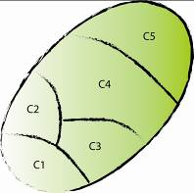
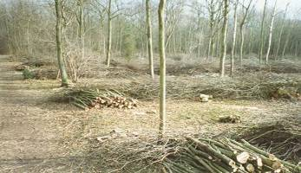
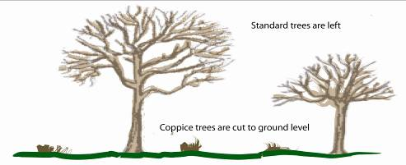
Coppicing as a conservation technique
Many deciduous species will coppice
Woodland split into compartments, one of which is cut per year.
Provides trees of different sizes & ages, open areas increases tree longevity
Provides a huge range of products
Involves periodically cutting tree stems to ground level to encourage multiple shoots

Slide 16
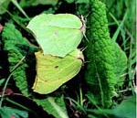
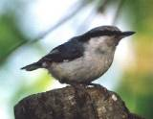
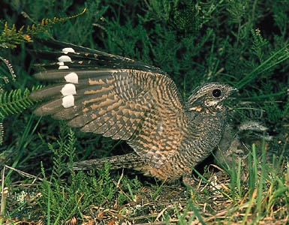
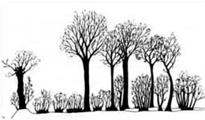
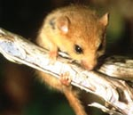
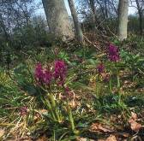
Coppicing as a conservation technique
Successive coppices are cut adjacent to each other, allowing species to move and creates larger areas of similar habitat for birds.
High structural diversity in coppice leads to many microhabitats = high biodiversity
Nuthatch
Nightjar
Brimstone
Orchid
Dormouse

Slide 17
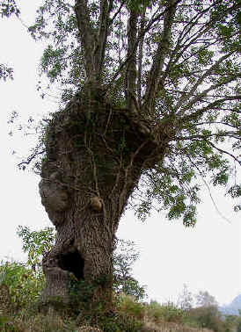
Pollarding
To prevent the coppice shoots being grazed by cattle, trees can be cut higher up (2 - 5m) so that the regenerating shoots are out of reach = pollarding

Slide 18
Woodland management - Modern methods
Large monoculture plantations which usually have low wildlife value.
New woodland areas around field margins.
Community forests planted for recreational and amenity use.

Slide 19
Woodland management - Conservation management
Coppicing to create wildlife habitats.
Creation of woodland clearings to increase habitat diversity.
Planting of mixed-species woodlands to increase biodiversity.

Slide 20
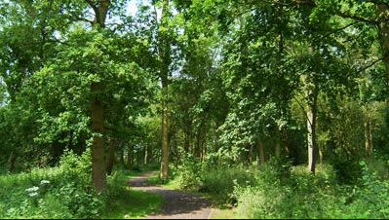
Planting of new woodlands
Large areas of new woodland have been planted in the UK over the past 30 years, usually on small areas of farmland.
These have often included a mix of indigenous tree species that are likely to have a high wildlife value as the woodlands mature.
They are especially valuable if they join existing areas of woodland, or habitats such as hedgerows, which can act as biological corridors linking small fragmented areas of woodland.

