Slide 1
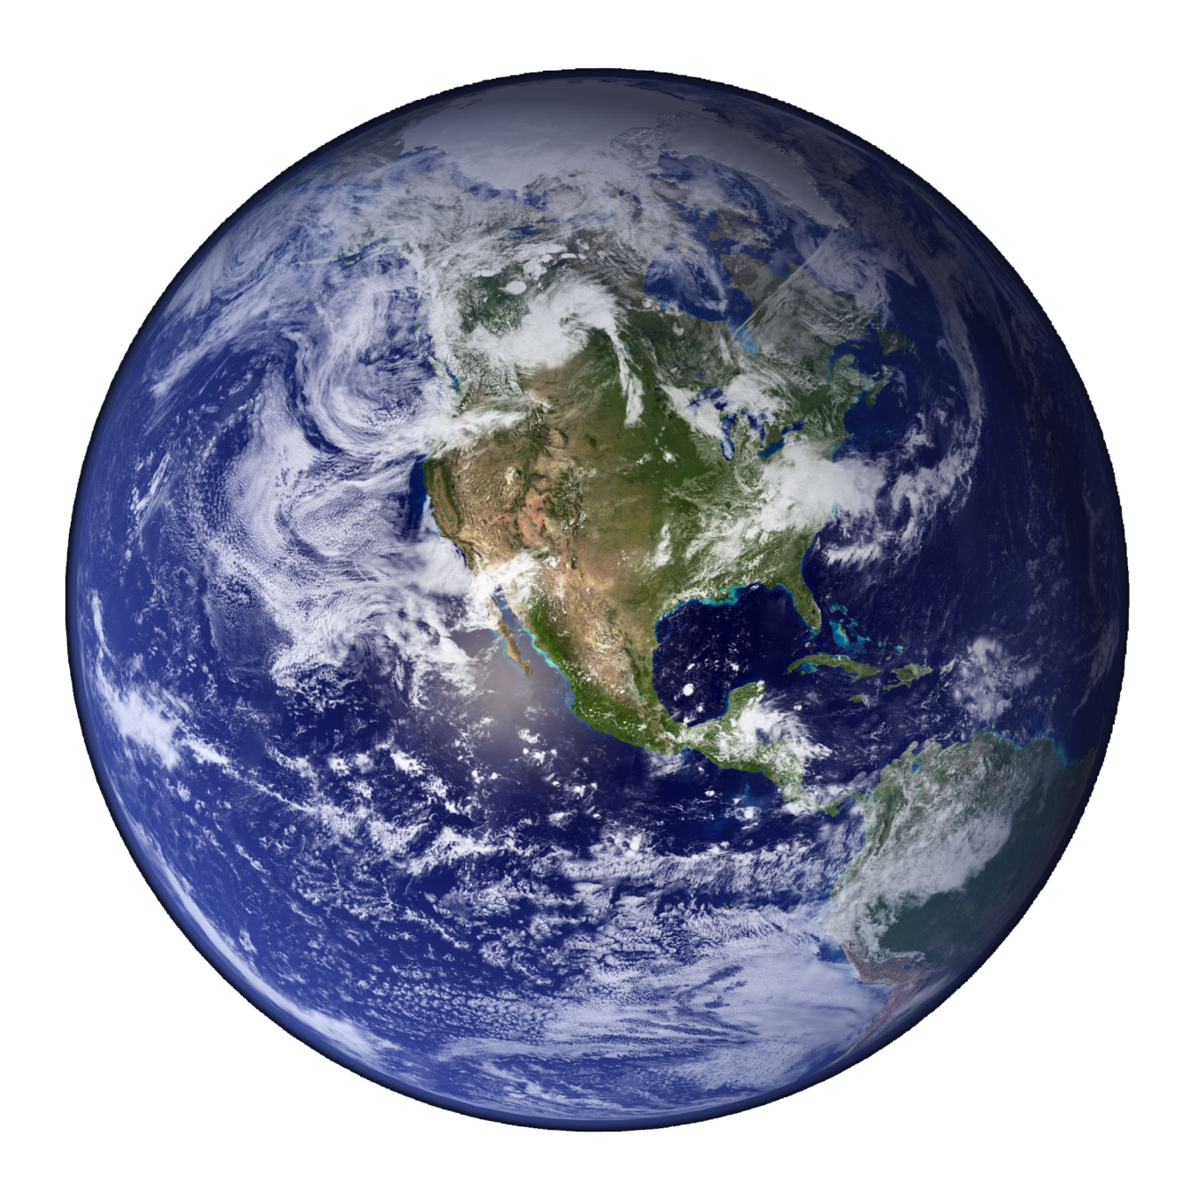
3.1.1- Conditions for Life on Earth
How the main conditions, which allowed early life to develop and survive on plant Earth, came about

Slide 2
Specification: 3.1.1.1
How the main conditions, which allowed early life to develop and survive on Earth, came about.
Content | Additional Information
Atmosphere | The mass of Earth and force of gravity retained an atmosphere. The atmosphere provided gaseous resources: carbon dioxide, methane, nitrogen. Atmospheric pressure and temperature maintained liquid water.
Insolation | A suitable temperature range was controlled by incoming insolation and its behaviour in the atmosphere. This was controlled by the surface albedo, absorption of infrared energy and the presence of the atmosphere.
Position in the solar system | Suitable temperatures were maintained by the distance from the Sun.
Orbital behaviour | The rotation and tilt of the Earth on its axis and its orbit around the Sun, controlled daily and seasonal variations in insolation and temperatures.
Magnetosphere | The magnetosphere provides protection from radiation: the Earth’s molten core produced a magnetic field (magnetosphere) that deflects solar radiation.

Slide 3
Specification: 3.1.1.2
How the presence of life on Earth has brought about environmental change.
3.1.1.2.1 How biota have helped to maintain stability
Content | Additional Information
Oxygen production | Oxygen was first produced by photosynthetic bacteria, then by algae and plants.
Ozone layer | Ozone was produced by chemical reactions involving oxygen and ultraviolet light in the stratosphere.
Carbon sequestration | Atmospheric carbon dioxide concentrations were reduced by photoautotrophs.
Biogeochemical cycles | The processes of biogeochemical cycles are linked by living organisms, preventing the build-up of waste products or shortages of resources.

Slide 4
Specification: 3.1.1.2
How the presence of life on Earth has brought about environmental change.
3.1.1.2.2 How historical conditions for life were monitored in the past and how these methods have been developed over time
Content | Additional Information
Limitations of early methods. | • Lack of ancient historical data. • Limited reliability of proxy data for ancient conditions. • Limited coordination between researchers. • Lack of sophisticated equipment for accurate measurements. • Inability to measure many factors. • Lack of data collection in many areas. • Reliance on proxy data, e.g. dendrochronology, pollen analysis.
Improved methods. | • Collection of long-term data sets. • The use of electronic monitoring equipment. • Gas analysis of ice cores. • Isotope analysis of ice cores. • Improved carriers for monitoring equipment, e.g. helium balloons, aircraft, satellites.

Slide 5
Features of Earth that control the conditions suitable for life.
Objectives:
To understand how the position of Earth in our solar system allowed life to develop
To explain how the physical features of Earth create conditions that are suitable for life.

Slide 6
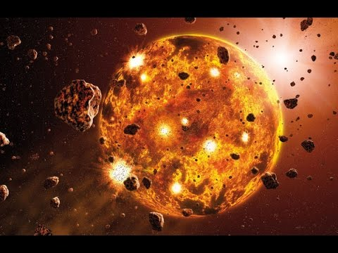
Formation of Earth
https://www.youtube.com/watch?v=Y2BclOxSvfk – visual history of the evolution of Earth (good one)

Slide 7

The Goldilocks Planet
4 important Abiotic (non-living) factors:
Water
Temperature
Ambient gases
Light and radiation
Mass of Earth controls force of gravity and is strong enough to retain an atmosphere
Tilted orbit produces seasonal climatic changes
Harmful solar radiation is deflected by Earth’s magnetic field
The gravitational attraction of the moon and Earth creates tides and keeps the Earth’s orbit nearly upright in relation to its movement around the sun
Distance from sun controls amount of Insolation and so also temperature and presence of liquid water.
Speed of rotation prevents excessive temperature fluctuations

Slide 8
Main features of the structure position and behaviour of Earth the made the development of life possible.
Complete the table in your booklets
Mass | Mass of Earth produces the force of gravity. This force was great enough to prevent gases escaping into space. Atmospheric pressure prevents water from boiling so it remains in liquid state.
Atmosphere | Contained elements needed for life (C, H, O and N) present in compounds such as methane, ammonia and carbon dioxide.
Distance from sun | Light from the Sun and distance from the sun provide a suitable temperature for life on Earth. Too hot/cold and there would be no liquid water.

Slide 9
Main features of the structure position and behaviour of Earth the made the development of life possible.
Axis of rotation | The tilt of the Earth’s axis produces seasonal variations in the conditions.
Speed of rotation | The time of rotation produces day and night cycles that prevent excessive heating and cooling of Earth’s surface.
Magnetosphere | The movement of molten iron/nickel in the outer core creates Earth’s magnetic field which deflects the ‘solar wind’ and prevents biologically damaging radiation reaching the Earth’s surface.

Slide 10
The development of life on Earth
Objectives:
To explain how the properties of water are essential for living organisms
To explain how temperature range, ambient gases and solar insolation provide the conditions needed to support life.

Slide 11
The development of life on Earth
After the formation of Earth conditions became suitable for life to develop. The following features made Earth suitable for the development of life.
Large amounts of water
Temperature range
The atmosphere
Solar insolation
These are controlled by features of the planet itself and by its position in the solar system.

Slide 12
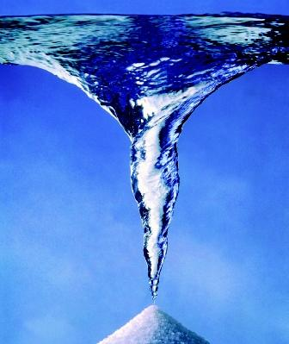
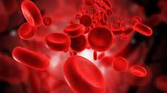
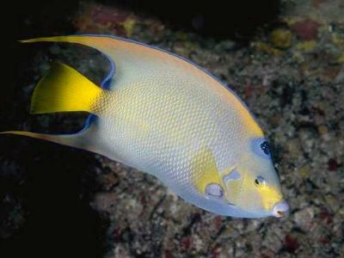
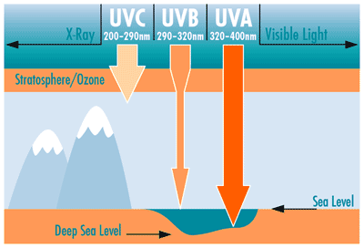
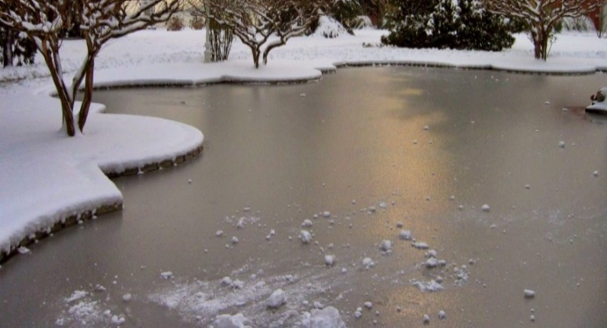

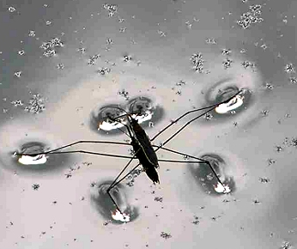
Biological importance of water
Water makes up 65 - 95% (mass) of most plants & animals
All living things require water for survival as it performs essential physiological functions and controls many environmental conditions.
Transport within organisms
Solvent
High specific heat capacity
Absorption of UV radiation
Anomalous expansion on freezing
Temperature control
Aquatic habitats

Slide 13
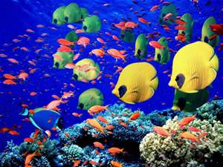
Water provides habitats for organisms
Rivers, lakes and oceans provide habitats for many organisms

Slide 14
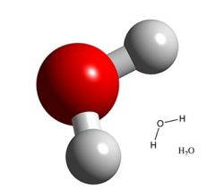
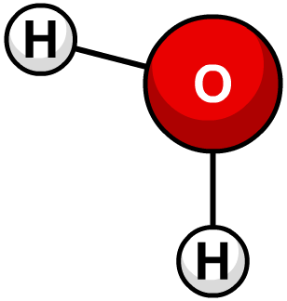
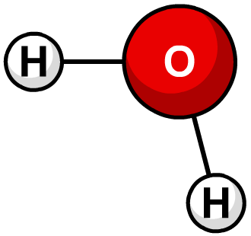
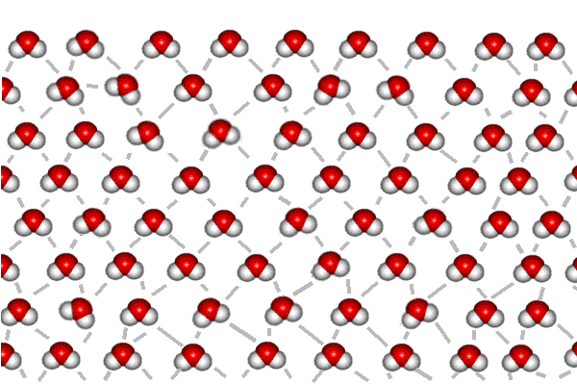
The Water Molecule
The oxygen atom of water has a slight negative charge and the 2 hydrogen atoms have a slight positive charge because the electrons in the covalent bond are shared unequally between the atoms of water.
This means it is a POLAR molecule.
So water molecules attract each other and form hydrogen bonds between each other.
hydrogen bond

Slide 15
Water Circus – Information Sheets
Read the information sheets for each station
Answer the questions in your student booklet

Slide 16
STATION 1 – Water is the universal solvent.
Solutions and suspensions: Water is not always pure – it is often found as part of a mixture. A mixture is a material composed of two or more elements or compounds that are physically mixed together but not chemically combined. Salt and pepper stirred together constitute a mixture. So do sugar and sand. Earth’s atmosphere is a mixture of gases. Living things are in part composed of mixtures involving water. Two types of mixtures that can be made with water are solutions and suspension.
If a crystal of table salt is placed in a glass of warm water, sodium and chloride ions on the surface of the crystal are attracted to the polar molecules. Ions break away from the crystal and are surrounded by water molecules. The ions gradually become dispersed in the water, forming a type of mixture called a solution. All the components of a solution are evenly distributed throughout the solution. In a salt-water solution, table salt is the solute, the substance that is dissolved. Water is the solvent – the substance in which the solute dissolves. Water’s polarity gives it the ability to dissolve both ionic compounds and other polar molecules, such as sugar. Without exaggeration, water is the greatest solvent on Earth.

Slide 17
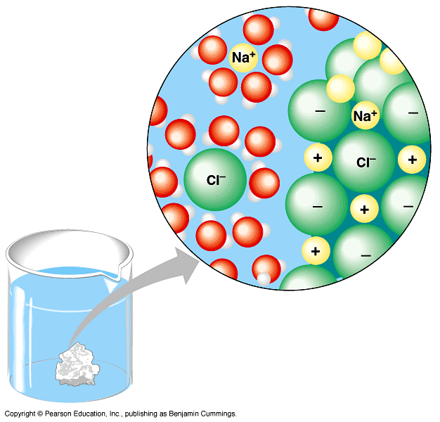
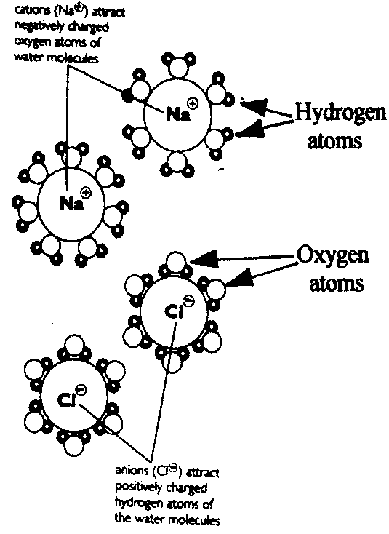
Importance of Water as a Solvent
Most chemical reactions in living organisms involve reactants that are dissolved in water.
Example: salt dissolved in water
Cations (Na+) attract negatively charged oxygen atoms of water molecules
Water is a Transport Medium
Water is a solvent in blood and sap. It transports oxygen, carbon dioxide, sugars, amino acids, waste products and mineral nutrients.
Anions (Cl-) attract positively charged hydrogen atoms of water molecules

Slide 18
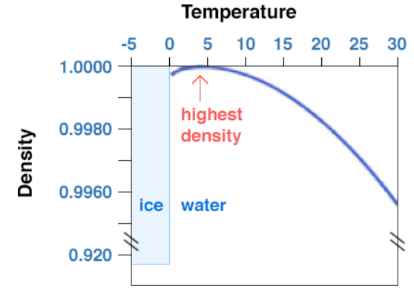
STATION 2 – Water is less dense as a solid than a liquid.
When water is a liquid, the water molecules are packed relatively close together but can slide past each other and move around freely. At 4˚ C water is the most dense. As the temperature increases or decreases from 4˚ C, the density of water decreases
When water freezes bonds are formed that lock the molecules in a regular (hexagonal) pattern which are now held further apart . While other materials contract and become more dense when they solidify, water expands into an evenly distributed crystalline structure. Water expands when it freezes making it less dense than the water. For this reason, ice floats on the water.
This property is important in making the environment suitable for life. If ice sank, then eventually all ponds, lakes and even oceans would freeze solid. When a layer of ice forms on the top of a lake, warmer more dense water sinks therefore the ice layer insulates the liquid water below, preventing it from freezing and allowing life to exist below the frozen surface. Besides insulating the water below, ice also provides a solid habitat for animals such as polar bears and seals.

Slide 19


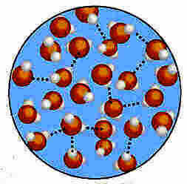
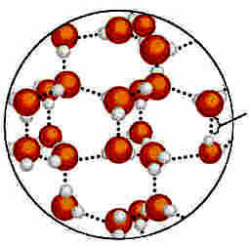
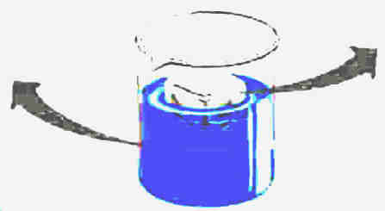
4 Anomalous expansion on freezing
At what temperature is the density of water at its maximum?
What do we mean by a ‘thermal insulator’?
Why does ice float on water?
Hydrogen bond
Liquid Water – hydrogen bonds constantly break and reform
Ice – hydrogen bonds are stable

Slide 20
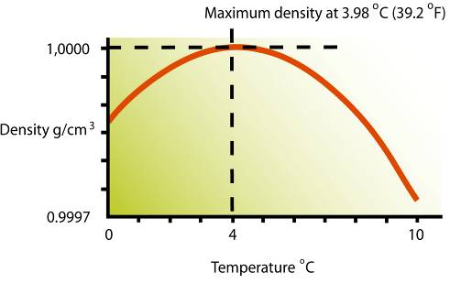
4. Anomalous expansion
Water has the very unusual property that its solid form (ice) floats on the liquid. Why is this important for living organisms?
Water is most dense at about 4ºC
So ice is less dense than cold water.
Thus water freezes from the top down and allows life to survive underneath

Slide 21
STATION 3 – Water has a strong surface tension.
A single water molecule may be involved in as many as four hydrogen bonds at the same time. The ability of water to form multiple hydrogen bonds is responsible for many of water’s properties. Cohesion is an attraction between molecules of the same substance. Because of hydrogen bonding, water is extremely cohesive. Water’s cohesion causes molecules on the surface of water to be drawn inward, which is why drops of water form beads on a smooth surface. Cohesion also explains why some insects and spiders can walk on a pond’s surface.
The cohesive property of water gives it a high surface tension. Surface tension describes the “stickiness” of water molecules on the surface of water. The attraction of the water molecules creates a strong film on the water’s surface. Surface tension allows water to hold up materials heavier and denser than itself. For example, the high surface tension of water enables a paper clip to float on the surface of water, and also allows some insects to walk on the surface of water.

Slide 22
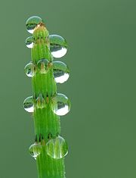
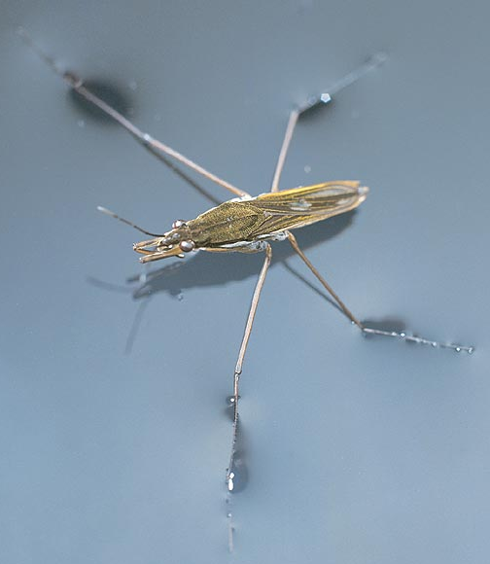
Water provides support and habitats for organisms
Water molecules show a strong attraction to one another, this is called cohesion. This creates surface tension.
The skin like surface tension allows creatures such as the pond skater to support them selves on the surface of the water.
Surface Tension of Water: – Jesus Lizard http://www.youtube.com/watch?v=K1vwHvR9jT0
Surface Tension of Water:- The Unsinkable Pygmy Gecko http://www.youtube.com/watch?v=_UWOKjfBmy4

Slide 23
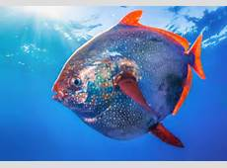
STATION 4 – Water has a high specific heat capacity
Due to the cohesive nature (stickiness) of water molecules, it takes more energy to heat a given mass of water this describes waters property of high specific heat capacity. Therefore, the specific heat capacity is the amount of energy needed to change 1kg of a substance by 1 degree C. This means that a relatively high level of heat is needed to raise the temperature of water by a small amount due to its high specific heat capacity.
In this respect, water acts as a buffer against sudden temperatures variations, making the aquatic environment a temperature-stable one. As organisms are mostly water, it buffers them against sudden temperature changes especially in terrestrial environments and enables them to control their body temperature more effectively.

Slide 24
3. Water has a high specific heat capacity
The specific heat capacity is the amount of energy needed to change 1kg of a substance by 1 degree C
  Water has a large specific heat capacity, so it can absorb much heat energy before its temperature rises.
This means it takes a lot of energy to heat it up and also it has to lose a lot of energy to cool down.
As a result, aquatic environments have stable temperatures. Water acts as a temperature buffer.
Why else is this important for organisms?
thermometer
1kg of water
This enables organisms to maintain particular temperatures in order to optimise enzyme activity.
Water acts as a temperature buffer

Slide 25
Water controls temperature
Latent heat of vaporisation or evaporation is the energy needed to convert liquid water to a gas
The high number of hydrogen bonds restrict the movement of molecules making it difficult for water molecules to escape (evaporate, become vapour) and so this is why it is so high for water
The molecules that do escape have high kinetic energy (KE). The cooling effect is because the average KE of the remaining molecules has decreased and so the temperature falls.
Latent Heat of Vaporisation:- Kangaroo Adaptation (1 min 57 s) http://www.bbc.co.uk/programmes/p0037pn8

Slide 26
Water provides support and habitats for organisms
Water molecules show a strong attraction to one another, this is called cohesion. This creates surface tension.
The skin like surface tension allows creatures such as the pond skater to support them selves on the surface of the water.
Rivers, lakes and oceans provide habitats for many organisms
Surface Tension of Water: – Jesus Lizard http://www.youtube.com/watch?v=K1vwHvR9jT0
Surface Tension of Water:- The Unsinkable Pygmy Gecko http://www.youtube.com/watch?v=_UWOKjfBmy4

Slide 27
Appropriate temperature range
Most areas of Earth have temperatures between 0ºC and 35ºC.
This ensures that there is enough liquid water for organisms to use. Also proteins such as enzymes that catalyse reactions within living organisms do not denature.

Slide 28
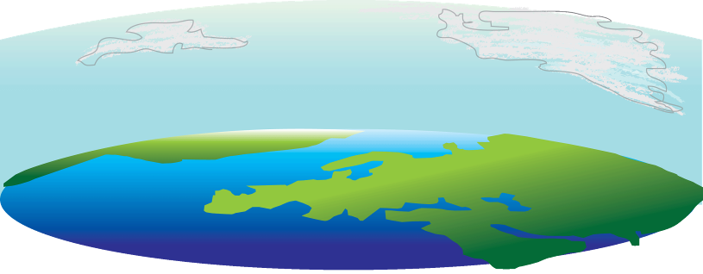
Appropriate temperature range
The greenhouse effect – the trapping of heat in the lower atmosphere – is a natural process and is essential for life on Earth. Without it, temperatures would be below 0ºC
Shortwave radiation reaches Earth’s atmosphere
Some is reflected
Some of the re-radiated longwave radiation is trapped by water vapour and “Greenhouse gases” (CO₂ CFCs, CH₄, N₂O)
Most gets through
Earth absorbs the radiation
Earth’s surface warms up and emits longwave radiation (re-radiates energy)
Earth’s surface warms up and emits longwave radiation (re-radiates energy)
The GHE ensures that most of our planet has a suitable temperature for life.

Slide 29
Atmospheric gases
(Including argon and CO₂)
Water vapour will contribute to the water cycle
Oxygen and carbon dioxide allow aerobic respiration and photosynthesis respectively.
0.035% CO₂, that is sufficient for photosynthesis: A higher percentage would run the risk of a runaway greenhouse effect.
21% O₂ allows plants and animals to carry out aerobic respiration – the efficient release of energy from chemical stores.
Nitrogen is used for protein synthesis

Slide 30
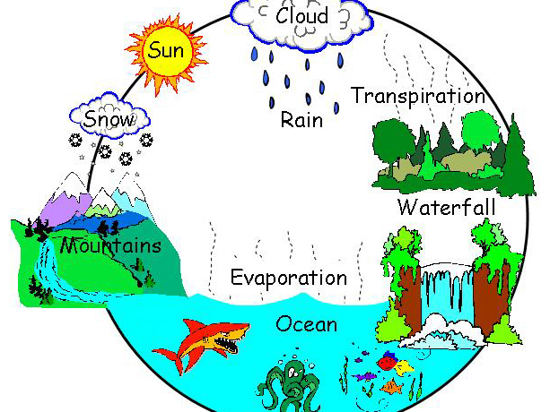
Solar insolation
Sunlight provides the energy for photosynthesis. The heat produced by the absorption of sunlight provides the energy to drive the water cycle and warms the Earth’s surface and the oceans
Heat energy from the sun causes water to evaporate.
Water is returned to the earth as rain.
This water may be returned to the oceans via rivers or used by plants.
The movement and loss of water by plants is called Transpiration.

Slide 31
How life on Earth caused environmental change.
Objective
To understand how the presence of early life changed environmental conditions which led to the evolution of other life forms

Slide 32
How the atmosphere has changed
Early Atmosphere | Today’s Atmosphere
Major Gases: Carbon Dioxide (86 %) Ammonia (10 %) Methane (4 %) Minor Gases: Nitrogen (< 1%) Water Vapour | Major Gases: Nitrogen (78 %) Oxygen (21 %) Noble Gases (1%) Minor Gases: Carbon Dioxide (0.04%) Methane (< 1%) Ozone
Add any notes to your timeline from the following slides

Slide 33
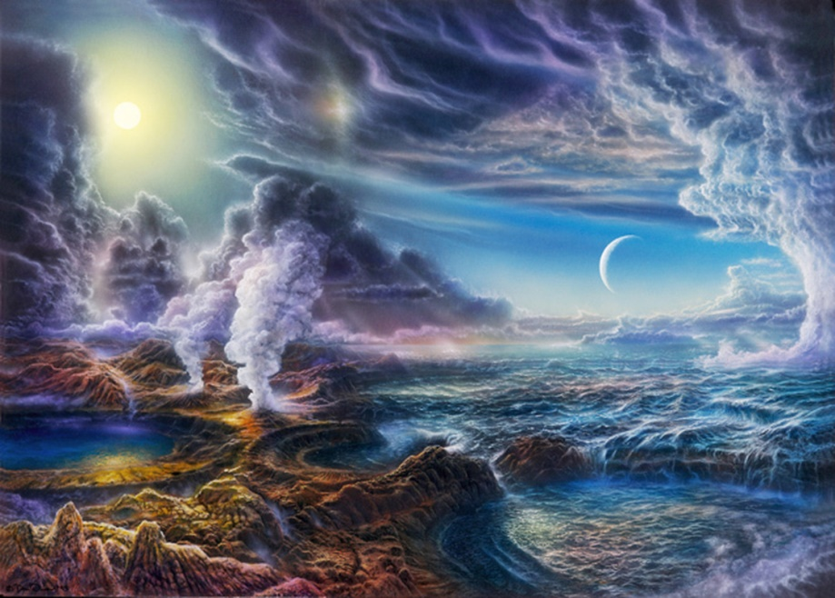
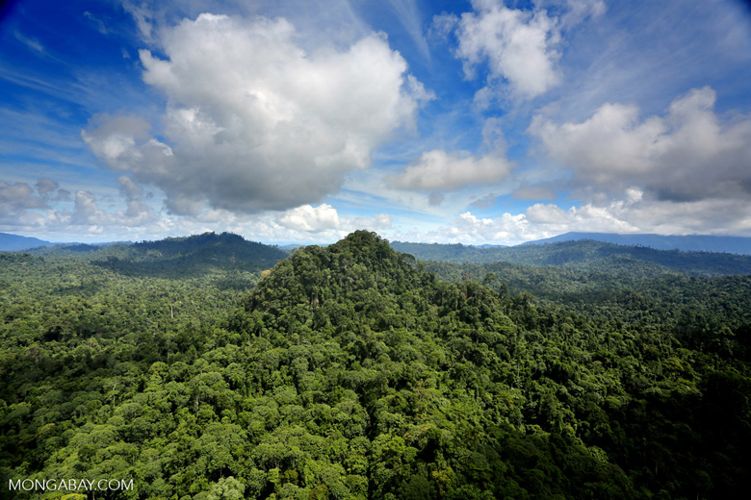
Earths Evolution
http://estream.godalming.ac.uk/View.aspx?ID=1822~4n~NNVB9emH
Life on Earth David Attenborough
From 17.08 - 25.00 min. section on how life has changed the early atmosphere of Earth.
Research the main events in Earth’s history.
Add information to your timeline in your student bookelt
Focus on the changes in abiotic conditions on Earth.

Slide 34
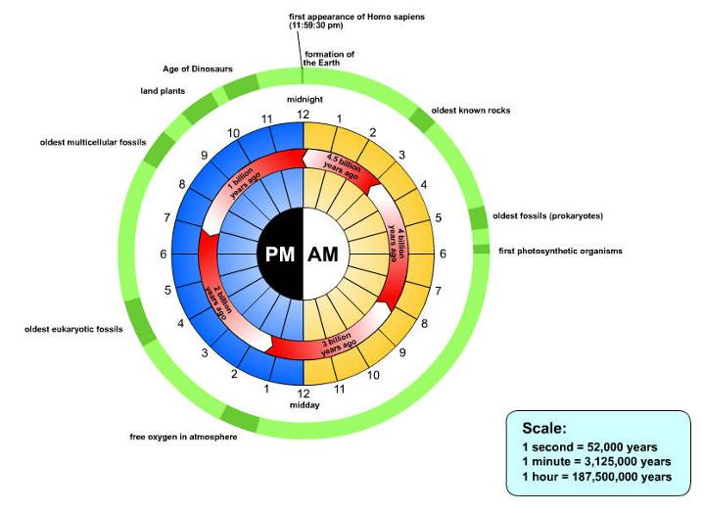
Life on earth – Diagram scaling the lifetime of Earth into 24 hr
First appearance of Homo sapiens (11:59:30 pm)
Age of dinosaurs
Formation of the Earth
Land plants
Oldest known rocks
Oldest multicellular fossils
Oldest fossils (prokaryotes)
First photosynthetic organisms
Oldest eukaryotic fossils
Planet Earth: 4.5 billion years old. Life evolved 3.9 billion years ago
Free oxygen in atmosphere
Life exists in the oceans, soil, on the surface, in rocks extending to several kilometres below the surface and in the air to an altitude of several kilometres.

Slide 35
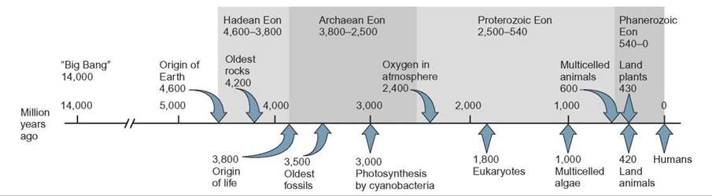
Main events in evolution

Slide 36
Earth’s evolution – major events
4.6 billion years ago - The earth forms. Volcanoes produce huge amounts of carbon dioxide
4.3 Billion years ago Volcanoes also produce water vapour. As the earth cooled this condensed to form the oceans.
4.0 Billion years ago Carbon dioxide starts to dissolve in the oceans. The levels of carbon dioxide in the atmosphere starts to fall.
3.4 Billion years agoFirst life forms appear. They are protected from the Sun’s harmful rays by the oceans. Oxygen first produced. This turns into ozone which blocks the Sun’s harmful UV radiation
3.0 to 2,5 Billion years ago Oxygen gas reacts with the harmful ammonia in the atmosphere turning it into Nitrogen
400 Million years ago Plants appear on the land. Photosynthesis removes carbon dioxide and adds oxygen to the atmosphere

Slide 37
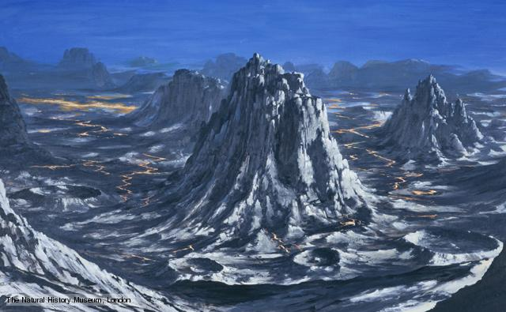
The Archean Era – The start of Life
About 3.5 billion years ago, giant mats of cyanobacteria began to form in shallow oceans. Probably around volcanic hydrothermal vents.
By 2.7 billion years ago, these Archaean bacteria were the first ‘photosynthesisers’ and released O₂. For millions of years this O₂ reacted with iron in the oceans. Once all the iron was used up the excess O₂ was then released into the atmosphere (2.45 billion years ago) and O₂ levels started to rise.
This atmospheric oxygen absorded UV light which form Ozone (O₃). A dynamic equilibrium developed between O,O₃ and O₂.
The build of O2 in the atmosphere lasted 2000 m years and was called the Proterozoic.
Before Ozone – life was not possible on earth
why do you think this is?

Slide 38
Dynamic Equilibrium
A dynamic equilibrium is when natural processes that may be opposing, balance out to maintain a stable, organised configuration (e.g. photosynthesis and respiration rates fluctuate but the overall the concentration of gases remains balanced)
In a dynamic system there are lots of fluctuations but an overall balance is maintained
All processes on earth are interconnected
Concept of dynamic equilibrium explained (watch only first 40 seconds) https://www.youtube.com/watch?v=wlD_ImYQAgQ

Slide 39
How life brought change
Oxygen in the atmosphere
Photosynthesis released O₂
O₂ molecules reacted with O atoms to form ozone (O₃)
This formed a layer in the atmosphere that filtered out harmful UV radiation from the sun
The ozone layer in the stratosphere absorbs UV radiation which would otherwise destroy organisms by causing mutations and cancers.
So O₂ , O₃ increased and CO₂ , CH₄ , UV decreased
Eventually conditions enabled life to move out of the oceans onto land

Slide 40

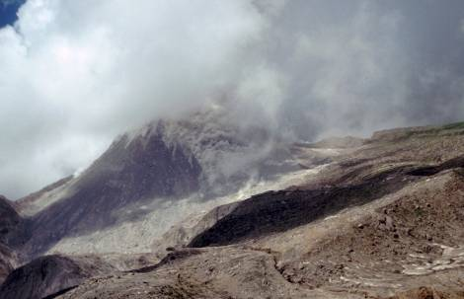
How life brought about change
Carbon Dioxide in the atmosphere
Before life on Earth, CO₂ was abundant in the atmosphere.
Eventually, photosynthetic organisms began to remove the CO₂.
CO₂ was dissolved in water and formed carbonate sediments.
As CO₂ and methane levels fell, so did temperatures
CO₂ is still released by volcanoes.
Is CO₂ a good thing?
Photosynthesis? Greenhouse gas?
Too cold without it?

Slide 41
Biogeochemical cycles
As more organisms evolved, interconnected biological processes developed which produced biogeochemical cycles. Small amounts of nutrient elements that support life did not become depleted e.g. C, N, P
Transpiration
Once plants had evolved, transpiration returned water vapour to the atmosphere and increase the rainfall in other areas allowing more plants to grow and survive

Slide 42
Monitoring conditions on Earth
How did scientists monitor the conditions on Earth in the past and today?
How have these methods changed?
Research:
Proxy data, ice core data, dendrochronology, data from sediments, pollen analysis, satellites, argo floats, atmospheric measurements
20 minutes to find out how scientists monitor conditions on Earth both today and in the past.
Feedback
How have these methods changed the confidence in our conclusions?

Slide 43
Monitoring conditions on Earth
Historical records from when humans evolved include written accounts of droughts, floods, especially extremely cold winters, unusually hot summers, and storms as well as timing and quality of harvests and timing of seasonal changes.
Such accounts lack the numerical precision of modern instrumental records, but span a much longer period of time.

Slide 44
Proxy data
Various types of data provide paleoclimatologists with information about the climates of ancient times. These types of data are called proxies.
Tree rings, ice cores from Greenland and Antarctica, sediments from the bottoms of lakes and seas, tree ring records span the most recent few thousands of years ice core records go back as much as hundreds of thousands of years; and fossils can be up to hundreds of millions of years old.

Slide 45
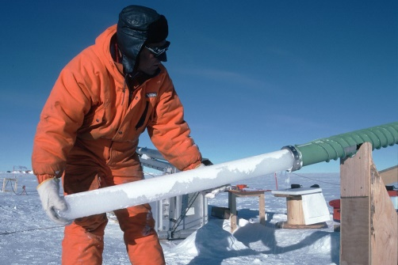
Ice core data
Most ice cores are collected from ice sheets covering Greenland and Antarctica, and some records span periods of hundreds of thousands of years.
The thickness of an ice layer; a thick layer corresponds to greater snowfall. Layer thickness also may tell us something about global temperatures since more snow tends to accumulate at the poles during global warm spells.
Air pockets between the grains become cut off from each other and produce bubbles in the ice. Gas bubbles trapped in the ice provide data about atmospheric composition including the concentration of greenhouse gases.
https://www.youtube.com/watch?v=VjTsj-fi-p0
https://www.youtube.com/watch?v=NbDU83wzzVY

Slide 46

Dendrochronology
Dendrochronology (or tree-ring dating) is the scientific method of dating tree rings to the exact year they were formed in order to analyse atmospheric conditions during different periods in history.
https://www.youtube.com/watch?v=gVJaqU9APuw

Slide 47
Data from sediments
Sediments from lakes beds and seafloors can be used and analysed as the climate history is preserved within layers of sediments that slowly accumulate on the bottoms of lakes and oceans can span hundreds of millions of years or longer.
https://www.youtube.com/watch?v=Yvu-g8BkkIg

Slide 48
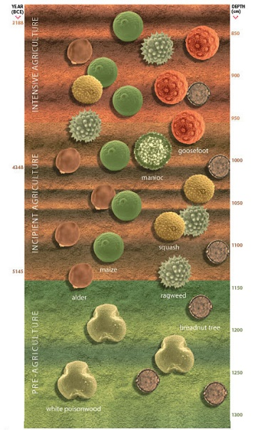
Pollen analysis
Fossil pollen: Different classes of plants produce pollen grains with different distinctive shapes. Such pollen grains are often found preserved in sediment cores from ponds, lakes and oceans. They provide information on the type of plants that grew nearby when the sediments were formed
Often, changes in the vegetation of an area may be due to changes of climate. Pollen has been identified from more than 300 million years ago
https://www.youtube.com/watch?v=mqBCl5bNHuw

Slide 49
Modern methods
The past 140 years we have relatively precise, quantitative, direct measures of climate such as temperature, precipitation, and wind speeds.

Slide 50
Ice cores
Improved methods of ice core analysis. Gas and isotope analysis of ice cores.
Beryllium-10 concentrations, linked to cosmic ray intensities, are an indirect indicator of solar activity.
The ratio of concentrations of two isotopes of oxygen in the water molecules in ice serves as an indicator of global temperatures.

Slide 51
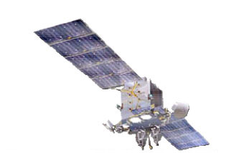
Satellites
Satellites. Hundreds of climate satellites send data to organisations such as the World Meteorological Organisation, NASA, NOAA and elsewhere that drive climate change modelling.
The Gaofen-2 (GF2) satellite launched on August 19, 2014 in the Shanxi Province of Northern China. This satellite supports applications in GIS (geographic information system) mapping, engineering and construction, climate change, environmental monitoring, precision agriculture, disaster relief, urban planning and many other applications.

Slide 52
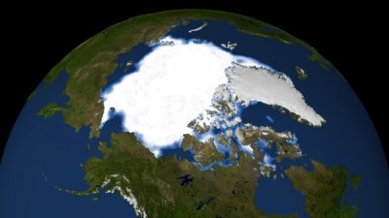
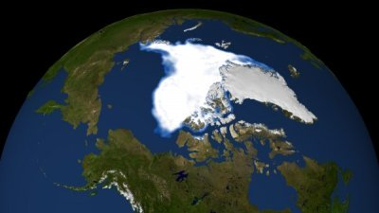
This satellite images show how much less summer sea ice there was in 2007 compared with the amount in 1983.

Slide 53
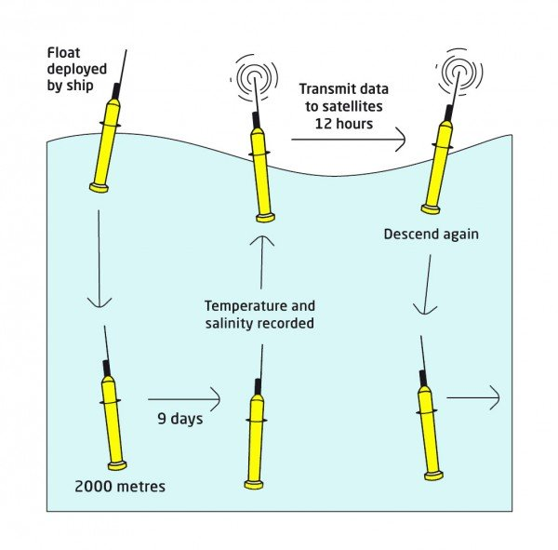
Argo floats
Argo floats. More than 3500 Argo floats are drifting along in the world’s ocean currents. These small robots constantly gather information about temperature and salinity.
https://www.youtube.com/watch?v=PzHZdwaBr_Q
https://www.youtube.com/watch?v=7DTCbmyV7jA

Slide 54
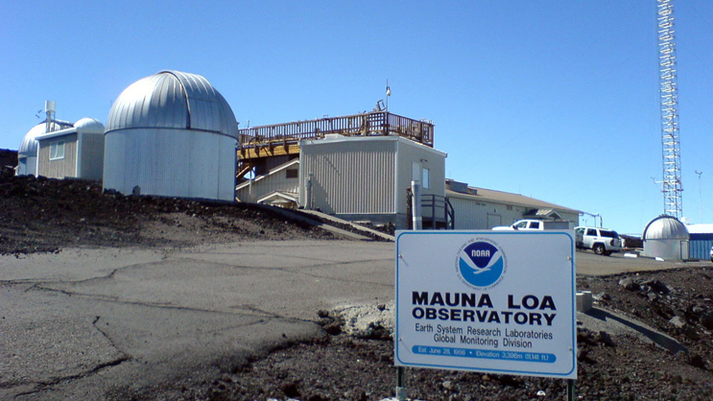
Atmospheric measurements
Atmospheric measurements. Baseline Air pollution stations around the world (Cape Grim in Tasmania, Mauna Loa Observatory in Hawaii). Take measurements that are state-of-the-art in precision and accuracy

Slide 55
Atmospheric measurements
Air samples are analysed at the stations to determine concentrations of greenhouse and ozone-depleting gases, other air pollutants, including aerosols and reactive gases, and radon.
Also measured are weather and climate indicators like wind speed and direction, rainfall, temperature, humidity and solar radiation.
Carbon dioxide concentrations in air are measured using Non-Dispersive Infrared (NDIR) gas analysers. Methane and nitrous oxide are measured using gas chromatography.
In groups discuss the limitations of historical methods

Slide 56
Limitations of early methods:
  • Lack of ancient historical data.
  • Limited reliability of proxy data for ancient conditions.
  • Limited coordination between researchers.
  • Lack of sophisticated equipment for accurate measurements.
  • Inability to measure many factors.
  • Lack of data collection in many areas.
  • Reliance on proxy data, e.g. dendrochronology, pollen analysis.
Improved methods:
  • Collection of long-term data sets.
  • The use of electronic monitoring equipment.
  • Gas analysis of ice cores.
  • Isotope analysis of ice cores.
  • Improved carriers for monitoring equipment, e.g. helium balloons, aircraft, satellites.

Slide 57
Time to consolidate and revise
Past Paper Questions
Note Cards
Mind maps
Posters
Activity: make a revision resource of your choice (mind map, note cards, poster)
  Read all your notes
  Decide on key words and phrases
  Condense notes down – use pictures, diagrams, colours to highlight key ideas

Slide 58
Homework
Complete the question pack
Revise everything you have learnt on this topic
Test next lesson

