Slide 1
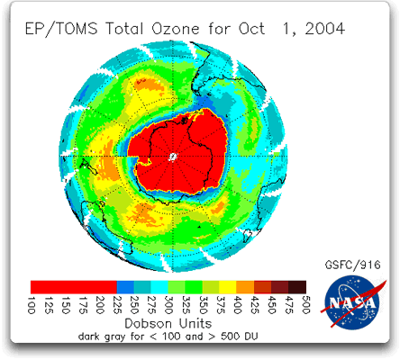
OZONE DEPLETION
Satellite imagery of the ozone hole over the Antarctic. Ozone concentration measured in Dobson units.

Slide 2

UV radiation
The sun emits UV radiation across a broad spectrum
X-rays
Ultraviolet
Visible
Infrared
C
B
A
0.1
1.0
Wavelength (µm)
UV A (320-400nm): Used by the skin to synthesise Vitamin A but it also causes sunburn and cataracts. Not absorbed
UV B (290-320nm): Higher energy than UV A. Damages organic molecules such as DNA and chlorophyll. Some absorbed
UV C: Would be rapidly fatal but is filtered out before it reaches the ground. Absorbed by ozone and oxygen

Slide 3
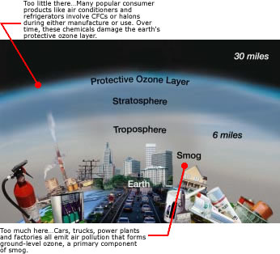
OZONE –Good up high/bad nearby

Slide 4
Evolution of Life
Life only able to evolve in places shielded from this UV radiation - in oceans and beneath organic material
Around 2 billion years ago, plant-like organisms started photosynthesizing and released oxygen. In the outer atmosphere molecular oxygen (O₂) absorbed UVB radiation and, in the process, decomposed into oxygen atoms (O)
UV
O₂
Oxygen atom
Oxygen atom
Then
Ozone molecule (O₃)
Oxygen atom
O₂
Then
Ozone molecule (O₃)
UV
O₂
Oxygen atom
Ozone absorbs wavelengths up to about 310 nm. Thus, all of the harmful UV C and most of the UV B radiation was absorbed in the ‘ozone layer’ and this allowed evolution to accelerate

Slide 5
What is Ozone?
Ozone is an allotrope of oxygen gas.
It is made naturally in the atmosphere
It can also be made by photocopiers and laser printers.
O₃
Ozone formation

Slide 6
Ozone Formation
In the Stratosphere;
Oxygen gas molecules are bombarded by high energy UV light from the Sun.
This causes them to break up to form Oxygen radicals, O.
O₂
O₂
UV
O₂
O·
O·

Slide 7
Ozone Formation
The oxygen radicals, O., then react with more oxygen gas molecules making ozone.
O₂ → 2O.
2O. + 2O₂→ 2O₃
3O₂ → 2O₃
O₂
O₂
O₃
O₃
O·
O·

Slide 8
Ozone Destruction
The Ozone gas molecules are hit by other UV radiation from the Sun.
They break up to form oxygen gas molecules and oxygen radicals
2O₃ →2O. + 2O₂
UV
UV
O₃
O·
O₂
O₂
O·
O₃

Slide 9
Ozone Destruction
Oxygen radicals join up to form O₂ molecules.
2O. →O₂
2O₃ →3O₂
O·
O₂
O₂
O·
O₂

Slide 10
The Ozone Cycle
UV
O₂
O·
O₃
O₂
UV
O·
O₂
O₂
O·
UV
O·
O₂
O₃
O₂

Slide 11
The Ozone Cycle
UV
O₂
O·
O₃
O₂
UV
O·
O₂
O₂
O·
UV
O·
O₂
O₃
O₂

Slide 12
The Ozone Cycle
UV
O₂
O·
O₃
O₂
UV
O·
O₂
O₂
Harmful UV has been absorbed
O·
UV
O·
O₂
O₃
O₂

Slide 13
CFCs

Slide 14
CFCs
A chlorofluorocarbon (CFC) is an organic molecule containing chlorine, fluorine and carbon atoms.

Slide 15
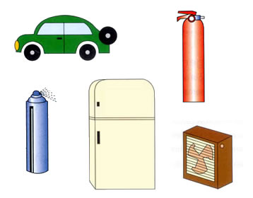
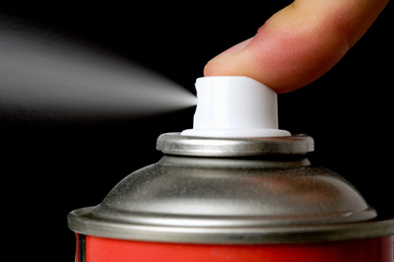
CFCs
CFCs are used as
  Refrigerants
  Bubbles in expanded polystyrene
  Inert atmospheres
  Aerosol propellants.
  electronic cleaning solvents

Slide 16
CFCs were very useful as:
Boiling point just below ambient so can be liquefied easily
They are a good solvent
They are not flammable
most are not toxic.
YouTube - When CFCs meet Ozone

Slide 17
Rowland-Molina Hypothesis
1974 - scientists suggested that the chemical properties of CFC’s could lead to ozone depletion. The theory was based on the chemical behaviour of CFC’s.
  Persistence of CFC’s – in atmosphere for a long time
  Dissociation by UV & the release of chlorine – in the stratosphere
  Reaction of chlorine and oxygen
  Other halogens (bromine & iodine react in the same way)
YouTube - When CFCs meet Ozone

Slide 18
Ozone depletion
CFCs are very stable in the troposphere so will eventually diffuse from the troposphere into the stratosphere
They then react with UV radiation from the Sun, releasing chlorine radicals
The radicals then react with and destroy ozone

Slide 19
How do CFCs remove ozone
Step 1
The stable CFCs last long enough in the atmosphere to reach the stratosphere.
Here they react with UV light.
This produces very reactive chlorine radicals in the upper atmosphere.
UV

Slide 20
How do CFCs remove ozone
Step 2
The chlorine radicals react with ozone molecules in the stratosphere
They remove them from the ozone cycle
O₃
Cl.

Slide 21
How do CFCs remove ozone
Step 2
Step 2
Cl. + O₃ → ClO. + O₂
The ozone goes back to being oxygen gas.
But what about the ClO.
O₃
O₂
Cl.
ClO.

Slide 22
How do CFCs remove ozone
Step 3
ClO. + O. → Cl.+ O₂
The ClO. radical takes oxygen radicals out of the ozone cycle.
O·
O₂
ClO.
Cl.

Slide 23
How do CFCs remove ozone
The two reactions are;
Cl• + O₃ → ClO• + O₂
ClO• + O• → Cl• + O₂
If we add these together and simplify
Cl• + O₃ + ClO• + O• → ClO• + O₂ + Cl• + O₂
O₃ + O• → 2O₂

Slide 24
The chlorine radicals
The chlorine radicals remove ozone
They turn it back into oxygen gas, without it absorbing UV light
The Cl. are reformed
They are very long lasting, up to 30 years.
They react with lots of ozone
Cl.

Slide 25
The Ozone Cycle
O₂
ClO·
O₃
O₂
Cl.
UV
O·
O₂
O₂
Cl.
O·
UV
O·
O₂
O₃
O₂

Slide 26
The Ozone Cycle
O₂
ClO·
O₃
O₂
Cl.
UV
O·
O₂
Less harmful UV has been absorbed
O₂
Cl.
O·
UV
O·
O₂
O₃
O₂

Slide 27
Ozone depletion
Ozone can be destroyed by a variety of Ozone-Depleting Substances (ODS), e.g. halogenated hydrocarbons (CFCs & HCFCs), halons and nitrous oxides
In the stratosphere, ODS are split by UV radiation (photolysis) releasing reactive free radicals (e.g. H, OH, NO, Br and Cl) which break down ozone
F
CFCl₃
F
UV
C
Cl
C
Cl
Cl
Cl
Cl
Then
Cl
CFCl₂
O
Ozone molecule (O₃)
O
Cl
O
Cl
O
O
O
ClO
O₂
Then
O
Cl
O
O
O
Cl
Oxygen atom
O₂
ClO

Slide 28
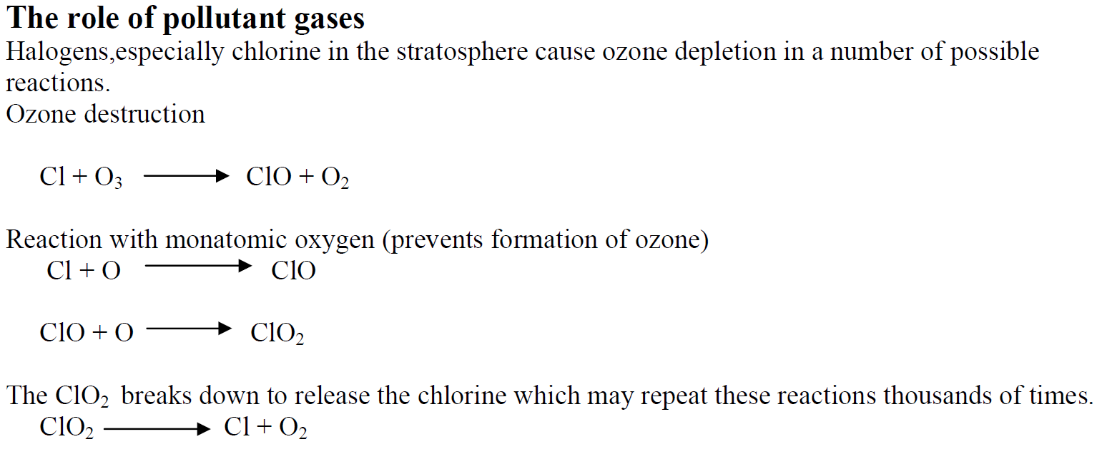

Slide 29
Less Removal of UV Radiation
Increased levels of ultraviolet light can lead to medical problems:
  increased risk of sunburn;
  accelerated ageing of skin;
  skin cancer & skin damage:
  increased risk of cataracts
Can be absorbed by living cells
Damages plant tissues
Inhibits reproductive cycle of phytoplankton
Inhibits reproductive cycle of shrimps, crabs, frogs and salamanders
http://www.bbc.co.uk/learningzone/clips/the-influence-of-cultural-and-genetic-factors-on-skin-cancer-levels/5707.html
Slip, Slop, Slap

Slide 30
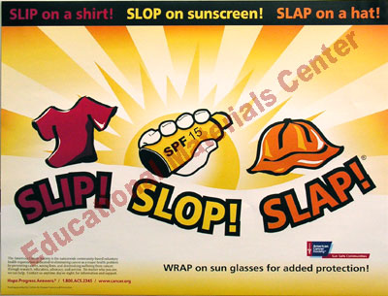

Slide 31
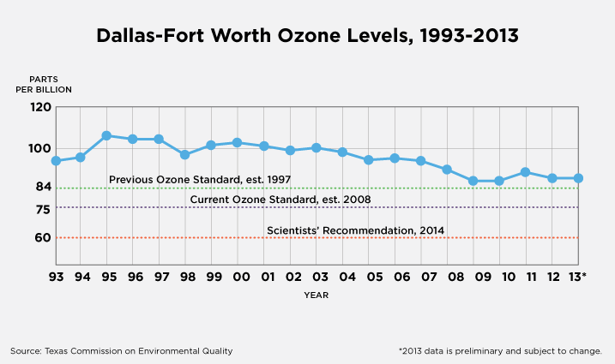
Measuring Ozone Levels

Slide 32
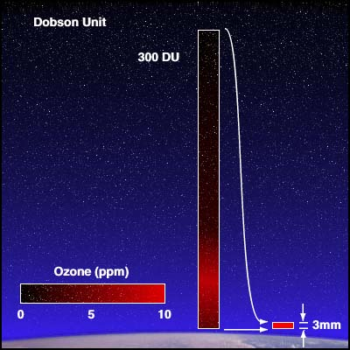
Measuring Ozone Levels
Ozone is measured in what are called Dobson units. A Dobson unit of gas is equal to a layer of gas, at the surface of the Earth, with a thickness of one hundredth of a mm. The ozone in the atmosphere is about 300 Dobsons. That means if you brought all of the ozone in the atmosphere down to a layer of pure ozone at the surface, it would be about three mm thick.

Slide 33
Evidence for reduction in ozone levels
Ground based data collection
  Detection of higher levels of UV at ground level = loss of ozone in stratosphere
Satellite surveys
  Satellites are above the stratosphere so UV passing downwards can’t be measured. But reading of UV reflected by Earth were higher than expected suggesting a loss in ozone
Air samples from the stratosphere
  Air samples collected by helium balloons and high-flying research aircraft confirmed the chemicals that were causing the depletion (Cl and ClO)

Slide 34
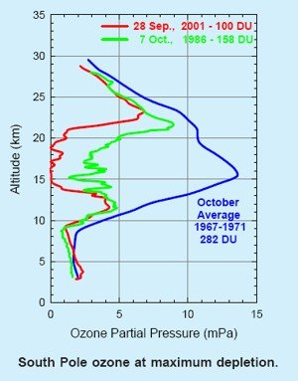
Ozone depletion in Antarctica
Worst ozone depletion occurs over Antarctica.
Atmospheric conditions over Antarctica make ozone depletion much more severe.
Stratospheric temperatures are lower forming stratospheric ice crystals and clouds that provide surfaces for chemical reactions to take place on.
Winds rotate to create a polar vortex where there is little mixing of air over Antarctica and rest of the atmosphere – maintaining low temperatures and higher concentrations of chlorine

Slide 35
Describe how scientists’ attitude to CFCs has changed:
Initial enthusiasm for the use of CFCs based upon their inertness;
Later discovery of ozone depletion and link to presence of CFCs;
Acceptance by scientists and the rest of the world community that the use of CFCs should be banned

Slide 36
Reduction/banning of CFC’s
Global stratospheric ozone decreased by 3% between 1980 and 2005 and has thinned by 50% over Antarctica in winter and spring.
Montreal protocol (1987)
  International agreement
  Reduce use of CFCs and other ozone deplete substances (ODS)
  Seek alternatives

Slide 37
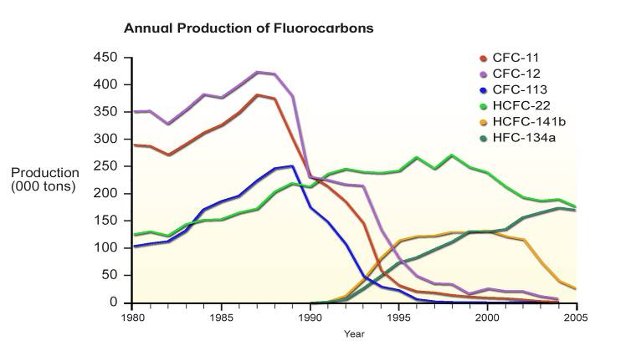
Montreal Protocol
Main aspects:
Phase out/ban manufacture & use of CFCs and other ozone depleting substances (ODSs)
Use of HCFC’s be phased out by 2030
Essential use of ODSs still permitted e.g. halon fire extinguishers in aircraft
Fund is available to help countries to implement the Montreal Protocol
Annual production of fluorocarbons

Slide 38
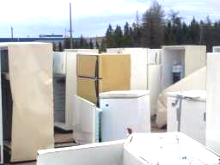
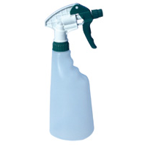
Use of alternative processes
Trigger sprays have replaced aerosol propellants
Roll-on deoderants

Slide 39
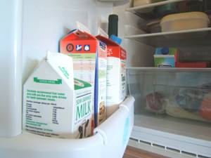
Use of alternative materials
Hydrochlorofluorocarbons (HCFCs) replaced CFCs for fridges & air-conditioning units. HCFCs are less chemically stable so break down before reaching the stratosphere
Hydrofluorocarbons (HFCs) have replaced HCFC’s. No chlorine to cause ozone depletion but they are more expensive and are greenhouse gases
CFC’s aerosols now use propane & butane (but these are flammable)

Slide 40
Use of alternative materials
CFCs in foam plastics were replaced with HCFCs, then HFCs and now CO₂ and nitrogen
CFCs in asthma inhalers were replaced with hydrofluoroalkanes (HFAs)
Alternatives to replace CFC solvents include alcohol, CO₂ pellet blasting & ultrasound cleaning
Safe waste disposal of waste CFCs – draining CFCs from old units & incinerating them. CFCs are broken down to CO₂ & acidic gases (HCl, HF) which are neutralised using lime

Slide 41
Evaluation of the effectiveness of ozone restoration
May be years before the severity of ozone depletion is reducing
Some ODSs have not been banned (e.g. dichloromethane)
Montreal protocol has been successful in international recognition of the consequences of ozone depletion

Slide 42
Utube clip of ozone destruction
YouTube - ozone hole
Ozone formation
YouTube - When CFCs meet Ozone
https://www.youtube.com/watch?v=UHIuG35fUxA (Ozone depletion in arctic & global warming)

