Slide 1
Carbon Capture and Storage (CCS) - Storage of carbon dioxide
https://www.youtube.com/watch?v=4v2_4Dr2Gds

Slide 2
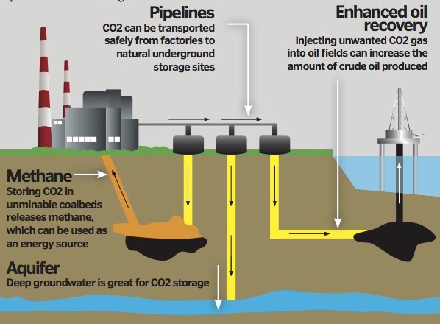
Carbon Capture and Storage

