Slide 1
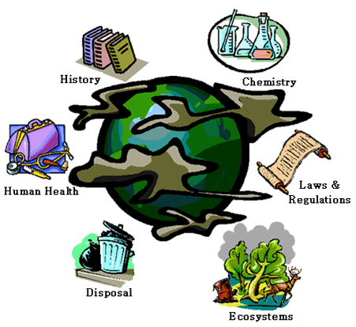
Pollution
Objectives
To know the definition of pollution
To describe and explain the properties of pollution
General properties of Pollution
http://www.youtube.com/watch?v=kdDSRRCKMiI

Slide 2
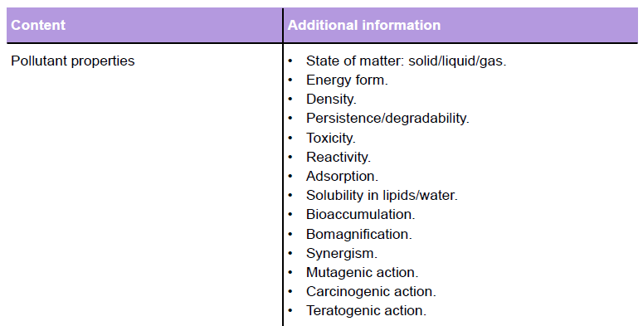
Specification – 3.4 Pollution

Slide 3
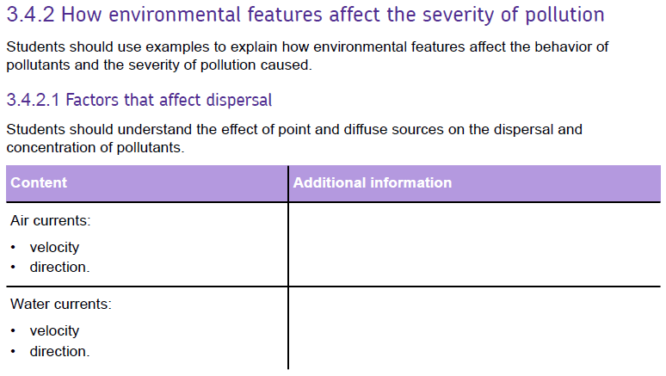
Specification – 3.4 Pollution

Slide 4
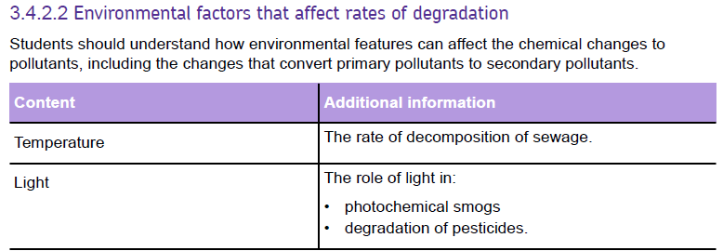
Specification – 3.4 Pollution

Slide 5
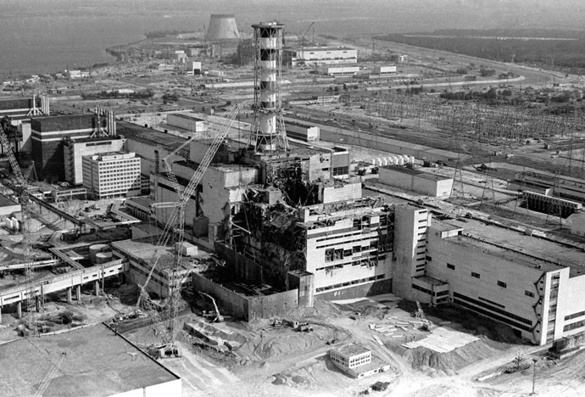
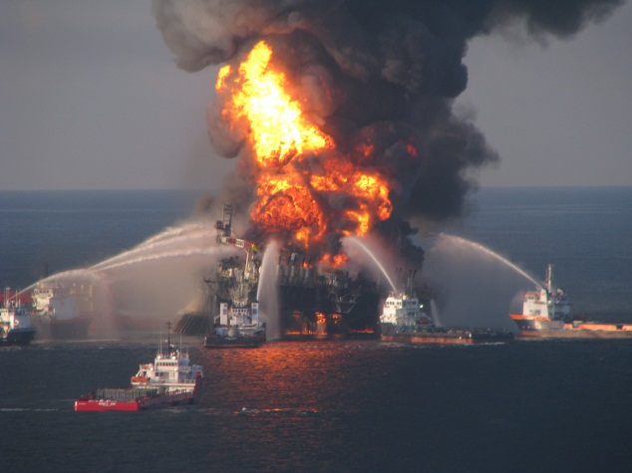
What is Pollution?
‘Pollution is energy or matter released into the environment with
the potential to cause adverse changes to an ecosystem’
They are usually released by human activities but natural events can produce similar effects.’
Brainstorm: what human activities might cause pollution
‘e.g. heat pollution, air pollution, groundwater pollution.
http://www.youtube.com/watch?v=aA8M9GUMEBA#t=15

Slide 6
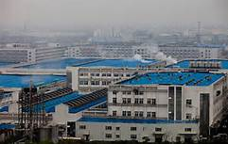
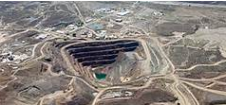
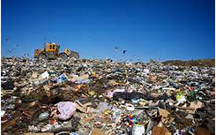
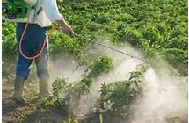
Human activities that cause pollution?
Fuel combustion
Manufacturing
Fuel extraction
Domestic and industrial waste
Pesticides and fertilisers

Slide 7
Pollution Disasters - Research
Find a pollution disaster that have occurred recently that have caused catastrophic effects on the environment
5 mins
Read and summarise the causes and effects of the disaster
Consider the following:
Type of pollution
What caused the pollution in the first place
Direct and indirect effects of the pollution
How the pollutant arrived in the environment
Did the pollution spread and how?
Clean up operation – was there a method to clean up pollution.

Slide 8
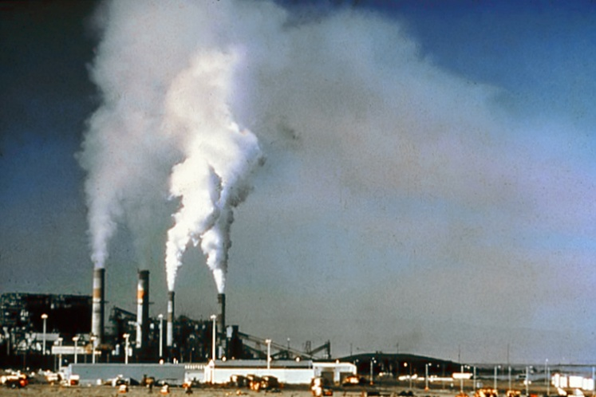
Behaviour of pollutants
All pollutants have sources, pathways and sinks
The properties of a pollutant determine where it travels and for how long it acts
By understanding how the properties of pollutants have caused problems we can predict the effect of new materials & anticipate/ prevent pollution problems
SOURCE: where pollution comes from
PATHWAY: route taken by pollutant
SINK: where it ends up
CHRONIC EFFECT: Causes effects over long periods of time (weakening organism so that it succumbs to another pollutant or disease);
ACUTE EFFECT: Causes rapid death

Slide 9
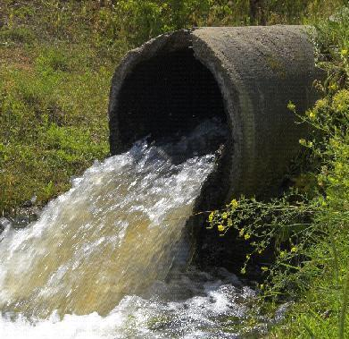
Point sources
Point sources – identifiable source and effect
E.g. power stations, oil refinery, large factories
Easy to see the effects mainly around source, diminishing as distance from source increases. https://earth.nullschool.net/#current/wind/surface/level/orthographic=-69.13,23.51,357

Slide 10
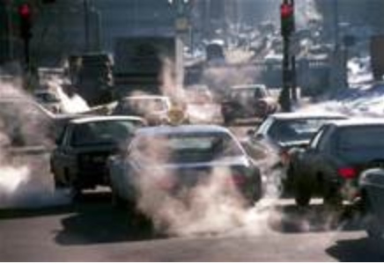
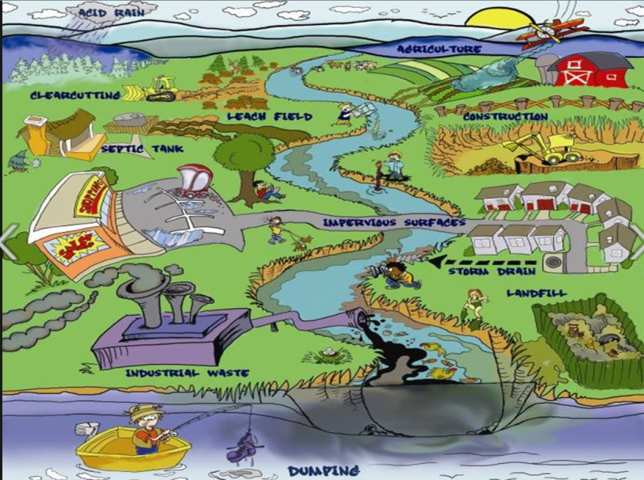
Diffuse sources
Pollutants released from a large number of small sources.
Difficult to judge effects as spread over large area and difficult to link to single source.

Slide 11
Direct and Indirect effects
Direct effect
pollutant causes harm by contact with or ingestion by organism
e.g. ionising radiation, acid rain (leaf cuticles), DDT (insects and thin egg shells and sterility in birds)
Indirect effect
pollutant doesn’t harm the organism directly but does so by harming the environment
e.g. acid rain may acidify soils, killing the food plant of a herbivore. Or CO2 and climate change.

Slide 12
Properties of pollutants
The properties of pollutants determine the length of time it may cause a problem, the level of harm and where and how far
State of matter
Energy form
Density
Persistence
Toxicity
Specificity
Reactivity
Primary & secondary pollutants
Adsorption
Solubility in lipids/water
Bioaccumulation
Biomagnification
Synergism
Mutagentic action
Teratogenic action
Mobility

Slide 13
Activity
Groups 4
Select a property of pollutants
Research the property (Text book Pgs 236-240)
Make a flash card for that property
Include definition
Examples

Slide 14
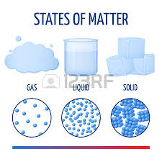
State of matter
State of matter will affect the pollutants ability to be dispersed by water or air.
Solids tend to be deposited close to the source.
Gases easily dispersed in the atmosphere

Slide 15
Energy form
Different pollutants have different energy forms (noise, heat, ioninsing radiation, light) and this will affect how they behave in the environment.

Slide 16
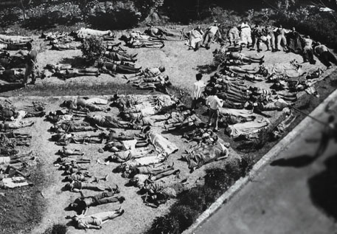
Density
Density affects dispersal.
More dense pollutants require more kinetic energy to keep them suspended (either in air/water) so are deposited close to the source.
E.g. hydrogen cyanide (Bhopal disaster 1984) is denser than air so settled close to the ground.

Slide 17
Persistence
Measure of how long it takes for a pollutant to chemically break down.
Persistence can be measured as the time it takes for half of the pollutant to break down = environmental half-life. (T _{½ ENV})
CFCs, organochlorine insecticides (DDT) – chemically stable and break down slowly = high persistence
Sewage, pyrethroid insecticides = low persistence
Heavy metals are elements so do not break down.

Slide 18
Toxicity
Measure of how poisonous a substrate is, usually caused by enzyme inhibition. Toxins usually damage protein function.
Pollutant | Toxic action
Carbon monoxide | prevents Haemoglobin carrying oxygen in red blood cells
Lead | Inhibits enzymes in nerve cells
Acids | Inhibit protein action by changing the shape of the protein e.g. active sites of enzymes
Cyanide | Inhibits enzymes in aerobic respiration

Slide 19
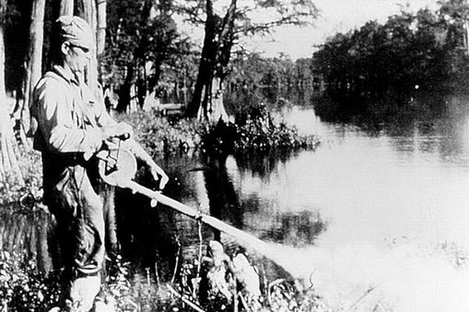
Toxicity - examples
DDT
Dichlorodiphenyltrichloroethane (DDT) is a organochlorine contact insecticide that kills by acting as a nerve poison.
http://npic.orst.edu/factsheets/ddtgen.pdf
Acids (acid rain or leaching from mine spoil heaps)
Change the shape of cell membranes and function of proteins so cell membrane does not function properly.
http://www.youtube.com/watch?v=yGhyJSGnW9g

Slide 20
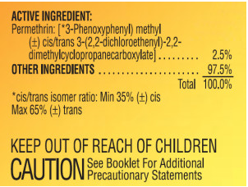
Specificity
Measure of the differing toxicities of a substance on different organisms.
A pollutant may be toxic to one organism and much less toxic to others.
E.g. Pyrethoid insecticides
Low in toxicity to mammals and birds;
High in toxicity to fish if applied directly to water;
Require very low doses to kill insects (high arthropod toxicity);
Fast-acting;
Especially effective against chewing insects, though many pyrethroid insecticides can be absorbed by the insect pest when it merely walks over the dry residue;
Bind tightly to soil and organic matter (therefore not as effective in penetrating soil to kill underground pests);
Dissolve very poorly in water.

Slide 21
Reactivity
Reactivity affects the severity of the pollution – can increase or reduce the problems caused.
Reactive pollutants may degrade rapidly (e.g. sewage) or react with other substances to produce secondary pollutants
Pollutant | Reactivity | Effect on pollution
CFCs | Low (except in UV) | Stable in the troposphere but broken down in stratosphere releasing chlorine
NO_{x}, ozone, hydrocarbons | High | React with each other to produce PANs which are more toxic

Slide 22
Primary and Secondary Pollutants
Primary pollutants are released by humans e.g.
CO₂ by burning fossil fuels
Oil released in tanker accidents
Pesticides used in agriculture release pollutants
Secondary pollutants are produced by the interaction of other materials release by human activities e.g.
Tropospheric ozone is produced by the interaction of oxides of nitrogen from fuel combustion with O₂ in the atmosphere
PANs which cause photochemical smogs, are produced by the interaction of oxides of nitrogen, ozone and unburnt hydrocarbons

Slide 23
Adsorption
Pollutants that attach to the surface of materials e.g. soil particle or aquatic sediments. This mobilizes them so they can’t cause pollution problems but they may be released later to cause problems e.g. sediments disturbed in a lake by a storm releasing phosphates or PCBs

Slide 24
Solubility
Water soluble pollutants are often more mobile in the hydrosphere E.g. Nitrates, phosphates
Liposoluble – organic compounds that dissolve in fats and oils can pass through cell membranes and be stored
e.g. mercury, DDT

Slide 25
Bioaccumulation
The absorption and storage of pollutants in the tissues of organisms increasing the amount in the organism over time
Small doses of pollutants build up to toxic levels
Liposoluble pollutants tend to build up in the body whereas water soluble pollutants can be excreted more easily.

Slide 26
Biomagnification
Substances become more concentrated as they pass along a food chain. Organisms in higher trophic levels have longer lifespans and build up higher concentrations.
http://www.youtube.com/watch?v=xI2M97Gl5qM
http://www.youtube.com/watch?v=E5P-UoKLxlA

Slide 27
Difference between Bioaccumulation & Biomagnification

Slide 28
Synergism
Interaction of 2 or more pollutants to create a greater impact than the sum of their individual impacts
Nitrates and Phosphates cause worse eutrophication together than individually;
A mixture of SO₂ & NO₂ (from coal burning) may be greater in causing acid rain problems than individually

Slide 29
Mutagens
A material that can cause changes in DNA = mutation
Gonadic effects (cells in ovaries or testes)
May causes birth abnormalities
Somatic effects (general body cells)
May cause uncontrolled cell division = cancer
E.g. Ionising radiation, UV light, Cadmium, asbestos, dioxins and PCBs.

Slide 30
Carcinogens
A mutagen that causes cancer
Eg asbestos, DDT, cadmium

Slide 31
Teratogenicity
Non–inherited birth defects (not passed on to future generations)
The interruption of DNA function so that the genes of an unborn embryo cannot cause normal growth and development.
Birth abnormalities may be produced (which are not inherited by future generations).
E.g. Dioxins such as Agent Orange
http://www.who.int/en/news-room/fact-sheets/detail/dioxins-and-their-effects-on-human-health
Mercury

Slide 32
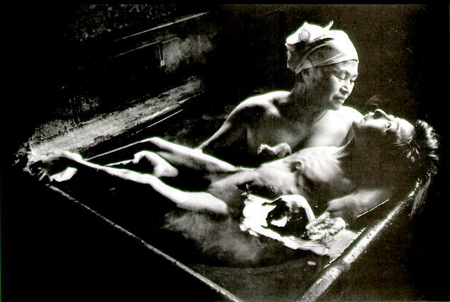
Minimata disease http://en.wikipedia.org/wiki/Minamata_disease

Slide 33
Mobility
Measure of the degree to which the pollutant is carried by wind, water or organisms. Depends on other properties (state of matter, density & solubility in water)
Examples:
CFCs not soluble so can travel long distances in atmosphere
Sulfur dioxide dissolves in rain so washed out of atmosphere
Smoke particles washed out of atmosphere and also settle due to gravity
Lead dust – high density of atmospheric dust causes most particles to be deposited close to the source

Slide 34
Effects of environmental features
The environment that a pollutant is released in can have a big impact on the extent and severity of the pollution.
Features affect degradation
Factors that affect dispersal

Slide 35
Degradation
The process of breakdown = degradation
Biodegradation – caused by living things, usually bacteria
Photodegradation – caused by light
Thermal degradation – caused by heat

Slide 36
Features affecting degradation
Temperature – higher temperatures increase rates of reaction
Light levels – provide activation energy that drive chemical reactions
Oxygen – involve in many reactions e.g.
aerobic bacterial decomposition of sewage
oxidation of sulphide ores producing sulfur dioxide
Oxidation state affects the solubility of many metals
pH – affects the solubility of substances e.g. heavy metals are more soluble in acid conditions
Pollutant interactions – one pollutant may be affected by another e.g.
Nox and hydrocarbons in photochemical smogs
Combined effect of phosphates and nitrates in eutrophication

Slide 37
Factors affecting dispersal
Wind & water currents:
Affects how far a pollutant is dispersed
Temperature inversions
Presence of adsorbent materials
MWB – Draw a graph to show how the temperature changes with altitude in the troposphere

Slide 38
Temperature inversions
Normally temperature goes down with increase altitude in the troposphere. Warm gases at ground level are less dense and rise and disperse.
http://www.youtube.com/watch?v=LPvn9qhVFbM
Demo

Slide 39
Temperature inversions
Air near the ground is cooler than air above
Pollutant gases less buoyant (denser) and will not rise and disperse so become concentrated. Air near the ground is cooler than air above
Pollutant gases less buoyant (denser) and will not rise and disperse so become concentrated.
http://www.youtube.com/watch?v=LPvn9qhVFbM
Demo

Slide 40
Under normal conditions

Slide 41
Thermal (temperature) inversion

Slide 42
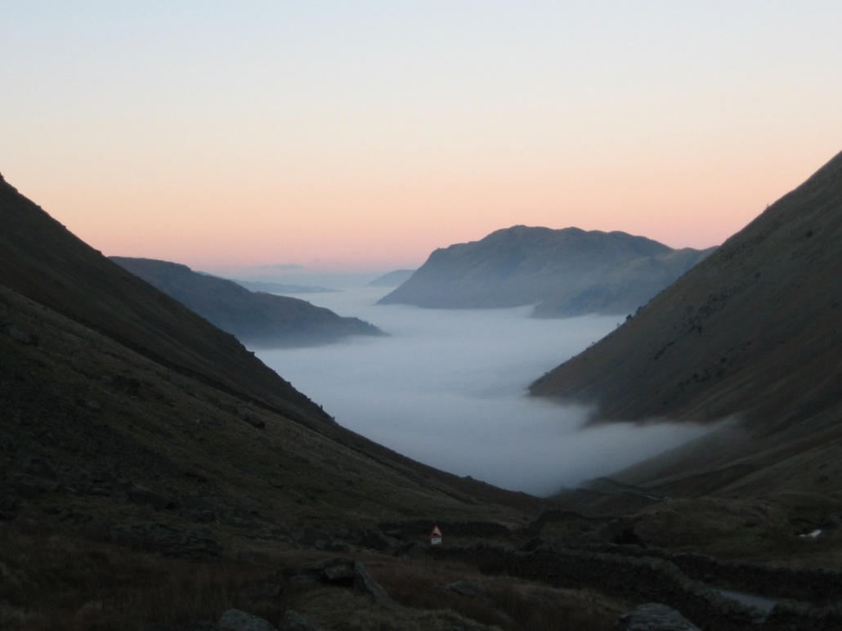
Ideal conditions for a temperature inversion
Valleys: the sheltering effect of valleys means that cool, dense air may sink under warmer air without winds dispersing it.
Clear night skies: loss of heat from IR radiation is increased, so the air above the ground cools.
Mist or fog: these reflect sunlight and prevent the ground from warming up as quickly.
Low wind speeds: reduces the mixing of layers of air, which would disperse cooler air below the inversion layer.

Slide 43
Temperature inversions
Lapse rate diagrams show the relationship between temperature and altitude.

Slide 44
Presence of adsorbant materials
Materials like clay particles or organic materials in aquatic sediments cause pollutants to adsorb onto them. This immobilises them and stop it causing problems.
Many naturally toxic metal ions are immobilised by being adsorbed onto soil particles e.g. aluminium and lead.

Slide 45
General Pollution Control
Objectives
To be able to distinguish between critical pathway analysis and critical group monitoring
To understand the main emission control strategies
To describe the principles behind pollution control

Slide 46
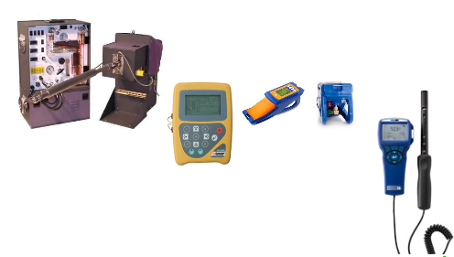
Environmental monitoring
Environment needs to be checked in the places where it is considered that a pollutant may pose a threat to humans. Sampling will be done to monitor levels of pollutant.
Sampling sites tend to be:
Where wind and water most likely to carry pollutants
Where people might be harmed
Where human activities occur (farming, fisheries)
Monitoring should confirm the accuracy of a CPA (critical pathway analysis)

Slide 47
Critical pathway analysis
Used to predict the movement of pollutants and to plan monitoring programmes. It can’t be assumed that any discharge will be diluted and dispersed. In the atmosphere and water it can become re-concentrated. (Think & link – water cycle)
Mainly used for movement of radioactive materials released from a nuclear power station or waste processing site. Ensures that sites at most risk are sampled
Factors to take into account:
State of pollutant (s,l,g)
Density
Solubility in water/lipids
Chemical stability
Wind speed and direction
Geology – porosity/permeability
Effect of pH and O2 on solubility
Temperature
Properties of the pollutant
Features of the environment

Slide 48
Critical Group Monitoring
A specific method of assessing the risk of public exposure to pollutants. It will look at members of the public whose lifestyle/job mean they are at risk. If their risk is low then it’s assumed that all other members of the public have an even lower risk.
http://www.youtube.com/watch?v=KxBe6ubGiow

Slide 49
Emission control strategies
Control of emission location
Some choices may affect the severity of the pollution caused:
Marine discharges where water currents will dilute and disperse emissions.
Emissions downwind of urban areas
Not discharging waste onto permeable rock above an aquifer
Control of emission timing
Tidal cycle
emissions into incoming tide will carry upstream. Emission into outgoing tide will disperse them
Temperature inversions
Atmospheric emissions in a temperature inversion will not disperse. Restrict emissions in cities where temperature inversions are common

Slide 50
Principles of pollution control
The polluter pays principle
Whoever causes the pollution is responsible for the problems caused and has an obligation to prevent it.
Costs of preventing are less than costs of damage
Complying with this is made greater by high financial penalities
The precautionary principle
It is assumed that a waste will cause pollution until research confirms it’s unlikely to when release is permitted.
This means being unaware of a problem is not an excuse and does not reduce responsibility

Slide 51
Selection of Control
Control method | Example
Production prevention | Desulfuristion of fossil fuels
Prevention of release | Electrostatic precipitators for smoke control Catalytic converters for NOx, CO and hydrocarbons
Post-release prevention | Oil spill clean-up methods Phytoremediation of land contaminated with heavy metals
Alternative processes | Use of electric vehicles instead of diesel or petrol Using pyrethroid pesticides instead of more polluting organochlorides (e.g. DDT) Using renewable energy sources

Slide 52
Efficiency of Pollution Control
Rarely practical to reduce pollution emissions to zero.
Costs of removing pollutants rises sharply as more pollutants are removed, until clean up costs exceed the harmful costs of the pollution
Break-even point = when costs of pollution are the same as clean up costs.
The point is determined by separately plotting clean-up costs and the cost of the pollution to society. The 2 curves are then added together to reveal the total costs
Economic impact of pollution worksheet
http://www.youtube.com/watch?v=KxBe6ubGiow

