Slide 1
Solid Waste Recycling
Learning objective:
To consider the pros and cons of recycling solid waste.
Success Criteria:
(E) To describe the sources of solid wastes.
(C) To explain why so much solid waste is produced.
(A) To explain what can be done with the solid waste produced.
Starter task:
Jot down your ideas: what might happen to a used piece of plastic?

Slide 2
Solid Waste
Simply put, it’s anything that isn’t needed…that’s solid.
Where you think it can come from?
Mining
Domestic
Agricultural
Industrial

Slide 3
Properties of solid wastes
Properties will influence the choice of disposal
Is it degradable? Quickly?
Conditions of degradability? (O₂, pH temp, presence of bacteria)
Is it radioactive? What type?
Is it flammable?
Is it toxic?

Slide 4
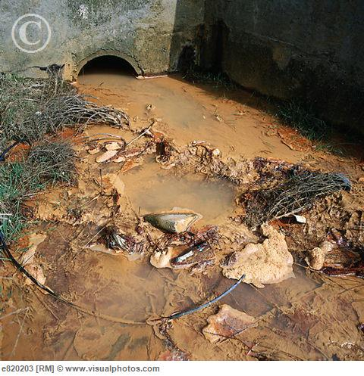
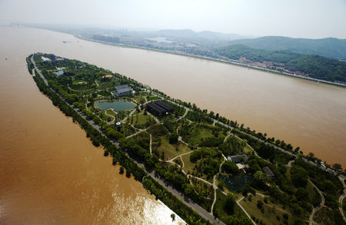
Mining waste
Mining and construction produce bulky wastes. Most are non-hazardous but some can cause problems because of particular hazardous materials.
Mine overburden – non-toxic
Mine spoil heaps – may contain toxic meals
Demolition waste – may contain hazardous material e.g. asbestos

Slide 5
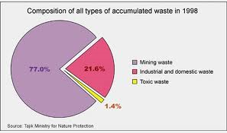
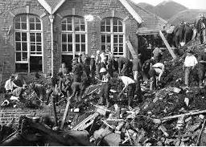
Sources of solid wastes
Mining:
Bulky wastes, Low mobility but leachate may cause problems e.g. heavy metals like copper, tin, zinc, arsenic salts.
Low to no degradation
Insoluble waste not hazardous but risk of toxic leachate; potential radioactivity in granite. Waste tips can move – Aberfan (S. Wales) caused a landslide onto a school

Slide 6
Domestic Rubbish
Domestic waste
The main categories of municipal waste are:
Packaging & containers
printed paper
organic materials – food and garden waste
Clothing & other textiles
broken or discarded domestic appliances.
Dealing with domestic waste poses a number of problems:
very large quantities are produced
every household produces waste so collection is labour intensive and expensive
the composition varies seasonally, e.g. more garden waste during the summer
many different types of waste are mixed together.

Slide 7
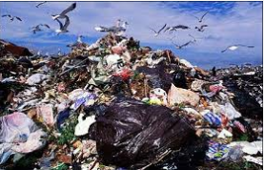
Sources of solid wastes
Municipal & domestic
Variable mobility – products of decay may leach e.g. organics; battery waste; methane is a fire / explosion risk
Paper, plant, animal materials are degradable
Some materials are hazardous:
Bacteria – decay;
Toxic – heavy metals;
CFC – foam, ‘fridges;
Dioxin – from burnt plastics;
Decay gases – methane;
Subsidence at tip with decay;
Plastic bags – blow
Rats, flies

Slide 8
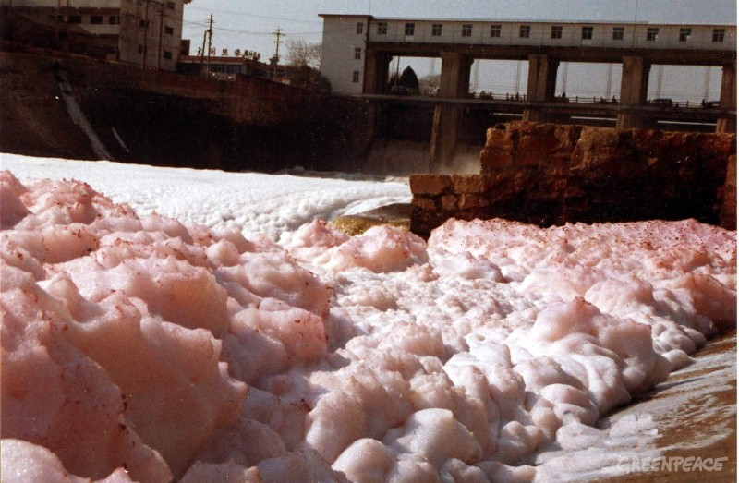
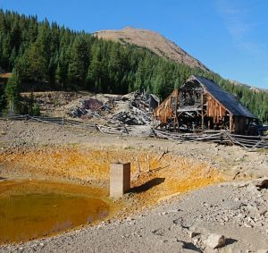
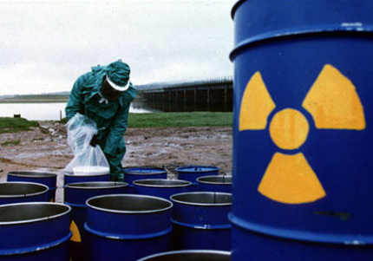
Industrial Waste
Industrial waste
Most industries produce solid wastes. The problems of disposal will depend on the quantity and properties of the particular waste.

Slide 9
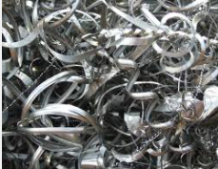
Sources of solid wastes
Industrial
Moderate to large volumes
Variable mobility
Variable degradation: anything organic is polluting, e.g. meat wastes, paper waste, dairy waste; solvents in air; smoke; metal swarf
Hazards are variable: organic can cause eutrophication; solvents & asbestos – carcinogenic; Heavy metals toxic

Slide 10
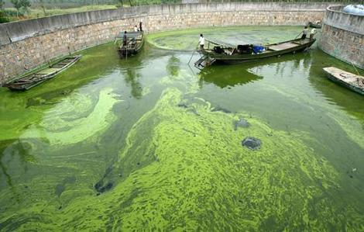
Agricultural Waste
Agricultural waste
Most solid farm waste is crop waste or manure. The main pollution risk is from nutrients causing deoxygenation or eutrophication.

Slide 11
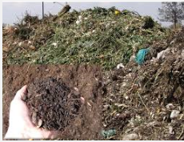
Sources of solid wastes
Agricultural
Bulky wastes
Variable mobility - slurry from cattle and sileage liquor have huge B.O.D
Most biodegradable
Hazards are variable: Eutrophication; Smoke (burnt straw); Pesticide / herbicide residues if persistent; Problem in storing wastes

Slide 12
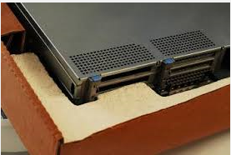
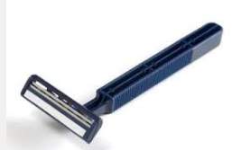
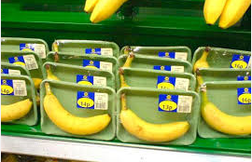
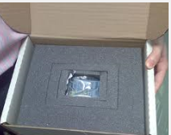
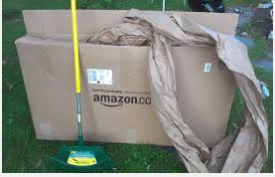
Links between waste and affluence
Most products bought have built in obsolescence (e.g. electrical & computers);
More papers and magazines bought;
Disposable products;
Much more packaging around materials e.g. cheese, vegetables;
Multi-packaging;
Affluence – we simply buy more consumer products;
More non-biodegradable waste (e.g. plastics);
More convenience foods;
Few returnable bottles used.

Slide 13
Solid Waste Disposal
Large amounts of solid wastes deliberately or accidentally dumped in the environment threaten wildlife.

Slide 14
Factors determining the choice of waste disposal
Population density - higher costs with fewer people
Mass of waste per capita
Properties of wastes e.g. toxicity, flammability
Availability of land
Availability of recycling technology
Level of environmental awareness – willingness to recycle, reuse, repair
Regulatory framework & legislation
Household income
Waste processing costs for labour or machinery

Slide 15
Why recycle?
Watch this video and jot down any reason why recycling is so important http://www.youtube.com/watch?v=Kr_DGf77OhM
Recycling helps conserve important raw materials and protects natural habitats for the future
There are over 1,500 landfill sites in the UK, these sites produce a quarter of the UK’s emissions of methane.
Using recycled materials in the manufacturing process uses considerably less energy than that required for producing new products from raw materials
Current UK recycling is estimated to save more than 18 million tonnes of CO₂ a year – the equivalent to taking 5 million cars off the road.

Slide 16
Can it be recycled?
You have been given two beakers (one labelled YES and one labelled NO).
Cut up your list of items and decide whether they can be recycled in Norfolk (YES) or that they can’t be (NO).
There are 15 YES’s and 15 NO’s.

Slide 17
Recycling
What can be recycled? Sort the items into 3 groups
Green bin (kerb recycling)
Black bin (waste)
Take to recycling centre
http://www.recyclenow.com/how_is_it_recycled/recycling_centre.html

Slide 18
Guildford recycling centre Moorfield Road, Slyfield Green Industrial Estate, Guildford, Surrey GU1 1RU.

Slide 19
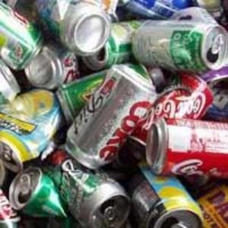
Recycling Aluminium
Losses - Not all will be recycled – litter will go into landfill
Transport – extraction of aluminium ore involves bulk resources (economies of scale). Recycling involves smaller quantities – more expensive
Separation – alloys of mixed metals not easily separated
ID – slow to identify the composition of recycled materials where composition is important for reuse
Energy cost – recycling saves energy needed for extraction of aluminium for bauxite (but see bullet 2).
Public cooperation – to separate waste
http://www.recyclenow.com/how_is_it_recycled/cans.html

Slide 20
Non-recyclable solid waste disposal
Learning objective:
To look at the options for disposal of waste.
Success Criteria:
(E) To state the pros and cons of each method.
(C) To describe the ideal landfill site.
(A) To design a poster to ‘sell’ the ideal landfill site.
Starter task:
How does a country decide which way it will dispose of it’s waste?

Slide 21
Possibilities
Landfill
Spoil heaps
Incineration
Specialist wastes – asbestos, cyanides
Encapsulation & vitrification
Land Pollution
http://www.youtube.com/watch?v=HjNv_iTsXn8

Slide 22
Advantages of landfill
Cheap
Generate electricity from methane
Little treatment required

Slide 23
Disadvantages of landfill
List as many ways as you can think:
Potential resources are lost, e.g. metals, glass, plastics
Landfill sites are large areas of land
Organic matter decays anaerobically, releasing methane and CO2 which contribute to global warming
Toxic leachate may leach from poorly managed sites
Wildlife habitats and farmand may be lost
Contaminants in the landfill site may prevent he later development of landfill sites for housing or agriculture
Transport delivering the waste to the site and the infrastructure around it generate noise and congestion in the local area.

Slide 24
Landfill
Task: The ideal landfill site has:
Separating different waste types & recording their composition & location
Plastic lining to prevent leaking leachate
Regular collection of leachate
Perimeter fence to trap rubbish
Covering of soil to prevent pest problems
Water/deoderising sprays to reduce odours
Collection of methane for use as a fuel
Impermeable cap to prevent water entering once the site is complete (clay and polymer)
Disposal of flammable materials rather than dumping large quantities on one place
Chemicals which may react with each other should not be dumped together
Your job is to sketch this design and annotate it so that the local council would want to buy your site.

Slide 25
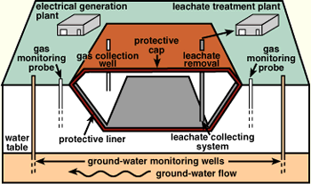
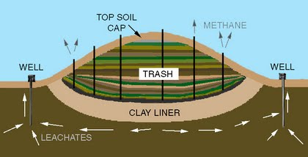
Here are some I made earlier…☺

Slide 26
Using what you learnt from last lesson…
Add five problems that your site will face when it is being reclaimed.
How will you get around these problems?
Why is landfill the best option for poor countries?

Slide 27
Incineration
Advantages | Disadvantages
Reduces the final volume of solid waste sent to landfill | Wet waste requires fuel to burn it which is expensive
Heat energy generated can be used for heating or generating electricity | If high temperatures aren’t achieved then toxic dioxins are released
No sorting or complicated management is needed | The resource value of recyclable materials is lost
If properly sorted, plastics can be used to create a new fuel (RDF – refuse derived fuel & TDF – tyre-derived fuel) | Atmospheric pollution is obviously increased and is expensive to treat

Slide 28
Flammable organic wastes
Chlorine released from CFCs will react for form HCl gas, and then acid pollution.
Chlorinated organic compound will release dioxins on burning.

Slide 29
Features of good incineration sites
Recyclable wastes removed before incineration
Wastes of high water content removed
Combustion temperature is kept high and waste gases cooled quickly (less dioxins)
Heat produced is harnessed and used
Atmospheric pollution is controlled
Some materials have additional treatment to make them safe
Hydrogen chlorides produced have a water spray scrubber to dissolve them and acid produced neutralised with alkali
Heavy metals can be removed by scrubbing and then stored in solid state at high pH to make them insoluble.

Slide 30
Spoil Heaps
Industrial spoil heaps involves large quantities of non-toxic solids but may produce leachate fluids that are polluting
Mining and quarrying e.g. coal, china clay, metal ores
Coal fired power stations and Incinerators produce ash
Iron blast furnaces produce slag

Slide 31
How can we deal with it?
Go to page 282-283 of the textbook.
I would like you to respond to the question after taking your notes:
“What problems are faced by those who seek to reclaim areas of land on which ‘spoil’ has been dumped?”

Slide 32
Management of Spoil Heaps
Stability – vegetation (roots), compaction, concrete bases
Drainage – reduces landslide
Lack of nutrients – add sewage/topsoil/fertiliser – encourage plant growth
pH – add lime (sulphides)
Contamination – phytoremediation - heavy metals, bioremediation – oil
Topography – landscape reshape
Toxic leachate – collected & treated, add deep layers soil
Heavy metals – alkalinity makes insoluble, cover spoil -airbourne metals
Flammable wastes – coal/shale = hydrocarbons explode. Layers fine-grained materil – reduce airflow

Slide 33
Specialist Wastes
Some solid wastes are hazardous so specialised storage or treatment is needed
Asbestos
Cyanide waste

Slide 34
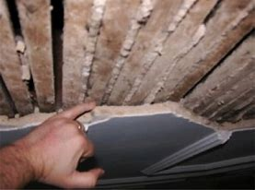
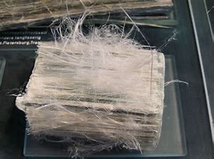
Asbestos
Dangerous when it disintegrates and fibres become airborne.
Inhalation causes asbestosis. Scar tissue forms in the lungs making breathing difficult.
Causes mesothelioma (cancer)
Asbestos used to strengthen cement roof panels.
Safe Removal
If encapsulated and remain intact it is safe
Double wrapped in heavy-duty polythene bags and put into special landfill sites where contents are recorded

Slide 35
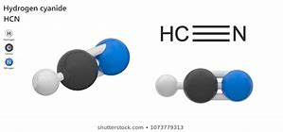
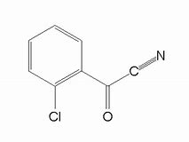
Cyanide wastes
Cyanide compounds have carbon to nitrogen triple bonds. A 4th bond links carbon to other elements (hydrogen, sodium)
Used in: paper, textile,plastic electroplating, metal cleaning and gold extraction industries
Very toxic enzyme inhibitors
Inhaled or ingested
Disposal by incineration
Carbon and nitrogen are oxidised into CO₂ and NOx

Slide 36
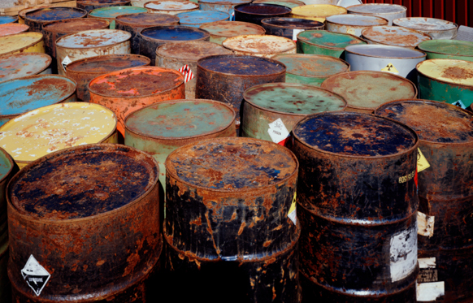
Encapsulation and Vitrification
Some wastes are so hazardous that they must be permanently stored so they won’t leak.
E.g. arsenic, mercury, nickel, chromium and intermediate level radioactive waste.
Encapsulation: wasteAn example of this waste would be radioactive material. During vitrification, waste is mixed with molten glass. When it solidifies, the glass encapsulates the radioactive waste. Even if the glass was shattered, the individual glass fragments would still contain it. The glass is stored in stainless steel containers, and stored in cylindrical buildings in concrete rooms.

Slide 37
Read the factsheet
What are leachates?
Identify and explain three risks at landfill sites.
What is the main component of biodegradable waste?
What environmental factors may change the composition of landfill gas?
What is the European Landfill Directive?

Slide 38
Homework
Complete the question pack
Essay:
Discuss the advantages and disadvantages of the methods that can be used to dispose of solid wastes. (25 marks)
Wednesday 23/1

