Slide 1
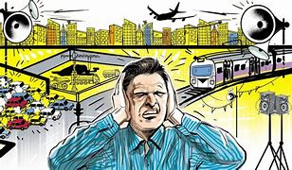
Noise Pollution
https://www.youtube.com/watch?v=5jfmzufa8qo

Slide 2
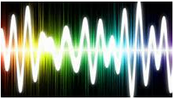
Noise and sound
Sounds are vibrations (wave-like and of different frequencies) that pass through matter (solids, liquids and gases). Sound vibrations cannot pass through a vacuum.
Noise is sounds that is unwanted as it is disturbing or can cause damage.
Noise has limited impact on wildlife but can have serious impacts on human health and quality of life

Slide 3
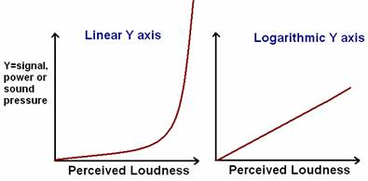
Logarithmic dB scale
The human ear is sensitive to a very wide range of sound power levels.
Shown as a logarithmic scale
An increase in 10dB represents a 10x increase in volume
0dB does not mean there is no sound it is the quietest sound that can be hear at 1000 hz and is the threshold for human hearing.

Slide 4
Frequency range of human hearing
Sound vibrations are picked up by tiny hairs in the cochlea in the ear. These are sensitive to particular frequency.
Typical range is 20 – 20000Hz
Exposure to excessive noise & some health issues reduce sensitivity and range

Slide 5
Effects on living organisms Humans
To ears:
Deafness – damage to nerve cells of the cochlea – especially high frequency sounds;
Tinnitus - (‘ringing’ in the ears)
Stress:
May lead to increased blood pressure and risk of heart attack;
nervous disorders and behavioural changes;
Headaches, ulcers, irritability
Communication problems:
Noise causing inability to work or concentrate on a task. Children in schools beneath airports may underperform educationally

Slide 6
Logarithmic graphs

Slide 7
Effects on living organisms
To livestock:
Livestock disturbance can cause injury or miscarriage
To wildlife:
May disturb breeding birds – birds that sing to establish territories or attract mates may have difficulties in urban areas. Birds may be scared off nests by sudden noises and ,eave eggs open to predation reducing population sizes. Cliff nesting birds may knock eggs off into the sea if frightnened by low-flying military aircraft
Reduced feeding success – animals that hear to find food e.g. bats, birds, owls) may find this difficult with background noise.
Hearing damage/behavioural changes of cetaceans e.g. whales, dolphins might be harmed by lounds noises like military sonar used to detect submarines.

Slide 8
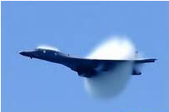
Effects on non-living things
Acoustic fatique: when objects have a frequency at which they naturally vibrate (=resonant frequency). Repetitive vibrations at the resonant frequency cause the cracking of a material and structural failure. E.g. early jet engine cowling (covering of a jet engine) led to new designs. http://www.youtube.com/watch?v=17tqXgvCN0E
Vibration damage: repetitive vibrations causes structural damage. E.g. bridges, underground
Shock impacts: forces of impact after sudden loud noises causes damage e.g. sonic boom of supersonic aircraft like concorde can cause structural damage to buildings
http://www.telegraph.co.uk/news/uknews/defence/9201259/RAF-sonic-boom-jets-spark-resident-alarm-after-helicopter-emergency.html

Slide 9
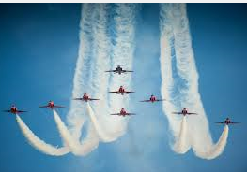
Aircraft noise pollution: military aircraft
Military aircraft- airfields built in rural areas but low level training flights cause noise pollution.
Minimising military aircraft noise pollution:
Farmers are informed of schedule so sensitive animals moved inside,
Avoid urban areas or sensitive sites
Flight paths are varied
UK is divided into 20 low-flying areas
Can request a temporary stop to low flying e.g. for agricultural shows & horse shows
Flights avoid sensitive ecological sites such as sea bird cliff breeding colonies

Slide 10
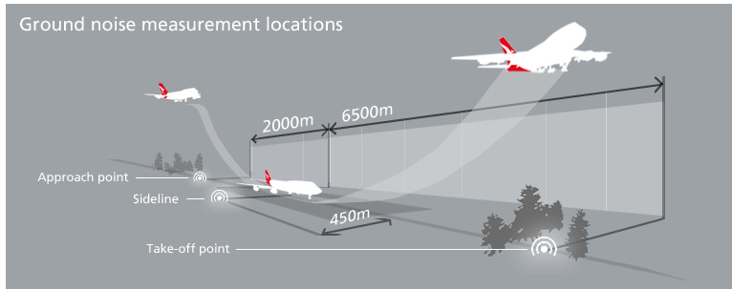
Aircraft noise pollution: civil aircraft http://www.dailymotion.com/video/x15t8gj_new-health-risks-of-living-near-an-airport-discovered_travel
Cruise at high altitudes so little/no noise reaches the ground (aside from take off and landing).
Many airports are built near urban areas
Levels of noise are affected by timings & number of flights each day.

Slide 11
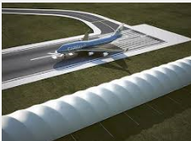
Reducing noise from aircraft: airport design & location
Built away from residential areas;
Aircraft taxi areas away from residential areas;
Engine test areas located away from residential areas, used in the day and surrounded by acoustic screens
Acoustic insulation for housing e.g. double glazing
Land use restrictions around airports e.g. industry allowed but not housing developments
Noise deflection/absorption with baffle mounds/acoustic screens
Multiple landing runways to reduce use of reverse thrusters. With a single runway, these are used to slow planes down quickly and get them off the runway for other planes to land

Slide 12
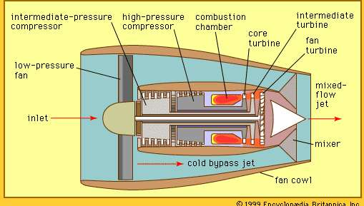
Reducing noise from aircraft: engine design
High-bypass ratio engines
Jets with a single cowling (tube/covering) around the jet produced a lot of turbulent gases = lots of noise
Modern jets have 2 cowling and a turbofan at the front of the jet which forces ‘bypass air’ around the inner cowling.
Bypass air smooths the flow of exhaust air and reduces noise levels.
The ratio is the bypass air:jet engine exhaust air

Slide 13
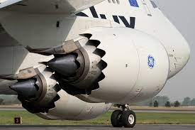
Reducing noise from aircraft: engine design
Chevron nozzles
Serrated trailing edge on the outer cowling mixes bypass air with surrounding air more smoothly
Engine hush kits
Work like chevron nozzles in a low bypass ration engine
Engine acoustic liners
Inside the outer cowling and around the inner cowling to absorb noise

Slide 14
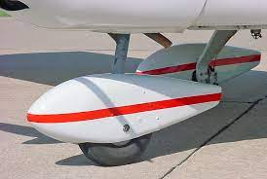
Reducing noise from aircraft: aircraft body design
Blended wing aircraft:
Engines located on top of the aircraft sot he body acts as a barrier reducing the noise that reaches the ground
Aerodynamics:
Fairings on undercarriage reduce turbulence around the wheels and leg struts.
Lighter aircraft:
Using composite materials like carbon fibre are lighter so less engine thrust is needed

Slide 15
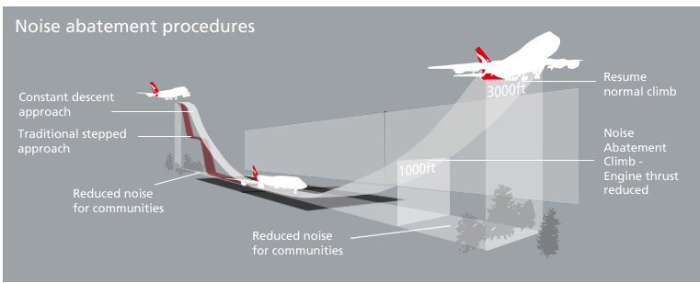
Reducing noise from aircraft: aircraft operation
Take off angle:
Engines run at higher power during take off and landing. If take off angle is steeper it reaches higher altitudes quicker where noise does not reach the ground
Flight path planning:
Routes avoid highly populated areas
Constant descent angle:
Stepped landing descents have periods of high thrust which is noisy so a constant descent angle reduces this
Night flight restrictions:
Restrictions on the number of night flights – especially take-offs

Slide 17
Control of noisier aircraft
Noise limits:
Air craft are categorised into groups (chapter 2,3,4) according to level of noise they use and older noisier aircraft groups are band from flying at airports.
Charges for noisier aircraft:
Aircrafts pay charges and these are linked to noise created – noisier airports at Heathrow pay 10x amount of similar sized quiet planes. Night flights cost 3x as much as day flights. There are fines for breaking noise limits.
Restricted flight times:
Aiports with high population density areas restrict or ban night flights

Slide 18
Control of noisier aircraft
Quota count systems:
Aircraft types are allocated points depending on their noise levels. Each airline is allocated a certain number of points. The total points can’t exceed their allocation. This encourages newer, quieter planes that have a lower quota count so that more flights can occur.
Control of supersonic flights:
There a no longer any supersonic civil airliners such as concorde

Slide 19
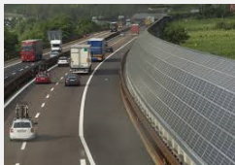
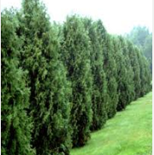
Ways to control road traffic noise
Engine noise:
Quieter engines by acoustic insulation around engines;
Quieter exhaust systems
Wheel noise:
Use of sound absorbing material on roads e.g. porous asphalt or asphalt that includes shredded rubber from old tyres
Vehicle air turbulence:
Improved vehicle aerodynamics
General road vehicle noise:
No excessive acceleration or braking through active traffic management
Fences, embankments and dense tree planting along roads to absorb noise
Encouraging use of rail transport instead of road transport.
Routes to avoid residential areas
Double glazing in houses near busy roads

Slide 20
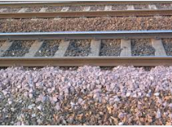
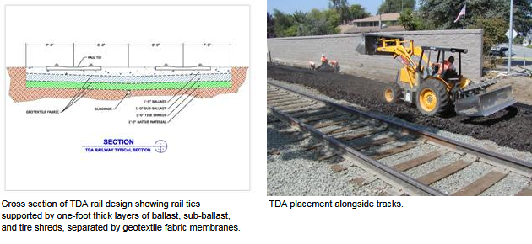
Ways to control railway noise
High speed passenger trains are the noisiest but freight trains are long and travel slowly so both contribute to noise pollution.
Wheel vibration & noise:
Track polishing and sound absorbing ballast rails reduce vibration and good suspension reduces noise
Engine noise:
Use sound-absorbing suspension
Wheel squeal on corners:
Lubrication of wheels/tack
Braking squeal:
Use composite braking materials

Slide 21
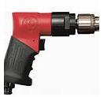
Sources and control of noise pollution
Industrial noise
Caused by impact between metal objects or the explosive expansion of gases.
E.g. Stamping equipment, pneumatic drills, air compressors to drive pumps

Slide 22
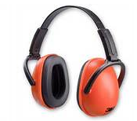
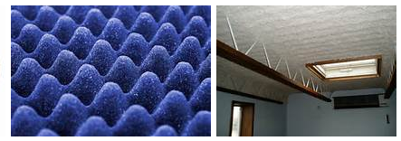
Ways to control industrial noise
General methods used to control industrial noise
Sound absorbing surfaces in rooms
Sound absorbing materials around equipment – acoustic curtains
Machinery placed on acoustic mats
Sound absorbing materials as part of the equipment.
Rotate machinery operation
Worker ear protection
Monitoring workers and limiting their exposure time to noise
Restricting access to noisy areas for workers
Remote/robotic operation of machinery

Slide 23
Ways to control industrial noise
Specific methods of reducing industrial noise
Air compressors & pumps:
Silencers to reduce the explosive expansion of air
Stamping machines:
Use alternative processes e.g. pressing and moulding
Metal conveyors (metal on metal contact):
Use of nylon bearings, wheels or rollers
Mine blasting
Regular timing of blasts to reduce public concerns
Use of baffle mounds
Pile-driving on land
Drilling instead of pile-driving
Pile-driving at sea (foundations of brides & wind turbines)
Air bubble curtains created around the pile driver absorbs noise and reduces the impact on cetaceans
Marine seismic survery and military sonar harming cetaceans

Slide 24
Domestic noise pollution sources
domestic appliances (e.g. washing machines);
audio-visual equipment (e.g. hi-fi)
DIY tools
garden machinery (e.g. mowers)
barking dogs, chickens (especially cockrels)

Slide 25
Ways to control domestic noise pollution
Domestic appliances with acoustic absorbers e.g. washing machines, vacuum cleaners
Volume limiters on music equipment
Wear ear defenders when using power tools
Buy ‘quiet’ appliances http://www.telegraph.co.uk/technology/9054465/Sshh...-lets-have-a-bit-of-peace-and-quiet.html
Keep pets under control
Education regarding the dangers of exposure to noise

Slide 26
Measuring noise pollution
A deciBel is a unit of sound used to measure noise pollution.
The deciBel scale is based on the sensitivty of human hearing.
The quietest sound that can be heard is 0 Bel. This is the ‘threshold of hearing’.
1 Bel = 10 deciBels
A logarithmic scale so a 1 Bel increase is a 10-fold increase in sound intensity

Slide 27
Measuring road traffic pollution http://www.youtube.com/watch?v=7-3vvy_Vg_U
L₁₀18_{h –} a measure of noise pollution used to monitor road traffic noise. Measures between 6am and midnight. Noise measured during the noisiest ten percent of each of these hours and a mean calculated.
Traffic noise index (TNI) – A measure which takes into account the noisiest 10 per cent and the quietest 90 per cent.
LA10 measures noise exceeded for 10% in any set period – good measure of the noisiest periods
LA90 measures the noise level exceeded for 90% in any set period – good measure of the quietest periods

Slide 28
Measuring aircraft noise
NNI - Noise and number index:
measures number of flights and the noise levels of aircraft above 80dB. This has been replaced by Leq 57 dB
Leq 57 dB:
Average sound level over a particular period. In the UK and average of 57dB between 7am and 11pm in the summer is used. Levels above this are considered annoying
EPNL – Effective Perceived Noise Level:
Estimate of the relative loudness of a particular type of aircraft dring take-off, overflight and landing. It’s calculated from many observations, recorder at 450m to the side of a flight path

