Slide 1
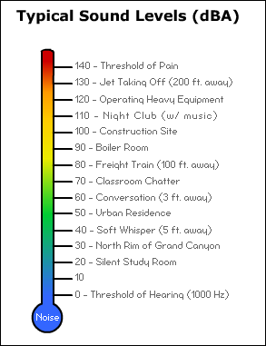
3.4.3.2.13 Noise Pollution
Explain the dB scale and why it is logarithmic. Sketch a graph to show this.
What is the frequency of sound? Explain the health issues related to frequency of sound
Key words:
Complete the table below explaining how military and civil aircraft reduce noise pollution.
Military Aircraft | Civil Aircraft
Describe and explain the effects of noise on living objects.
Effects on humans:
Effects on other living organisms;
Describe and explain the effects of noise on non-living objects
How can the design and location of an airport help reduce noise pollution?
Describe and explain how aircraft engine design can reduce noise pollution

Slide 2
3.4.3.2.13 Noise Pollution
Describe and explain how aircraft body design can reduce noise pollution
Describe and explain how aircraft operation can reduce noise pollution
Describe and explain how we can control noisier aircraft to reduce noise pollution
Complete the table showing the sources of railway noise and how it can be controlled
Complete the table showing the sources of road traffic noise and how it can be controlled
Source | Control
Source | Control
Indicate how noise pollution can be measured in both road traffic and aircraft noise.
Complete the table showing the sources of industrial noise and how it can be controlled
Source | Control
Describe how domestic noise can be controlled

