Slide 1
Biogeochemical Cycles

Slide 2
Biogeochemical
What must this word actually be referring to?
What does bio mean?
What does geo mean?
So what does this word mean?
‘The movement and transformation of chemical elements and compounds between living organisms, the atmosphere, and the Earth's crust’

Slide 3
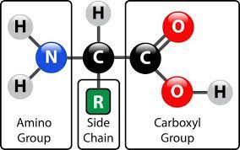
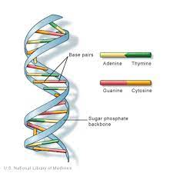
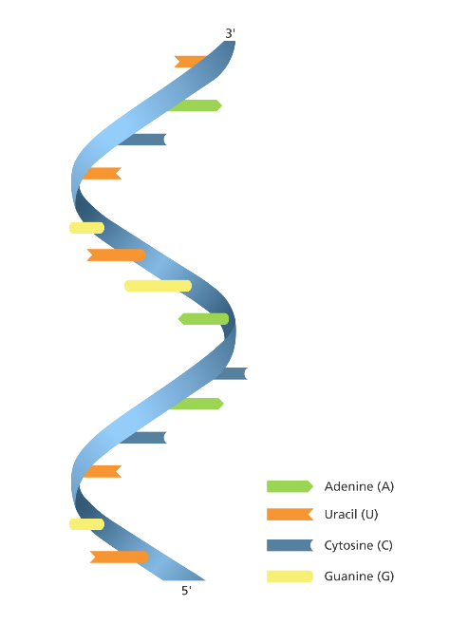
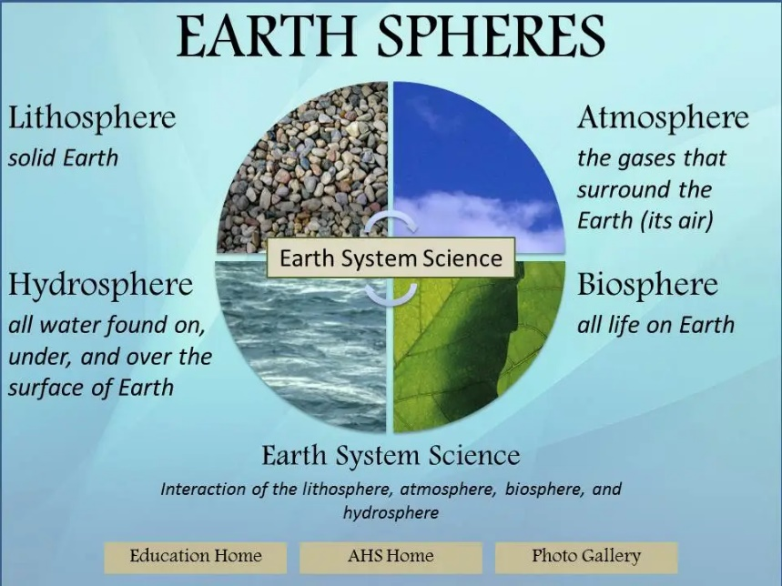

Q1. Why are the carbon, nitrogen and phosphorus cycles important?
Q2. Where are each of the elements ‘in existence’/cycled?

Slide 4
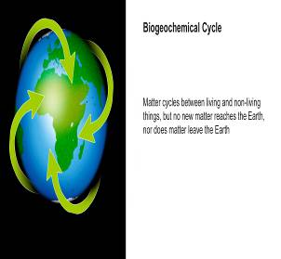
Biogeochemical cycles
An understanding of these cycles aids the management of nutrient supply systems and the control of human activities.
  agricultural nutrient management;
  control of eutrophication;
  predicting global climate change
Matter cycles between living and non-living things, but no new matter reaches the earth nor does matter leave the earth

Slide 5
Biogeochemical cycles
C, N and P are essential components of all living things
All life on Earth is carbon-based.
N and P are needed to make DNA, RNA and proteins
C and N cycle between the atmosphere, plants and animals, soils and rocks and water
P cycles between rocks, animals and plants and water – it has no gaseous phase

Slide 6
Biogeochemical cycles
The constant supply of energy to Earth from the Sun replaces energy lost as it passes from link to link in a food chain. New energy is therefore always entering food chains from plants as they harness energy from the sun.
However, the same is not true of nutrients or other chemicals essential to life, such as water. There is a finite, or limited, amount of these on our planet.
They must be cycled around ecosystems constantly if life is to be sustained.

Slide 7
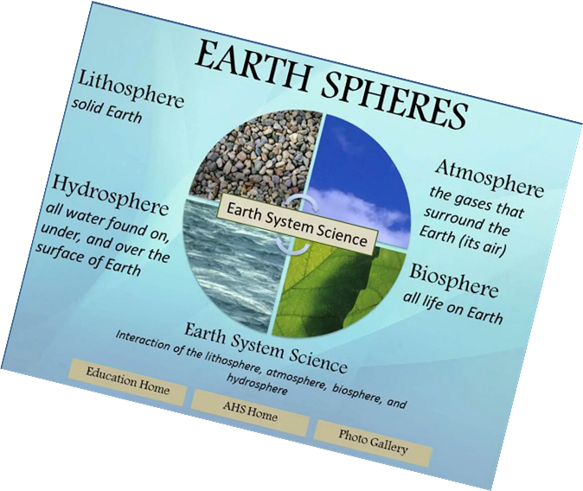
Biogeochemical cycles
The cycling of elements, including plant nutrients, occurs between the gaseous, hydrological, sedimentary and biological reservoirs with varying residence times.
They are driven directly or indirectly by solar energy.

Slide 8
The Carbon cycle
https://www.youtube.com/watch?v=09_sWPxQymA
    Carbon cycle 6:50

Slide 9
Carbon Cycle - Task
List the principal reservoirs of carbon in the carbon cycle
Describe the processes involved in moving carbon between the reservoirs in the carbon cycle
Explain the effects of human activity on the carbon cycle and the significance of these changes

Slide 10
Where might we find carbon?
Organic Carbon
  In water as dissolved salts of carbonic acid
  In plants, animals and dead organic matter as carbohydrates, lipids and proteins
  In carbonaceous rocks (e.g. limestone) as calcium carbonate
  In fossil fuels mainly as carbon and hydrocarbon
Carbon Dioxide
Atmosphere
Factories
Petrol/Diesel engines
Volcanoes
Oceans

Slide 11
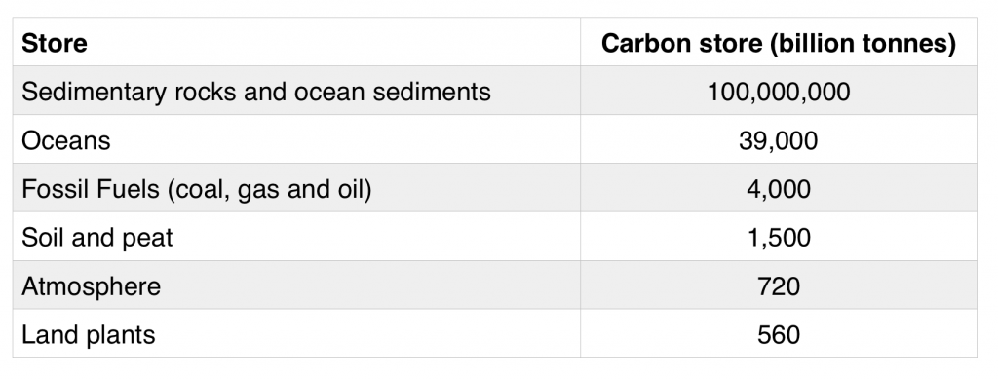

Slide 12
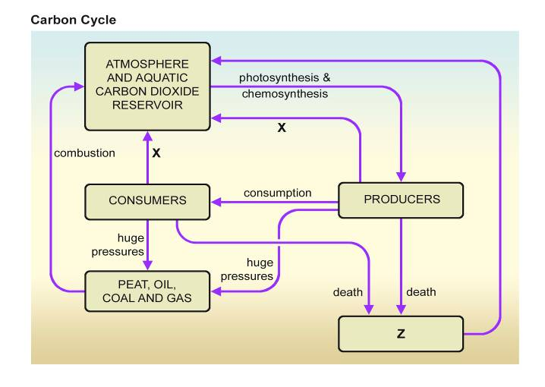
Carbon Cycle
Respiration Decomposers
What is X? What is Z?

Slide 13
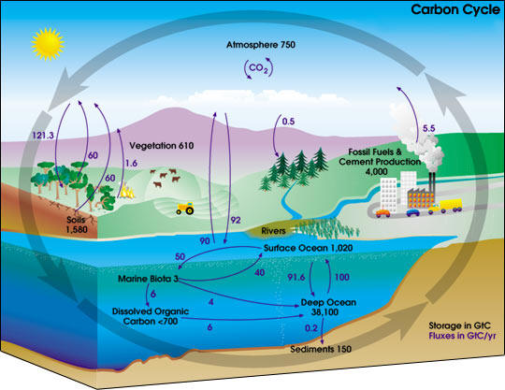

Slide 14
Processes in the Carbon Cycle
What processes are involved in moving carbon between the reservoirs in the cycle?
  Photosynthesis
  Respiration
  Food Chains
  Fossilisation
  Decomposition
  Combustion

Slide 15
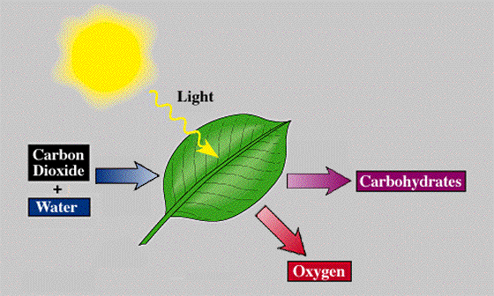
Photosynthesis
The capture of light energy by pigments such as chlorophyll
Carbon dioxide and water are converted into high energy carbohydrates which can be stored if necessary
Oxygen is a by-product

Slide 16
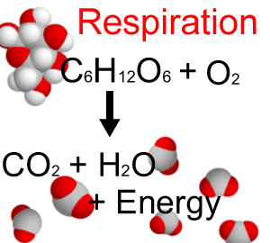
Respiration
The release of energy from high-energy substances, such as carbohydrates, to drive metabolic processes.
Aerobic respiration can break down organic compounds more fully and release much more energy
than anaerobic respiration.
Anaerobic respiration allows some organisms to survive and use food sources in oxygen-deficient environments, releasing methane.

Slide 17
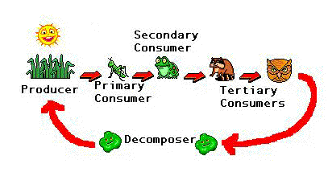
Food chains
Organic compounds passed as food between organisms

Slide 18
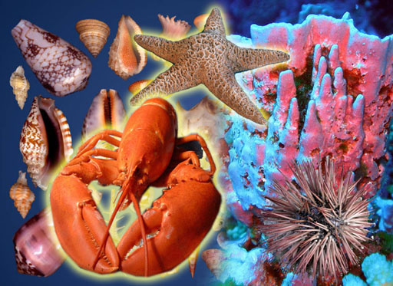
Fossilisation
Incomplete decomposition of organisms leading to deposition of fossil fuels
The absorption of carbon dioxide by marine organisms, its storage in their skeleton and subsequent sedimentation of limestone and chalk on the seabed

Slide 19
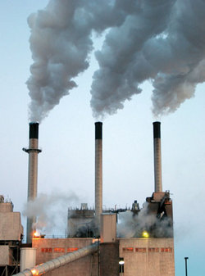
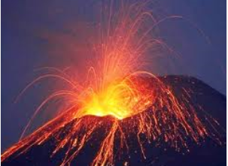
Combustion
The release of carbon dioxide by the burning of organic substances such as wood and fossil fuels
Some is also released during natural processes, such as volcanic eruptions.

Slide 20
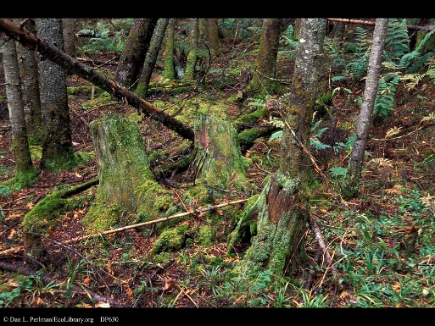
Decomposition
Breakdown of organic matter by microorganisms, releasing gases such as CO₂under aerobic conditions and methane in anaerobic conditions.
Decomposition is the largest source through which carbon is returned to the atmosphere as carbon dioxide.
Decomposers are microorganisms that live mostly in the soil but also in water, and which feed on the rotting remains of plants and animals.
It is their job to consume both waste products and dead matter, during which they also return carbon dioxide to the atmosphere by respiration.

Slide 21
Carbon cycle
Real World: The Carbon Cycle -- Essential for Life on Earth – YouTube
Context video of prof Brian Cox
Wonders of Life - Godalming College eStream - Powered by Planet eStream

Slide 22
Carbon dioxide in the atmosphere
Carbon in surface layers of the sea
Methane
Carbon in plants
Carbon in land animals
Carbon in phytoplankton
Carbon in marine animals
Dead organic matter
Dead organic matter
Fossil fuels
Carbonate rocks
Dissolved in deep ocean

Slide 23
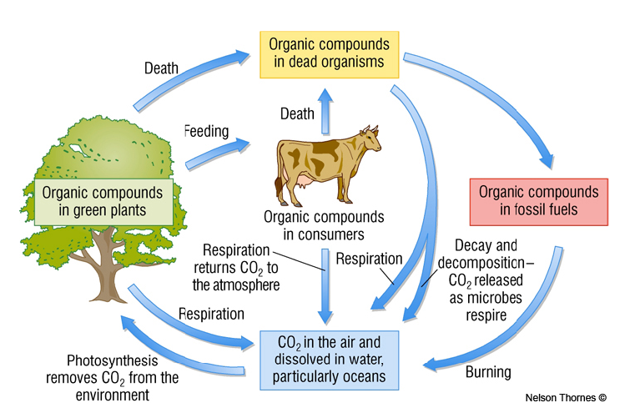

Slide 24
Carbon reservoirs
In water: mainly as salts of carbonic acid (hydrogen carbonate ions) and dissolved carbon dioxide
In plants, animals and dead organic matter: mainly as carbohydrates, lipids and proteins.
In carbonaceous rocks (eg limestone): mainly as calcium carbonate.
In fossil fuels: mainly as carbon and hydrocarbons.

Slide 25
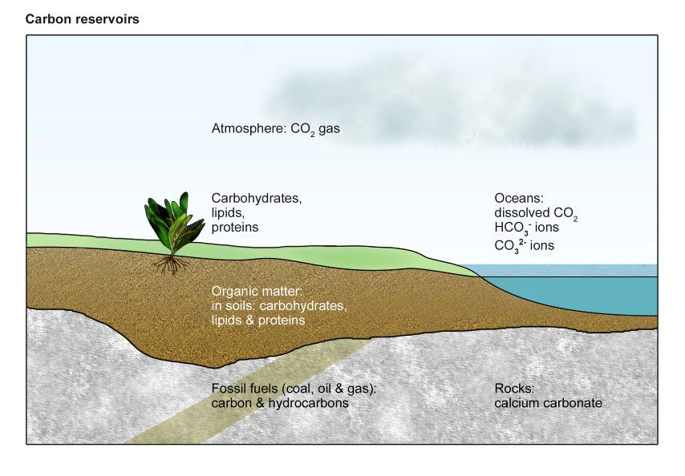
Carbon Reservoirs

Slide 26
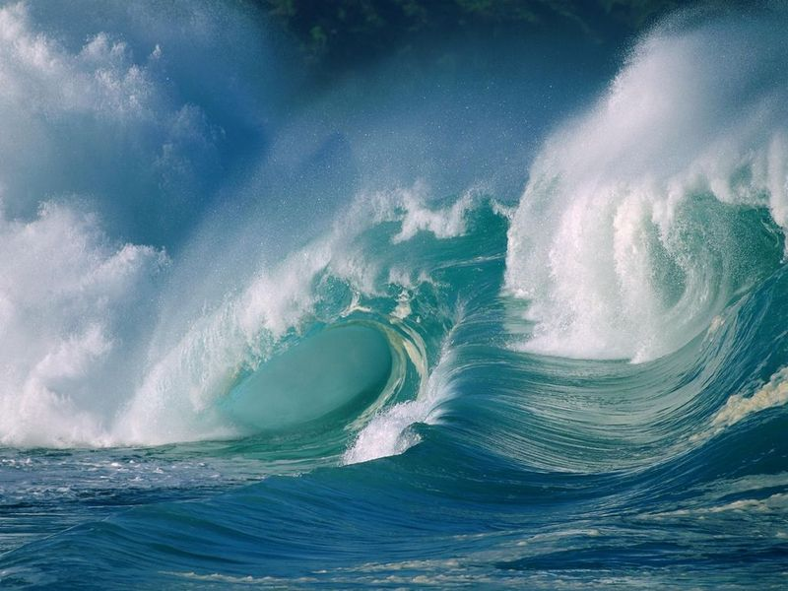
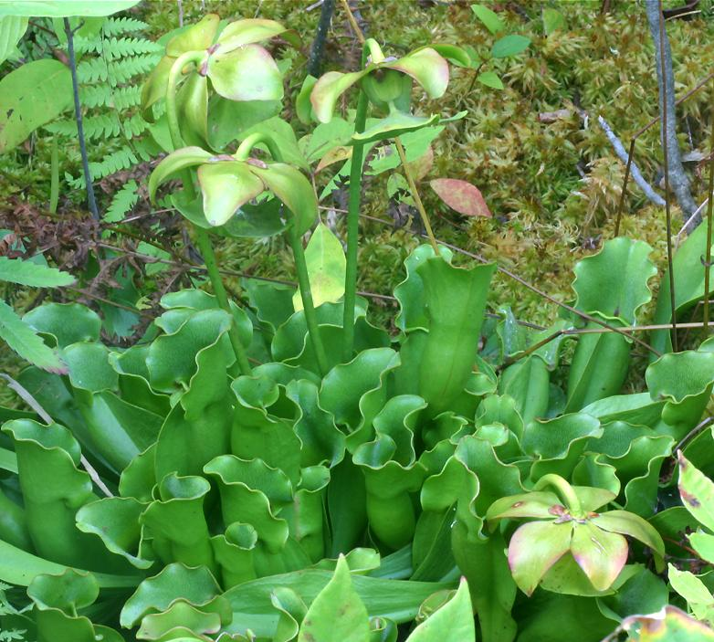
Carbon Sinks
These can be divided in living and non-living reservoirs:
Abiotic sinks – limestone, chalk, fossil fuels, the oceans
Biotic sinks – humus, plants via photosynthesis
Biggest sinks on Earth are the oceans, marine sediments and sedimentary rocks

Slide 27
Carbon sinks in the Ocean
Carbon Dioxide dissolves into the water at the surface
It is taken up by phytoplankton and used in photosynthesis
Carbon is also stored in the shells of marine creatures and in coral reefs
These processes remove dissolved carbon dioxide from the water and ensure that the concentration in the water is kept low enough that more is constantly dissolving in

Slide 28
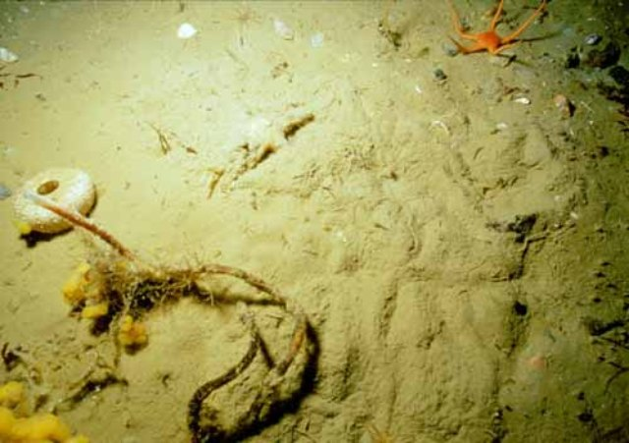
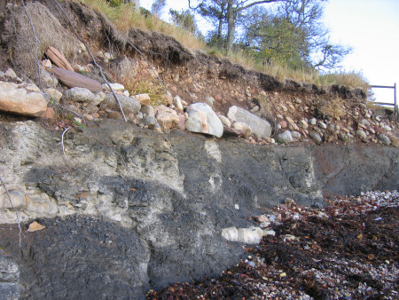
Carbon sinks in the Ocean
Marine creatures die, they produce carbon containing waste, they lose their shells – carbon sinks to the ocean bed
Currents work to move carbon-rich water downwards and bring more water up to take in more carbon from the surface
Carbon becomes trapped in marine sediments and eventually is compressed into sedimentary rocks

Slide 29
Dynamic Equilibria
If the in and out flows balance, then dynamic equilibria exists. By this we mean that there is a state of balance.
Any significant change to the cycle will result in a negative feedback mechanism which will re-balance the system in a new way.
The cycle’s ability to do this means that it can remains stable over a very long period of time.

Slide 30
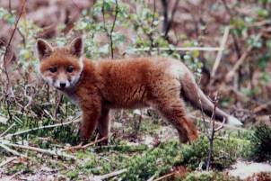
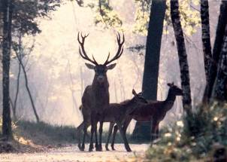
Dynamic equilibrium
Carbon moves back and forth between the atmosphere and living things
The transfers cancel each other out, so the net effect is no change e.g.
Photosynthesis removes CO₂ from the atmosphere and converts it into plant leaves, stems and roots
Respiration returns CO₂ to the atmosphere by oxidising sugars
Photosynthesis and respiration are in balance

Slide 31
How many gigatons of carbon?
(Some alarming figures!) https://informationisbeautiful.net/visualizations/how-many-gigatons-of-co2/

Slide 32
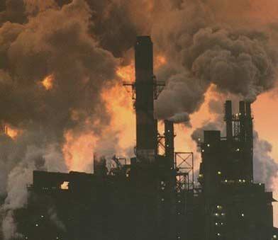
Recall from previous topics:
How is human activity upsetting the natural balance of the Carbon Cycle?
What effect is this having?

Slide 33
Do the following increase, or decrease the amount of carbon in the atmosphere? Explain your reasoning if you can…
Burning fossil fuels
Rice farming
Adding manure to farmland
Ploughing and harvesting
Rearing livestock
Using machinery that burns fossil fuels
Using fertilisers that contain fossil fuels
Deforestation
Urbanisation
Population increase
Burning fuels in pure oxygen
(The link below provides more facts and figures on some of the processes above)
https://www.alevelgeography.com/changes-in-the-carbon-cycle-human-causes/

Slide 34
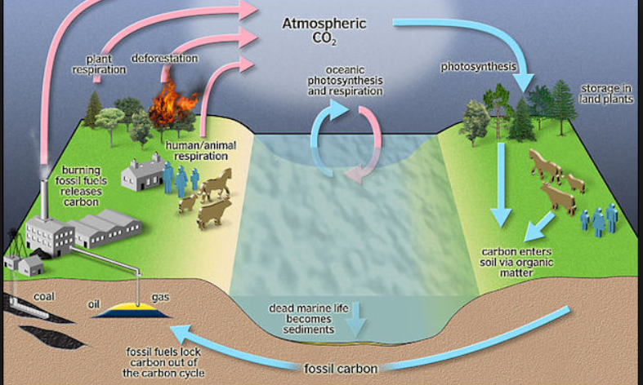
Effects of humans on the carbon cycle

Slide 35
Human Impacts
Humans can cause changes to the equilibria by prevent the feedback mechanisms from working e.g.
Deforestation – reduced photosynthesis and carbon in biomass AND increases atmospheric carbon dioxide
Combustion of fossil fuels
Coal mines, anaerobic gut bacteria, rice padis all release methane
Soil disturbance by ploughing increase the rate of decomposition
GCC increases the rate of decomposition, increases the rate of photosynthesis, melts icecaps which release methane.

Slide 36
Impact on the Carbon cycle
carbon compounds in tertiary consumers
feeding
Decomposition by fungi
carbon compounds in secondary consumers
carbon in fossil fuels
feeding
sedimentation
carbon compounds
in dead organisms
respiration
carbon compounds in primary consumers
Death
carbon calcium carbonates
feeding
carbon compounds in plants
precipitation
photosynthesis
carbon dioxide in air or dissolved in water
weathering
burning

Slide 37
Carbon dioxide in the atmosphere
Carbon in surface layers of the sea
Carbon in plants
Carbon in land animals
Carbon in phytoplankton
Carbon in marine animals
Methane
Dead organic matter
----> reduced movement
____> increased movement
Fossil fuels

Slide 38
Watch the two videos on the website to see why CCS is important, and how it is done. https://www.bgs.ac.uk/discovering-geology/climate-change/carbon-capture-and-storage/

Slide 39
Use the website to research/find out a little more about: post-combustion pre-combustion oxyfuel combustion https://www.bgs.ac.uk/discovering-geology/climatechange/carbon-capture-and-storage/

Slide 40
Carbon Capture and Storage (CCS)
This involves capturing carbon, usually as CO₂, so that it is not released into the atmosphere. A range of technologies is being developed.
1. Post-combustion technology
Carbon dioxide can be removed from the exhaust gases of fossil fuel combustion using several methods:
dissolving it in a solvent;
high pressure membrane filtration;
adsorption/desorption processes;
cryogenic separation.
None of these methods is fully developed and the costs for large-scale CO₂ removal are uncertain. The costs are increased because only about 20% of the gases produced by combustion in air is CO₂.

Slide 41
Carbon Capture and Storage (CCS)
2. Pre-combustion technology
Changing the fuel used, or the way it is combusted, may be expensive and require the development of new technologies but it may make the removal of CO₂ easier or more efficient. Post-combustion capture may not be practical for many small sources such as road vehicles. It would be better if the fuel could be modified at a large-scale facility where the carbon could be captured before the fuel is used, so that the fuel would not release CO₂ when burnt.
Gasification converts a fuel such as coal into gaseous hydrogen and CO₂. The CO₂ can be removed for storage, then the hydrogen can be distributed for use in vehicles, homes, or industry. When burnt, the exhaust gases contain water vapour but no CO₂.
3. Oxy-fuel combustion systems
use pure oxygen so that only CO₂ and water vapour are produced. The water vapour can be removed by cooling the gases so that it condenses. Capture of the CO₂ is then much easier as it is not mixed with other gases.

Slide 42
Storage
After the CO₂ has been captured it must be stored so that it cannot return to the atmosphere. Most proposals involve storage underground in suitable geological structures such as depleted aquifers, oil fields, or gas fields. It can also be injected into oil reservoirs to provide the pressure needed in secondary oil recovery. Research suggests that CO₂ pumped into fractured basalt may react with the minerals in the rock, producing solid carbonate minerals.

Slide 43
The Nitrogen Cycle
https://www.youtube.com/watch?v=09_sWPxQymA
Nitrogen cycle 7:40

Slide 44
Importance of Nitrogen
Why is nitrogen important? What do we use it for?
Essential component of proteins – enzymes, cell membranes and hormones
Component of DNA, RNA and chlorophyll
What are the chemical formulae for these molecules?
Nitrogen
Nitrate
Nitrite
Ammonia
Ammonium ion

Slide 45
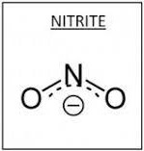

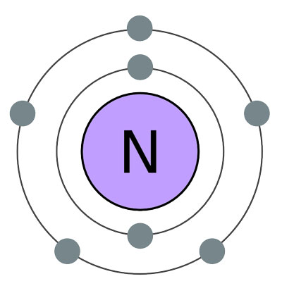
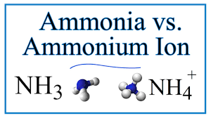

Slide 46
Why is Nitrogen important?
Most of the nitrogen on Earth is immobile in rocks. The rest is in the atmosphere
No plants or animals can assimilate it directly.
Neither can they directly reuse the nitrogenous wastes they release.
A range of processes, largely carried out by bacteria, ‘fix’ nitrogen and recycle it, therefore making it available to other living organisms.

Slide 47
Nitrogen reservoirs
In the atmosphere: mainly as gaseous nitrogen, with some oxides of nitrogen.
In plants: mainly as proteins.
In animals: mainly as proteins.
In dead organic matter: mainly as proteins which break down to release ammonium compounds.
In soil: as nitrates, nitrites and ammonium compounds
In water: as dissolved nitrates and ammonium compounds.
In rocks: in minerals containing nitrogen.

Slide 48

The Nitrogen Cycle and Bacteria
Nitrogen Fixing Bacteria.
These turn nitrogen in the atmosphere into ammonia which can be taken up by plants.
Nitrifying Bacteria.
These turn ammonia into the nitrates and nitrites that plants need,
Denitrifying Bacteria.
These bacteria turn nitrates back into nitrogen gas which can go back into the atmosphere.
Decomposers.
Bacteria and fungi that break down dead animals and plants, and waste from living things into ammonia.

Slide 49
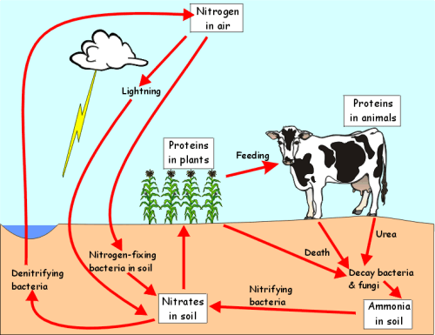

Slide 50
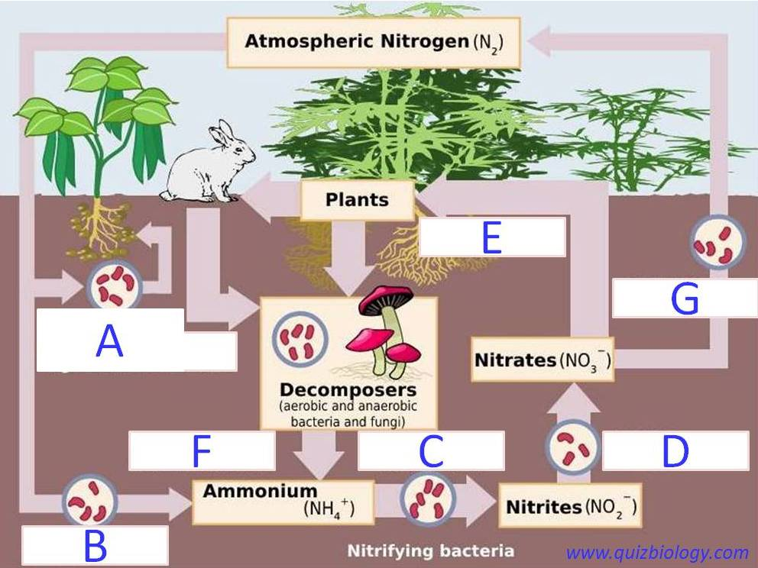

1
What are the N compounds (1-5)?
What are the processes in the cycle (A-G)?
2
3
5
4

Slide 51
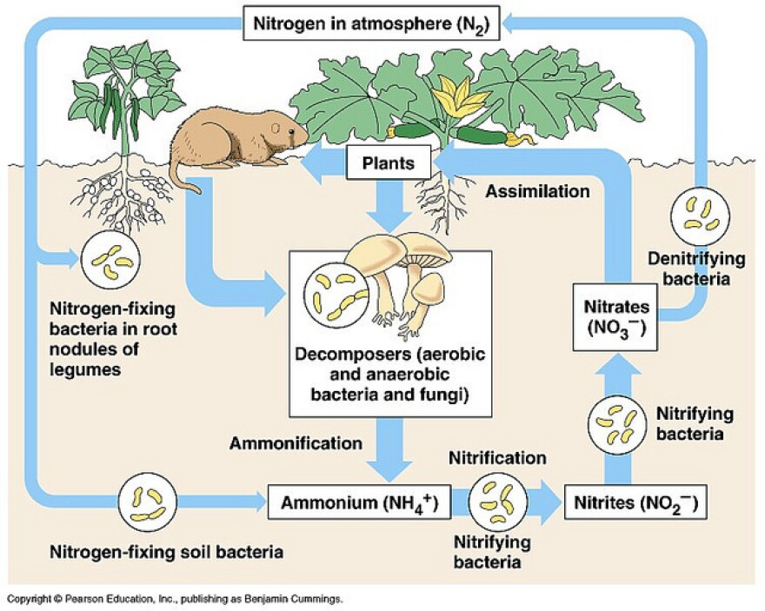

Slide 52
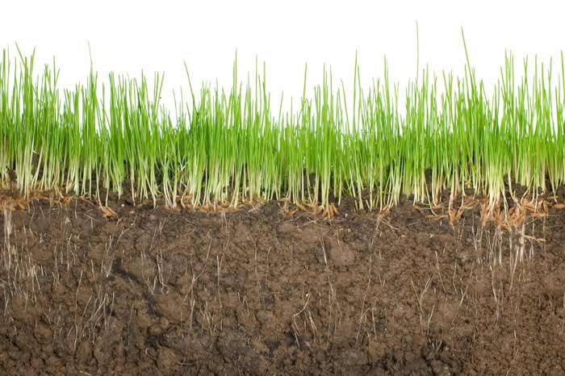
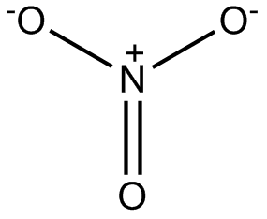
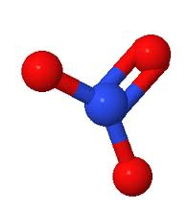
Nitrogen is in the form of nitrates in the soil
Potassium nitrate
Sodium nitrate
Notes:
Nitrogen exists as nitrates in the soil – dissolved in the soil.

Slide 53


The Nitrogen Cycle
Absorbed by plant roots and used to build plant proteins
Nitrogen is in the form of nitrates in the soil
Eaten by animals and stored as animal proteins
Dead plants and animals broken down releasing nitrogenous compounds back into the soil.
Notes:
Nitrogen exists as nitrates in the soil.

Slide 54


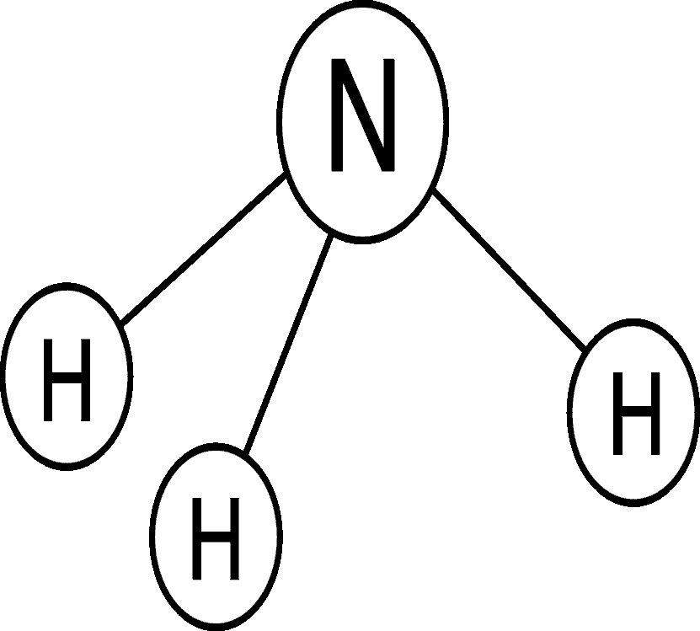
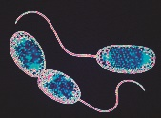
Decomposers
https://www.youtube.com/watch?v=vZ9b5c8BOT4
Then Bacteria step in…
One form of bacteria is called nitrifying bacteria because they convert the ammonia to nitrates (To be used by plants)
Denitrifying bacteria in the soil break down nitrates, releasing nitrogen into the air. (Denitrifying are all anaerobic)
Animal wastes, urea and faeces, contain nitrogen. They are converted to ammonia by decomposers.
When plants and animals die and decay decomposers break their proteins down, releasing ammonia.

Slide 55
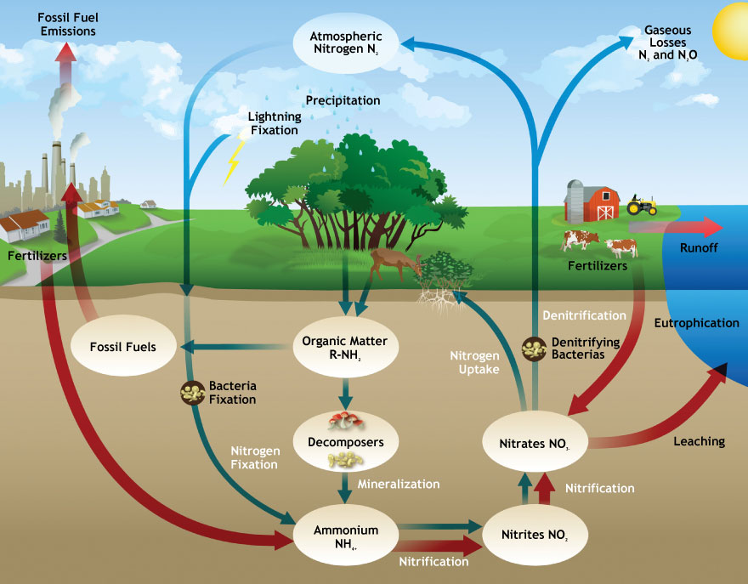

Slide 56
Processes in nitrogen cycle
Ionisation
The events that provide the energy for atmospheric nitrogen and oxygen to react and produce oxides of nitrogen.
eg lightning and meteor trails (ionising phenomena)
Fixation
The chemical reduction of nitrogen to ammonia by some micro-organisms.
eg free-living in the soil, or in the root nodules of legumes.
Food chains
The passage of nitrogen between organisms as amino acids and proteins in food.

Slide 57
Processes in nitrogen cycle
Nitrification
The oxidation of ammonium ions to nitrites then to nitrates by nitrifying bacteria in the soil.
Denitrification
The chemical reduction of nitrates in soil to nitrogen and nitrogen oxide gases by denitrifying bacteria in the soil.
Leaching
The loss of soluble substances such as nitrates from the surface layers of the soil as it is carried away by water.
Absorption by roots
As soluble ions such as nitrates, nitrites and ammonium compounds.

Slide 58
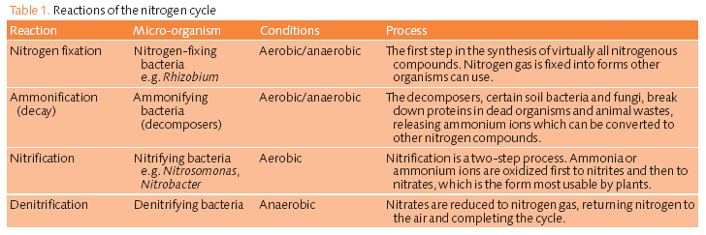

Slide 59
How can we get nitrogen into the soil?
A nitrogen molecule cannot be absorbed directly by plants. However, they can absorb nitrogen in the form of nitrate compounds and ammonium compounds. A process called fixation enables nitrogen compounds to be formed.
Bacteria enable fixation to be achieved. In this process the nitrogen in the air is converted into nitrates. The bacteria reside in the roots of the plants.
Fertilisers, containing ammonium nitrates, can be added to the soil to increase the nitrogen levels. Fertilizers cost money, and many farmers around the world are unable to afford to buy them. Over-use of fertilizers can also result in damage to the soil, and also present environmental damage in rivers and streams by increasing bacterial levels.

Slide 60
How are nitrates removed from the soil?
There are a number of processes which remove nitrates from the soil.
Certain types of bacteria in the soil will break down the nitrates. This releases nitrogen gas back into the atmosphere.
Harvesting crops.
Raising animals on the land.
Rain can remove nitrates, in many cases the water enters streams and rivers.

Slide 61
What is symbiosis? Why is it important?
Symbiosis is when two organisms (normally bacteria) live intimately together to benefit both organisms e.g. coral (protection) and zooxanthellae (oxygen).
An example here is nitrogen fixing bacteria in plants. The bacteria carries out nitrogen fixing in the nodules of the plants roots and in return gains sugars from the plant

Slide 62
Can you write the processes on?
Atmospheric nitrogen
Nitrate ions NO³⁻
Nitrogen in plants
Nitrogen in animals
Dead organic matter
Nitrite ions NO²⁻
Ammonium ions NH⁴⁺

Slide 63
The Nitrogen Cycle with the processes shown

Slide 64
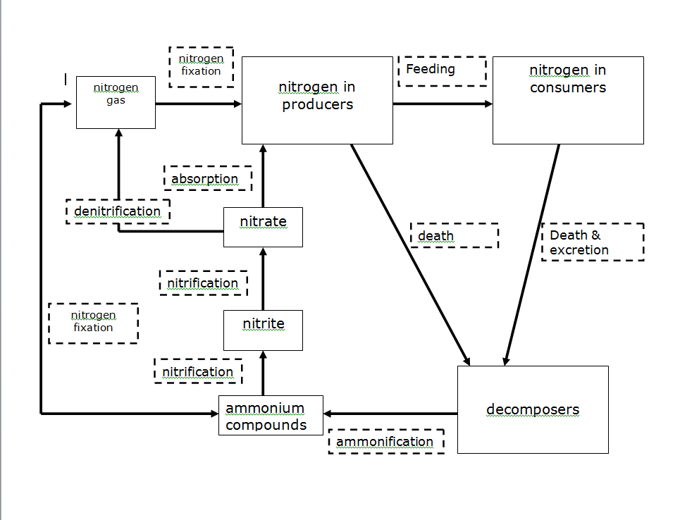

Slide 65
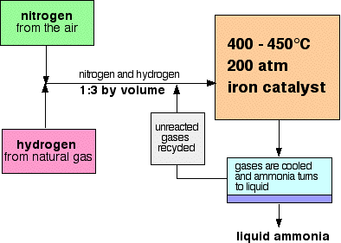
The effects of human activities on the nitrogen cycle
The Haber process
An industrial process to fix nitrogen and turn it into ammonia
Ammonia is oxidise to make nitrates and nitrites which are used to make fertilisers and explosives

Slide 66
Agriculture
Nitrate fertilisers may increase the problems caused by leaching
Drainage increases the numbers of nitrifying bacteria and reduces the numbers of denitrifying bacteria
Ploughing increases the rate of decomposition which releases more ammonia into the soil
Ploughing changes the amounts of denitrifying and nitrifying bacteria in the soil
Legumes will increase the levels of nitrogen compounds in the soil

Slide 67
Pollution
Nitrous oxides are released into the atmosphere by combustion processes. This may eventually increase the amounts of nitrates washed into the soil by rain.

Slide 68
Atmospheric nitrogen
Nitrate ions NO³⁻
Nitrogen in plants and algae
Nitrogen in animals
Nitrite ions NO²⁻
Dead organic matter
----> reduced movement
____> increased movement
Ammonium ions NH⁴⁺

Slide 69
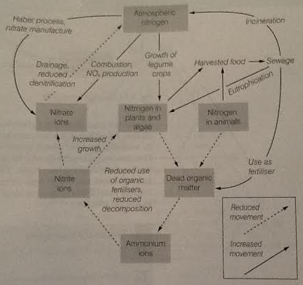

Slide 70
Task
Outline the ways in which human activities affect the processes in the nitrogen cycle (9 marks).
OR
Suggest how the deliberate control of the nitrogen cycle can increase agricultural productivity (6 marks).

Slide 71
Phosphorus Cycle https://www.youtube.com/watch?v=pFieYBlU91o

Slide 72
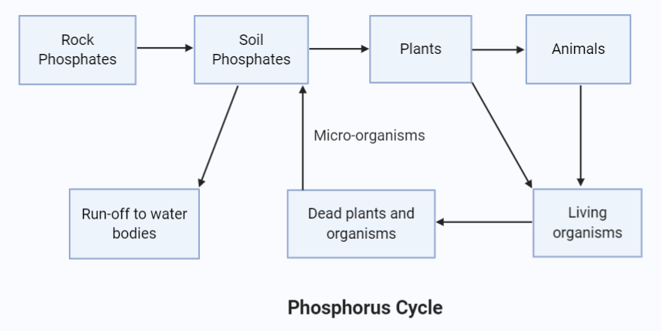
Back to back
https://www.youtube.com/watch?v=RKkC2JpjaGc
Bozeman

Slide 73
Why is Phosphorus important?
All living organisms need a source of phosphorus to make molecules such as DNA, ATP (adenosine triphosphate) and hence protein.
ATP provides organisms with necessary energy
The amount of phosphorus available can therefore have a dramatic effect upon the productivity of an ecosystem.

Slide 74
Differences from carbon and nitrogen cycles
The phosphorus cycle is very different from the carbon and nitrogen cycles in that the atmosphere is not involved.
Phosphorus compounds, usually as phosphates (PO₄³⁻), are not very soluble and are often the limiting factor on plant growth, especially in the deep oceans where there are no rocks to release phosphates during weathering.

Slide 75
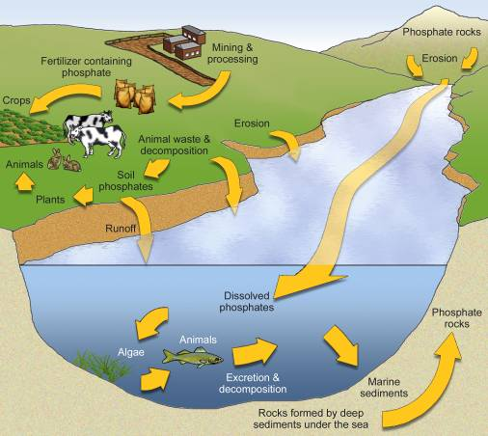
Where can we find phosphorus (sinks)?
Plants and animals:
  E.g. in bones, ATP and DNA
Sediments and rocks:
  E.g. apatite, calcium phosphate
Water:
  As dissolved phosphates produced by the weathering of rock (although most are relatively insoluble).

Slide 76
Processes involved in the Phosphorus Cycle
Absorption by roots
  Dissolved phosphates are absorbed by plants and are passed along food chains. Plants can only obtain their phosphorus from the soil in which they are growing.
2. Food chains
Phosphates are passed along food chains when animals consume them. They use them to form ATP.
3. Decomposition
Phosphates that are excreted or found in dead organic matter may be available for other plants to use.
4. Sedimentation
When DOM is broken down it is very likely that the phosphate is lost to sediments and is locked away.
If plants are harvested and removed, then all the phosphorus they contain is lost from that area, and replenishment through weathering and leaching would take thousands of years

Slide 77
Problems with the phosphorus cycle
Most soils have only small amounts from the weathering of sparsely distributed rocks.
Phosphorus is more insoluble than other nutrients and less mobile, hence less phosphorus travels in the soil solution; roots generally must grow into a zone of phosphorus availability.
Phosphorus that drains from the land to the ocean is used by organisms in the surface waters, but a considerable amount is lost to the sediments in the shells and bones of marine organisms.

Slide 78
Phosphorus cycle
Harvesting crops removes P so farmers apply millions of tonnes of phosphate fertiliser annually
That fertiliser is made from phosphate-containing rocks that were formed from marine sediments laid down millions of years ago
The lack of a gas phase and slow supply from weathering rocks = phosphorus is a finite resource

Slide 79
Things to remember
The phosphorus cycle refers primarily to the biosphere whereas the majority of phosphate exists FIXED in the lithosphere.
The only natural phosphate available to plants comes from absorption from soil.
When an organism dies, a significant % of phosphate is leached into soil, some of which is then lost to the cycle as it is locked up in rocks.

Slide 80
Phosphate weathers from rocks (enters soil).
Most phosphate gets locked up in minerals (lost).
Some plants manage to uptake small amounts of phosphate.
Animals eat the plants and convert it into ATP.
When they die, they either decompose (lost to soil) or harvested/killed for food (lost to other organisms).
NOTE – the phosphate ions move quickly through plants and animals but take thousands of years to re-cycle through the soil.

Slide 81
Limiting factor – the lack of a substance that prevents a process from occurring e.g. sunlight for photosynthesis.
How can the low solubility of phosphates and the absence of a gaseous reservoir make the availability of phosphorus the limiting factor on plant growth (3 marks)?
Solubility affects plants growth as it means that the ion cycles far too slowly in the soil for plants to uptake it regularly (can be changed artificially by using fertilisers).
Lack of a gaseous reservoir means that bacteria can’t fix the ion i.e. there is not a large availability of phosphate.
Plants require phosphate to grow and therefore if it is not present, then their growth is limited.

Slide 82
Human Impacts on the Phosphorus Cycle
Sedimentary deposits are rapidly being mined to make fertilise
Use of phosphate fertilisers to increase yields
Often this use is inappropriate, or the farming practice is inappropriate and therefore large losses of phosphorus occurs from agricultural land.
Huge amounts of phosphates found in detergents have entered freshwater systems- it is often the limiting factor in freshwater ecosystems and small extra inputs can rapidly accelerate eutrophication (the rapid growth and subsequent decay of aquatic vegetation caused by effluents rich in phosphates and nitrates).

Slide 83
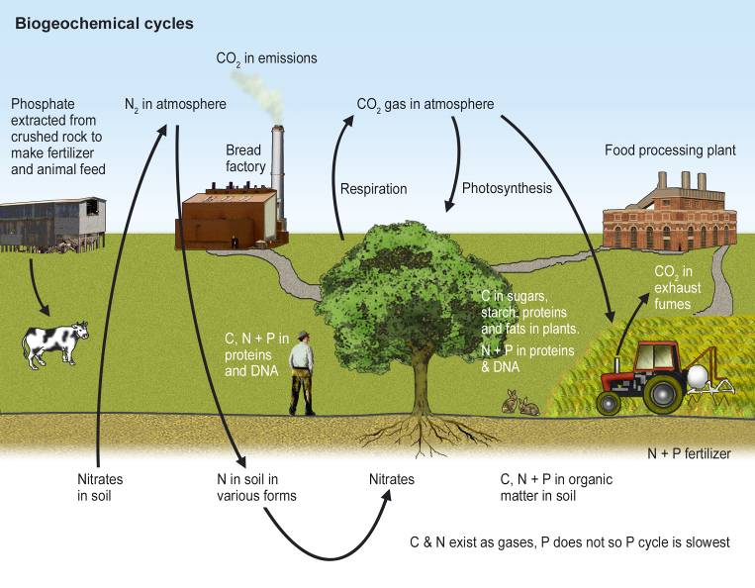
The three cycles do not work in isolation

