Slide 1
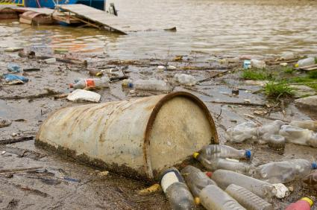
Intro to Water Pollution
Learning objectives:
To describe the factors that affect water pollution.
How do you think water can become polluted?
List as many ways that you can think of.

Slide 2
Water pollution
Pollutants in water are mobile, carried by moving water such as rivers, ocean currents and groundwater flow.

Slide 3
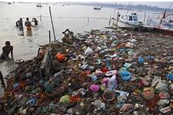
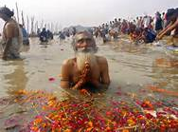
Water bodies likely to be polluted
River Tyne – industrial areas
Ganges – large human populations

Slide 4
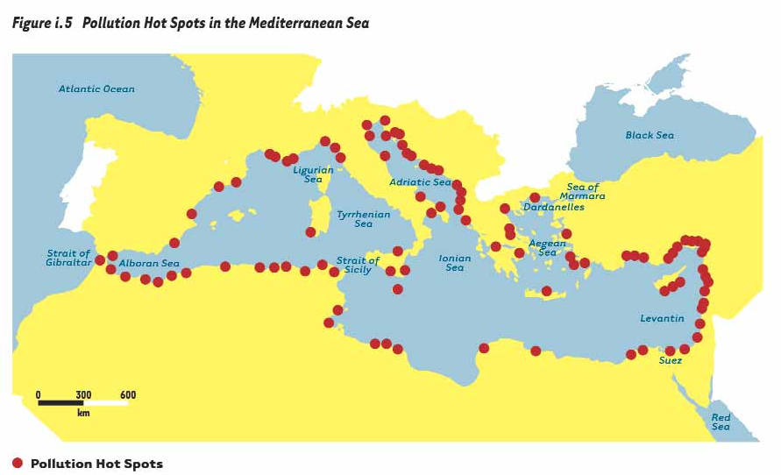
Enclosed lakes or seas where pollutants can collect

Slide 5
Heavy shipping in the English Channel

Slide 6
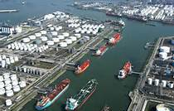
Ports and Oil Terminals
Oil terminals and ports - Rotterdam

Slide 7
Water bodies likely to be polluted
Cause
Examples of Water bodies affected
Industrial areas
Areas with high populations
Pollutants entering enclosed bodies of water
Heavy shipping
Oil terminals and ports
Rivers; Tees, Tyne, Danube, Rhine
River Ganges
Mediterranean Sea, Great Lakes of N. America
English Channel, Persian Gulf, St Lawrence Seaway
Rotterdam, Persian Gulf

Slide 8
Factors affecting concentration of water pollution
Factors affecting the water body
Size of emission
Volume of water
Residence time of water
Factors affecting degradation
Sunlight and UV
Dissolved O2
TemperatureRemoval rate of pollutant
Removal rate
Dispersal by currents

Slide 9
Factors affecting the water body
Size of emissions
Larger emissions will produce higher concentrations. If concentration is low the pollutants may not be harmful.
Volume of water
Releases in small water bodies (lake, bay) will produce a higher concentration compared with an ocean
Residence time of water
The shorter the residence time, the more likely that the pollutant will be carried away by flowing water and not accumulate.

Slide 10
Factors affecting degradation
What is degradation?
What are the 3 ways degradation can occur?
Rate of degradation is determined by:
High levels of sunlight & UV – increases the rate of photochemical degradation
More dissolved O₂ – increases the rate that aerobic bacteria break down sewage
Higher temperatures - increase the rate of most reactions

Slide 11
Examples of biodegradable pollutants | Examples of non- biodegradable pollutants

Slide 12
Examples of biodegradable pollutants | Examples of non- biodegradable pollutants
paper | Most plastics eg PVC
Faeces | Synthetic rubber
Oil (but slow breakdown) | Heavy metal salts
Vegetable wastes | Nuclear isotopic
Brewery waste | Nutrient salts (eg. nitrates, phosphates)
Sileage liquor | Inorganic ions e.g. chloride

Slide 13
Removal rate
Pollutants are removed from water by being adsorbed onto sediment particles e.g. pesticides and phosphates. Suspended solids may settle out if the flow rate is slow.
Dispersal
Pollutants can be carried away and diluted by currents. Knowledge of currents can determine where to select effluent sites.
Pollutants may appear to have disappeared but are just diluted. If persistent/non-biodegradeable they can become more concentrated e.g. bioaccumulation of heavy metals

Slide 14
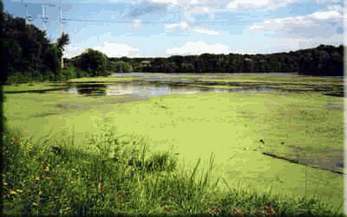
Nutrient Pollution
Learning outcomes:
To look at the different inorganic and organic nutrient pollution sources and their environmental effects.

Slide 15
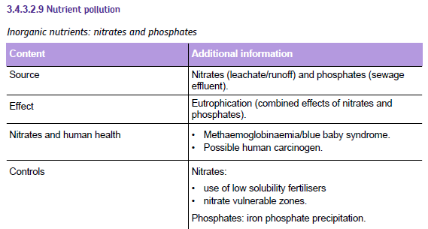
Specification content

Slide 16
Specification content

Slide 17
Nutrient Pollution
https://www.youtube.com/watch?v=vCicSNnKUvM Nutrient pollution USA from US Environmental Protection Agency EPA 2012 video 2 min 5 s
A nutrient is a substance that increases the growth of an organism. Surplus nutrients in water cause excessive growth can cause problems, but inorganic and organic nutrients do this in different ways.

Slide 18
Inorganic and Organic nutrients
Inorganic and Organic nutrients
Inorganic nutrients – plant nutrients such as compounds of nitrogen and phosphorus such as nitrates and phosphates.
(in other words the inorganic ions needed by plants and that are often provided by synthetic fertilisers - BUT you need to know the definition above)
Organic nutrients – high energy nutrients, such as carbohydrates, lipids and proteins from plant and animal material.
Notes:
Note that the definitions refer specifically to nutrients, not to organic and inorganic materials so are based on the nutrient meaning of the words.

Slide 19
Major Sources of Excess Nutrients
Major sources of excess nutrients are agricultural fertilisers, domestic sewage and livestock wastes.
Agricultural fertilizers provide inorganic nutrients.
Sewage and wastes provide both inorganic and organic nutrients.

Slide 20
Excess Inorganic Nutrients
Agricultural runoff from fertilizers and effluent from secondary sewage treatment plants are the primary sources of inorganic nutrient addition to aquatic ecosystems.
These sources are rich in nitrogen and phosphorus.

Slide 21
Sources of inorganic nutrients
Nitrates (very soluble)
Washed off farmland after artificial fertiliser use, manure application, ploughing or silage fluids
Fish farm effluents
Sewage effluents
Phosphates (not very soluble)
Sewage effluent
Silage fluids
Fertiliser run off (smaller quantities)
Inorganic nutrients are releases during breakdown of dead organic matter such as sewage and manure
http://www.bbc.co.uk/education/clips/zyrbwmn bitesize on Nitrate pollution in Scotland Sands of Forvie Nature reserve set up in 2001 3 min 51 s

Slide 22
Effects of inorganic nutrient pollution
Nitrates are soluble and can get into drinking water supplies
Effect of nitrates on babies
In the gut, bacteria can convert nitrates to nitrites.
These nitrites can react with haemoglobin reducing its ability to transport oxygen leading to the disease methaemoglobinanaemia (blue baby syndrome)
Nitrites are also ingested as food additives in meat, fish & cheese products
Nitrates and cancer
Nitrites can also form nitrosamines which are carcinogenic and may cause stomach cancer

Slide 23
Eutrophication
Eutrophication is the accumulation of nutrients in aquatic ecosystems.
It alters the dynamics of a number of plant, animal and bacterial populations; thus, bringing about changes in community structure.
It is a form of water pollution and like all other forms of pollution is the result of human activities influencing ecological cycles.

Slide 24
Eutrophication
Definition - The nutrient enrichment of an aquatic ecosystem.
Natural Eutrophication -- a process that occurs as a lake or river ages over a period of hundreds or thousands of years.
Cultural Eutrophication -- a process that occurs when humans release excessive amounts of nutrients; it shortens the rate of aging to decades.

Slide 25
Natural Eutrophication
Lakes can be classified based on nutrient content and production of organic matter.
Oligo- nutrient poor; meso- middle nutrient; eu- nutrient rich.

Slide 26
Oligotrophic Aquatic Ecosystems
A clear water stream or deep blue lake contains enough bacteria to decompose organic material from organisms that die.
Water is neither acidic or basic.
Inorganic nutrients are present in low concentrations.
Ammonia produced by animals and bacteria is taken up and used for plant growth.
http://www.youtube.com/watch?v=wMZ8xfHPNu8

Slide 27
Cultural Eutrophication
The addition of excess nutrients from a variety of sources results in the rapid changes of aquatic ecosystems.
During this process the species composition of the aquatic community changes.

Slide 28
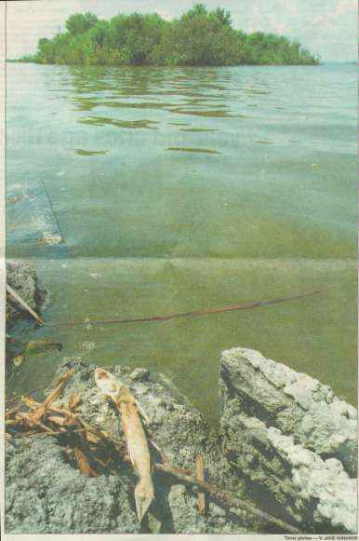
Nutrients Stimulate Algal Blooms
Nitrogen and phosphorus from runoff and effluents or decay of organic matter stimulates aquatic plant growth.
Algae and cyanobacteria absorb nutrients directly from the water.
Algal “blooms” lead to a range of problems.

Slide 29
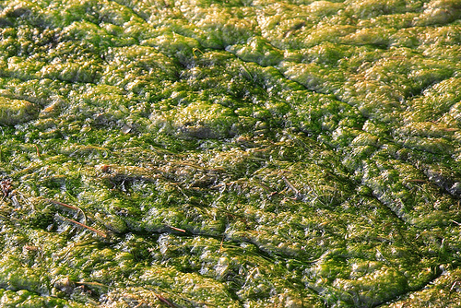
Effects of algal blooms
Cyanobacteria can release harmful toxins which can affect livestock, pets and people who drink the water.
Floating algae shades the submerged or rooted macrophytes (larger plants that are rooted at the base or margins of the water body).

Slide 30
Plants Die, Bacteria Grow, Deplete Oxygen, Fish Die
Macrophytes can’t photosynthesis and will die which disrupts the food web.
Decay by aerobic bacteria of dead plants and animals leads to deoxygenation.
Fish and invertebrates die when oxygen gets too low.

Slide 31
Eutrophication Visually

Slide 32
Oxygen Replenishment and Ecosystem Recovery
In temperate regions, the growing season ends.
Bacteria eventually use up their food and populations decline.
The concentration of dissolved oxygen increases, either primarily through atmospheric replenishment or through photosynthesis of plants.
If stocks are available then fish and invertebrates can recolonise and the stream or lake will recover.

Slide 33
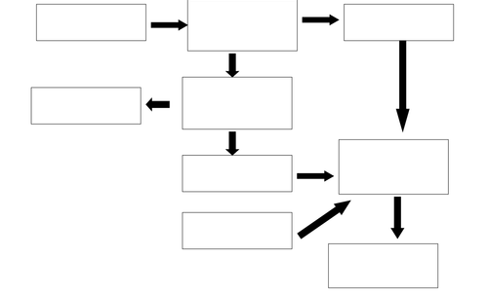
Task
Create a flow chart to show how a lake may undergo eutrophication from inorganic nutrients.
Flow charts will have boxes of information and arrows leading from 1 box to another link the one below

Slide 34
Eutrophication
http://www.youtube.com/watch?v=UGqZsSuG7ao 1 min 28 s animation
https://www.youtube.com/watch?v=0JnKkit5ocI National geographic 15 min (from 1:17)
What does the word mean?
https://www.youtube.com/watch?v=6LAT1gLMPu4 1 min 54 s animation type explanation of Eutrophication
Eutrophic lake – lots of nutrients so lots of plants
Oligotrophic lake – few nutrients, little plant growth
https://www.youtube.com/watch?v=WaIrLFq3DGI I min video to music shows an algal bloom.

Slide 35
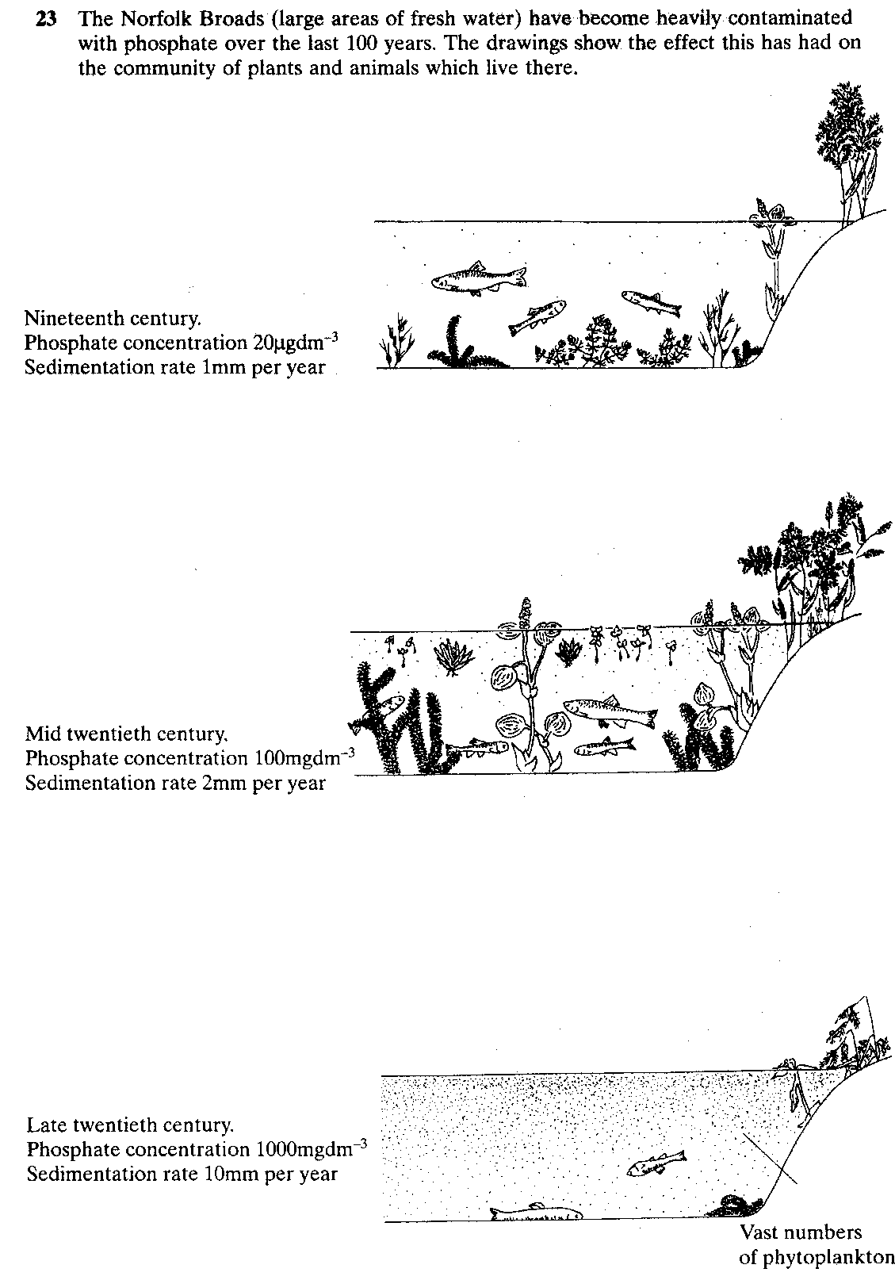

Slide 37
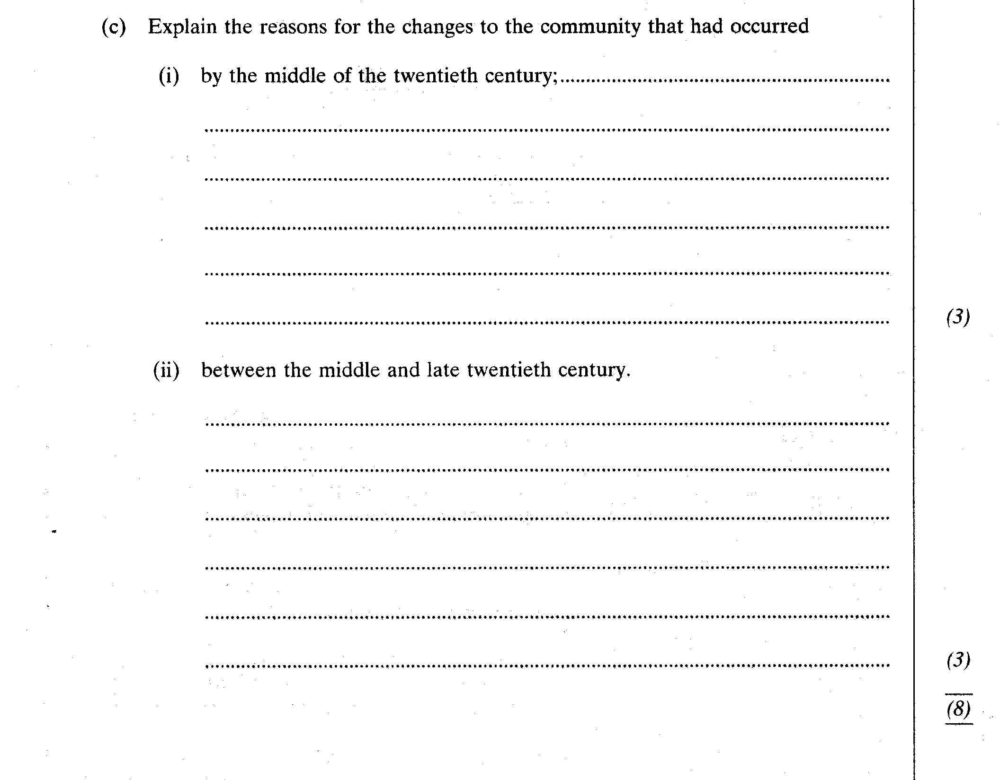

Slide 38
Control of Nitrates
Use slow release fertilisers
reduce use of fertilisers
Ploughing in heavy rain
Do not dump organic material
Cultivate crops that require less nitrogen e.g. triticale not wheat
Buffer strips near rivers
Nitrate control areas – important near aquifers.

Slide 39
Control of Phosphates
Slow release fertilisers
Buffer strips
Remove phosphates from effluent using iron (III) sulphate. This causes the phosphates to precipitate out.
Remove predatory fish to encourage growth of zooplankton which eat algae

Slide 40
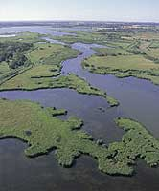
The Norfolk Broads

Slide 41
Norfolk Broads
Remediation has been achieved by:
All sewage works now use Iron (III) Sulphate to remove phosphates from the run off.
Dredging
Iron Sulphate has been added to lakes to precipitate the soluble phosphates.
Populations of zooplankton are maintained at high levels by removing the fish which eat them, these in turn eat the algae.

Slide 42
What comprises Organic Nutrients
Biochemicals that have a living origin:
Carbohydrate
Lipids
Proteins
Nucleic acids
I.e. Dead or waste material that has not yet undergone complete decomposition.
NB different to inorganic but often with a similar initial origin, BE CAREFUL!

Slide 43
The effects of Organic Nutrient Pollution
Deoxygenation – aerobic organism will decompose this material and use up O₂ in the water. This may well kill larger aerobic organisms. The bacteria can also shade the submerged plants and therefore reduce photosynthesis further reducing oxygen levels.
Pathogens – untreated sewage can be a source of diseases such as typhoid, dysentery, cholera, E.coli
Release of inorganic nutrients – this happens as the material decays and can lead to eutrophication.

Slide 44
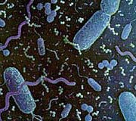
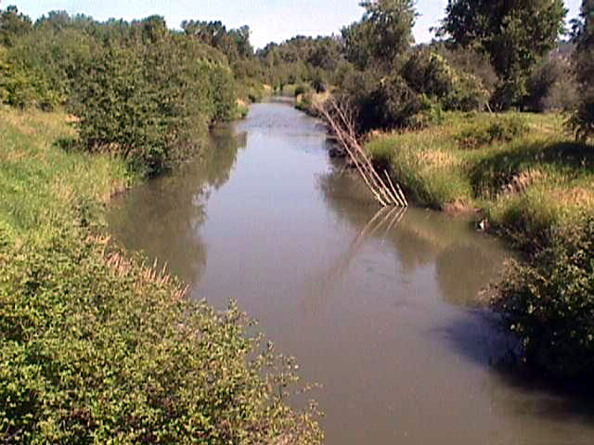
Excess Organic Matter
Untreated sewage, manure, paper pulp, packing plant wastes are sources of excess organic matter added to aquatic ecosystems.
Results in exponential growth of bacterial populations.
Bacteria deplete dissolved oxygen in the water.

Slide 45
Low Oxygen Levels Cause Die-off
Rapidly growing bacterial populations need exponentially increasing amounts of oxygen.
Once dissolved oxygen levels become too low, fish and many freshwater invertebrates die, thus adding more organic matter.

Slide 46
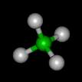
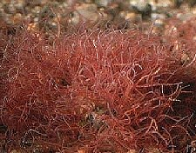
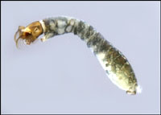
Oxygen Depleted Waters
As oxygen disappears, anaerobic bacteria produce methane, hydrogen sulfide and ammonia.
Bacterial respiration increases carbonic acid.
In all but the most oxygen depleted waters, tubificid worms, midge larvae and mosquito larvae replace oxygen-loving invertebrates.

Slide 47
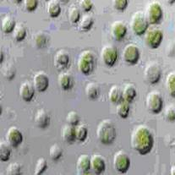
Oxygen Replenishment
If organic material is not continually added or the water moves downstream, bacteria eventually use up their food and populations decline.
The concentration of dissolved oxygen increases, either through atmospheric replenishment or increased photosynthesis.

Slide 48
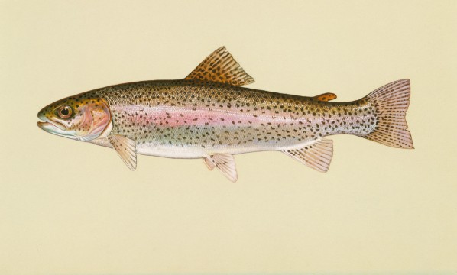
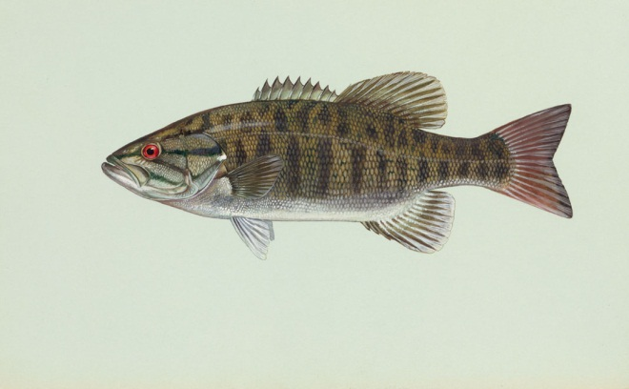
Recovering Aquatic Ecosystem
If stocks are available then fish can recolonize and the stream or lake will recover.
Carp, which tolerate low oxygen levels, do well.
Oxygen-loving species such as trout, bass and other game fish may return.

Slide 49
Sewage Treatment
Research sewage treatment
Make notes on
Activated sludge treatment
Pre-treatment
Primary treatment
Sludge disposal
Secondary treatment
Tertiary treatment
Annotate the sheet with the key information from your research

Slide 50
Sewage Treatment
Raw sewage contains waste from:
Baths, sinks, washing machines, dishwashers, toilets mixed with some non toxic industrial waste and rain water.
Treatment involves:
removing solids,
separation of organic solids,
breakdown (digestion) of organic matter in the fluids,
treatment to remove bacteria and phosphates,
treatment of sludge.
Silage effluents are, by law, controlled. It is illegal to discharge them into water courses.
Silage = conserved grass cuttings made by farmers under naturally produced acidic conditions which ‘pickle’ the grass and form a winter livestock feed. It is moist and so liquid waste (effluent) is produced which is a pollutant of water. Nowadays strict controls govern the disposal of this effluent.
Effluent = agricultural or industrial liquid waste.

Slide 51
Effluent inflow
Sewage, domestic waste, treated industrial waste, some surface water drainage
Pre-treatment
Screens and grit traps
Primary treatment
Sedimentation tank
Digested Sludge to fertiliser / landfill / incineration
Sludge Disposal
Anaerobic digestion
Secondary treatment
Aeration tank and Sedimentation tank
Sewage Treatment
Tertiary treatment
Phosphate stripping by iron sulphate
Alternative Secondary treatment
A combined tank with rotating spray arms and a trickling filter bed containing microorganisms that digest organic matter and denitrify nitrates.
Treated Effluent to river, lake or sea.
Notes:
Effluent = agricultural or industrial liquid waste.

Slide 52
Sewage Treatment Processes Overview
Pre treatment – removal of solid objects by filtering with metal screens and grit traps.
Primary treatment – separation of most of the organic solids from the fluid
Secondary treatment – digestion and breakdown of remaining organic matter by aerobic microorganisms.
Tertiary treatment – removal of phosphates and bacteria by addition of iron sulphate.
Sludge disposal – solid wastes from the primary treatment are sent to an anaerobic digester where anaerobic bacteria digest the sludge and produce methane (can be used as fuel) and safe digested material (can be used as fertiliser).

Slide 53
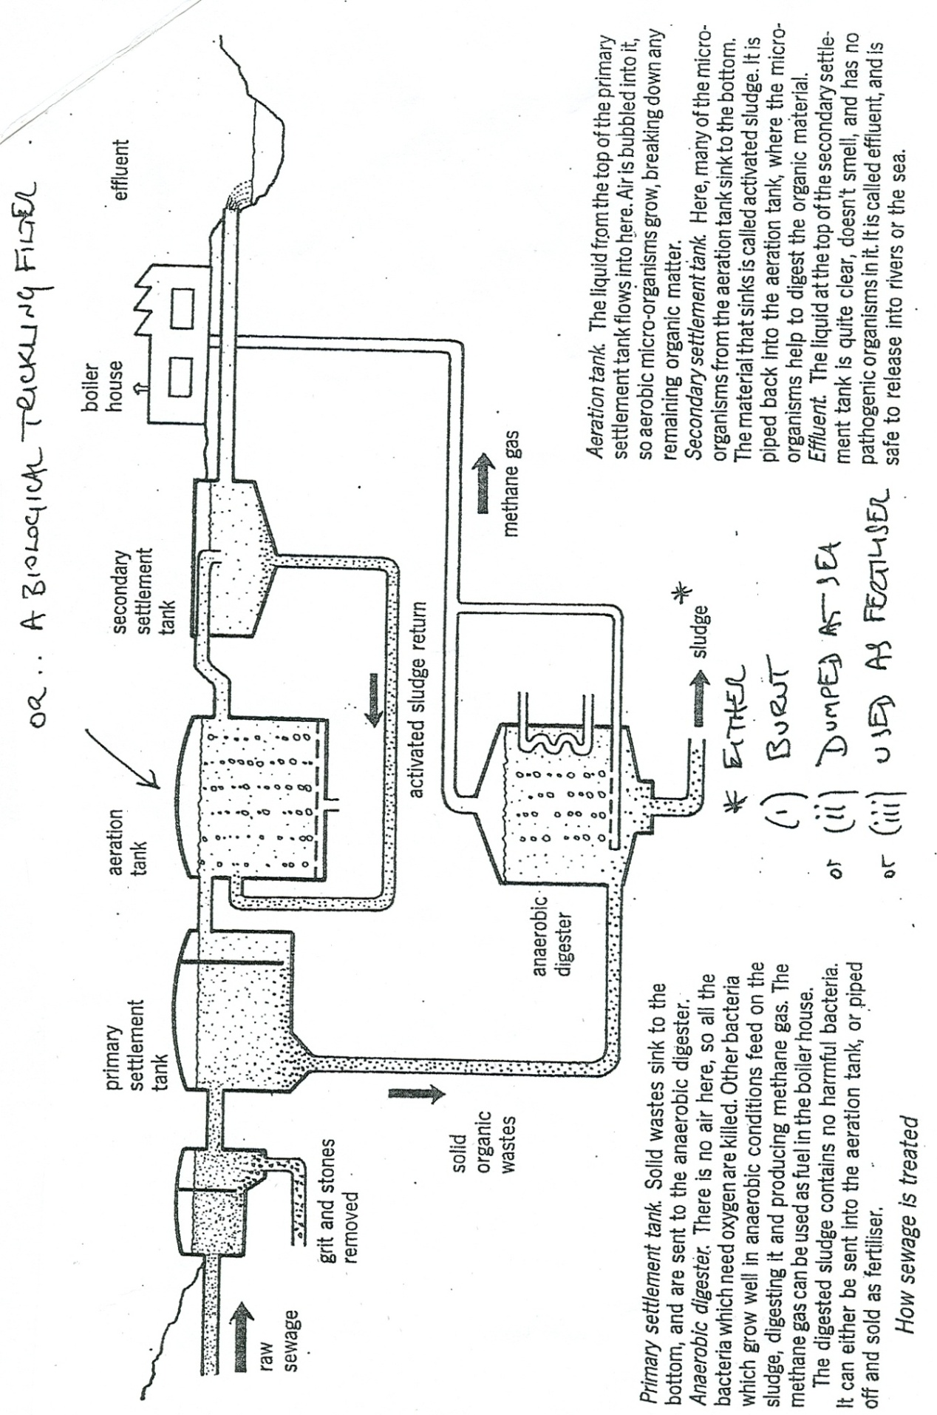
Sewage Treatment
Primary Settlement tank
Aeration Tank
Secondary Settlement tank
Effluent
Grit and Stones removed
Aeration Tank: The liquid from the top of the primary settlement tank flows into here. Air is bubbled through it, so aerobic micro-organisms grow, breaking down any remaining organic matter.

Slide 54
A note on chief examiner.
He regularly criticises students for not knowing the difference between inorganic and organic pollutants and the ‘different’ effects that they have.
Be precise.
Essay

Slide 55
Investigating the effect of nutrients on plant growth
Learning outcomes:
Describe how to carry out an experiment to investigate how nutrients effect plant growth.
Explain how you controlled variables and the limitations of the experiment.
Explain what eutrophication is and the consequences for the environment.

Slide 56
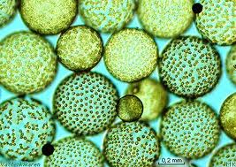
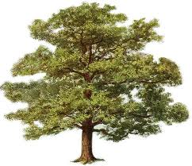
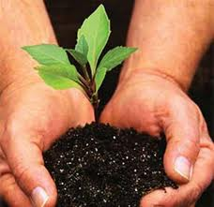
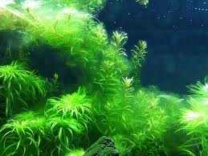
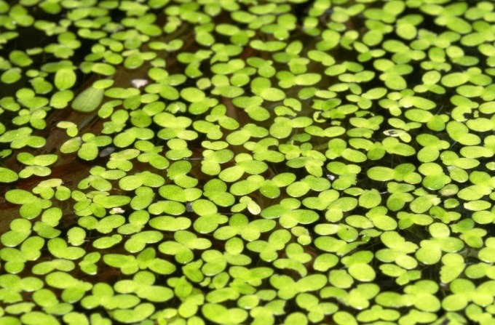
How do we measure growth of plant biomass over time?
Jot down your ideas and discuss.

Slide 57
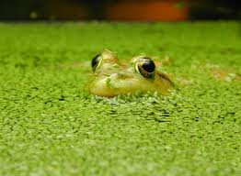
Design your investigation
How does nutrient concentration affect the growth of duckweed?

