Slide 1
Monitoring Water Pollution
Water quality can be measured in different ways – either physica, chemical or biological methods can be used.
Physical methods – turbidity
Chemical - nitrate levels, pH, biological oxygen demand
Biological – coliform counts, biotic indices

Slide 2
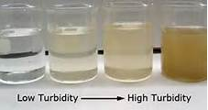
Turbidity
Measured as Total Suspended Solids (TSS)
Units are mg l⁻¹

Slide 3
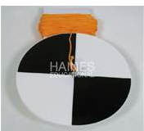
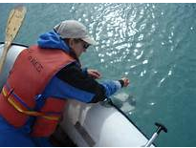
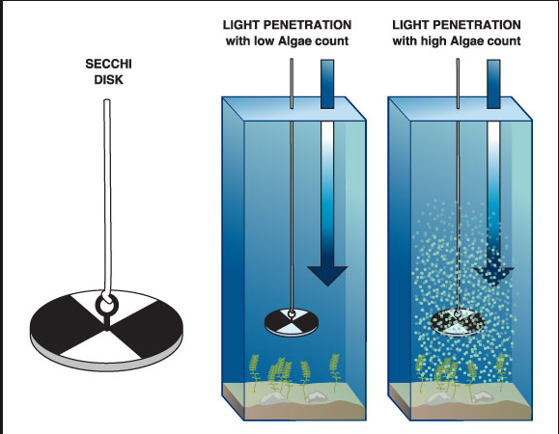
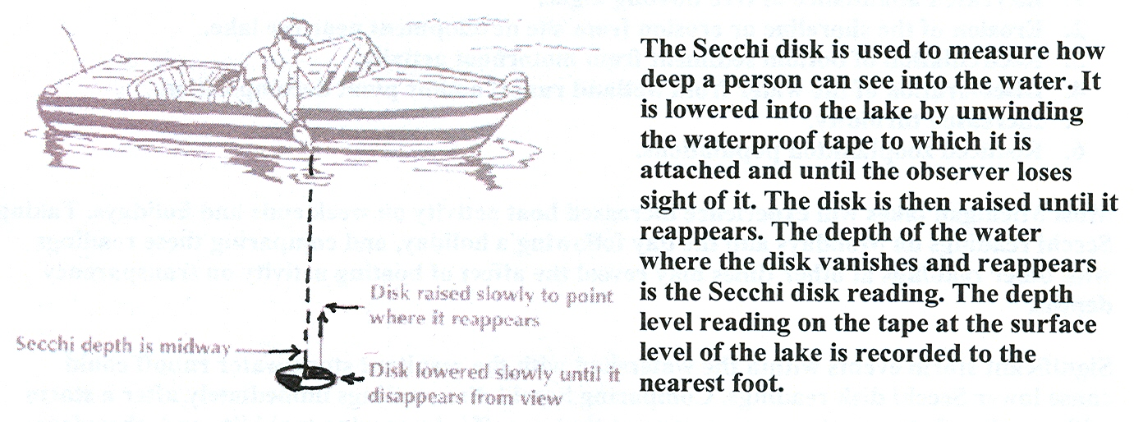
Secchi dischttp://www.youtube.com/watch?v=xuH_xLTjmOQ

Slide 4
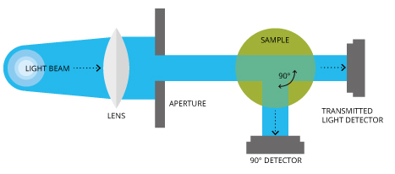
Electronic Turbidimeters

Slide 5
pH
What could you use to measure pH?
Universal indicator (paper or solution)
Electronic pH meters

Slide 6
Testing Nitrate levels
The concentration of many substances can be estimated using a colorimeter.
A standard volume of test solution is taken and standard volume of test reagent is added. Any nitrate present reacts with the reagent producing a coloured solutions.
The colorimeter measure the amount of light of the appropriate colour that passes through the solutions which is a measure of the original amount of nitrate that was present.
Simple colorimetric method can be used for a wide variety of ions
e.g. ammonia and phosphates

Slide 7
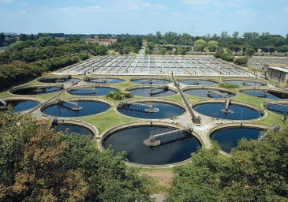
Biological or Biochemical Oxygen Demand (BOD)
What might increase the oxygen demand of a water system?
If there is organic matter in water then bacteria will use this material as ‘food’ (for respiration) and in so doing they use up oxygen in the water.

Slide 8
What is BOD?
Indication of the
organic quality
of water
In short….it is the oxygen required by biochemical processes.
In detail….the oxygen REQUIRED by biochemical processes to COMPLETELY aerobically decompose organic matter.
In the normal course of an aquatic ecosystem, there is significant bacterial activity that serves to decompose organic matter under normally aerobic conditions. The BOD is how much the total source requires..

Slide 9
How is BOD different than dissolved oxygen?
“Dissolved oxygen” is there. It is a measure of how much oxygen is dissolved in a water sample. It is a measure of oxygen content.
BOD is the amount of oxygen that would be consumed to completely decompose the organic matter in a water sample. It is not an indication of oxygen content. It is an indication of the amount of organic material present.

Slide 10
The decomposition reaction
Complete oxidation of organic materials yield identical products no matter what the organic starting material.
C_{n}H_{a}O_{b}N_{c} + O₂ → CO₂ + H₂O + NH₃
(unbalanced)

Slide 11
How would you determine BOD?
Add bacteria.
Add oxygen quantitatively.
Wait until all of the organic material is gone.
Report on the amount of oxygen used.

Slide 12
Problems with BOD calculations
Which bacteria should we use? There are millions of different kinds.
How long? What if it takes 10 years for all the organic material to disappear? What if some of it NEVER decomposes?
Other factors: Temperature? Amount of light present? Concentration of oxygen?

Slide 13
Solution to the Problem
Standardise the type of bacteria.
Standardise the temperature.
Standardise the amount of oxygen present - saturate it.
Standardise the time
http://www.youtube.com/watch?v=TSKNydzmeqc

Slide 14
The standardised BOD method
Standard BOD Test
Run in the absence of light (algae)
@ 20°C for 5 days, defined as BOD₅
Standard 300 mL volume BOD bottle

Slide 15
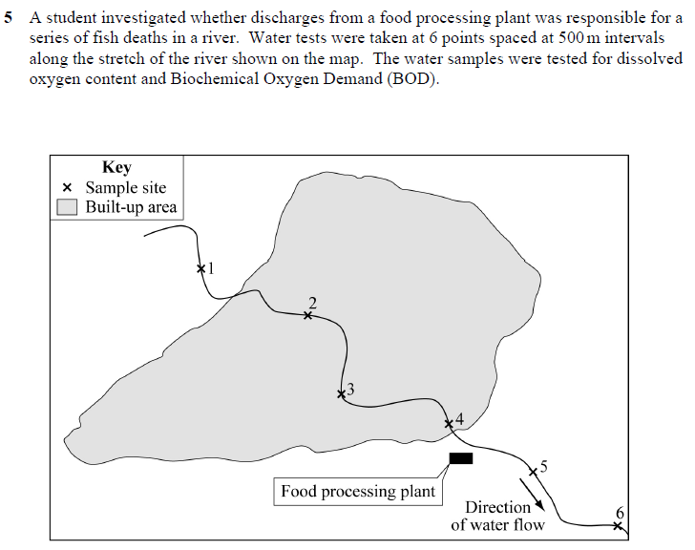
Exam

Slide 18
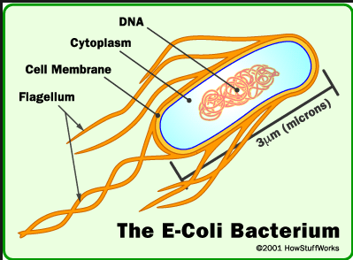
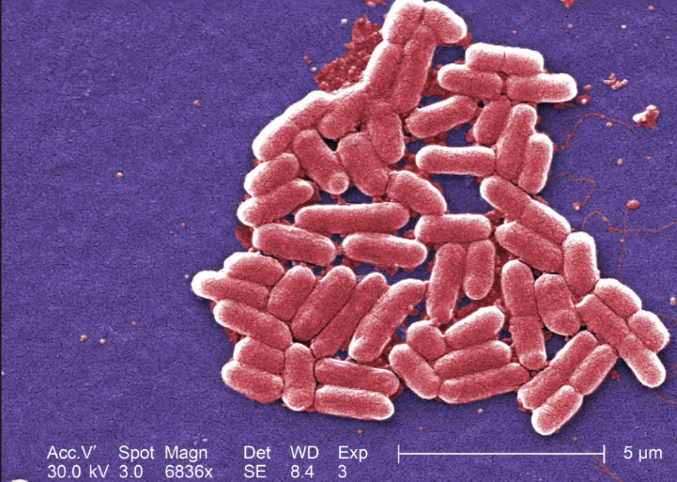
Biological tests
Human Faecal Pollution Determination: Coliform Counts

Slide 19
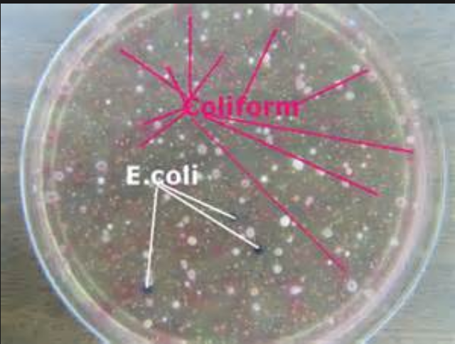
Coliform count
If E.coli present then this is proof of faecal contamination
Water samples are smeared onto sterile agar plates (a type of nutrient jelly that bacteria like to grow on) . The agar has an indicator that changes colour if E. coli colonies start to grow.

Slide 20
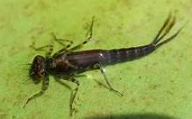
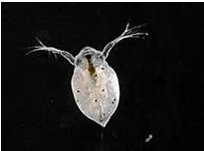
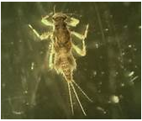
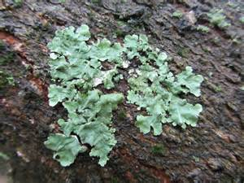
Biotic indices
Monitor the levels of pollution in a waterway by using the presence or absence of different species.
Characteristics of suitable species are:
Different sensitivities to pollution
Easy to identify
Easy to find
Normally present
Usually common
Generally distributed

Slide 21
The effect of inorganic nutrients on the growth of plants/algae
If plants/algae have more inorganic nutrients they will grow faster.
Growth = more biomass
If we measure the biomass of plants in different concentration o nutrients we can see the effect.
Problems: most living things contain lots of water
dry mass is more precise but kills the plants
Solutions: measure leaf area instead as you can use same plants
Controlling variables: temperature
light levels

Slide 22
