Slide 1
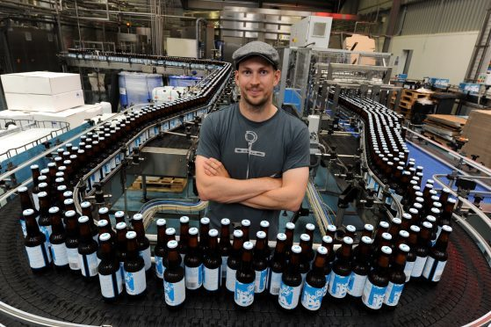
Brewdog: culture & leadership style
BrewDog is a multinational brewery and pub chain based in Ellon, Scotland. It was founded in 2007 by James Watt and Martin Dickie. Together they own 46% of the company
Brewdog co-founder James Watt has apologised and vowed to "listen, learn and act" after a group of ex-employees joined together to allege a culture of fear at the company.
Unit 6 Topic 2
Learning Aim D1

Slide 2
BREWDOG IN THE MEDIA
Ex-Brewdog staff allege culture of fear at brewer - BBC News
https://www.theguardian.com/business/2021/jun/10/brewdog-punk-brewery-beer-scottish-brewer-controversy
https://www.theguardian.com/lifeandstyle/2016/mar/24/the-aggressive-outrageous-infuriating-and-ingenious-rise-of-brewdog
https://www.theguardian.com/business/2021/jun/10/brewdog-staff-craft-beer-firm-letter
BrewDog Believe – BrewDog
BrewDog now worth £1 billion after deal with US equity firm - Evening Express

Slide 3
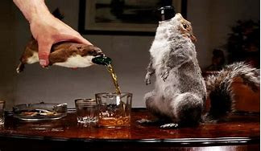
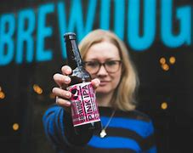
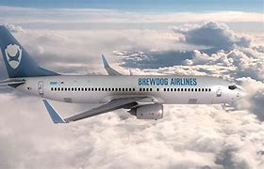
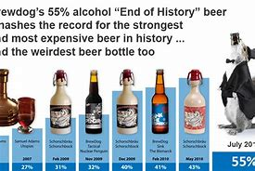

Slide 4
Issues?
Cult of personality (Handy) fast growth unchanged culture
PR Campaigns (charity donations cut)
Sexism & misogyny (LGBT fiasco and staff treatment)
Environmental issues (private jet) vanity projects
Safety concerns (ignoring H&S guidelines) and breaking rules
Top down leadership and management style – poor treatment of staff not challenged (bullying)
Pursuit of others in legal cases to protect their name
Resulting culture of fear

Slide 5
Task
Read through the Brewdog articles/links
Identify the issues at stake and link them to the theory on culture, leadership and motivation
What should they do next? How can they move forward with i) their employees ii) the media iii) their shareholders?

